Slide 1
The Key to Better Medication Adherence Better Physician-Patient Communication
Mind the Gap Academy
Physician-Patient Communication Master Series
Stephen Wilkins, MPH
July 2014

Slide 2
Physician-Patient Communication
Two patients each visit their physicians with identical complaints and receive identical prescriptions. Only one fills the prescription.
The aim of this paper is to help understand why…and what can be done to improve medication adherence.

Slide 3
Physician-Patient Communication
Goal: How specific, patient-centered communication skills and techniques – the gold standard for high quality patient communications – can transform any clinician into a “high performer” when it comes to:
Patient Engagement / Patient health outcomes
Adherence / Value
Patient Trust / Patient experience
Adoption and integration of Health IT

Slide 4
Definition of Medication Adherence
Taking a medication as prescribed, e.g. in the right amount, for the prescribed duration and in the recommended way.
Adherence is the result of active, voluntary collaboration between patient and physician to produce a therapeutic result.

Slide 5
Medication Adherence
Medication nonadherence – patients do not take their medications. Includes patients who:
Never fill, pick-up or take a newly prescribed medication called primary nonadherence
Do not take it in the amount, time or method prescribed called secondary nonadherence.

Slide 6
Medication Adherence
Intentional nonadherence is a rational decision to:
Disagreement with physician’s diagnosis
Disagreement with physician’s assessment of severity
Concerns about the safety of medication
Concerns about efficacy of medication
Concerns about the cost of medication.

Slide 7
Medication Adherence
2003 report by Boston Consulting Group estimated that 75% of all medication nonadherence is intentional; 25% was unintentional, the result of forgetfulness, etc.
Medication Persistence refers to how long patients take a medication before stopping. 25%-50% of patients discontinue prescribed medications within 60 days of starting.

Slide 8
Medication Adherence
Medication nonadherence is responsible for:
125,000 preventable deaths per year
$290 Billion in annual health care costs
27% of preventable ER visits
33%-69% of all medical hospital admissions
11% of all hospital admissions.

Slide 9
Medication Adherence
Adherence | Hyperlipidemia | Diabetes
Nonadherent | $6,810/patient | $8,812/patient
Adherent | $3,124/patient | $3,808/patient
Cost Difference | $3,686/patient | $5,004/patient

Slide 10
Physician-Patient Communication
 | Adherent (# = 19,912) | Nonadherent (# = 17,496) | % Difference
Any Hospitalization | 47.5 | 47.9 | -0.4
# Hospitalizations | 1.4 | 1.6 | -0.2
# Hospital Days | 5.9 | 8 | -2.1
Any ED Visits | 43.7 | 45.1 | -1.4
# ED Visits | 3.6 | 4 | -0.4

Slide 11
Key Drivers of Medication Nonadherence
Historically, viewed as a “lack of commitment” by patient to their treatment plan. In last 20 years, physician communication practices seen as a driver of nonadherence. Over 200 “factors” now associated:
Patient Factors
Physician Factors

Slide 12
Key Drivers of Medication Nonadherence
“Inadequate (physician) communication about medications accounts for up to 55% of Medication nonadherence.”
Odds of patient adherence:
2.16 times higher with effective communications
3.6 times higher with social support
1.83 times higher with emotional support
3.03 higher depression support
2.5 times higher with perception of disease severity.

Slide 13
Physician-Patient Communication
By communicate well refers to physicians who employ a Patient-centered Communications Style.
By do not communicate well refers to physician who employ a Biomedical Communications Style.

Slide 14
Physician-Patient Communication
At one end of the continuum is the Biomedical or Disease- Oriented Communication Style.
Also referred to as Physician-Directed, physicians employing this style focus on obtaining only the biomedical information they feel they need to arrive at a diagnosis and treatment.
The voice of the patient is largely absent from this communication style.
The Physician assumes the role of “expert”, is in control of the visit, does most of the talking and makes all the decisions while the patient assumes a “passive sick role.”

Slide 15
Physician-Patient Communication
At the other end of the communication continuum is the Psycho-Social or Patient-Centered Style. Clinicians employing this communication style strike a balance between focusing on the patient’s medical condition
(Biomedical) as well as the person behind the medical complaint (Psycho-Social). They actively seek the “patient’s voice”, e.g., their story and perspectives, share control of talk time during the visit, and engage in more information sharing. In short, the patient is an active partner of the clinician employing a Patient-Centered Communication Style.

Slide 16
Physician-Patient Communication
Perhaps the most surprising finding is that the average primary care physician spends less than 60 seconds out of a typical visit talking to patients about new medications:
why a new medication is necessary
how to take it along with dosages
when to stop taking it and side effects?

Slide 17
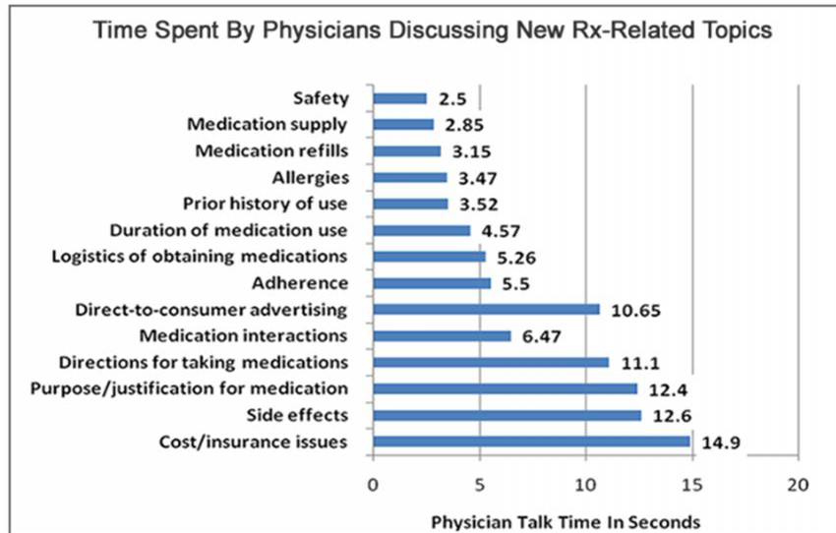
Physician-Patient Communication

Slide 18
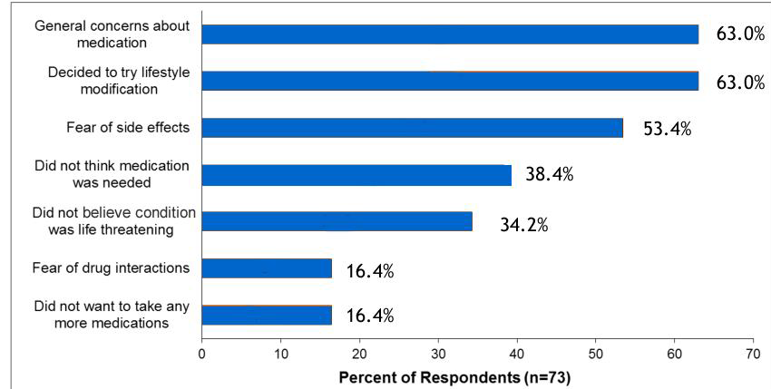
Patients’ Reasons For Not Picking Up A New Prescription For Statins Kaiser, Southern California

Slide 19
Physician-Patient Communication
An Applied Example - The Mediating Role Of The Physician’s Communication Style
Imagine an exam room in which a recently diagnosed,
middle-aged, male diabetes patient has just been told by their doctor that they need to take insulin injections the rest of their life.
Immediately upon receiving the news from the doctor the patient’s mind starts racing. Should he accept the doctor’s recommendation or not.

Slide 20
Physician-Patient Communication
The patient’s resistance to taking insulin is driven by a combination of:
Their beliefs about diabetes and insulin
Negative self-perceptions and attitudinal barriers (sense of personal failure or self-blame for the necessity of insulin use)
Fear of side effects and complications from insulin use
Depression
Concerns about lifestyle restrictions because of insulin use for the rest of their life
Social stigma of having to take insulin

Slide 21
Physician-Patient Communication
Absent an “information therapy intervention” by the physician aimed at helping this patient better understand the seriousness of their condition and the need to go on insulin, the patient’s “concerns’ will win trump the “necessity” for insulin.
The net result is that this patient will be non-adherent.
So what would the exam room conversations between the patient and a primary care physician look like for a physician with a biomedical or physician-directed style of communication look like?
How would it compare to a physician with a patient-centered style?

Slide 22
A Physician-Directed Communication Approach
Doctor: We have got to get your blood glucose under control. The Metformin is not enough. I will need to put you on insulin.
Patient: You mean shots every day?
Doctor: Yup…it’s the only way to get this problem under control.
Patient: My aunt had a touch of sugar and didn’t need insulin.
Doctor: Yeah well she’s not you
Patient: When would I need to start?
Doctor: Tomorrow if possible…the sooner the better
Patient: I hate shots…I can’t give myself shots every day.
Doctor: My nurse will show you how to do and you will get used to it.
Patient: Are you sure I need this?
Doctor: Let me give you a brochure which explains how insulin works and why your body needs it.
Patient: Ummhmmm
Doctor: I will send an e-prescription to the pharmacy and you can pick up your insulin on the way home. Let the pharmacists know if you have any questions.
Doctor: Now let’s talk about your weight….

Slide 23
Physician-Patient Communication
Note how the physician in Example # 1:
Does not explanation why the patient needs insulin
Ignores the patient’s concerns about “shots” every day.
Does not follow-up on patient’s beliefs/experiences regarding his aunt’s diabetes.
Misses several opportunities to provide empathy and support to patient.
Misses opportunities to provide additional information regarding the severity of his condition and the necessity for insulin.
Assumes patient will be adherent & makes no attempt to validate that assumption.

Slide 24
Fast Forward 12 Months
Not surprisingly, the patient in the first example did not immediately agree with the physician’s recommendation to begin taking insulin.
The patient filled the prescription and told the doctor they were trying it out. After a few months the patient, when confronted by the doctor admitted to not taking the insulin.
Within 6 months, the nonadherent patient ended up in the ER twice with complications from their uncontrolled diabetes.
This patient was hospitalized and placed on insulin after the second ER visit. The total cost associated with these events came out to over $60,000.

Slide 25
Exam room conversation patient centered communication
Doctor: We have got to get your blood glucose under control. Metformin not enough. Recommend start on insulin. It is the right thing to do for someone in your situation. Your A1C is not under control and your body will soon be affected.
Patient: You mean shots every day?
Doctor: Yes…I know how overwhelming this must be for you right now. Care to share your thoughts?
Patient: You got that right...I am kind of numb. I feel like running out of here screaming. Am scared.
Doctor: I’d probably be feeling the same way if I were in your shoes. I am sorry you have to deal with this.
Patient: Uhhmmmm
Doctor: It might help you if you better understood why you need insulin…conversation about how insulin helps the body process glucose]…Before we do anything I want you to understand
Patient: I am not sure where to start?
Doctor: Let’s start at the beginning with you understanding your options. Before you leave today let me hook you up with our diabetes care manager who can walk you through process of taking insulin.
Patient: I don’t want to talk the Diabetes person today. I need some time to think about this.
Doctor: I understand. This is a lot to get hit with all at once. psychological insulin resistance.
Patient: I will believe me.
Doctor: Good. Let’s follow up in a week or so after you have had a chance to talk with our diabetic case manager. At that point we can decide how best to proceed.
Patient: Ok

Slide 26
Physician-Patient Communication
Note how the physician in Example # 2:
Explains why the patient needs to go on insulin.
Pick up on the patient’s fear about shots.
Acknowledges how the patient is feeling – empathy.
Asks about the patient’s perspective.
Offers support and training to help patient but self-confidence and self-efficacy.
Seeks patient agreement with care plan.

Slide 27
Fast Forward 12 Months
The patient in the second example decided to go on insulin and was adherent. The patient met with the practice’s diabetes coordinator, learned how to administer the insulin and became very effective and confident in their self-care abilities.
The patient was routinely followed up with by their primary care physician and their health care team of diabetic educators. The patient did not experience any ER visits or hospitalizations associated with their condition.

Slide 28
Physician-Patient Communication
Five Patient Communication “Best Practices” Used By High Performing Physicians And Linked To Increased Patient Adherence:
Begins With Trusting Doctor-Patient Relationship
Understanding The Patient’s Perspective Is Vital
Seeks Patient Agreement – Shared Decision-Making
Don’t Neglect The Patient’s Psycho-Social Needs
Don’t Underestimate The Patient’s Need/Desire For Information…Even If They Don’t Ask Questions

Slide 29
Physician-Patient Communication
As this paper demonstrates, a big part of the answer to this question lies with the physicians’ patient communication style and skills. Specifically it depends upon their ability to:
Build a strong case with the patient concerning the necessity for taking action, e.g., take a new medication. This means eliciting the extent and accuracy of the patient’s knowledge about their diagnosis and its’ severity.
Provide the patient with the evidence needed to build trust in the safety and efficacy of the treatment recommendation. How do you know how much information to provide? Ask the patient.

Slide 30
Physician-Patient Communication
Assess the patient’s level of agreement with their diagnosis, its’ severity, and need for treating the problem.
Assess the patient’s level of agreement with the safety and efficacy of the proposed treatment.
Help patients cognitively process points of disagreement with their diagnosis and/or treatment recommendations.
Work towards an agreement concerning treatments that are acceptable to both they and the patient.

