Slide 1
Business Intelligence and Reporting at SETMA: Improving Quality, Outcomes and Clinical Practices
Dr. James L. Holly, MD
CEO, Southeast Texas Medical Associates, LLP
April 29, 2011

Slide 2
Conflict of Interest Disclosure James L. Holly, MD
Has no real or apparent
conflicts of interest to report.

Slide 3
Conflict of Interest Disclosure James L. Holly, MD
Salary: No
Royalty: No
Receipt of Intellectual Property Rights/Patent Holder: No
Consulting Fees (e.g., advisory boards): No
Fees for Non-CME Services Received Directly from a Commercial Interest or their Agents (e.g., speakers’ bureau): No
Contracted Research: No
Ownership Interest (stocks, stock options or other ownership interest excluding diversified mutual funds): No
Other: None

Slide 5
About SETMA
Southeast Texas Medical Associates, LLP (SETMA) was
founded August 1, 1995.
SETMA currently has 29 healthcare providers in the following specialties:
Internal Medicine
Family Practice
Pediatrics
Nurse Practitioners
Cardiology
Neurology
Infectious Disease
Ophthalmology

Slide 6
SETMA’s Landmarks
March 1998 – Acquired Electronic Health Records (EHR)
January 1999 – All patients seen using EMR
May 1999 – Began thinking in terms of “Electronic Patient Management” (EPM), rather than EHR
October 2009 – Began “COGNOS Project”
June 2010 – NCQA Tier 3 Patient-Centered Medical Home (PCMH)
August 2010 – Affiliate of Joslin Diabetes Center, an Affiliate of Harvard Medical School
August 2010 – NCQA Diabetes Recognition

Slide 7
SETMA’s Landmarks
August 2010 - Accreditation Association Ambulatory Healthcare (AAAHC) Accredited Ambulatory Care
August 2010 – AAAHC Accredited Medical Home
January 2011 - All SETMA Primary Providers Certified as Joslin Certified Primary Care Providers
February 2011 - Named one of 30 Exemplary Practices by Office of National Coordinator, Health Information Technology, Health & Human Services

Slide 8
SETMA’s Landmarks
February 2011 - Innovator Award, Healthcare Informatics
March 2011 - Patient Centered Primary Care Consortium, Practices in the Spotlight: The Medical Home and Diabetes Care
March 2011 - Dr. And Mrs. James L. Holly Distinguished Professorship, Patient-Centered Medical Home, University of Texas Health Science Center San Antonio, Texas
May 2011 – Semi-Finalist, Gartner Award

Slide 9
Systems Thinking and Health
“Systems-thinking” (Senge, The Fifth Discipline) and the data display designed on those principles allow the provider to “see” the patient as a whole: as a “granular portrait”, rather than as a faceless “silhouette.”

Slide 10
Data Display
Data display can obscure effective management, if it simply presents more detail while ignoring or obscuring the dynamic interaction of one part of a biological system with another.

Slide 11
Seeing Circles of Causality
“Reality is made up of circles, but we see straight lines…Western languages…are biased toward a linear view. If we want to see system-wide interrelationships…we need a language of interrelationships, a language of circles.”
(The Fifth Disciple, Dr. Peter Senge)

Slide 12
Linear Thinking

Slide 13
Circular Causality

Slide 14
SETMA’s Diabetes Management

Slide 15
SETMA’s Model of Care
Performance Tracking – one patient at a time
Performance Auditing – by panel or population
Analysis of Provider Performance Data
Public Reporting by Provider Name
Quality Assessment/Performance Improvement

Slide 16
Tracking Performance
SETMA tracks multiple Physician Consortium for Performance Improvement (PCPI) measurement sets:
Chronic Stable Angina
Congestive Heart Failure
Diabetes
Hypertension
Chronic Renal Disease
Weight Management
Care Transitions

Slide 17
Tracking Performance
SETMA also tracks the following published quality performance measure sets:
HEDIS
NQF
AQA
PQRI
BTE
Each is available to the provider, interactively at each patient encounter.

Slide 18
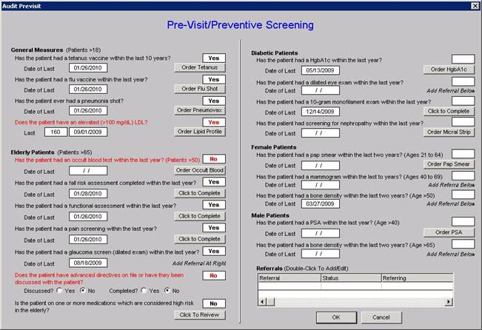
Tracking Performance
This tool allows the provider to assess comprehensive quality measures for “screening” and “prevention” of each patient.

Slide 19
Tracking Performance

Slide 20
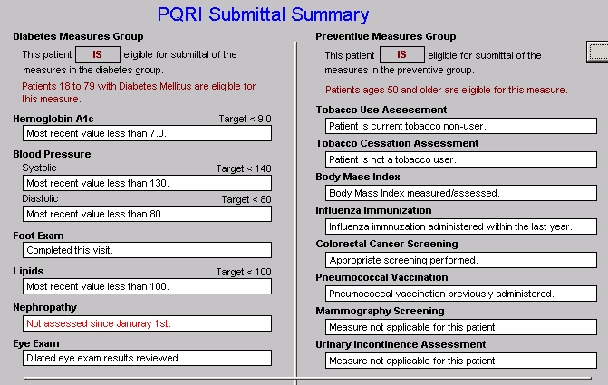
Tracking Performance
PQRI

Slide 21
Clusters and Galaxies
A “cluster” is seven or more quality metrics for a single condition, i.e., diabetes, hypertension, etc.
A “galaxy” is multiple clusters for the same patient, i.e., diabetes, hypertension, lipids, CHF, etc.
Fulfilling a single or a few quality metrics does not change outcomes, but fulfilling “clusters” and “galaxies” of metrics at the point-of-care can and will change outcomes.

Slide 22
Auditing Performance

Slide 23
Auditing Performance

Slide 24
Auditing Performance
Unlike a single metric, such as “was the blood pressure taken,” which will not improve care, fulfilling and then auditing a “cluster” or a “galaxy of clusters” in the care of a patient will improve treatment outcomes and will result in quality care.

Slide 25
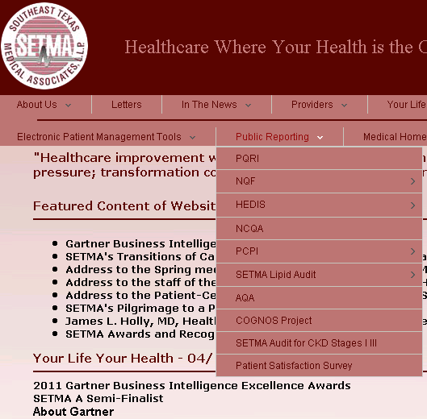
Auditing Performance
What is most often missing in quality improvement initiative is real-time, auditing with comparative display of results, and public reporting.

Slide 26
Auditing Performance
SETMA employed IBM’s Business Intelligence software, COGNOS to audit provider performance and compliance.
COGNOS allows all providers to:
Display their performance for their entire patient base
Compare their performance to all practice providers
See outcome trends to identify areas for improvement
See this at the point-of-care

Slide 27
Auditing Performance
SETMA contracted with LPA Systems (www.lpa.com) to build our auditing tools.
LPA designed a data warehouse to minimize the impact on our production servers.

Slide 28
Auditing Performance
LPA used SQL Server Integration Services (SSIS) to clean and scrub the hundreds of data points we needed for our audit rather than having to process the millions of data points contained in our EHR.
SSIS scrubs and preloads our EHR data into the warehouse, which gives us both speed in reporting and confidence in the results in our COGNOS reports.

Slide 29
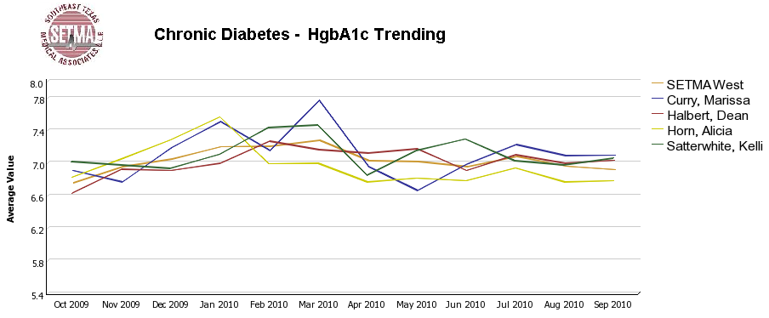
Auditing Performance

Slide 30
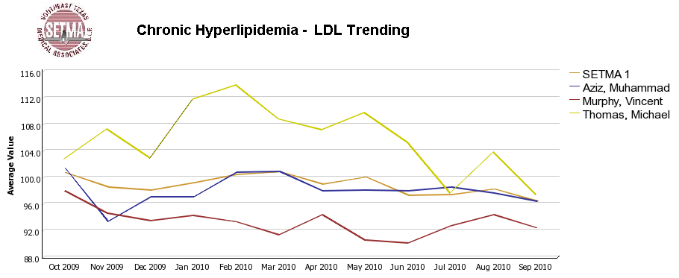
Auditing Performance

Slide 31
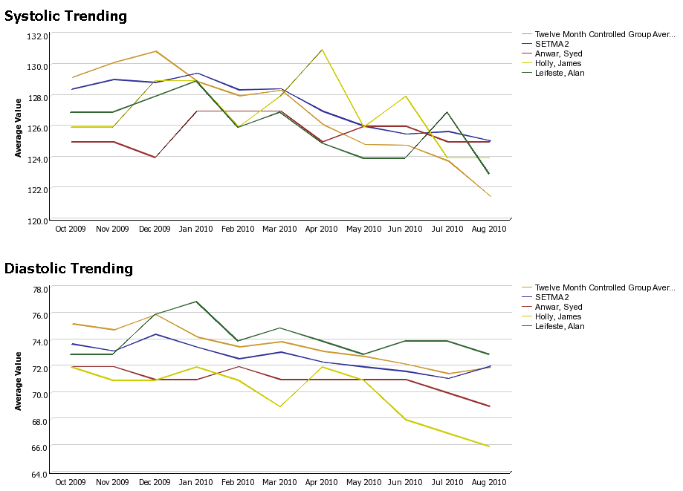
Auditing Performance

Slide 32
Auditing Performance
Beyond how one provider performs (tracking and auditing), SETMA looks at data as a whole (analyzing) from which to develop new strategies for improving patient care.
We analyze patterns which may explain why one population is not to goal while another is. Some of the parameters, we analyze are:
Frequency of visits
Frequency of key testing
Number of medications prescribed
Were changes in treatments made, if patient not to goal
Referrals to educational programs
Etc.

Slide 33
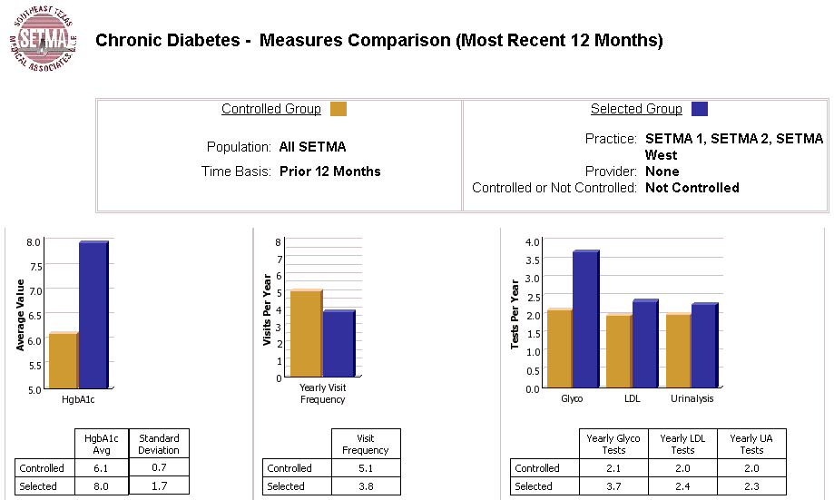
Analyzing Provider Performance

Slide 34
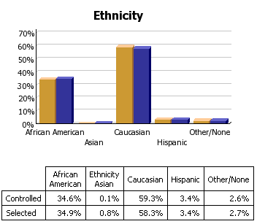
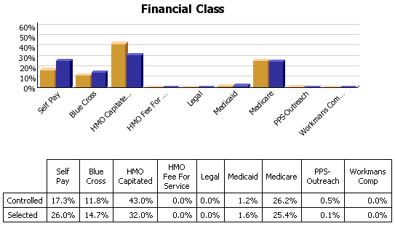
Analyzing Provider Performance

Slide 35
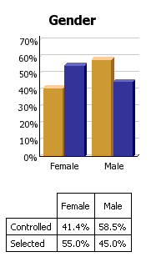
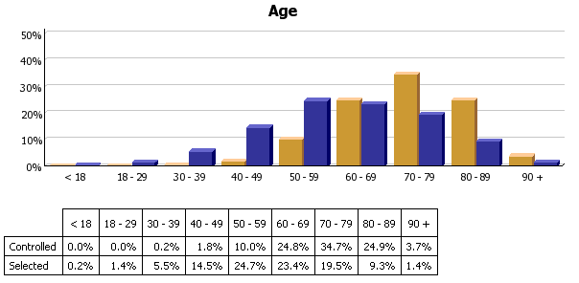
Analyzing Provider Performance

Slide 36
Analyzing Provider Performance
Raw data can be misleading. For example, with diabetes care, a provider may have many patients with very high HgbA1cs and the same number with equally low HgbA1cs which would produce a misleadingly good average. As a result, SETMA also measures the:
Mean
Median
Mode
Standard Deviation

Slide 37
Analyzing Provider Performance
SETMA’s average HgbA1c as been steadily improving for the last 10 years. Yet, our standard deviation calculations revealed that a subset of our patients were not being treated successfully and were being left behind.
By analyzing the standard deviation of our HgbA1c we have
been able to address the patients whose values fall far from the
average of the rest of the clinic.

Slide 38
Public Reporting of Performance
One of the most insidious problems in healthcare delivery is reported in the medical literature as “treatment inertia.” This is caused by the natural inclination of human beings to resist change. As a result, when a patient’s care is not to goal, often no change in treatment is made.
To help overcome this “treatment inertia,” SETMA publishes all of our provider auditing (both the good and the bad) as a means to increase the level of discomfort in the healthcare provider and encourage performance improvement.

Slide 39
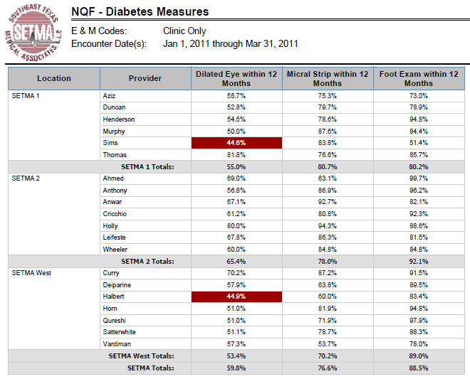
Public Reporting of Performance
NQF
Diabetes
Measures

Slide 40
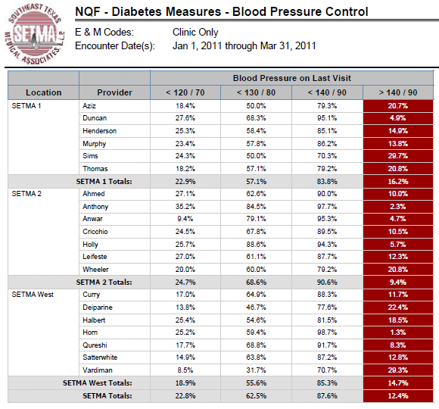
Public Reporting of Performance
NQF
Diabetes
Measures

Slide 41
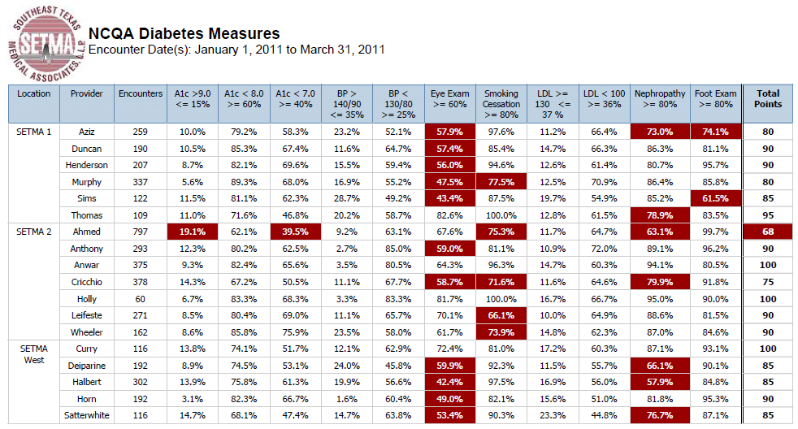
Public Reporting of Performance
NCQA Diabetes Recognition

Slide 42
Quality Assessment & Performance Improvement
Quality Assessment and Performance Improvement (QAPI) is SETMA’s roadmap for the future. With data in hand, we can begin to use the outcomes to design quality initiatives for our future.
We can analyze our data to identify disparities in care between
Ethnicities
Socio-Economic Groups
Age Groups
Genders

Slide 43
Quality Assessment & Performance Improvement
SETMA’s Model of Care along with the technology of COGNOS -- this pairing of medicine and technology -- can transform the delivery of healthcare and is worthy of being adopted by others.

Slide 44
Quality Assessment & Performance Improvement
By expanding SETMA’s COGNOS Project, we are also designing a quality improvement initiative for the elimination of preventable readmissions to the hospital.

Slide 45
www.jameslhollymd.com
Please visit us at www.jameslhollymd.com where you will find all of our public reporting, electronic patient management and medical home materials.

Slide 46
www.jameslhollymd.com

Slide 47
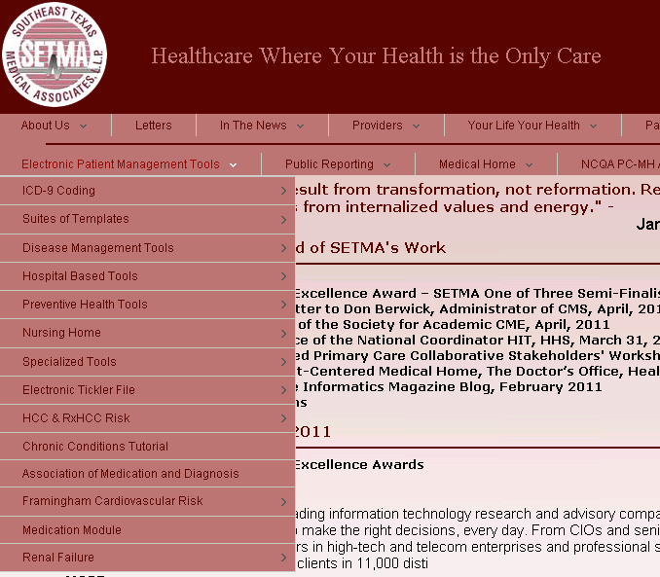
www.jameslhollymd.com

Slide 48
The Future
The future of quality metrics and the auditing of provider performance are constantly evolving. SETMA’s COGNOS Project allows us to both participate in the future and to define it; and, ultimately to pay attention to the things that matter and the things that will result in improved health for all of our patients.

