Slide 1
Business Intelligence and reporting at SETMA: Improving quality, outcomes and clinical practices
Dr. James L. Holly, MD
CEO, Southeast Texas Medical Associates, LLP
September 29, 2010

Slide 2
About SETMA
Southeast Texas Medical Associates, LLP
Founded August 1, 1995
29 Healthcare Providers:
Internal Medicine
Family Practice
Nurse Practitioners
Cardiology
Neurology
Infectious Disease
Ophthalmology

Slide 3
SETMA Landmarks
Adopted EMR, March 1998
January, 1999, all patients seen in EHR.
May, 1999, Morphed from EHR to Electronic Patient Management
October, 2009 – COGNOS Project
August, 2010, Affliate, Joslin Diabetes Center
September, 2010 – PC-MH Tier III

Slide 4
Systems thinking and Health
Systems-thinking and the data
display designed on those
principles allow the provider to
“see” how the treatment of one
disease augments or complicates
the treatment of another.

Slide 5
Creating Discomfort in Provider
Creation of discomfort in the
provider via self-auditing at the
point of care allowing the provider
to measure his/her performance
against an accepted standard.

Slide 6
“Treatment inertia”
“Lack of treatment intensification in a patient not at evidence-based goals for care.”

Slide 7
“Dynamic Complexity”
This occurs when “cause and effect are
subtle, and where the effects over time of
interventions are not obvious.”
“The real leverage in most management
situations lies in understanding “dynamic
complexity.”

Slide 8
Data Display
Data display can obscure effective
management if it simply presents
more detail while ignoring, or
further obscuring, the dynamic
interaction of one part of a
biological system with another.

Slide 9
Seeing Circles of Causality
“Reality is made up of circles, but we see
straight lines…Western languages…are
Biased toward a linear view. If we want to
see system-wide interrelationships, we need
a language of interrelationships, a language
of circles.”
(The Fifth Disciple, Dr. Peter Senge)

Slide 10
If excellent care requires healthcare organizations to:
Be “learning organizations”
Avoid “learning disabilities”
Think in a circular rather than a linear fashion
Look at dynamic complexity rather than detail complexity

Slide 11
If health science has the capacity:
To create far more information than anyone can absorb,
To foster far greater interdependency than anyone can manage
To accelerate change far faster than anyone’s ability to keep pace.

Slide 12
EMR Power
How can electronic patient records and/or
electronic patient management help solve
these problems and make it possible for
healthcare providers to remain current and
fulfill their responsibility of caring for
patients with the best treatments available?

Slide 13
Linear Thinking

Slide 14
Circular Causality

Slide 15
Data flow to and from the patient’s core information, and to and from interactive disease management capabilities:
Acute condition data
Longitudinal data
Standards of care which reflect a positive state of health
Automatically-populated-treatment reflecting best practices based on random controlled trials
Auditing tools which reflect provider excellence
Automatically-populated-patient follow-up instructions
Automatically-created-patient education

Slide 16
SETMA’s Model of Care
Key to our Patient Centered – Medical Home (PC-MH) is SETMA’s Model of Care:
Personal Performance Tracking – one patient at a time
Auditing of Performance – by panel or by population
Analysis of Provider Performance -- statistical
Public Reporting by Provider Name – www.jameslhollymd.com
Quality Assessment and Performance Improvement

Slide 17
Tracking Performance At The Point of Care
SETMA currently tracks the following Physician Consortium for Performance Improvement (PCPI) measurement sets:
Chronic Stable Angina
Congestive Heart Failure
Diabetes
Hypertension
Chronic Renal Disease
Weight Management
Care Transitions

Slide 18
Tracking Performance At The Point of Care
SETMA also currently tracks the following published quality performance measure sets:
HEDIS
NQF
AQA
PQRI
BTE
Each is available to the provider interactively within the EHR at the time of the encounter.

Slide 19
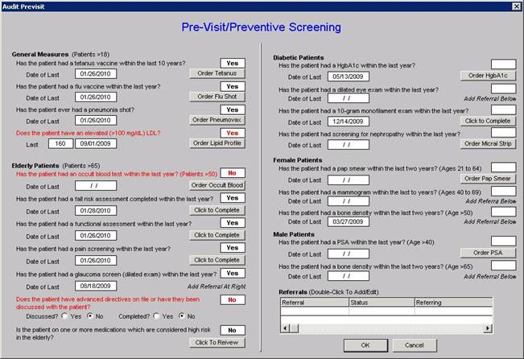
Tracking Performance At The Point of Care
A pre-visit screening tool allows each provider to assess quality measures for each patient at each encounter.

Slide 20
Tracking Performance At The Point of Care
HEDIS

Slide 21
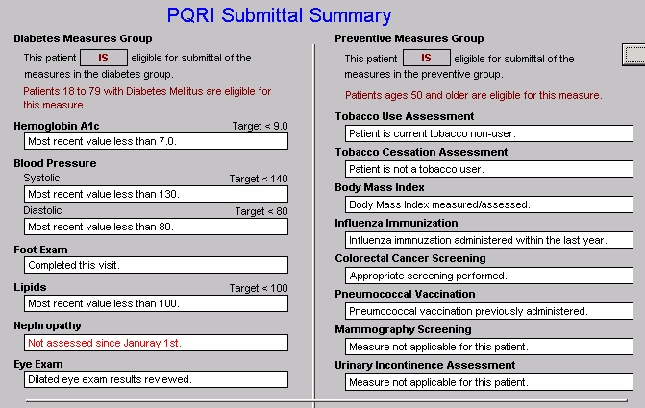
Step I - Provider Performance Tracking
PQRI

Slide 22
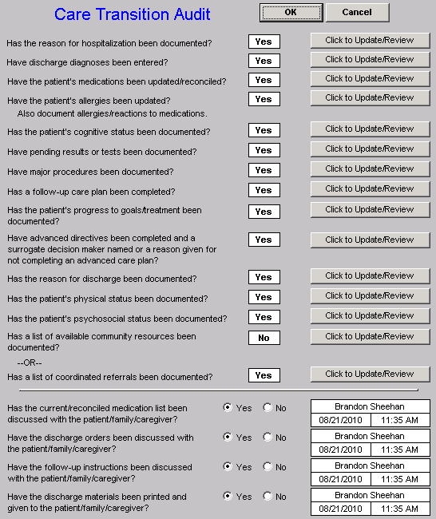
Step I - Provider Performance Tracking
Care
Transition
Audit

Slide 23
Step I - Provider Performance Tracking
Bridges to Excellence

Slide 24
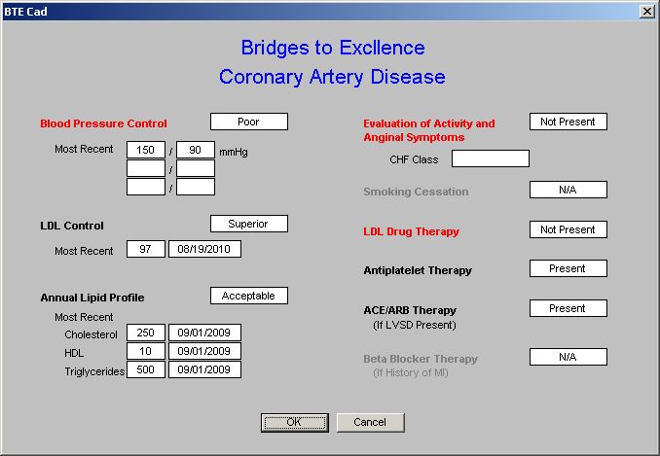
Step I - Provider Performance Tracking
Bridges to Excellence

Slide 25
auditing
Clusters and Galaxies
A single or a few quality metrics do not change outcomes
A cluster – seven or more quality metrics for a single condition, i.e., diabetes, etc.
A galaxy – multiple clusters for the same patient, i.e., diabetes, hypertension, lipids, CHF, etc.

Slide 26
Graphic of a cluster Diabetes
PCPI
To be design

Slide 27
Grphic of a galaxy
To be designed
Number of quality metrics for each cluster
Total number of metrics for galaxy

Slide 28
Unlike a single metric, such as “was th blood pressure taken,” which will not improve care, auditing a cluster or a galaxy of clusters in the care of a patient WILL improve the outcomes and result in quality care.

Slide 29
What is most often missing in quality improvement initiative real-time, comparative and public reporting on provider performance at the time of the pateint coutner or within 24 hours thereof.

Slide 30
Step II -- Auditing Provider Performance
SETMA employed IBM’s Business Intelligence software, Cognos to audit provider performance and compliance after patient encounters.
Cognos allows all providers to:
Display their performance for their entire patient base
Compare their performance to all practice providers
See outcome trends to identify areas for improvement
See this contemporaneous with care given

Slide 31
To allow SETMA to do real-time data auditing, without interfering with clinic processes, we selected COGNOS and contracted with LPA (www.lpa.com) to build auditing tools.
Because we want to audit complexes processes daily, and because we use our EHR 24 hours a day, seven days week, we need a data mart from which to audit several hudred data points rather than the miilons in our EHR.

Slide 32
In addition, we needed to process our data (SSIS full name) in order to make sure that the information transferred into the data mart was accurate.
The critical issue was that when we analyzed data that it was real and valid.

Slide 33
COGNOS allows SETMA with the support of LPA to be confident of the data upon which we will see areas of need for improvement in the quality of care and upon which we will design quality improvement initiatives.

Slide 34
The following are a series of static slides which are snapshots of COGNOS functions which are used by SETMA for auditing performance. That perfomance can be audit by:
The individual provider
Professional management
Administrative Mnagment

Slide 35
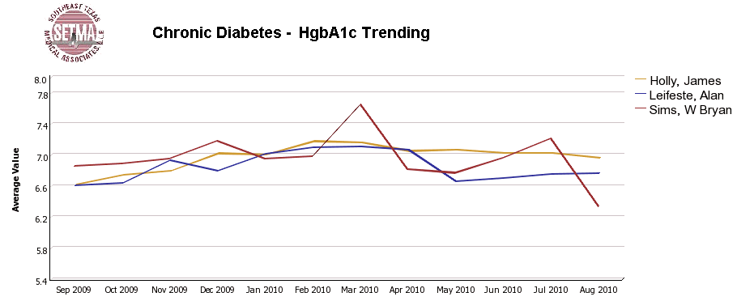
Step II -- Auditing Provider Performance

Slide 36
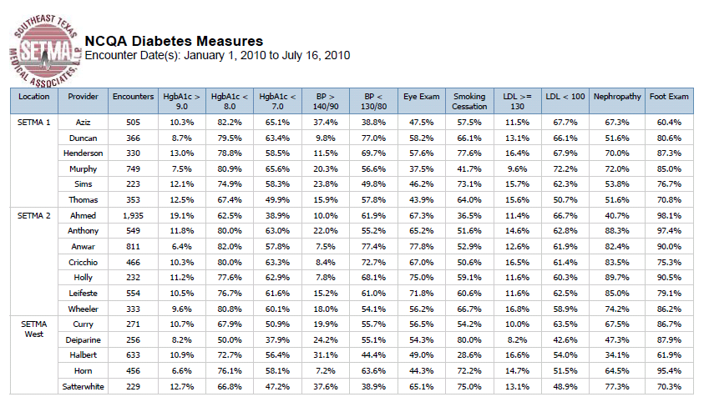
Step II -- Auditing Provider Performance

Slide 37
Step III -- Analyzing Performance
Beyond how one provider performs (auditing) we look at data as a whole (analyzing) to develop new strategies for improving patient care.
We analyze patterns which may explain why one population is not to goal while another is. Some of the parameters, we analyze are::
Frequency of visits
Frequency of key testing
Number of medications prescribed
Changes in treatments if any, if patient not to goal
Referrals to educational programs

Slide 38
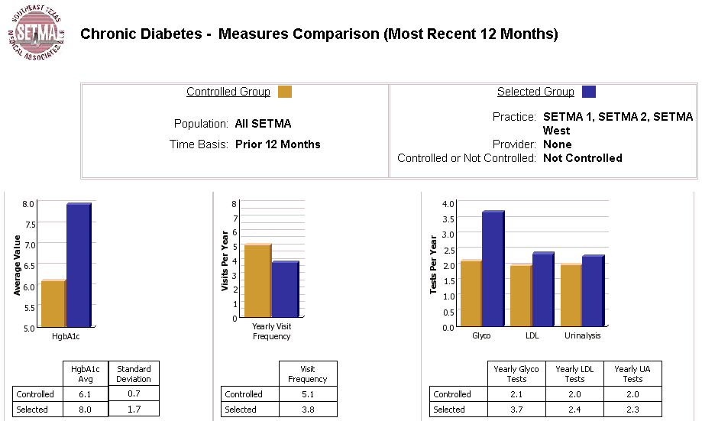
Step III -- Analyzing Performance

Slide 39
Step III -- Analyzing Performance
Raw data can be misleading. For example, with diabetes care, a provider may have many patients with very high HgbA1cs and the same number with equally low HgbA1cs which would produce a misleadingly good average. As a result, SETMA also measures the:
Mean
Median
Mode
Standard Deviation

Slide 40
Step III -- Analyzing Performance
SETMA’s average HgbA1c as been steadily improving for the last 10 years. Yet, our standard deviation calculations revealed that a small subset of our patients were not being treated successfully and were being left behind.
As we have improved our treatment and brought more patients to compliant levels, we have skewed our average.
By analyzing the standard deviation of our HgbA1c we have been able to address the patients whose values fall far from the average of the rest of the clinic.

Slide 41
Step IV - Public Reporting of Performance
One of the most insidious problems in healthcare delivery is reported in the medical literature as “treatment inertia.” This is caused by the natural inclination of human beings to resist change. As a result, when a patient’s care is not to goal, often no change in treatment is made.
To help overcome this “treatment inertia,” SETMA publishes all of our provider auditing (both the good and the bad) as a means to increase the level of discomfort in the healthcare provider and encourage performance improvement.

Slide 42
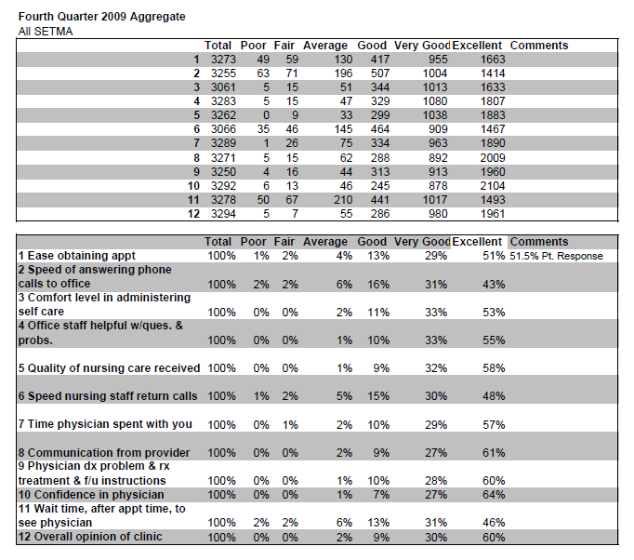
Step IV - Public Reporting of Performance
Published patient satisfaction survey results.

Slide 43
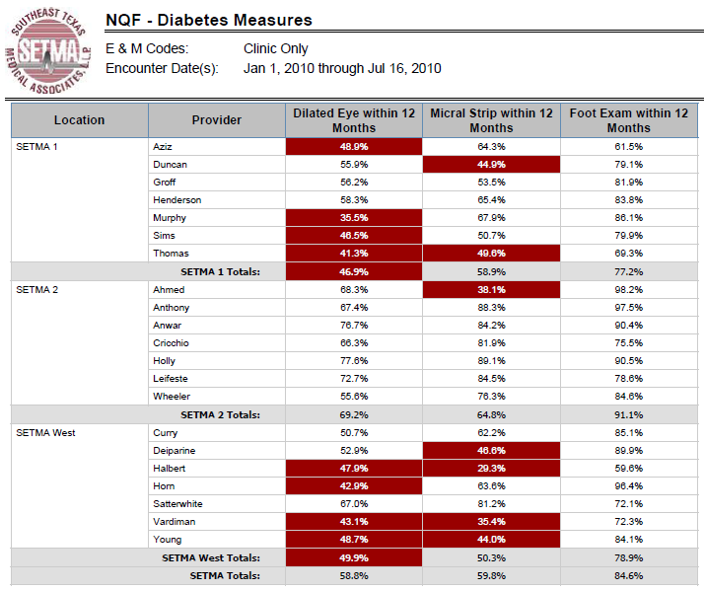
Step IV - Public Reporting of Performance
NQF
Diabetes
Measures

Slide 44
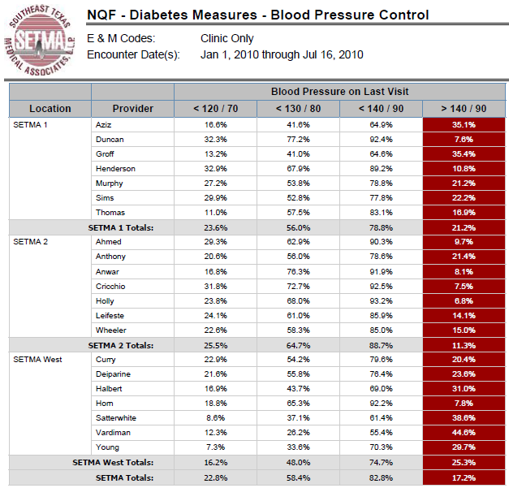
Step IV - Public Reporting of Performance
NQF
Diabetes
Measures

Slide 45
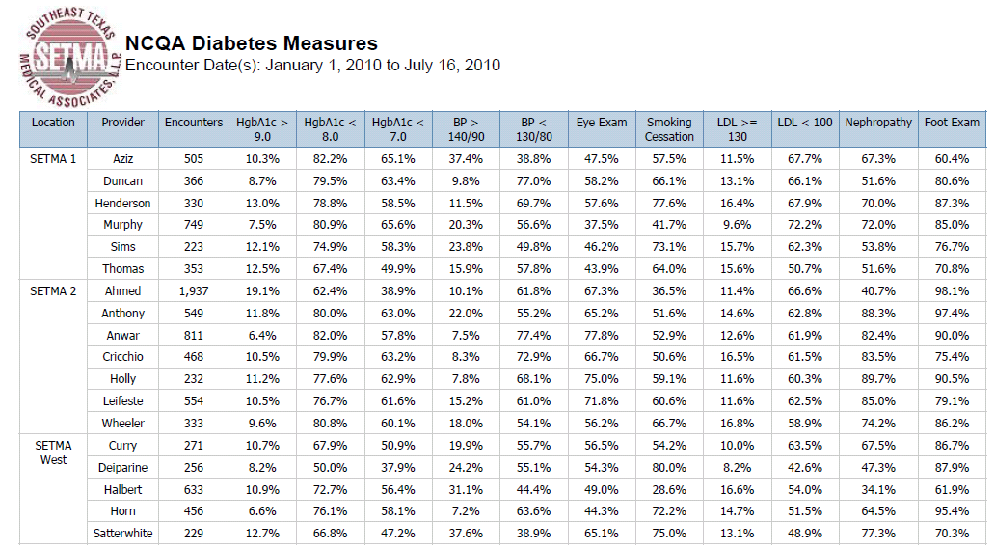
Step IV - Public Reporting of Performance
NCQA Diabetes Recognition

Slide 46
Step V -- Quality Assessment & Performance Improvement
Quality Assessment and Performance Improvement (QAPI) is SETMA’s roadmap for the future. With data in hand, we can begin to use the outcomes to design quality initiatives for our future.
We can analyze our data to identify disparities in care between
Ethnicities
Socio-Economic Groups
Age Groups
Genders

Slide 47
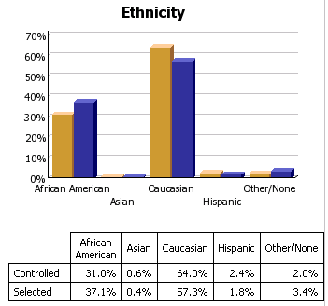
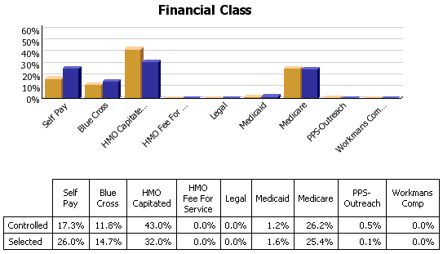
Step V -- Quality Assessment & Performance Improvement

Slide 48
Summary - SETMA Model of Care
With the evidenced-based, science foundation of
SETMA’s Model of Care, Coordination and Integration
of Care, with the deployment of NextGen’s NextMD @
and Health Information Exchange@, continue to
place the patient at the center of all healthcare delivery
in SETMA’s PC-MH.

Slide 49
Coordination of Care
“Coordination” has come to mean to SETMA,
“specialized scheduling” which translates into:
Convenience for the patient, which
Results in increased patient satisfaction, which contributes to
The patient having confidence that the healthcare provider cares personally, which
Increases the trust the patient has in the provider, all of which,

Slide 50
Coordination of Care
5. Increases compliance in obtaining healthcare services recommended which,
Promotes cost savings in travel, time and expense of care which
Results in increased patient safety and quality of care.

Slide 51
Director of Coordinated Care
SETMA’s Director of Coordinated Care is responsible for
building a Department of Care Coordination.
This could be called the “Marcus Welby Department,” as it recognizes the value of each patient as an individual, and has as its fundamental mission the meeting of their healthcare needs and helping them achieving the degree of health which each person has determined to have.
The driving force of care coordination is to make each patient feel as if they are SETMA’s ONLY patient where all their questions are answered, all their needs are met and their care meets all quality standards presently known.

Slide 52
The Transformation
SETMA’s Model of Care is the power source of
SETMA’s Patient-Centered Medical Home. We
believe this model will transform our delivery of
healthcare and is a model worthy of being
adopted by others.
The Partners, Providers and Staff
SETMA, LLP
www.jameslhollymd.com

