Slide 1
Care Transitions: The heart of Patient-Center Medical Home
Scottsdale Institute Webinar
May 24, 2011
Dr. James L. Holly, CEO
Southeast Texas Medical Associates, LLP
www.jameslhollymd.com

Slide 2
Care Transitions
In SETMA’s Model of Care -- Care Transition involves:
1. Evaluation at admission -- transition issues : “lives alone,” barriers , DME, residential care, or other needs
2. Fulfillment of PCPI Transitions of Care Quality Metric Set
3. Post Hospital Follow-up Coaching -- a 12-30 minute call made by members of SETMA’s Care Coordination Department and additional support
4. Plan of Care and Treatment Plan
5. Follow-up visit with primary provider

Slide 3
National Priorities Partnership
National Priorities Partnership
National Quality Forum
Input to the Secretary of HHS
Priorities for the 2011 National Quality Strategy
Wellness and Prevention
Safety
Patient and Family Engagement
Care Coordination
Palliative and End of Life Care

Slide 4
National Priorities Partnership
Addressing the fourth NPP goal, the NQF report to HHS stated that in regard to care coordination:
“Healthcare should guide patients and families through their healthcare experience, while respecting patient choice, offering physical and psychological supports, and encouraging strong relationships among patients and the healthcare professionals accountable for their care….”

Slide 5
National Priorities Partnership
Focus in care coordination by NPP are the links between:
Care Transitions— …continually strive to improve care by … considering feedback from all patients and their families… regarding coordination of their care during transitions between healthcare systems and services, and…communities.
Preventable Readmissions— …work collaboratively with patients to reduce preventable 30-day readmission rates.

Slide 6
Care Transitions & Hospital Readmission
In SETMA’s experience, there are fifteen steps required to address care coordination and hospital readmissions, as a function of a quality care initiative which is sustainable.
The steps and the solution for each are as follows.

Slide 7
Care Transitions & Hospital Readmission
In January,1999, SETMA began using the EHR to document patient encounters. In May, 1999, SETMA modified the goal to electronic patient management (EPM) in order to leverage the power of electronics to improve treatment outcomes. In October, SETMA began using the EMR in the hospital for hospital H&Ps, creating continuity-of-care process, based on healthcare data being electronically created and being available at all points of care.

Slide 8
Care Transitions & Hospital Readmission
2. In 2000, realizing that excellent care in the 21st Century was going to be team-based, SETMA formed a hospital service team, which provides 24-hour-a-day, seven-day a week, in-house coverage for all of our patients.

Slide 9
Care Transitions & Hospital Readmission
In 2001, SETMA began using the EHR to produce hospital discharge summaries which further advanced continuity-of-patient-care and established the groundwork both for care transitions and for effectively addressing preventable readmissions.
At this point, medication reconciliation could take place in the: clinic, hospital, nursing home, home health and emergency department.

Slide 10
Care Transitions & Hospital Readmission
In 2003, SETMA designed hospital-admission-order sets, based on national standards of care, which created a consistency of treatment plans and eliminated delay in the initiation of excellent care.

Slide 11
Care Transitions & Hospital Readmission
5. Also ,in 2003, SETMA began using the EHR in all twenty-two nursing homes we staff. Because our patients’ care is managed in the same electronic data base, whether in the ambulatory setting, hospice, home health, physical therapy, hospital, emergency department, or nursing home, there is a continuity-of-care which is data and information driven.

Slide 12
Care Transitions & Hospital Readmission
In 2004, SETMA designed an electronic, Inpatient Medical Record Census (IMRC); deployed on SETMA’s intranet and HIPPA compliant, the IMRC allows searchable-data recording of:
a. date of admission to the hospital
b. place of admission
c. date and time of completion of the History and Physical
d. date of discharge
e. date and time of completion of the Hospital Care summary and post-hospital plan of care and treatment plan.
f. Posting of questions from business office which need research by hospital care team.

Slide 13
Care Transitions & Hospital Readmission
In 2007, SETMA’s partners realized that many of our patients, even those with insurance, cannot afford all of their health care. This resulted in the creation of The SETMA Foundation.
SETMA partners have given over $1,500,000 to the Foundation which pays for medications, surgeries and other care, such as dental, for our patients who cannot afford it.

Slide 14
Care Transitions & Hospital Readmission
In June, 2009, the Physician Consortium for Performance Improvement (PCPI) published the first national quality measurement set on Care Transitions; the same month, SETMA deployed the measures in our EHR. Since then, of the 2995 discharges from the hospital, 99.1% have had the Hospital Care Summary completed at the time the patient left the hospital.

Slide 15
Care Transitions & Hospital Readmission
9. October, 2009, SETMA adapted a Business Intelligence tool to create an audit of hospitalized patients to examine differences between patients who are re-admitted and those who are not. The audit looks at: gender, ethnicity, socio-economic issues, social isolation, morbidities and co-morbidities, lengths of stays, age, timing of follow-up after discharge, whether a follow-up call was received and other issues. These measures look for leverage points for “making a change, which will make a difference in readmissions”

Slide 16
Care Transitions & Hospital Readmission
10.November, 2009, SETMA began publicly reporting performance on over 200 quality metrics by provider name at www.jameslhollymd.com. Disease management plans-of-care documents for diabetes, hypertension, and cholesterol, include the provider performance on that patient’s care, as judged by these quality metrics.

Slide 17
Care Transitions & Hospital Readmission..
In July, 2010, pursuant to becoming a Tier 3 PC- MH, SETMA created a Department of Care Coordination, which is tasked with:
Post Hospital follow-up calling
Completing SETMA Foundation Referrals
Patient counseling for barriers to care
Establishing continuity of care
Engaging patients in their own care
Alerting providers to patients’ special needs
Another level of mediation reconciliation

Slide 18
Care Transitions & Hospital Readmission”
12. September, 2010, at a National Quality Forum workshop on Care Transitions, SETMA realized that the term “discharge summary” was outdated. We changed the name to “Hospital Care Summary and Post Hospital Plan-of-Care and Treatment-Plan,” long and perhaps awkward, this name, is functional, focusing on the unique elements of Care Transition which contribute to the foundation for a sustainable plan for addressing preventable readmissions to the hospital.

Slide 19
Care Transitions & Hospital Readmission
13. In 2010, SETMA deployed both a secure web portal and a health information exchange to allow the seamless exchange of information between the hospitals , nursing homes, home health agencies, hospices, and SETMA. The HIE has been expanded to a seven-county project including all healthcare providers and agencies, which will ultimately be the key to preventing readmission to the hospital.

Slide 20
Care Transitions & Hospital Readmission
Since 1997, SETMA has partnered with a Medicare Advantage home health agency, with other home health agencies and with free-standing hospices to provide compassionate, competent care for our patients in settings other than hospital inpatient to reduce readmissions of our most vulnerable patients while providing excellent care to them.

Slide 21
Care Transitions & Hospital Readmission
15. As a Patient-Centered Medical Home, SETMA makes certain that the Hospital Care Summary and Post Hospital Plan of Care and Treatment is transmitted to the next site of care as the “baton,” (see below). With these care coordination, continuity of care and patient- support functions, SETMA believes that we are ready to make a major effort to decrease preventable readmissions to the hospital.

Slide 22
Care Transitions & Hospital Readmission
These tools and functions have allowed sustainable improvements. For example:
In February, 2011, during one weekend, SETMA discharged 26 patients in two days.
Most of these discharges were challenging, but all were treated all through SETMA’s standard procedures and processes described above.
Over the next 60 days, 6.8% were readmitted.

Slide 23
Care Transitions
In SETMA’s Model of Care -- Care Transition involves:
1. Evaluation at admission -- transition issues: “lives alone,” barriers , DME, residential care, or other needs
Fulfillment of PCPI Transitions of Care Quality Metric Set
Post Hospital Follow-up Coaching -- a 12-30 minute call made by members of SETMA’s Care Coordination Department and additional support
Plan of Care and Treatment Plan
Follow-up visit with primary provider

Slide 24
Hospital Care Summary
SETMA’s Hospital Care Summary is a suite of
templates with which the transition of care document
Is created. (A full tutorial of these templates can be
found on our website at www.jameslhollymd.com under
“Electronic Patient Tools” at “Hospital Based Tools.”)
The following is a screen shot of the Master Discharge
Template entitled “Hospital Care Summary”. This
screen shot is from the record of a real patient whose
identify has been removed.

Slide 25
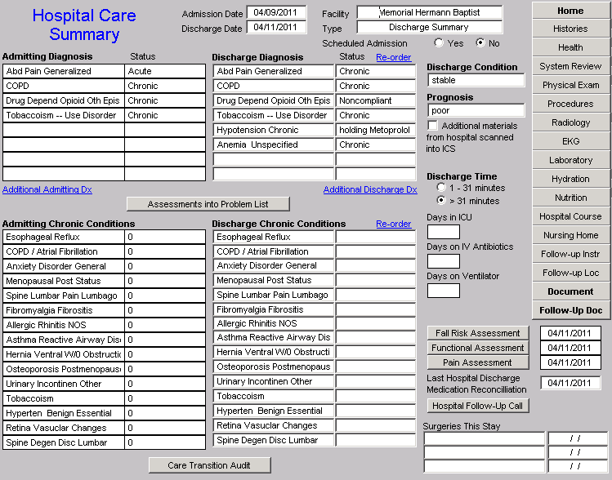
Hospital Care Summary

Slide 26
Care Transition Audit
At the bottom of this template, there is a button Entitled “Care Transitions Audit.” Once the suite of Templates associated with the Hospital Care Summary has been completed, the provider depresses this button and the system automatically aggregates the data which has been documented and displays which of the 18-data points have been completed and which have not.

Slide 27
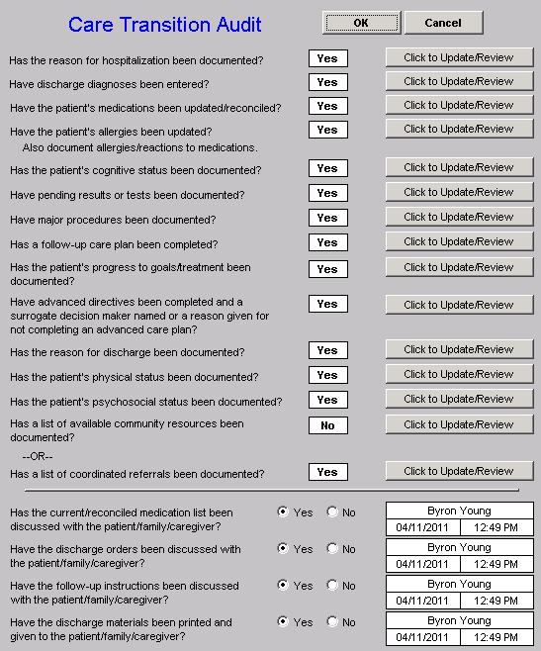

Slide 28
Care Transition Audit
The elements in black have been completed; any in red have not. If an element is incomplete, the provider simply clicks the button entitled “Click to update/Review.” The missing information can then be added. This fulfills one of SETMA’s principles of EHR design which is “We want to make it easier to do it right than not to do it at all.”

Slide 29
Care Transition Audit
Quarterly and annually, SETMA audits each provider’s performance on these measures and publishes that audit on our website under “Public Reporting,” along with over 200 other quality metrics which we track routinely.
The following is the care transition audit results by provider name for 2010.

Slide 30
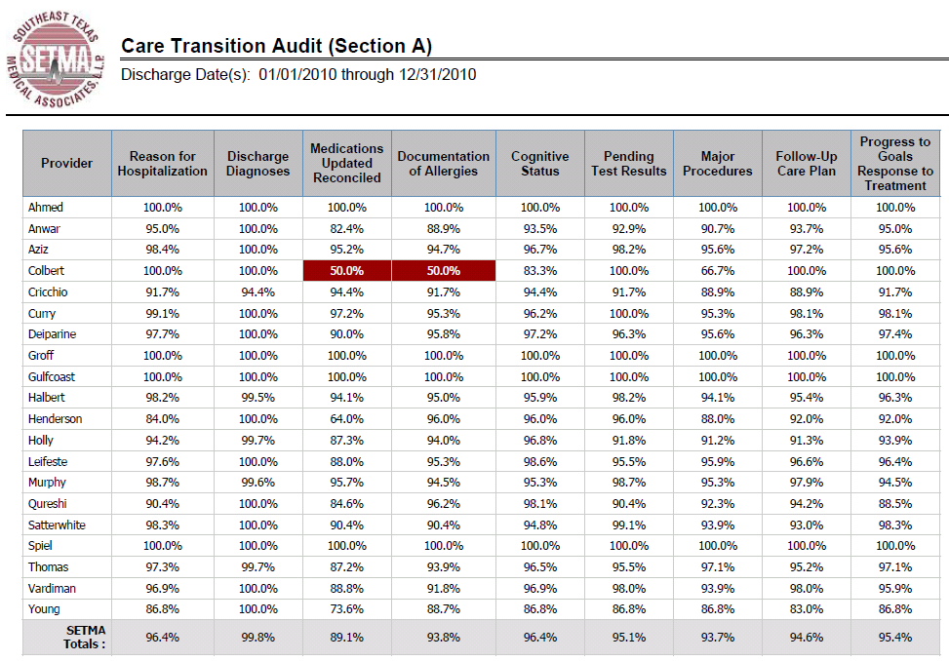
Care Transition Audit

Slide 31
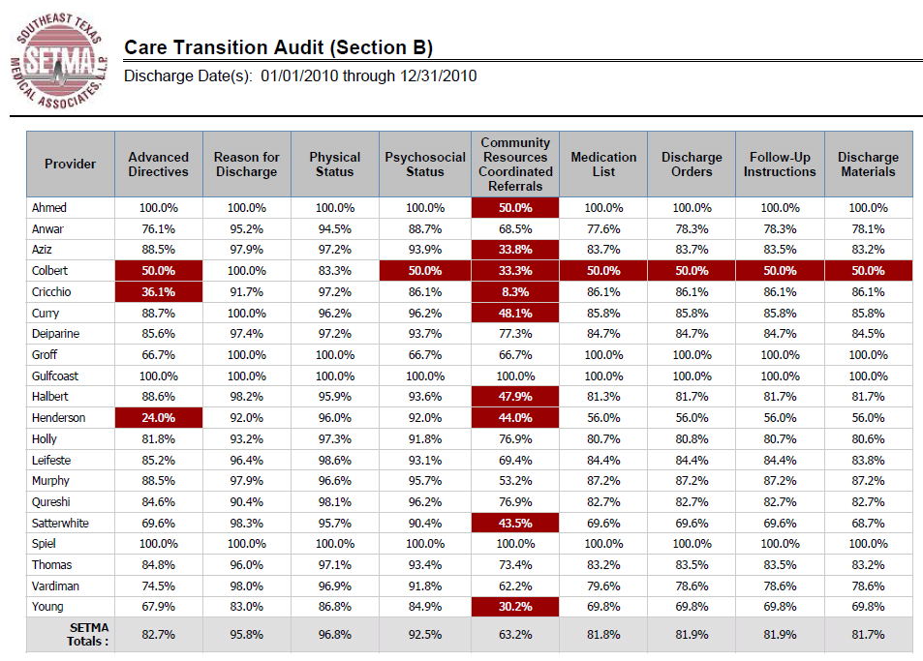
Care Transition Audit

Slide 32
Hospital Care Summary
Once the Care Transition issues are completed, The Hospital Care-Summary-and-Post- Hospital-Plan-of Care-and Treatment-Plan document is generated and printed. It is given to the patient and/or to the patient’s family, and to the hospital.

Slide 33
The Baton
The following picture is a portrayal of the “plan of care and treatment plan” which is like the “baton” in a relay race.

Slide 34
The Baton
“The Baton” is the instrument through which responsibility for a patient’s health care is transferred to the patient or family. Framed copies of this picture hang in the public areas of all SETMA clinics and a poster of it hangs in every examination room. The poster declares:
Firmly in the provider’s hand
--The baton -- the care and treatment plan
Must be confidently and securely grasped by the patient,
If change is to make a difference
8,760 hours a year.

Slide 35
The Baton
The poster illustrates:
That the healthcare-team relationship, which exists between the patient and the healthcare provider, is key to the success of the outcome of quality healthcare.
That the plan of care and treatment plan, the “baton,” is the engine through which the knowledge and power of the healthcare team is transmitted and sustained.
That the means of transfer of the “baton,” which has been developed by the healthcare team, is a coordinated effort between the provider and the patient.

Slide 36
The Baton
That typically the healthcare provider knows and understands the patient’s healthcare plan of care and the treatment plan, but without its transfer to the patient, the provider’s knowledge is useless to the patient.
That the imperative for the plan – the “baton” – is that it must be transferred from the provider to the patient, if change in the life of the patient is going to make a difference in the patient’s health.

Slide 37
The Baton
That this transfer requires that the patient “grasps” the “baton,” i.e., that the patient accepts, receives, understands and comprehends the plan, and that the patient is equipped and empowered to carry out the plan successfully.
That the patient knows that of the 8,760 hours in the year, he/she will be responsible for “carrying the baton,” longer and better than any other member of the healthcare team.

Slide 38
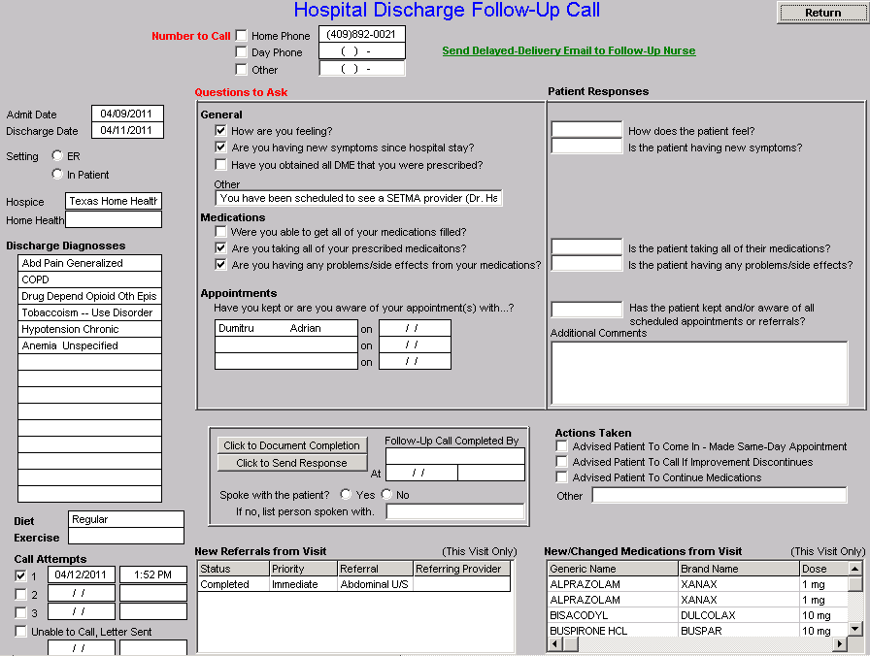
Hospital Follow-Up Call
After the care transition audit is completed and the document is generated, the provider completes the Hospital-Follow-up-Call document:

Slide 39
Follow-Up Call -- I
During that preparation of the “baton,” the provider checks off the questions which are to be asked the patient in the follow-up call.
The call order is sent to the Care Coordination Department electronically. The day following discharge, the patient is called.
The call is the beginning of the “coaching” of the patient to help make them successful in the transition from the inpatient setting.

Slide 40
Follow-Up Call – II
The Care-Coordination, post-hospital call takes 12-30 minutes with each patient and engages the patient in eliminating barriers to care.
If appropriate, an additional call is scheduled at an appropriate interval.
If after three attempts, the patient is not reached by phone, the box in the lower left-hand corner by “Unable to Call, Letter sent” is checked. Automatically, a letter is created which is sent to the patient asking them to contact SETMA.

Slide 41
Coordinated Care
The genius and the promise of the Patient-Centered Medical Home are symbolized by the “baton.” Its display continually reminds the provider and will inform the patient, that to be successful, the patient’s care must be coordinated, and must result in coordinated care.
In 2011, as we expand the scope of SETMA’s Department of Care Coordination, we know that the principal failure-points of coordination are at the “transitions of care,” and that the work of the healthcare team – patient and provider – is that together they evaluate, define and execute a plan which is effectively transmitted to the patient.

Slide 42
Transition of Care
The complexity of the Transition of Care
process is illustrated by this analysis of the
eight different places this document can
need to be sent.

Slide 43
Hospital Care Summary
1. Inpatient to ambulatory outpatient (family) – The "baton," in a printed format, is given to the patient or in the case of a minor or incompetent adult to a parent or care giver.
The "plan of care and treatment plan" -- "the baton" -- is reviewed with the patient, parent and/or family before the patient leaves the hospital.

Slide 44
Hospital Care Summary
Inpatient to ambulatory outpatient (clinic physician) – for patients who are seen at SETMA, the "baton" is created in the EHR and is immediately accessible to the follow-up provider.

Slide 45
Hospital Care Summary
3. Inpatient to ambulatory outpatient (follow-up call) -- after the Hospital Care Summary and Post Hospital Plan of Care and Treatment Plan is completed, a secure e-mail is sent to the department of Care Coordination scheduling the post-hospital, follow-up call and letting the caller know the issues which need to be addressed.

Slide 46
Hospital Care Summary
4. Emergency Department to ambulatory care – the same process as in "1" above.
5. Inpatient to Nursing Home -- the "baton," with a special set of Nursing Home orders, is given to the patient or family, and a copy is sent to the Nursing Home with transportation of the patient to the Nursing home.
6. Inpatient to Hospice -- the same as with number “5“
7. Inpatient to Home Health -- the same as number "5“ and "6" above. If the patient is seeing SETMA's home health, they have access to SETMA EHR and thus to the "baton."

Slide 47
Hospital Care Summary
8. Inpatient to outpatient out of area -- "Baton" given to patient and family and also posted to web portal and HIE. token sent to health provider in remote location area, which allows one time access to this patient's information.

Slide 48
Follow-Up Visit
The Transition of Care is complete when the patent is seen by the primary care provider in follow-up.
Many issues are dealt with in this follow-up visit, but one of them is another potential referral to the Care Coordination Department. If the patient has any barriers to care, the provider will complete the following template.
In this case, with checking three buttons, the need for financial assistance with medications and transportation is communicated to the Care Coordination Department.

Slide 49
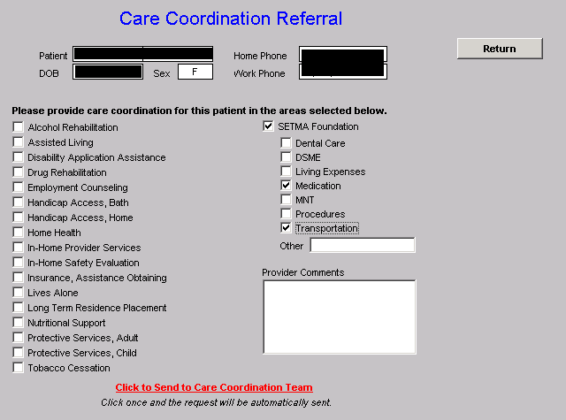
Care Coordination Referral

Slide 50
SETMA Foundation
Under the Medical Home model the provider has NOT done his/her job when he/she simply prescribes the care which meets national standards. Doing the job of Medical Home requires the prescribing of the best care which is available and accessible to the patient, and when that care is less than the best, the provider makes every attempt to find resources to help that patient obtain the care needed.

Slide 51
SETMA Foundation
In February 2009, SETMA saw a patient who has a very complex healthcare situation. When seen in the hospital as a new patient, he was angry, bitter and hostile. No amount of cajoling would change the patient’s demeanor.
During his office-based, hospital follow-up, it was discovered that the patient was only taking four of nine medications because of expense; could not afford gas to come to the doctor; was going blind but did not have the money to see an eye specialist; could not afford the co-pays for diabetes education and could not work but did not know how to apply for disability.

Slide 52
SETMA Foundation
He left SETMA with the Foundation providing:
All of his medications. The Foundation has continued to do so for the past two years at a cost of $2,200 a quarter.
A gas card so that he could afford to come to multiple visits for education and other health needs.
Waiver of cost for diabetes education in SETMA’s American Diabetes Association accredited Diabetes Self Education and Medical Nutrition Therapy program.
Appointment to an experimental, vision-preservation program at no cost.
Assistance with applying for disability.

Slide 53
SETMA Foundation
Are gas cards, disability applications, paying for medications a part of a physician’s responsibilities? Absolutely not; but, are they a part of Medical Home? Absolutely! This patient, who was depressed and glum in the hospital, such that no one wanted to go into the patient’s room, left the office with help.
He returned six-weeks later. He had a smile and he had hope. It may be that the biggest result of Medical Home is hope. And, his diabetes was treated to goal for the first time in ten years. He has remained treated to goal for the past two years.

Slide 54
SETMA Foundation
Every healthcare provider doesn’t have a foundation and even ours can’t meet everyone’s needs, but assisting patients in finding the resources to support their health is a part of medical home.

Slide 55
SETMA Foundation
And, when those resources cannot be found, Medical Home will be “done” by modifying the treatment plan so that what is prescribed can be obtained.
The ordering of tests, treatments, prescriptions which we know our patients cannot obtain is not healthcare, even if the plan of care is up to national standards.

Slide 56
Hospital Care Summary
With this infrastructure
With this care coordination
With this continuity of care
With these patient support functions
SETMA is ready to make a major effort to decrease preventable readmissions to the hospital.

Slide 57
Care Transitions & Hospital Readmissions
With this vision, SETMA expects to significantly affect hospital preventable re-admission rates over the next two years and to sustain those improvements.
Supported by care transitions, coordination of care, medication reconciliation (at multiple points of care) patient safety, quality of care and cost of care will be positively impacted.

