Slide 1
September 21-23, 2011 Baltimore, Maryland
22nd Annual Conference of the
National Task Force on CME/Provider/Industry Collaboration
Collaborating to Improve
Professional Education and
Health Outcomes

Slide 2
Excellence and Innovation in Education
James L. Holly, MD
CEO, Southeast Texas Medical Associates, LLP September 22, 2011

Slide 3
Where Are We Going Today
How do you make it easier to do it right than not do it at all?
Do we want to perpetuate the problem of information overload, or contribute to the solution?
Do we want others simply to participate in our programs, or do we want to create sustainable innovations in healthcare?
How will we measure the success of our CME offerings?

Slide 4
The Future of Healthcare
Since SETMA adopted electronic medical records in 1998, we have come to believe the following about the future of healthcare:
The Substance Evidenced-based medicine and comprehensive health promotion
The Method Electronic Patient Management
The Organization Patient-centered Medical Home
The Funding Capitation with payment for quality

Slide 5
SETMA’s Model of Care
During this time, we have developed the five points of the SETMA Model of Care:
Provider Performance Tracking – one patient at a time
Auditing of Performance – by panel or by population
Analysis of Provider Performance – statistical
Public Reporting by Provider Name – www.jameslhollymd.com
Quality Assessment and Performance Improvement

Slide 6
Performance Improvement
SETMA’s ability to track, audit and analyze data has improved our clinical outcomes as illustrated by the following NCQA Diabetes Recognition Program audit which takes 30 seconds to complete through SETMA’s Business Intelligence (BI) software deployment.
While quality metrics are the foundation of Continuous Quality Improvement, auditing of performance is often overlooked as a critical component of the process.

Slide 7
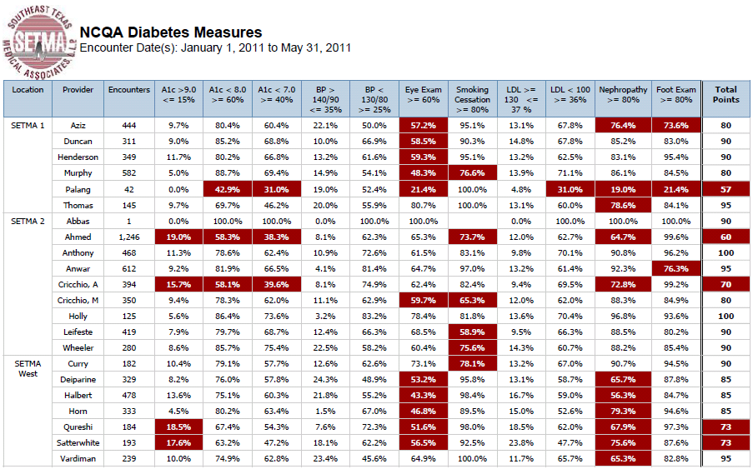
Performance Improvement

Slide 8
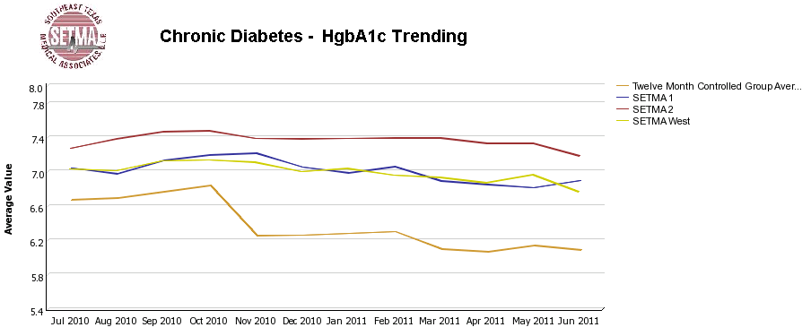
Performance Improvement
SETMA’s use of BI also allows care-outcomes trending such as with HbA1c:

Slide 9
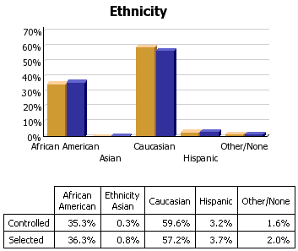
Performance Improvement
SETMA’s goal of eliminating ethnic disparities in care can be substantiated with BI analytics:

Slide 10
Performance Improvement
SETMA’s philosophy of health care delivery includes the concept that every patient encounter ought to be evaluation-al and educational both for the patient and for the provider. The patient and the provider need to be learning, if the patient's health and the provider’s healthcare delivery are to be continuously improving.

Slide 11
Performance Improvement
The concept that both the impact of continuous professional development and the process of that development should and must continue in the clinical setting, while implicit in CME, had become a more explicit and expressed object of CME.
Because of its dynamic, creative and sustainable nature, this may be the most significant improvement in CME resulting from PI-CME.

Slide 12
Redesigning Continual Education
Addressing the foundation of Continuous Performance Improvement, IOM produced a report entitled: “Redesigning Continuing Education in the Health Professions” (Institute of Medicine of National Academies, December 2009). The title page of that report declares:
“Knowing is not enough; we must apply.
Willing is not enough; we must do.”
- Goethe

Slide 13
Performance Improvement
The IOM report stated:
“…it now takes 14-17 years for new evidence to be broadly implemented…Shortening this period is key to advancing the provision of evidence-based care, and will require the existence of a well-trained health professional workforce that continually updates its knowledge.” (p. 16)

Slide 14
Performance Improvement
The tension between “information,” which is inherently static and “learning,” which is dynamic and generative, is the heart of The Fifth Discipline, in which Peter Senge, said:
“Learning is only distantly related to taking in more information…,” which classically has been the foundation of medical education. Traditional CME has perpetuated the idea that “learning” is simply accomplished by “the taking in of more information.”

Slide 15
Performance Improvement
Senge argues that “system thinking,” which is essentially a new way of learning, is needed because for the first time humankind has the capacity to:
“Create far more information than anyone can absorb.”
“Foster greater interdependency than anyone can manage.”
“Accelerate change faster than anyone’s ability to keep pace.”

Slide 16
Performance Improvement
Systems Thinking is:
“A discipline of seeing wholes”
“A framework for seeing interrelationships rather than isolated things”
“For seeing patterns of change rather than static ‘snapshots’”
“A set of general principles spanning (diverse) fields”
Intended for business, systems thinking precisely
addresses major issues in continuous – healthcare --
professional development.

Slide 17
Performance Improvement
Transformation is defined by sustainability and in human endeavor both require “Personal Mastery , which is the discipline of continually clarifying and deepening your personal vision, of focusing your energies, of developing patience, and of seeing reality objectively” (Senge).
The difference between current reality and our personal vision is “creative tension.” And, “the essence of personal mastery is learning how to generate and sustain creative tension in our lives.” (Senge)

Slide 18
Performance Improvement
Those with “personal mastery”
Live in a continual learning mode.
They never ARRIVE!
(They) are acutely aware of their ignorance, their incompetence, their growth areas.
And they are deeply self-confident!
This is “creative tension.” And this is the goal of PI-CME, i.e., the
producing of healthcare professional “creative tension” by
establishing and revealing the difference between where we are and
where we want to be.

Slide 19
Performance Improvement
Healthcare transformation, which will produce Continuous Performance Improvement, results from the internalized ideals, which create vision and passion, both of which produce and sustain “creative tension” and “generative thinking.”
Transformation is not the result of pressure and it is not frustrated by obstacles. In fact, the more difficult a problem is, the more power is created by the process of transformation in order to overcome the problem.

Slide 20
Performance Improvement
The change of mind which results in learning rather than simply “taking in more information,” results in “forward thinkers” who are able to create and sustain “creative tension.”
They can be described as “relentless” in the pursuit of the future they have envisioned. They will constantly be declaring:
“I want it done right and
I want it done right now!”

Slide 21
Performance Improvement
“The role of PI CME in achieving sustainable change,”
Susan Nedza, MD,
CPPD Report, AMA Continuing Medical Education
Winter 2009/No. 27
“…(healthcare) transformation…will only be successful if national efforts to improve quality:
enable QI where care is provided...
in which) provider tools…make performance measurement a by-product of the care process
(with) a commitment that supports continuous efforts to transform care at the practice level.”

Slide 22
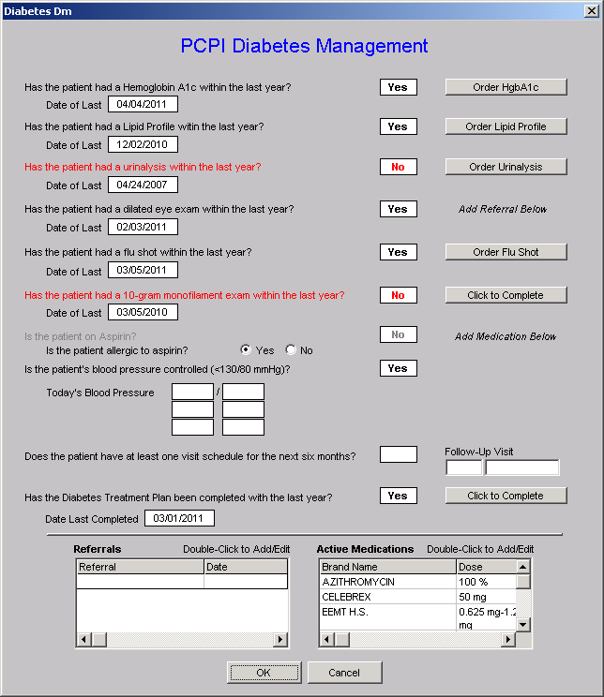
SETMA deployed the PCPI Diabetes set in 2004. This is a copy of the template.
The provider, at the point of care, can measure his/her performance by clicking on the template.
Measures in black have been met; those in red have not.

Slide 23
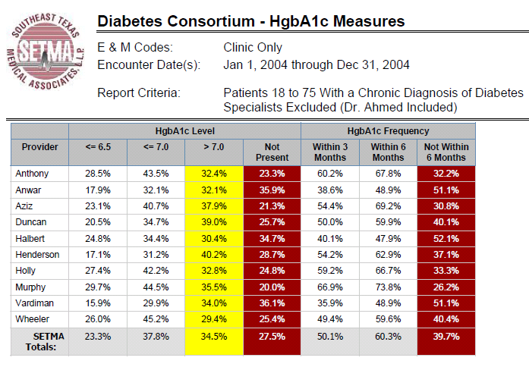
Performance Improvement

Slide 24
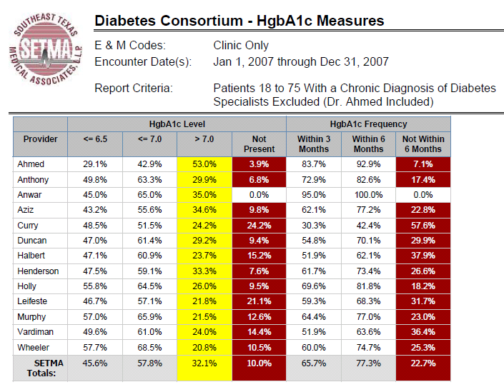
Performance Improvement

Slide 25
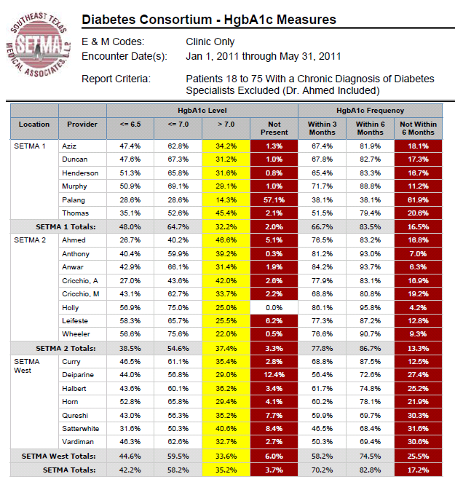

Slide 26
Performance Improvement
SETMA’s Model of Care, actually models PI-CME:
We continually measure our current performance on over 250 quality metrics.
The aggregation of quality data is incidental to the delivery of care, requiring no additional effort on the providers’ part.
Monthly, we have nursing and provider meetings to conduct peer review, review treatment strategies and to discuss quality improvement .
We share training material to improve our knowledge.
We have a goal of improving and continue to monitor our performance at the point of care, not only encouraging but demanding improvement of ourselves.

Slide 27
Changing Model of CME
As the classic lecture-CME setting has increasingly been shown not to change provider behavior, new iterations of CME have been developed.
In 2002, the AAFP introduced evidence-based CME
In 2004, AMA, AAFP and OA changed the measurement of CME from hours to credits.
In 2005, AMA implemented two new formats: Internet point of care (PoC) and performance improvement (PI) CME

Slide 28
Performance Improvement-CME
The Steps of Performance Improvement CME (PI-CME)
First stage, assessment of each physician’s current practice using identified evidence-based performance measures. Feedback to physicians compares their performance to national benchmarks and to the performance of peers.
Second stage, implementation of an intervention based on the performance measures assessed in the practice.
Third stage, revaluation of performance in practice including reflection and summarization of outcome changes resulting from the PI CME activity.

Slide 29
Joslin Performance Improvement-CME
SETMA is involved with two PI-CME Programs with the Joslin Diabetes Center. The first project focuses upon hemoglobin A1C and the assessment of and the elements of the cardiometabolic risk syndrome. The second is Eldercare. (All Joslin PI CME are approved by ABIM to qualify for part 4 MOC)
SETMA has disease management tools for diabetes and the cardiometabolic risk syndrome. (Both can be reviewed at www.jameslhollymd.com under “Electronic Patient Management Tools” by clicking on “Disease Management Tools”)

Slide 30
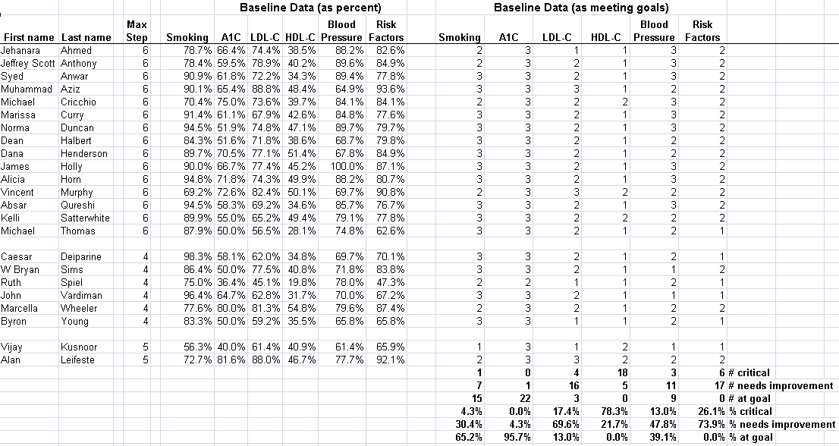
Joslin PI-CME Selected SETMA Diabetes Patients

Slide 31
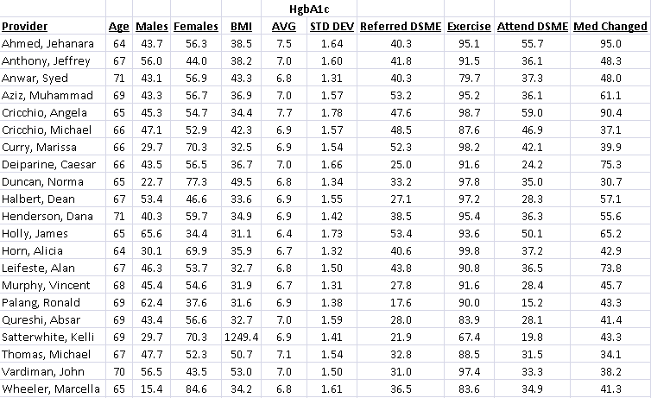
Joslin PI-CME Glyco All SETMA Patients with Diabetes

Slide 32
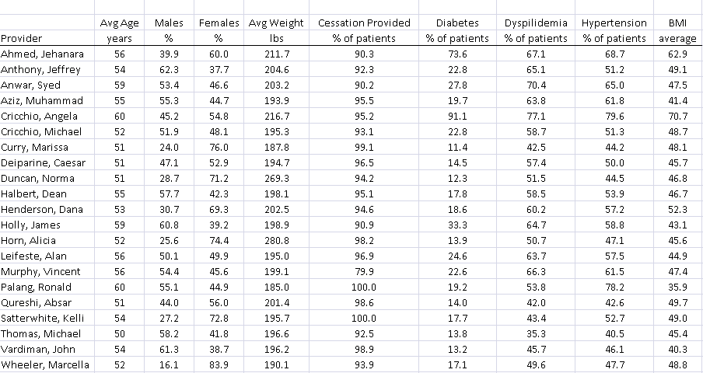
Joslin PI-CME Cardio All SETMA Patients with Diabetes

Slide 33
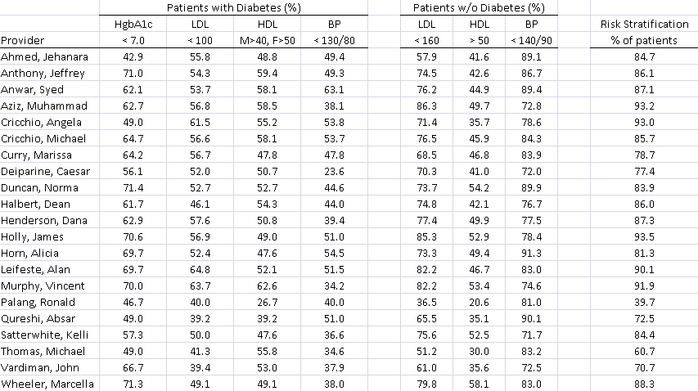
Joslin PI-CME Cardio All SETMA Patients with Diabetes

Slide 34
Performance Improvement
The 2009 IOM report referenced above further stated:
“….continuing professional development (CPD)…is learner-driven, allowing learning to be tailored to individual needs….
“CPD methods include self-directed learning and organizational and systems factors; and it focuses on both clinical content and other practice-related content, such as communications and business.” (p. 17)

Slide 35
Performance Improvement
“…an effective continual professional development system should ensure that health professionals are prepared to:
“Provide patient-centered care.
“Work in inter-professional teams.
“Employ evidence-based practice.
“Apply quality improvement.
“Use health informatics.” (IOM, p. 94)

Slide 36
Joslin PI-CME
“Provide patient-centered care”
SETMA has achieved both NCQA Tier III Medical Home
recognition and AAAHC accreditation as a Medical Home.
Joslin’s PI-CME builds on the patient’s engagement in their
own care both through DSME and MNT and also with the
Coordination of Care possible with a Medical Home’s
personalized plan of care and treatment plan.

Slide 37
Joslin PI-CME
“Work in inter-professional Teams”
Joslin’s PI-CME course on GlycoCardio including on-site
training of physicians, nurse practitioners, nurses, unit
Clerks, and DMSE and MNT educators.
This not only recognizes the IOM’s requirement for
Performance Improvement including inter
professional teams but also Medical Home’s
requirement of a team approach to care.

Slide 38
Joslin PI-CME
“Employ evidence-based practice”
Joslin’s PI-CME examples and promotes the latest in
research combined with candid discussions of:
What we know
What we think
What we don’t know
A dialectic approach – a dialogue -- is substituted for the
traditional didactic – pedagogical – CME method. As Medical
Home engages the patient in a discussion about their
health, Joslin engages providers in a discussion about
evidence-based medicine.

Slide 39
Joslin PI-CME
“Apply quality improvement”
The third step of PI-CME is measuring improvement in process and
outcomes quality metrics. Joslin PI CME recognizes that process
metrics can be changed quickly but that outcomes take longer. The
key is sustainability which is always the challenge where
improvement is measured with change .
Joslin tackles sustainability by implementing PI over time – rather
than as an ‘episodic PI CME activity’ -- to promote a culture of
improvement. This is more difficult but, in my opinion, is much
more effective and useful. A PI CME done just for the sake of doing
It, will not promote sustainable change/improvement

Slide 40
FROM HOURS TO OUTCOMES
The “missing link” is the incorporation of new
information into a clinician’s workflow which was
learned in PI-CME.
SETMA had one provider who routinely completed 500
hours of CME a year. He knew more than almost
anybody but his outcomes never changed. He never
incorporated what he knew into his workflow.

Slide 41
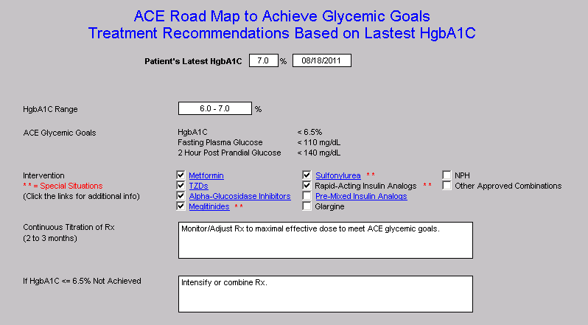
FROM HOURS TO OUTCOMES

Slide 42
Conclusion
More than at anytime in the history of Medicine those who prepare and deliver continuing medical education programs are part of the equation which will produce excellence in patient care.
The effective power of our contribution to medicine will depend upon our designing and producing educational modules which have measurable results and sustainable outcomes.
In many ways, we will also participate in promoting “personal mastery” in health care providers which allows them not only to husband their energy but to recreate that energy through passion, vision and personally generated “creative tension”.
This is a new kind of learning, a new kind of CME and a new strategy for both.

