Slide 1
Dallas Methodist Physician Network/Universal American
HCC/HEDIS
Physician Education Dinner
September 25 & 26, 2013
Dallas, Texas

Slide 2
Maximizing HCC Risk Value to the Patient and to the Practice
James L. Holly, MD
Chief Executive Officer
Southeast Texas Medical Associates, LLP

Slide 3
HCC Risk Value
Structure, Organization and Concepts of the
Hierarchical Condition Categories (HCC)
15,000 ICD-9 codes were organized into 189 HCCs.
5,243 ICD-9 Codes, contained in 70 HCCs, were included in the HCC/RxHCC list.
A coefficient (a number) was assigned to each selected code, which translated into an enhanced payment for the diagnosis.
Most of those excluded were for various reasons most commonly because of potential for abuse or because they did not add to the cost of care of the patient.

Slide 4
HCC Risk Value
Established in 2004 to reward Medicare + Advantage programs who do not “cherry-pick” only well Medicare beneficiaries.
The HCC/RxHCC Codes have value in Medicare Advantage, Medical Home and ACO.
It is anticipated that practices which are Medical Homes will be paid based on the level of MH recognition and on the total value of the HCC/RxHcc coefficient aggregate.
The highest per member per month reimbursement will be fore NCQA Tier III and a coefficient aggregate of 2.0 and higher.

Slide 5
General Concepts
In 2007, Medicare Advantage programs were funded by CMS using both demographics (AAPCC) and the Hierarchical Conditional Codes known as HCC.
2007 was the year that RX HCC codes were added to complement the reimbursement for managing patients with other illnesses which while they did not rise to the level of complexity and cost-for-care, as the HCC diagnoses, they did qualify for a lower additional payment due to increased medication costs.

Slide 6
General Concepts
The RxHCC designations cover many diagnoses not covered in the HCC. They represent an enhanced payment due to the medication cost of treating the condition.
Almost all HCC diagnoses are also RxHCC codes, but NOT all RxHCCs are also HCCs.
While HCCs have a greater value, there are so many more RxHCCs than HCCs, the total revenue from RxHCCs will typically exceed the total revenue from HCCs.

Slide 7
HCC Risk Value
CMS identified ten principles which guided
the creation of Hierarchical Conditions
Categories. The following of those
principles should impact provider
documentation of these codes…

Slide 8
HCC - Principle 1
Diagnostic categories should be clinically meaningful.
Conditions must be sufficiently clinically specific to minimize opportunities for gaming or discretionary coding.
Clinical meaningfulness improves the face validity of the classification system to clinicians, its interpretability, and its utility for disease management and quality monitoring.

Slide 9
HCC – Principle 5
The diagnostic classification should encourage specific coding.
Vague diagnostic codes should be grouped with less severe and lower-paying diagnostic categories to provide incentives for more specific diagnostic coding, i.e., “CAD” grouped with CHF, Acute MI, Chronic Stable Angina, etc.

Slide 10
HCC – Principle 6
The diagnostic classification should not reward coding proliferation. The classification should not measure greater disease burden simply because more ICD 9-CM codes are present.
Hence, neither the number of times that a particular code appears, nor the presence of additional, closely related codes that indicate the same condition should increase predicted costs.

Slide 11
HCC – Principle 7
Providers should not be penalized for recording additional diagnoses (monotonicity).
This principle has two consequences for modeling:
No condition category should carry a negative payment weight, and
A condition that is higher-ranked in a disease hierarchy (causing lower-rank diagnoses to be ignored) should have at least as large a payment weight as lower-ranked conditions in the same hierarchy.

Slide 12
HCC – Principle 10
Discretionary diagnostic categories should be excluded from payment models.
Diagnoses that are particularly subject to intentional or unintentional discretionary coding variation or inappropriate coding by health plans/providers, or that are not clinically or empirically credible as cost predictors, should not increase cost predictions.
Excluding these diagnoses reduces the sensitivity of the model to coding variation, coding proliferation, gaming, and up coding.

Slide 13
HCC Risk Value
The coefficients from different categories accumulate to add additional payments for the patient's care.
For example, a male with heart disease, stroke, and cancer has (at least) three separate HCCs coded, and his predicted cost will reflect increments for all three problems.
However, the HCC model is more than simply additive because some disease combinations interact. For example, the presence of both Diabetes and CHF could increase predicted cost by more than the sum of the separate coefficients for people who have diabetes or CHF alone.

Slide 14
HCC Risk Value
Also, the patient’s age and gender will play a part in the HCC/RxHCC coefficient aggregate. For instance, unrelated to any diagnosis, a 74 year old female will have an HCC coefficient of .46 added to the total coefficient aggregate score based simple on age.

Slide 15
HCC vs. RxHCC
Here are some examples of diagnoses which are not HCC but are RxHCC codes:
Hypertension is not an HCC (i.e., 401.1 or 401.9, etc.) but hypertension is an RxHCC.
Osteoporosis, another common illness, is not a medical HCC but is an RxHCC.
CAD in itself is not a medical HCC, but it is an RxHCC. Because CAD is a general term, it is imperative that if the patient has angina or an old MI, the chronic problem list should include angina or old MI as they are HCC diagnoses. (Note : in 2014 “old MI” is being dropped as an HCC.)

Slide 16
HCC Risk Value
HCCs are assigned using hospital and healthcare provider diagnoses from any of five sources:
Principal hospital inpatient
Secondary hospital inpatient
Hospital out-patient
Physician , CFNP, PA
Clinically trained non-physician (e.g., psychologist, podiatrist)

Slide 17
New Auditing Policy
New Auditing Policy Announced 2008
CMS issued a new audit policy regarding HCCs. They have also announced a substantial change in what they will do when they find a problem with coding. In the past, any coding problems were fixed for just the specific codes that were in error in the audit – i.e. the exposure was minimal. Going forward the percent of error will be applied to the total HCC/RxHCC report.

Slide 18
New Auditing Policy
The new procedure will assume they have audited an appropriate sample of codes and correct the entire payment amount by the sample error rate – i.e. extraordinary exposure. So a 5% error rate in the sample will result in a 5% reduction in premium – big.
No one has seen detailed audit regulations yet. They may be having difficultly putting such a policy into place – but they strongly believe there is significant over coding going on across the industry – hence the reason for the new policy.

Slide 19
Requirements
The requirements for successfully benefiting from the HCC Risk program are:
You must have a robust ICD-9 code list which is intuitively accessible by healthcare providers in the context of a patient encounter.
You must have a means of identifying which codes are HCC, RxHCC, or both.

Slide 20
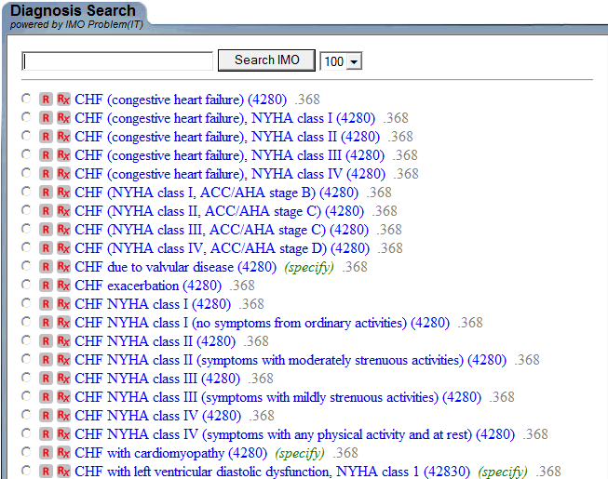
Robust ICD-9 Codes

Slide 21
Robust ICD-9 Codes
Depending upon how you count, there are over 15,000 ICD-9 codes available to be used. However, the descriptions of those codes are either obscure or incomprehensible in the electronic versions published by CMS.
Physicians typically utilize two hundred codes.
In that there are 5,243 ICD-9 codes that are HCC/RXHCC, that leaves a great deal of value untapped.

Slide 22
Requirements
You must have a system which audits the validity of assigning those ICD-9 codes to a particular patient to avoid the potential for abuse in over-diagnosing patients for financial benefit.
You must have a means for aggregating this information for reporting to the health plan and by the health plan to CMS.
You must have a means of evaluating each of the HCC and/or RxHCC diagnoses and documenting that evaluation.

Slide 23
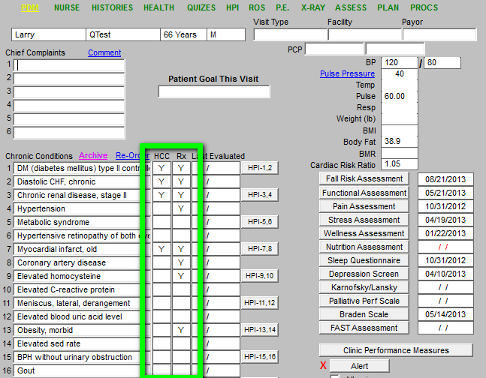
Robust ICD-9 Codes

Slide 24
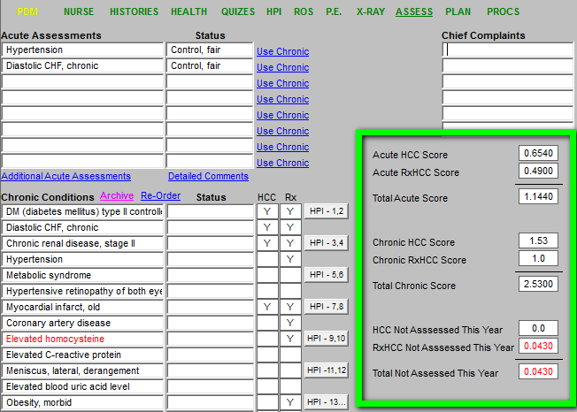
Robust ICD-9 Codes

Slide 25
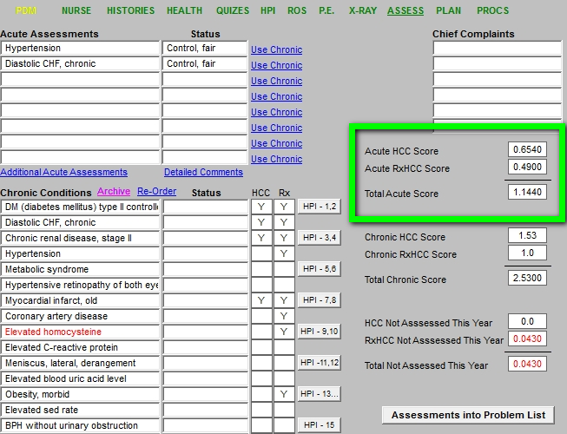
Robust ICD-9 Codes

Slide 26
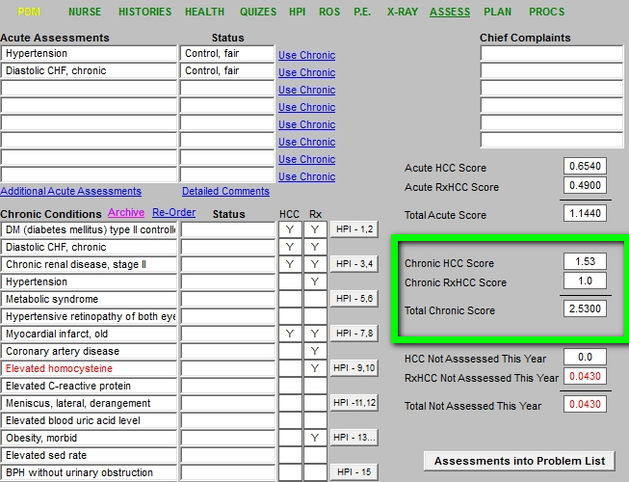
Robust ICD-9 Codes

Slide 27
SETMA’s Strategy
At each visit, providers can view the patients HCC/RxHCC status for both the acute visit and the patient’s chronic conditions.
Chronic conditions which are an HCC or RxHCC, that have not been evaluated during the year, are highlighted in red to alert a provider to assess them before the end of the payment year.

Slide 28
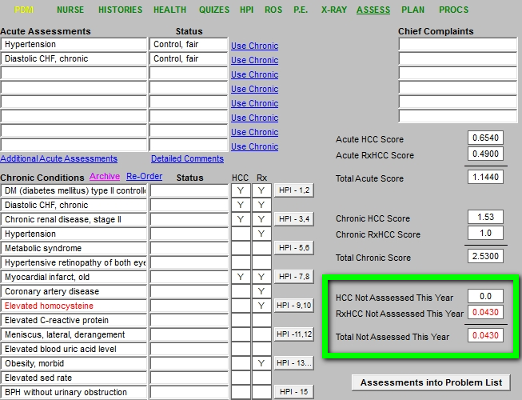
Robust ICD-9 Codes

Slide 29
Robust ICD-9 Codes
The following are examples of coding so as to maximize valid HCC/RxHCC codes rather than using non-specific diagnostic codes which are not HCC/RxHCC.

Slide 30
Robust ICD-9 Codes
Chronic Kidney disease (CKD) vs. Renal insufficiency:
Review GFR levels on labs and re-run labs within 3 months if GFR less <60. When GFR levels are consistently <60, use CKD unspecified 585.9, or use specific level CKD III 585.3 (GFR 30-59), CKD IV 585.4 (GFR 15-29), or CKD V 585.5 (GFR less than 15). Do not use Renal insufficiency 593.9 if level is consistently <60.
Cardiac arrhythmia vs. specified arrhythmia:
Atrial Fib/PAF (427.31), Atrial Flutter (427.32), SSS/Sinoatrial Node Dysf (427.81), PSVT (427.0), Parox. Tachycardia (427.2), Parox Ventric Tachycardia (427.1) are specific and risk-assessed. Cardiac arrhythmia 427.9 is not risk-assessed.

Slide 31
Robust ICD-9 Codes
Abuse vs. Dependence:
Alcohol dependence 303.90 is risk-assessed. Alcohol or drug abuse is not.
The word “chronic” makes some diagnoses risk-assessed:
Chronic Hepatitis 571.40 is risk-assessed vs. Hepatitis 573.3, which is not.
Chronic Hepatitis B 070.32 is risk-assessed vs. Hepatitis B 070.30, which is not.

Slide 32
Robust ICD-9 Codes
Major, recurrent depression is risk-assessed:
296.X Episodic mood disorder (Mild 296.1, Moderate 296.2, Severe 296.3) 296.80 Bipolar disorder, unspecified
296.90 Mood disorder, episodic, unspecified
296.2 Major depression, single episode
296.3 Major depression, recurrent episode
Definition of mood disorder from Ingenix ICD-9-CM for Physicians 2009 Expert: “Mood disorder that produces depression, may exhibit as sadness, low self-esteem, or guilt feelings; other manifestations may be withdrawal from friends and family, interrupted sleep.”
Unspecified depression is not risk-assessed:
311 Depression, not otherwise specified
Must document the characteristics of the depression and it’s current status, i.e. Major depression - stable on meds, Bipolar disorder – not controlled, referred to Dr. Smith.

Slide 33
Robust ICD-9 Codes
Code higher level DM and code manifestation:
250.00 DM w/o Complication
250.40 DM w/Renal Manifestations + CKD 585.9, Nephropathy 583.81, or Nephrosis 581.81
250.50 DM w/Ophthalmic Manifestations + Glaucoma 365.44, Macular Edema 362.07, Retinopathy 362.01-362.07, Cataract 366.41, or Retinal Edema 362.07
250.60 DM w/Neurological Manifestations + Polyneuropathy 357.2, Gastroparesis 536.3, Peripheral Autonomic Neuropathy 337.1, Neurogenic Arthropathy 713.5
250.70 DM w/Peripheral Circulatory Disorders + PVD 443.81
250.80 DM w/Other Specified Manifestations + DM w/Ulcerations 707.10, 707.9, Bone Changes 731.8, or Hypoglycemia (no add’l code)
250.90 DM w/Unspecified Complication
You may document the manifestation immediately without listing the higher level of manifestation category.
i.e. instead of writing “DM with Renal manifestations”, which does not specify the manifestation, use “DM w/CKD” to be more concise.

Slide 34
Robust ICD-9 Codes
If a patient is currently being treated for a condition, do not use “History of”, even if condition is stable. Instead document as “CHF - compensated, Angina - stable, COPD - compensated, SSS - stable with pacemaker, A-fib on Coumadin, Old MI w/CAD”.
“History of”, “S/P”, or “H/O” refers to conditions the patient had in the past, which could be resolved, i.e. H/O DVT, H/O Angina w/CABG, H/O Prostate CA w/Prostatectomy. The exception to “History of” is Old MI, which is a risk-assessed diagnosis (ICD-9 code 412).
DO NOT use ICD-9 code 436 for “History of” CVA. Instead diagnose as: “Old CVA” (ICD-9 code V12.54); OR “Old CVA with late effects”, i.e. aphasia, slurred speech, gait problem, etc. (ICD-9 code 438.9); OR “Old CVA w/hemiplegia” (ICD-9 code 438.20). Please note that ICD-9 code 436 is acute, but ill-defined, cerebrovascular disease, which is okay if cerebrovascular disease is documented but not CVA. Acute CVA is coded 434.91 and should only be used in a hospital setting.

Slide 35
2013 CMS HCC Weights
http://www.univhc.com/docs/Doctors Hospitals/MRA/2013_CMS-HCCs_Weights.pdf
This is a list of new codes for 2013 which have extraordinary coefficient values, some as high as 2.7.

Slide 36
Guiding Principles
The risk adjustment diagnosis must be based on clinical medical record documentation from a face-to-face encounter,
Coded according to the ICD-9-CM Guidelines for Coding and Reporting;
Assigned based on dates of service within the data collection period,
Submitted from an appropriate risk adjustment provider type and an appropriate risk adjustment physician data source.

Slide 37
Validation Guidelines
The medical record documentation must support an assigned HCC.
Beneficiary HCCs and risk adjustment records are selected based on risk adjustment diagnoses (ICD-9 codes),
Provider type, Health Insurance Claim (HIC) number that is submitted to the Risk Adjustment Processing System (RAPS).

Slide 38
Provider Signatures on Progress Notes
All hand written Progress Notes must be signed by the provider rendering services.
Provider credentials must either be pre-printed on the Progress Note as a stationary or the provider must sign all Progress Notes with his/her credentials as part of the signature.

Slide 39
Provider Signatures on Progress Notes
Dictated notes and consults must be signed by the provider. The provider’s credentials must either follow the signature or be pre-printed on the stationary.
Stamped signatures are no longer acceptable as of January 1, 2009, as stated by the Centers for Medicare & Medicaid Services (“CMS”).

Slide 40
Provider Signatures on Progress Notes
EMR Progress Notes must have the following wording as part of the signature line: “Electronically signed”, Authenticated by”, “Signed by”, “Validated by”, Approved by”, or “Sealed by”.
The signed EMR record must be closed to all changes.
Any additional information or updates can be added as a separate addendum to the DOS, i.e. lab result returned which confirms diagnosis within 30 days of the initial DOS.

Slide 41
Requirements for Progress Notes
CMS wants an evaluation of each diagnosis on the Progress Note, not just the listing of chronic conditions, i.e.: DM w/Neuropathy - meds adjusted, CHF - compensated, COPD - test ordered, HTN - uncontrolled, Hyperlipidemia - stable on meds.
CMS considers diagnoses listed on the Progress Note without an evaluation or assessment as a “problem list”, which is unacceptable for encounter data submission.
Each Progress Note must be able to “stand alone”. Do not refer to diagnoses from a prior Progress Note, problem list, etc.

Slide 42
Areas of Concern – Active vs. History
Coding errors predominately often fall into two categories:
CVA submitted as a current condition instead of as “History of”.
Cancer submitted as a current condition instead of as “History of”.

Slide 43
Areas of Concern – Active vs. History
CVA becomes “history of” when the member is discharged from the hospital after the acute episode.
At the point of PCP follow-up, post-CVA with no residual effects is coded as V12.54. It is not coded as 434.91 or 436.
Residual effects of CVA should be coded using ICD-9-CM codes from the 438 section of ICD-9-CM.

Slide 44
Areas of Concern – Active vs. History
Cancer becomes “history of” when all current and adjunct treatment has been completed.
History of Cancer is coded using V-codes from the V10 section of ICD-9-CM.
Use a V-code from the V67 section in ICD-9-CM for ongoing surveillance following completed treatment.

Slide 45
SETMA’s Strategy Evaluating Each Problem Annually
SETMA has ways of documenting the evaluation of an HCC/RxHCC which are discussed at length in the tutorial which has been passed out to you. They are:
Disease management tools;
Chronic Conditions evaluation pop-ups;
“Detailed Comment” pop-ups which launch from the Assessment Template;
The main body of the patient encounter in GP Master.

Slide 46
What Documentation Is Necessary?
Because all of the HCC and/or RxHCC are Chronic Conditions, the following would be required:
They must be identified in the E&M coding event for that encounter and they must appear on the Chronic Problem list for that patient.
Lab, x-rays and procedures should be appropriate to that condition, when required.

Slide 47
What Documentation Is Necessary?
Medications should be reviewed and appropriate medications for the condition should be present in the documentation for the encounter
Physical examination should be specific for that condition – for instance if you state the patient has CHF and do not document the lungs and heart, it would not be a valid evaluation. If you say the patient has cancer of the prostate and you do not comment whether they are currently in treatment or are in surveillance, that would not be valid.
Documented History (CC, ROS, PMH) should be appropriate for that condition.

Slide 48
What Documentation Is Necessary?
What steps must be taken take to qualify a diagnosis as an HCC? The diagnosis must be:
Established as applying to this patient.
Documented in the patient’s record in the Chronic Problem list
Evaluated at least once in the year prior to the qualification as an HCC or RxHCC and reported in the Acute Assessment of the record.
Reported to the HMO and via the HMO to CMS

Slide 49
Provider Responsibility
Providers simply need to pay attention to the needs and condition of the patient and
Add any HCC or RxHCC which you diagnose to both your chronic problem list and to the acute assessment.
Update your Chronic Problem list so that the HCC and RxHCC are displayed on your diagnoses.
Evaluate each of the HCC and RxHCC at least once during the year.
Pay particular attention to specialty consultations or reports and make sure the capture those diagnoses in your problem list and that you evaluate them at least once a year.

Slide 50
What Documentation Is Necessary?
The best way to evaluate whether you have identified ALL of the HCC and/or RxHCC is to review:
Scanned documents particularly under cardiology, discharge summaries, radiology, specialty correspondence, pulmonary, echo’s, x-rays, etc.
The patient’s past history template.
Laboratory results and medications.
Previous encounters.

Slide 51
Numbers Don’t Lie

Slide 52
Interesting Cases of HCC/RxHCC
Altered Mental Status see AOC Altered Mental Status
Amputations – including toes
Attention to all ostomies
Aneurysms
Halitosis Choking Sneezing Mouth Breathing
Death Sudden Unattended
Decubitus

Slide 53
Interesting Cases of HCC/RxHCC
Vegetative state Persistent, see, AOC Vegetative State Persistent
Decubitus and Ulcers of the skin and extremities
Difficulty walking due to deranged joints
Drug Depend and addiction including alcohol
Fluid and electrolyte balance
Malnutrition
Generalized Pain see Pain Generalized

Slide 54
HCC/RxHCC In The Same Category
HCC/RxHCC codes which are in the same category, will result in a payment for only one of those codes, but it will be the highest value code, i.e., the diagnosis of CAD and MI are in the same category so you will be paid for only one, which is the highest, MI.

Slide 55
HCC/RxHCC In The Same Category
Related Codes from different categories will result in payment for both, i.e., Diabetes and Diabetic Neuropathy are related conditions but are in different HCC categories and will thus both be paid.
Example…If a patient has CHF Systolic and CHF Diastolic, you need to document both for clinical purposes but for HCC purposes you will only be paid for one.

Slide 56
Important Facts
Initially, HCCs codes were valuable only in Medicare Advantage, but now are valuable in Patient-Centered Medical Home and in Accountable Care Organizations.
In PC-MH it is the Coefficient Aggregate which is important while in MA and ACO it is the individual codes which results in increased revenue.

Slide 57
PC-MH and HCC
Some payments are being made in some states for Patient-Centered Medical Home. CMS continues to discuss such payments but have not yet launch the program due to the ACA and cost reduction. When that happens and it will, it will be based on two things:
The level of medical home you have achieved
The coefficient aggregate for each individual patient

Slide 58
PC-MH and HCC
If a provider has NCQA Tier III and if the patient has a coefficient aggregate of 2.0 or above, then the monthly payment for that patient will be the maximum.
Discussions are between $20-100 per member per month.

Slide 59
Coefficient Aggregates
Each HCC/RxHCC code has a coefficient associated with it.
When the total value of the coefficients for each HCC/RxHCC code is added up, you produce the “coefficient aggregate.”
For older patients a coefficient value is added for age.

Slide 60
Coefficient Aggregates and E&M Codes
SETMA has been experimenting with the auditing of Evaluation and Management Code distribution in practice.
The most subjective aspect of E&M coding is the complexity of medical decision making.
It follows that the higher the HCC Coefficient aggregate for the acute visit, the more complex the medical decision making is.

Slide 61
Coefficient Aggregates and E&M Codes
By implication, we think there is a correlation between the acute diagnoses’ HCC/RxHCC coefficient aggregate and the E&M code. The higher the HCC/RxHCC coefficient aggregate for the acute visit, the higher it is reasonable to expect the E&M coding to be, IF the documentation is present in the record related for two or more chronic conditions.

Slide 62
Coefficient Aggregates and E&M Codes
Because SETMA’s EMR displays whether a diagnosis is an HCC, an RxHCC or both, and because our system aggregates the coefficients for all of the diagnoses which are documented in a patient’s care, it is possible for a provider to know on each patient he/she treats:
The coefficient aggregate for the acute diagnoses documented for each visit.
The coefficient aggregate for the chronic diagnoses documented for each patient.
The coefficient aggregate which has not been evaluated on a patient for the current year.

Slide 63
Coefficient Aggregates and E&M Codes
The following tables contrast:
Medicare Fee-for-Service HCC/RxHCC coefficient aggregates with Medicare Advantage HCC/RxHCC aggregates
Medicare Fee-for-Service contrasted with Medicare Fee-for-Service E&M Code distribution by provider name
All Payers HCC/RxHCC aggregates contrasted with E&M Codes

Slide 64
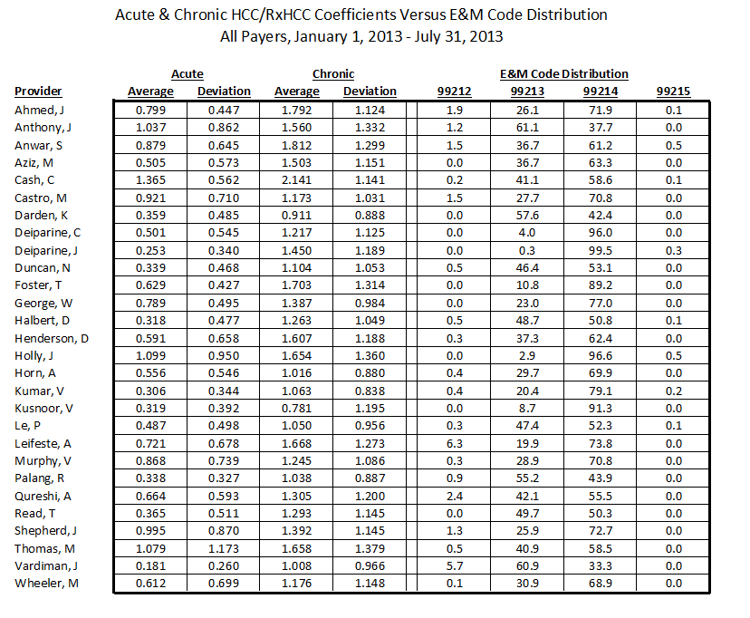
Coefficient Aggregates and E&M Codes

Slide 65
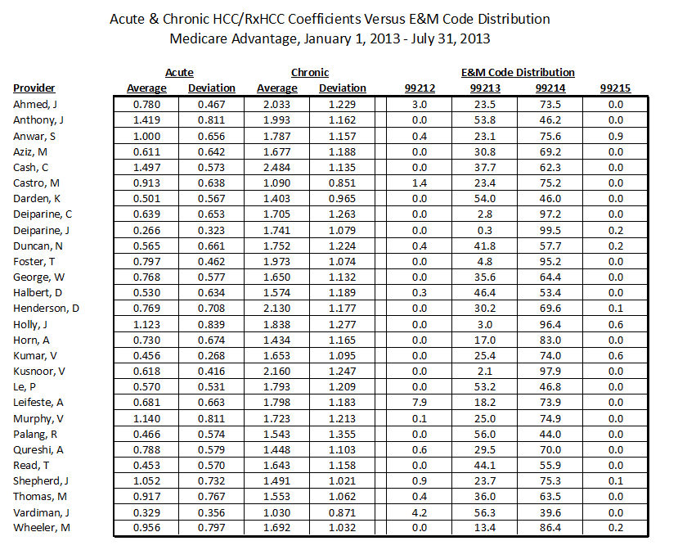
Coefficient Aggregates and E&M Codes

Slide 66
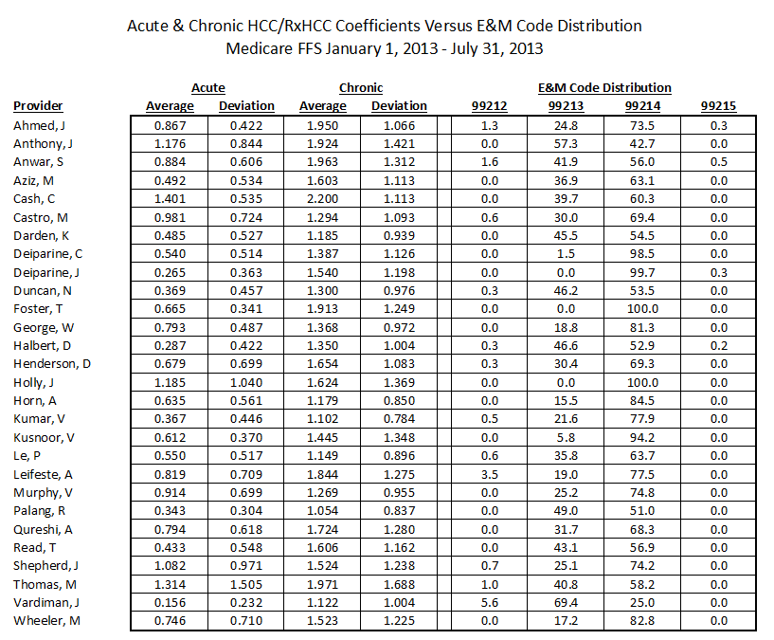
Coefficient Aggregates and E&M Codes

Slide 67
Coefficient Aggregates and E&M Codes
There has been no official endorsement of this analysis, but it seems to us to be valid. It has exposed several coding errors in SETMA’s work which has enable us to correct those errors.
We look forward to other practices experimenting with this contrast to see if they validate our findings.
Whether ultimately validated or not, it illustrates how data analysis and associates should attract our attention.

Slide 68
HEDIS
The Healthcare Effectiveness Data and Information Set (HEDIS) is a tool used by more than 90 percent of America's health plans to measure performance on important dimensions of care and service.
Altogether, HEDIS consists of 75 measures across 8 domains of care. Because so many plans collect HEDIS data, and because the measures are so specifically defined, HEDIS makes it possible to compare the performance of health plans on an "apples-to-apples" basis.

Slide 69
HEDIS
Produced by the National Committee for Quality Assurance (NCQA).
Used by more than 90 percent of America's health plans to measure performance on important dimensions of care and service.

Slide 70
HEDIS
Altogether, HEDIS consists of 75 measures across 8 domains of care.
Because so many plans collect HEDIS data, and because the measures are so specifically defined, HEDIS makes it possible to compare the performance of health plans on an "apples-to-apples" basis.

Slide 71
HEDIS
The Medicare Advantage STARS and the Accountable Care Organization Quality Measures are HEDIS.
http://www.jameslhollymd.com/epm-tools/Tutorial-STARs
http://www.jameslhollymd.com/epm-tools/Tutorial-Medical-Home-Coordination-Review
SETMA Deployment of HEDIS can be reviewed at www.jameslhollymd.com.

Slide 72
Why Not Cheat?
If you are going to measure the quality of care given by healthcare providers,
If you are going to give a test to healthcare providers, and
If you are going to give them the test questions before hand, and
If the test is open-book, and
If there is no time limit for taking the test.

Slide 73
Why Not Cheat?
Look up the answers before the test so you can know your performance before you get the test results.
Don’t wait until a STARS (MA), an insurer, an ACO, or an agency audits your HEDIS performance.
Do it yourself and do it at the point of care and share the results with your patients.

Slide 74
Why Not Cheat?
The ultimate “game changer” in healthcare is when the provider knows how he/she is doing in the care of an individual patient, or a panel of Or population of patients and then when the provider shares this information with patients and with the public at large.
The game is changed because the motivation to improve is maximized.

Slide 75
Why Not Cheat?
Of course, ethically there is no “cheating” in this context.
Unlike traditional medical education, this test is not measuring what you know; it is measuring what you have access to; to what you pay attention.
It is measuring how efficiently and excellently you are applying what you know.

Slide 76
HEDIS
The HEDIS test is not measuring what you remember; it is measuring that of which you are reminded.
If you have Clinical Decision Support (CDS) which reminds you of what needs to be done, and if you have CDS which allows you to measure your own performance at the point of care, you can consistently improve your performance.

Slide 77
Public Reporting of Performance
The public reporting by provider name of performance on hundreds of quality measures including HEDIS, places pressure on all providers to improve, and it allows patients to know what is expected of providers.

Slide 78
Public Reporting of Performance
SETMA public reports quality metrics two ways:
In the patient’s plan of care and treatment plan which is given to the patient at the point of care. This reporting is specific to the individual patient.
On SETMA’s website. Here the reporting is by panels or populations of patients without patient identification but with the provider name given.

Slide 79
Public Reporting of Performance
One of the most insidious problems in healthcare delivery is reported in the medical literature as “treatment inertia.” This is caused by the natural inclination of human beings to resist change.
Often, when care is not to goal, no change in treatment is made. As a result, one of the auditing elements in SETMA’s COGNOS Project is the assessment of whether a treatment change was made when a patient was not treated to goal.

Slide 80
Public Reporting of Performance
Overcoming “treatment inertia” requires the creating of an increased level of discomfort in the healthcare provider and in the patient so that both are more inclined to change their performance.
SETMA believes that one of the ways to do this is the pubic reporting of provider performance. That is why we are publishing provider performance by provider name atwww.jameslhollymd.com under Public Reporting.

Slide 81
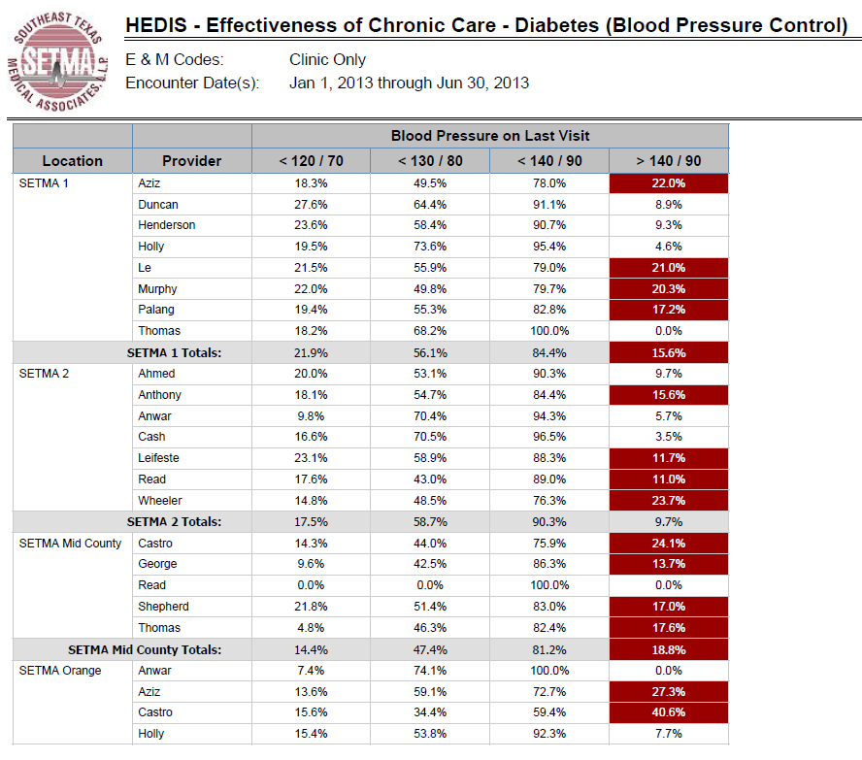
Public Reporting of Performance

Slide 82
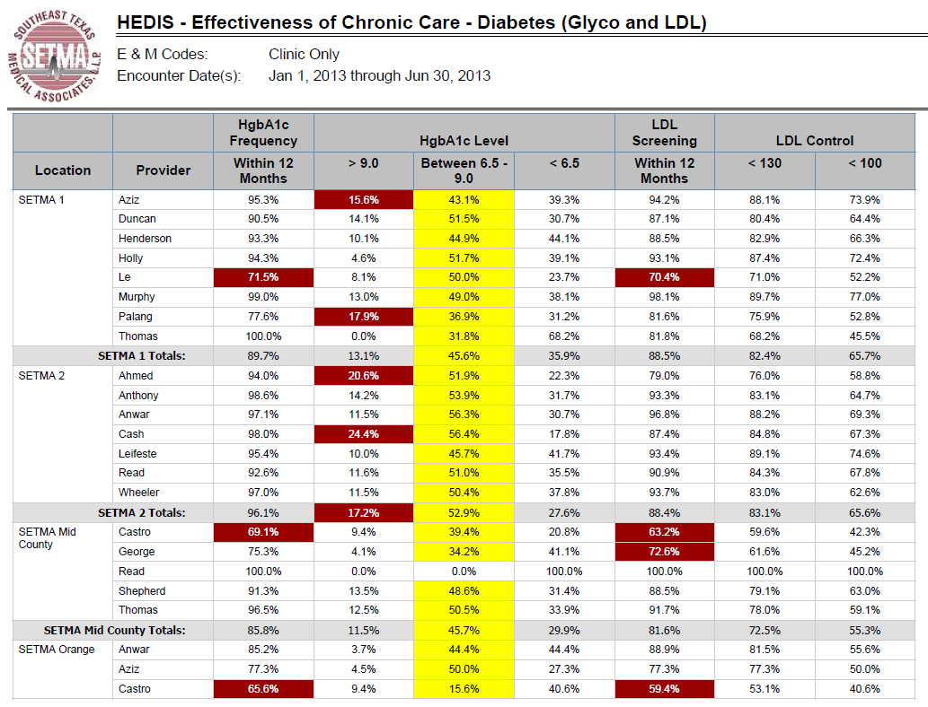
Public Reporting of Performance

Slide 83
Public Reporting of Performance
Once you “open your books on performance” to public scrutiny, the only safe place you have in which to hide is excellence.

Slide 84
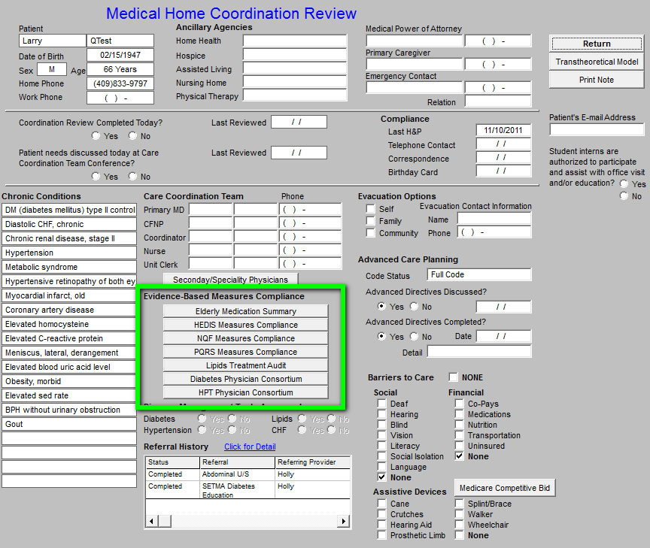
HEDIS

Slide 85
HEDIS

Slide 86
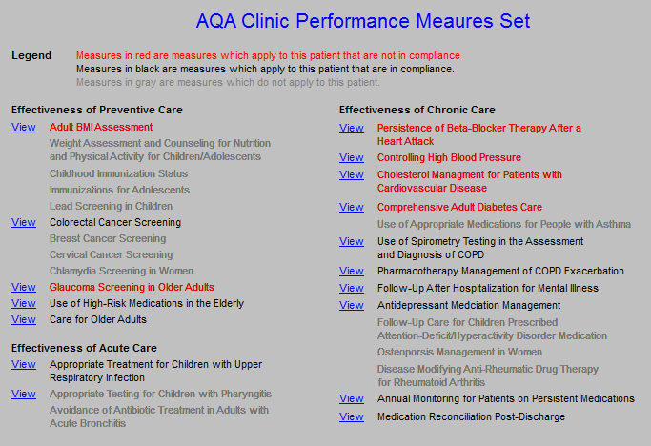
HEDIS

Slide 87
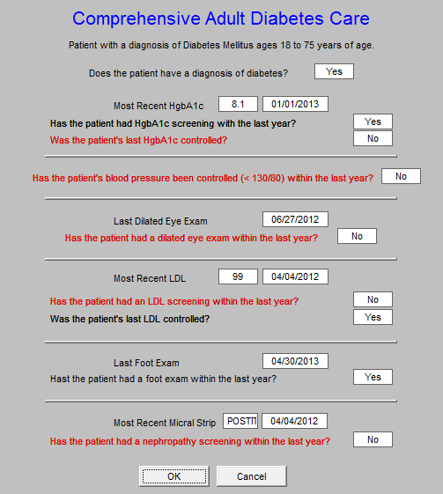
HEDIS

Slide 88
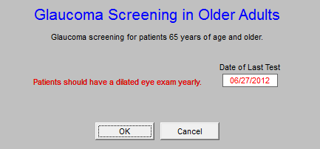
HEDIS

Slide 89
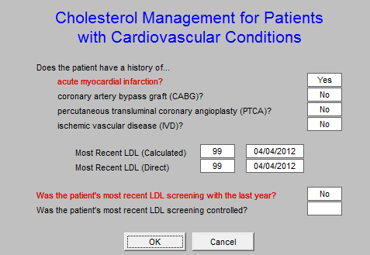
HEDIS

Slide 90
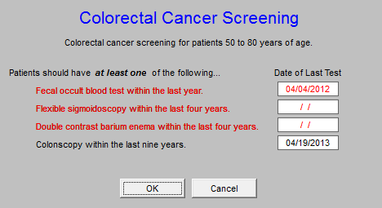
HEDIS

Slide 91
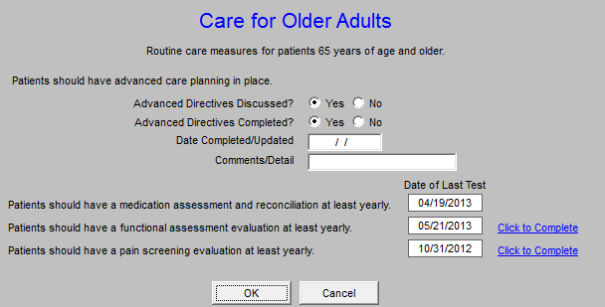
HEDIS

