Slide 1
Gartner Business Intelligence Excellence Award Semi-Finalist Southeast Texas Medical Associates, LLP
Dr. James L. Holly, MD
CEO, Southeast Texas Medical Associates, LLP
May 3, 2011

Slide 3
SETMA’s Model of Care
Performance Tracking – one patient at a time
Performance Auditing – by panel or population
Analysis of Provider Performance Data
Public Reporting by Provider Name
Quality Assessment/Performance Improvement

Slide 4
Clusters and Galaxies
A “cluster” is seven or more quality metrics for a single condition, i.e., diabetes, hypertension, etc.
A “galaxy” is multiple clusters for the same patient, i.e., diabetes, hypertension, lipids, CHF, etc.
Fulfilling a single or a few quality metrics does not change outcomes, but fulfilling “clusters” and “galaxies” of metrics at the point-of-care can and will change outcomes.

Slide 5
Auditing Performance After the Visit

Slide 6
Auditing Performance After the Visit

Slide 7
Auditing Performance After the Visit
Unlike a single metric, such as “was the blood pressure taken,” which will not improve care, fulfilling and then auditing a “cluster” or a “galaxy of clusters” in the care of a patient will improve treatment outcomes and will result in quality care.

Slide 8
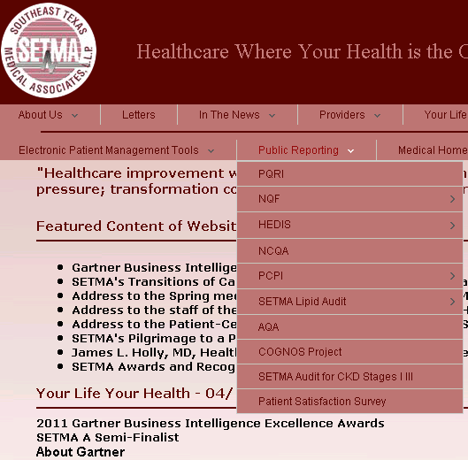
Auditing Performance After the Visit
What is most often missing in quality improvement initiative is real-time, auditing with comparative display of results, and public reporting.

Slide 9
Auditing Performance After the Visit
SETMA employed IBM’s Business Intelligence software, COGNOS to audit provider performance and compliance.
COGNOS allows all providers to:
Display their performance for their entire patient base
Compare their performance to all practice providers
See outcome trends to identify areas for improvement
See this at the point-of-care

Slide 10
Auditing Performance After the Visit
SETMA contracted with LPA Systems (www.lpa.com) to build our auditing tools.
LPA designed a data warehouse to minimize the impact on our production servers.

Slide 11
Analyzing Provider Performance
LPA used SQL Server Integration Services (SSIS) to clean and scrub the hundreds of data points we needed for our audit rather than having to process the millions of data points contained in our EHR.
SSIS scrubs and preloads our EHR data into the warehouse, which gives us both speed in reporting and confidence in the results in our COGNOS reports.

Slide 12
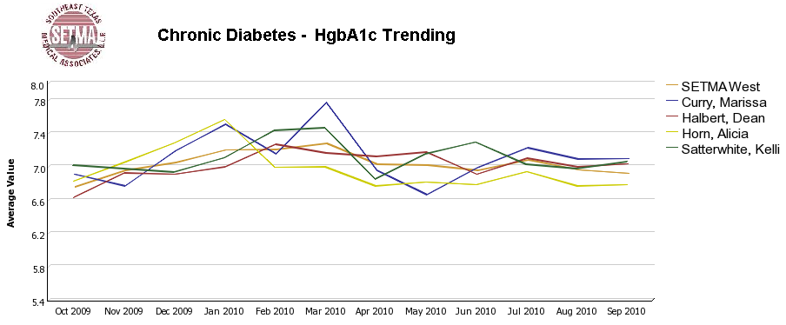
Auditing Performance After the Visit

Slide 13
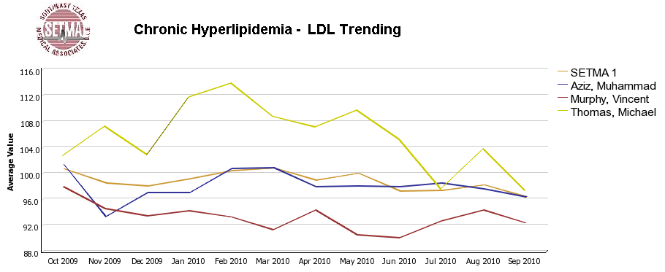
Auditing Performance After the Visit

Slide 14
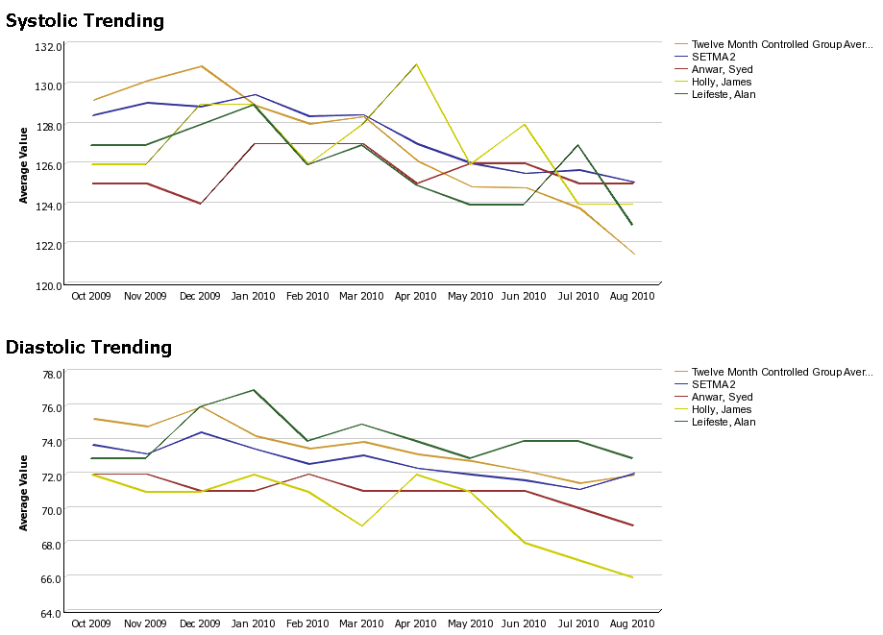
Auditing Performance After the Visit

Slide 15
Auditing Performance After the Visit
Beyond how one provider performs (tracking and auditing), SETMA looks at data as a whole (analyzing) from which to develop new strategies for improving patient care.
We analyze patterns which may explain why one population is not to goal while another is. Some of the parameters, we analyze are:
Frequency of visits
Frequency of key testing
Number of medications prescribed
Were changes in treatments made, if patient not to goal
Referrals to educational programs
Etc.

Slide 16
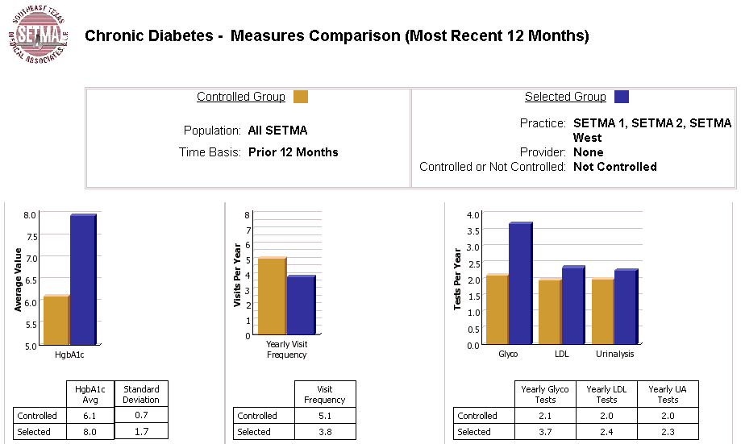
Analyzing Provider Performance

Slide 17
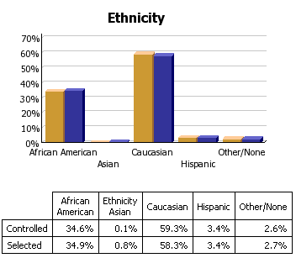
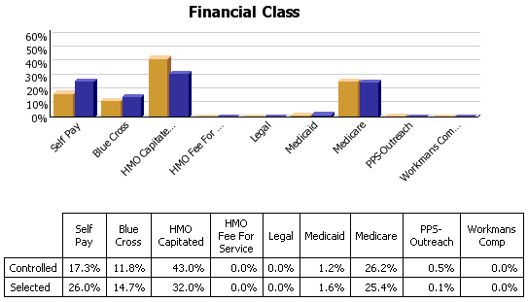
Analyzing Provider Performance

Slide 18
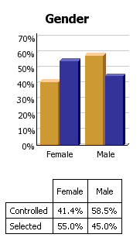
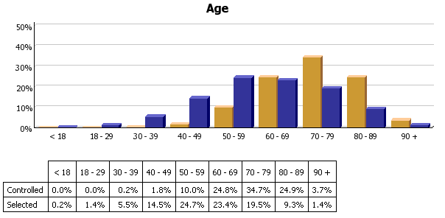
Analyzing Provider Performance

Slide 19
Analyzing Provider Performance
Raw data can be misleading. For example, with diabetes care, a provider may have many patients with very high HgbA1cs and the same number with equally low HgbA1cs which would produce a misleadingly good average. As a result, SETMA also measures the:
Mean
Median
Mode
Standard Deviation

Slide 20
Analyzing Provider Performance
SETMA’s average HgbA1c as been steadily improving for the last
10 years. Yet, our standard deviation calculations revealed that
a subset of our patients were not being treated successfully and
were being left behind.
By analyzing the standard deviation of our HgbA1c we have
been able to address the patients whose values fall far from the
average of the rest of the clinic.

Slide 21
Public Reporting of Performance
One of the most insidious problems in healthcare delivery is reported in the medical literature as “treatment inertia.” This is caused by the natural inclination of human beings to resist change. As a result, when a patient’s care is not to goal, often no change in treatment is made.
To help overcome this “treatment inertia,” SETMA publishes all of our provider auditing (both the good and the bad) as a means to increase the level of discomfort in the healthcare provider and encourage performance improvement.

Slide 22
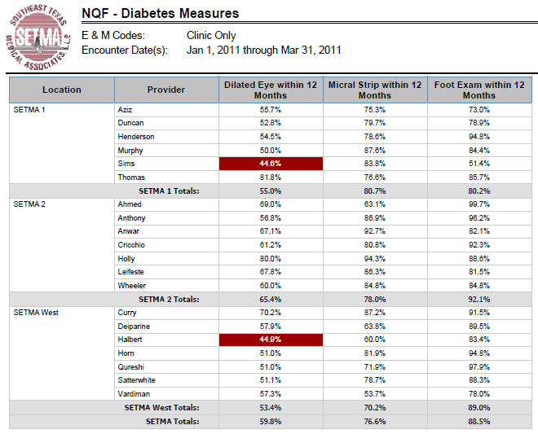
Public Reporting of Performance
NQF
Diabetes
Measures

Slide 23
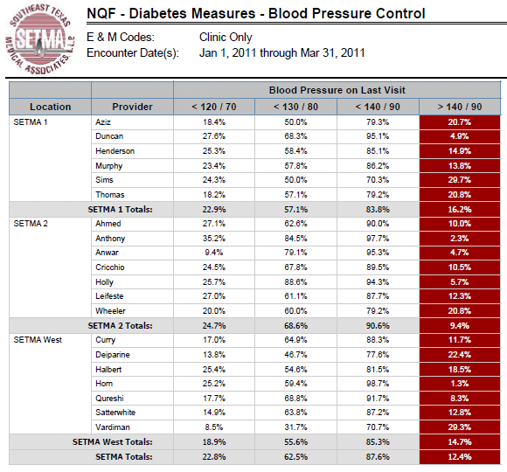
Public Reporting of Performance
NQF
Diabetes
Measures

Slide 24
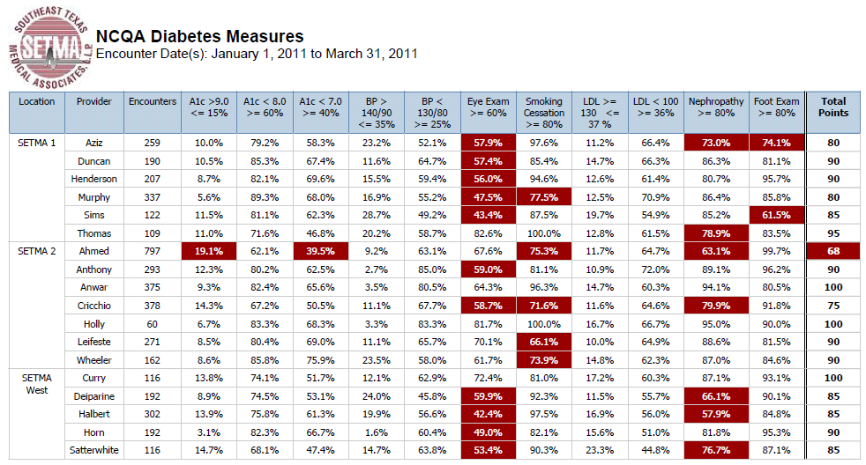
Public Reporting of Performance
NCQA Diabetes Recognition

Slide 25
Quality Assessment & Performance Improvement
Quality Assessment and Performance Improvement (QAPI) is SETMA’s roadmap for the future. With data in hand, we can begin to use the outcomes to design quality initiatives for our future.
We can analyze our data to identify disparities in care between
Ethnicities
Socio-Economic Groups
Age Groups
Genders

Slide 26
Quality Assessment & Performance Improvement
SETMA’s Model of Care along with the technology of COGNOS -- this pairing of medicine and technology -- can transform the delivery of healthcare and is worthy of being adopted by others.

Slide 27
Quality Assessment & Performance Improvement
By expanding SETMA’s COGNOS Project, we are also designing a quality improvement initiative for the elimination of preventable readmissions to the hospital.

Slide 28
www.jameslhollymd.com
Please visit us at www.jameslhollymd.com where you will find all of our public reporting, electronic patient management and medical home materials.

Slide 29
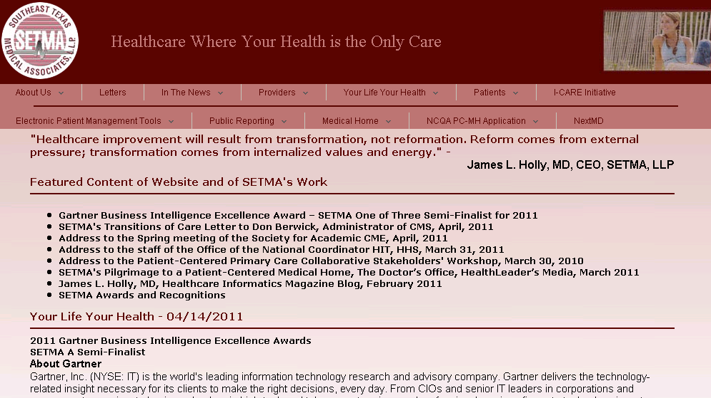
www.jameslhollymd.com

Slide 30
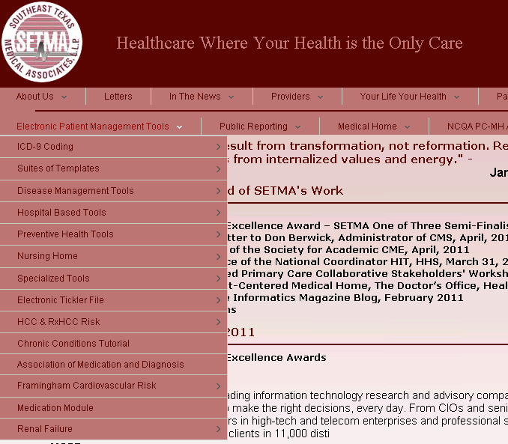
www.jameslhollymd.com

Slide 31
The Future
The future of quality metrics and the auditing of provider performance are constantly evolving. SETMA’s COGNOS Project allows us to both participate in the future and to define it; and, ultimately to pay attention to the things that matter and the things that will result in improved health for all of our patients.

