Slide 1
IBM Healthcare Academy Community Healthcare IT Solutions Where we are? Where we need to go?
December 14, 2011
James L. Holly, MD
CEO, SETMA, LLP
www.jameslhollymd.com

Slide 2
SETMA Ten Principles of Electronic Health Record Solution
Pursue Electronic Patient Management rather than Electronic Patient Records
Bring to every patient encounter what is known, not what a particular provider knows
Make it easier to do “it” right than not to do it at all

Slide 3
SETMA Ten Principles of Electronic Health Record Solution
Continually challenge providers to improve their performance
Infuse new knowledge and decision-making tools throughout an organization instantly
Promote continuity of care with patient education, information and plans of care

Slide 4
SETMA Ten Principles of Electronic Health Record Solution
Enlist patients as partners and collaborators in their own health improvement
Evaluate the care of patients and populations of patients longitudinally

Slide 5
SETMA Ten Principles of Electronic Health Record Solution
Audit provider performance based on endorsed quality measurement sets
Integrate electronic tools in an intuitive fashion giving patients the benefit of expert knowledge about specific conditions

Slide 6
Fourteen Critical Supports for Healthcare Performance Improvement
Care where the same data base is being used at ALL points of care.
A robust EHR to accomplish the above.
A robust business-intelligence analytics system, which allows for real-time data analysis at the point of care.

Slide 7
Critical Supports Required for Success in Healthcare Performance Improvement
A laser printer in every examination room so that personalized evaluation, educational and engagement materials can be provided to every patient at every encounter, with the patient’s personal health data displayed and analyzed for individual goal setting and decision making.

Slide 8
Critical Supports Required for Success in Healthcare Performance Improvement
Quality metric tracking, auditing and statistical analysis.
Public Reporting of quality metric performance by provider name (BI Deployment).
Quality Improvement initiatives based on tracking, auditing and analysis of metrics.

Slide 9
Critical Supports Required for Success in Healthcare Performance Improvement
Shared vision among all providers, support staff and administrators – a personal passion for excellence -- which creates its own internalized, sustainable energy for the work of healthcare transformation.

Slide 10
Fourteen Critical Supports for Healthcare Performance Improvement
Celebratory culture which does not compete with others but continually improves the organization’s own performance, using others as motivation but not as a standard.
Monthly peer-review sessions with all providers, to review provider performance and to provide education in the use of electronic tools.

Slide 11
Fourteen Critical Supports for Healthcare Performance Improvement
Adequate financial support for the infrastructure of transformation.
Respect of the personal value of others and the caring for people as individuals.

Slide 12
Fourteen Critical Supports for Healthcare Performance Improvement
An active Department of Care Coordination and a hospital-care support team which is in the hospital twenty-four hours a day, seven days a week.
Aggressive end-of-life counseling with all patients over fifty, and active employment of hospice in the care of patients when appropriate.

Slide 13
SETMA’s Quality-Metrics, Public-Reporting Driven By Assumptions
Quality metrics are not an end in themselves. Optimal health at optimal cost is the goal of quality care. Quality metrics are simply “sign posts along the way.” They give directions to health. And the metrics are like a healthcare “Global Positioning Service”: it tells you where you want to be; where you are, and how to get from here to there.

Slide 14
SETMA’s Quality-Metrics, Public-Reporting Driven By Assumptions
The BI auditing of quality metrics gives providers a coordinate of where they are in the care of a patient or a population of patients.

Slide 15
SETMA’s Quality-Metrics, Public-Reporting Driven By Assumptions
BI Statistical analytics are like coordinates to the destination of optimal health at optimal cost. Ultimately, the goal will be measured by the well-being of patients, but the guide posts to that destination are given by the analysis of patient and patient-population data.

Slide 16
SETMA’s Quality-Metrics, Public-Reporting Driven By Assumptions
There are different classes of quality metrics. No metric alone provides a granular portrait of the quality of care a patient receives, but all together, multiple sets of metrics can give an indication of whether the patient’s care is going in the right direction or not. Some of the categories of quality metrics are: access, outcome, patient experience, process, structure and costs of care.

Slide 17
SETMA’s Quality-Metrics, Public-Reporting Driven By Assumptions
The collection of quality metrics should be incidental to the care patients are receiving and should not be the object of care. Consequently, the design of the data aggregation in the care process must be as non-intrusive as possible. Notwithstanding, the very act of collecting, aggregating and reporting data will tend to create a Hawthorne effect.

Slide 18
SETMA’s Quality-Metrics, Public-Reporting Driven By Assumptions
The power of quality metrics, like the benefit of the GPS, is enhanced if the healthcare provider and the patient are able to know the coordinates while care is being received.

Slide 19
SETMA’s Quality-Metrics, Public-Reporting Driven By Assumptions
Public reporting of quality metrics by provider name must not be a novelty in healthcare but must be the standard. Even with the acknowledgment of the Hawthorne effect, the improvement in healthcare outcomes achieved with public reporting is real.

Slide 20
SETMA’s Quality-Metrics, Public-Reporting Driven By Assumptions
Quality metrics are not static. New research and improved models of care will require updating and modifying metrics.

Slide 21
The SETMA Model of Care
The tracking by each provider on each patient of the provider’s performance on preventive and screening care and on quality standards for acute and chronic care. This occurs simultaneously with care given by the healthcare team, including personal provider, nurse and clerk. Data aggregation occurs automatically at all points-of-care.

Slide 22
The SETMA Model of Care
The auditing on the above standards is done for the practice, each clinic, or each provider. The focus of the audit is an individual patient, a unique population of patients, or a panel of patients.

Slide 23
The SETMA Model of Care
The BI statistical analyzing of audit results to measure improvement by practice, by clinic, or by provider. This includes analysis for ethnic disparities, and other discriminators such as age, gender, payer class, socio-economic groupings, education, frequency of visit, frequency of testing, etc. This allows SETMA to look for leverage points through which to improve care and/or to design quality improvement initiatives.

Slide 24
The SETMA Model of Care
The public reporting by provider name of performance over 200 quality measures. This helps overcome “clinical inertia,” by pressuring all providers to improve; it also allows providers and patients to know what is expected of them. The disease management tools “plans of care” and the medical-home-coordination document summarize a patient’s care and encourages him/her to ask the provider for any preventive or screening care which has not been provided.

Slide 25
The SETMA Model of Care
The design of Quality Assessment and Performance Improvement Initiatives – SETMA’s 2011 initiatives involved the elimination of all ethnic disparities of care for diabetes, hypertension and dyslipidemia, and reducing hospital preventable readmissions.

Slide 26
The Key to SETMA Model of Care
The key to this Model is the real-time ability of providers to measure their own performance at the point-of-care. This is done with multiple displays of quality metric sets, with real-time aggregation of performance, incidental to excellent care. The following are several examples which are used by SETMA providers.

Slide 27
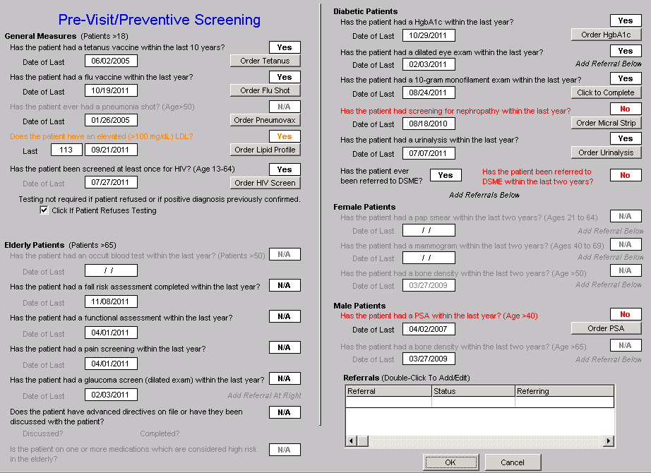
Data Aggregation Incidental to Care Pre-Visit/Preventive Screening

Slide 28
Data Aggregation Incidental to Care National Quality Forum (NQF) Measures
There are similar tools for all of the quality metrics which SETMA providers track each day. The following is the tool for NQF measures currently tracked and audited by SETMA:

Slide 29
National Quality Forum (NQF) Measures

Slide 30
SETMA COGNOS Dashboards
The following are examples of BI auditing dashboards for provider performance analysis. Note: Columns in gold represent patients treated to goal and those in purple are the patients not treated to goal.

Slide 31
SETMA COGNOS Dashboards

Slide 32
SETMA COGNOS Dashboards
SETMA is able to look at differences between the care of patients who are treated to goal and those who are not. Patients can be compared as to socio-economic characteristics, ethnicity, frequency of evaluation by visits, and by laboratory analysis, numbers of medications, payer class, cultural, financial and other barriers to care, gender and other differences. This analysis can suggest ways in which to modify care in order to get all patients to goal.

Slide 33
SETMA COGNOS Dashboards

Slide 34
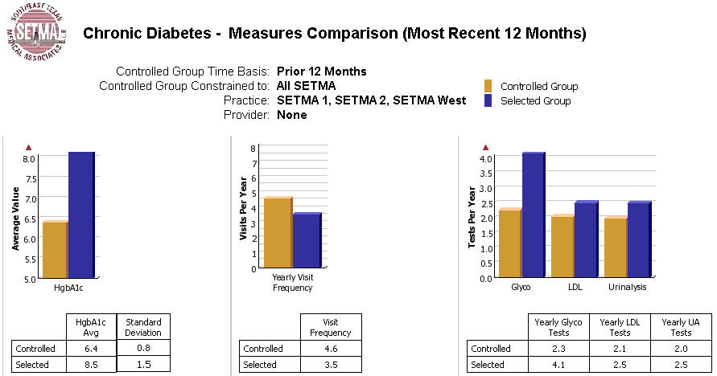
SETMA COGNOS Dashboards

Slide 35
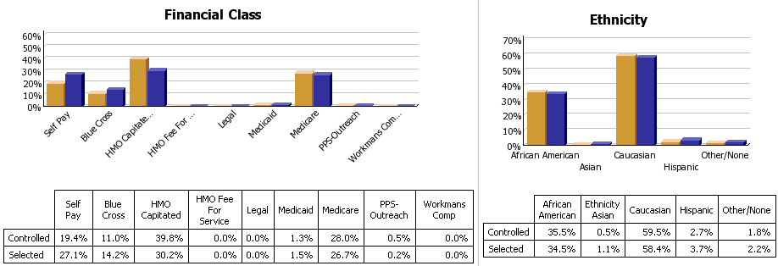
SETMA COGNOS Dashboards

Slide 36
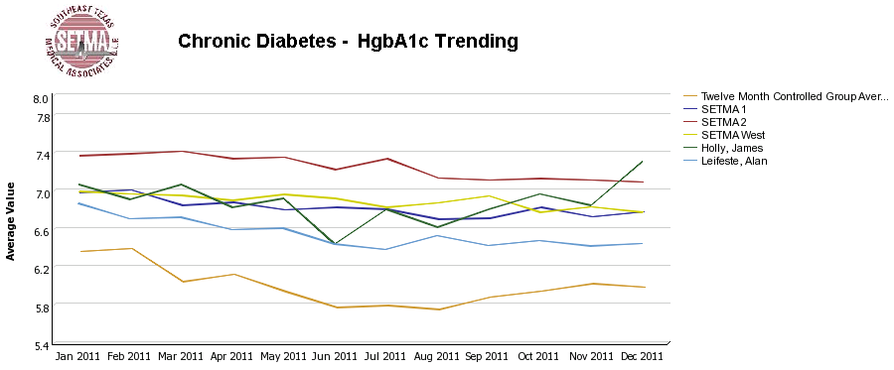
SETMA COGNOS Dashboards
SETMA can also compare different providers and clinics with one another:

Slide 37
Auditing Performance
SETMA’s provider performance is benchmarked against published, evidence-based, national standards of care. Because SETMA has deployed a robust Business Intelligence (BI, COGNOS) solution for data auditing and analytics, and because we have bought multiple licenses, practice leadership, informatics staff and healthcare providers can review performance outcomes. SETMA also has monthly peer-review sessions with all providers. The clinic is closed for a morning, and performance on quality metrics, patient satisfaction and gaps in care are discussed openly among all providers. Collegial relationships and an organizational-cultural commitment to excellence make it possible for SETMA to be specific about needs for improvement in these monthly meetings.

Slide 38
SETMA COGNOS Dashboards Auditing Performance
Dashboards are color coded: “white” is to goal, “yellow” needs improvement, and “red” is unacceptable. This display is of NQF Diabetes Metrics on HbA1c and LDL:

Slide 39
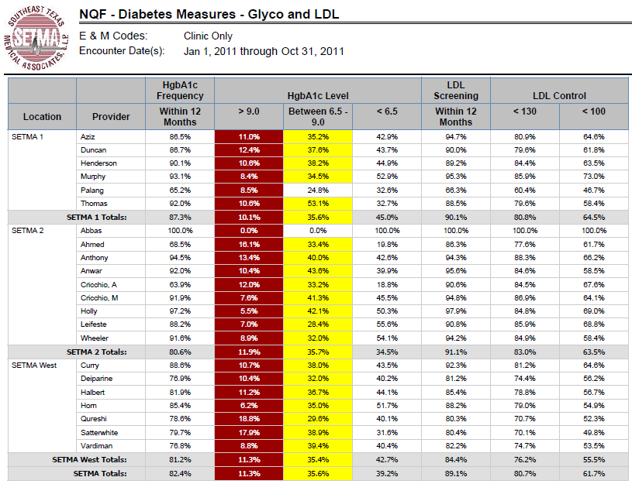
SETMA COGNOS Dashboards

Slide 40
SETMA COGNOS Dashboards Auditing Performance
Comparing 2007 results with 1/1/2011-12/31/2011, shows that the quality standards are still being met. HbA1c percentages above 9.0% are shown in red as SETMA “standard” is that this value should be zero, but the NCQA benchmark is less than 15% of the patients being treated for diabetes. All but one SETMA provider exceeds that standard.

Slide 41
SETMA COGNOS Dashboards

Slide 42
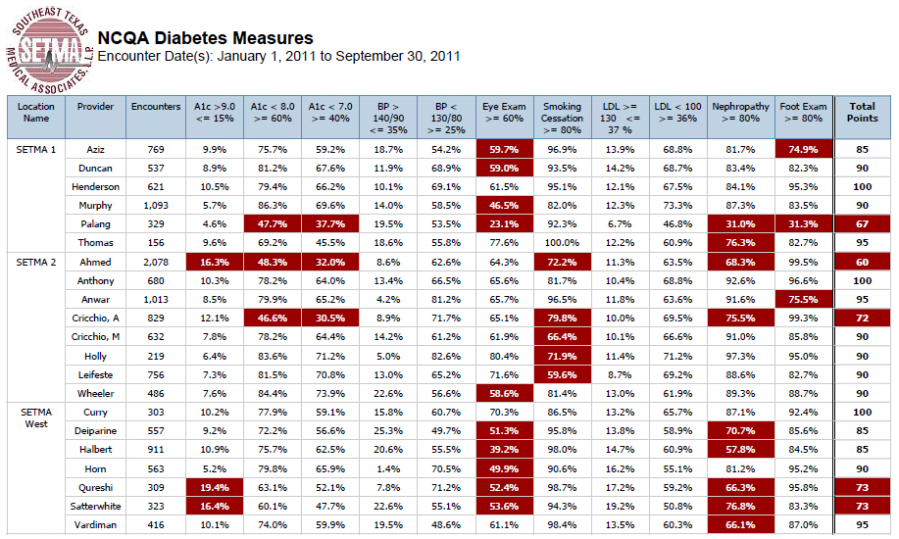
SETMA COGNOS Dashboards NCQA Diabetes Recognition

Slide 43
NCQA Diabetes Recognition
Specific dashboards, such as the one above, have also been developed for programs such as the NCQA Diabetes Recognition Program. All SETMA clinics and providers qualified for this recognition in 2010-2013. Quarterly and annually, we now measure this standard so as to make sure that we continue to improve. As can be seen below, the dashboard gives the metric, the benchmark, the provider’s performance and the aggregate score required for recognition.

Slide 44
SETMA COGNOS Dashboards NCQA Diabetes Recognition
This material is given to the provider and it is posted on our website at www.jameslhollymd.com under Provider Performance, NCQA Diabetes Recognition Program Audit. Because all deficiencies in care are displayed in “red,” SETMA providers have developed their own commitment to “get the RED out.”

Slide 45
What We Don’t Have
Our COGNOS BI deployment presently does not allow us to examine and compare the cost of care between different providers. Our greatest need is to be able to Compare outcomes in conjunction with the cost of producing those outcomes.
This will require a different BI function than we currently have.

Slide 46
What We Don’t Have
While we have and are expanding the functions of our Health Information Exchange and our secure web portal, we need to be able to share data dynamically between these functions. For instance, we have the ability to complete daily hospital progress notes with our EHR, but it is time consuming because we have to manually re-enter vital signs, medications, laboratory values.
When these are done electronically, we will gain the power of electronics in performing this task excellently.

Slide 47
What We Don’t Have
A deepening philosophical rationale for the “medicine of the future” surrounding patient-centric, cost effective, collaborative care with the patient accepting responsibility for their own health and collaborating with their healthcare provider to choose rational options based on facts and not emotions.

Slide 48
What We Don’t Have
An acceptance by patients and provides, and the public, that there is time where the best choice is loving, compassionate, low-tech, nurturing care while a patient is going through the last acts of life.

Slide 49
The Future – What We Need
A robust EHR with disease management and screening and preventive care tools in place and functioning.
The additional IT requirement of a secure web portal through which to communicate with patients and to engage them in their own care is essential.
An HIE which promotes the continuity of care through effective communication and sharing of patient-care information.

Slide 50
The Future – What We Need ACO Development and Deployment
Experience with global risk for healthcare such as was gained by managed care in general and Medicare Advantage and its predecessors in particular.
Experience with quality metrics in tracking, auditing and analyzing data through which to design quality improvement initiatives, after finding leverage points for improvement.

Slide 51
The Future – What We Need ACO Development and Deployment
The integration of data aggregation over a large network of providers, facilities and practice types. SETMA has this capacity internally and the MSO and HMO partner add to that capacity.
Proved ability to provide high quality, low cost care which is valued by patients. This has been proved by our success with HMO patients and by RTI International’s cost, coordination and quality analysis of Medicare Fee-for-Service experience at SETMA for 2007, 2008, 2009 and 2010.

Slide 52
The Future – What We Need ACO Development and Deployment
Experience with patient-centric care in a coordinated setting and with Patient-Centered Medical Home functionalities.
Administrative, financial and coordination capabilities which include risk stratification, care management and direction, referral mapping, case management, etc.

Slide 53
The Future – What We Need ACO Development and Deployment
A willingness on the part of healthcare providers to build a future for their patients and for themselves which in the short run will cost them but which in the long run will benefit all who participate.

Slide 54
The Key Is Coordination
Recently, Mark Bertolini, Chairman, CEO & President of AETNA said, “Convenience is the new word for quality." The statement on its face seems an oversimplification. However, as SETMA became a PC-MH, we came to see that "Coordination" translates into:

Slide 55
The Key Is Coordination
Convenience for the patient, which,
Results in increased patient satisfaction, which contributes to,
The patient having confidence that the healthcare provider cares personally which,
Increases the trust the patient has in the provider, all of which,

Slide 56
The Key Is Coordination
Increases compliance (adherence) in obtaining healthcare services recommended which,
Promotes cost savings in travel, time and expense of care which,
Results in patient safety and quality of care with cost savings.

Slide 57
Convenience
It was only through this analysis that we accepted "convenience" as a worthy goal of quality care as opposed to it only being a means of "humoring" patients. This fulfilled SETMA's goal of ceasing to be the constable, attempting to impose healthcare on our patients; and, to our functionally becoming the consultant, the collaborator, the colleague to our patients, empowering them to achieve the health they have determined to have.

