Slide 1
Medical Home & Coordinated Care
SETMA Provider Training
October 19, 2010

Slide 2
What is Care Coordination?
One of the catch phrases to medical home
is that care is coordinated. At SETMA it
means more than just coordinating visits. It
also addresses other needs of the patients.
Such as transportation, financial needs and
patient education.
It is a continued effort to advance towards our
goal of a holistic approach to healthcare.

Slide 3
Care Coordination Staff
Pat Crawford, Director of Care Coordination
Neena Weible, RN Care Manager
Patricia Sam, LVN Care Manager

Slide 4
Goal
To provide all patients of SETMA with the caring and personal attention that the medical home model is created for.
To promote cost savings through patient education and compliance with outpatient services, which will ultimately decrease hospitalizations and promote better quality of life.

Slide 5
Department Responsibilities
Follow up calls to all patient’s that have been discharged from the hospital.
Follow up calls to patients seen in the office in which providers are concerned about exacerbation of disease process, compliance and / or teaching.

Slide 6
Department Responsibilities
Follow up calls to patients who have received three or more referrals. To insure that the patient understands the reason for the referral, is in agreement with the plan of treatment and agrees to participate in their care.

Slide 7
Department Responsibilities
Assisting patients with compliance by facilitating with resources available for medication, transportation and coordination of visits.
Scheduling all pre-surgery clearances for GTPA.
Documenting patient complaints and resolving issues of concern within a timely manner.
Assisting patients and family members with a holistic and non judgmental approach by offering support related to social and economical challenges.

Slide 8
Conclusion
The services provided by the Care Coordination Department will result in convenience for our patients, increased patient satisfaction, patient confidence, trust and compliance.

Slide 9
Coordinated Care
One of the “catch phrases” to medical home is that the care is “coordinated.” While this process traditionally has referred to scheduling, i.e., that visits to multiple providers with different areas of responsibility are “scheduled” on the same day for patient convenience, it has come to mean much more to SETMA.
Because many of our patients are elderly and some have limited resources, the quality of care they receive very often depends upon this “coordination.” It is hard for the frail elderly to make multiple trips to the clinic. It is impossible for those who live at a distance on limited resources to afford the fuel for multiple visits to the clinic.

Slide 10
Elements of Coordinated Care
Convenience for the patient which
Results in increased patient satisfaction which contributes to
The patient having confidence that the healthcare provider cares personally which
Increases the trust the patient has in the provider, all of which,
Increases compliance in obtaining healthcare services recommended which,
Promotes cost savings in travel, time and expense of care which
Results in increased patient safety and quality of care.

Slide 11
Opportunities with Coordinated Care
Schedule visits with multiple providers on the same day, based on auditing the schedule for the next 30-60 days to see when a patient is scheduled with multiple providers and then to determine if it is medically feasible to coordinate those visits on the same day.
Schedule multiple procedures, based on auditing of referrals and/or based on auditing the schedule for the next 30-60 days to see when a patient is scheduled for multiple providers or tests, and then to determine if it is medically feasible to coordinate those visits on the same day.

Slide 12
Opportunities with Coordinated Care
Scheduling procedures or other tests spontaneously on that same day when a patient is seen and a need is discovered.
Recognizing when patients will benefit from case management, or disease management, or other ancillary services and working to resources those needs.
Connecting patients who need help with medications or other health expenses to be connected with the resources to provide those needs such as The SETMA Foundation, or sources.
Time, energy, and expense are conserved with these efforts
in addition to increasing compliance thus improving
outcomes!

Slide 13
Director of Coordinated Care (DCC)
Responsible for building a department of Care Coordination
Establish protocols and methods for facilitating the care of patients with: special needs, complex-care needs, disease management and case management needs
Make each patient feel as if they are SETMA’s only patient

Slide 14
Integrated Care
All elements of the patient’s needs are attended to and future needs are anticipated and addressed
No longer is a patient encounter simply used to address current needs but potential future needs are identified and addressed
Future contacts are scheduled, with our without a clinic visit, for assessing whether the patient has made the changes necessary to maintain their health

Slide 15
Quality of Care & Patient Safety
It will be important to see if more people are getting their mammograms, bone densities, immunizations, etc as a result of coordinated care
These outcomes must be measured and analyzed to see if our anticipated improvements have in fact occurred

Slide 16
Quality of Care & Patient Safety
It will be important to see if more people are getting their mammograms, bone densities, immunizations, etc as a result of coordinated care
These outcomes must be measured and analyzed to see if our anticipated improvements have in fact occurred

Slide 17
Continuity of Care
A personal physician who accepts primary responsibility for the patient's care who is more than just a friendly affect when the patient is see in the clinic.
Answering patient inquiries outside the clinic
Providing same day response to telephone and email requests
Alleviating patient anxieties about their care

Slide 18
Continuity of Care
Continuity of care in the modern electronic age means not only personal contact but it means the availability of the patient’s record at every point-of-care
SETMA’s Health Information Exchange will provide patient records to providers and facilities throughout the community
SETMA’s NextMD will provide patient access to maintain and review their own records

Slide 19
Care Coordination Template
As SETMA has continued to develop its Patient-Centered Medical Home, we have worked with the guidance of the standards published by CMS, NCQA and AAAHC, as well as the medical literature. We have also worked independent of the published materials to develop our concept of Care Coordination in our efforts to achieve Coordinated Care.
Our PC-MH Coordination Review template has been discussed elsewhere. It provides a tool in which to review many of the elements required in order to produce coordinated care. A new tool has now been added. As demonstrated below it is entitled “Care Coordination Referral” and it is launched from the AAA Home Template in our EMR.
As SETMA has continued to develop its Patient-Centered Medical Home, we have worked with the guidance of the standards published by CMS, NCQA and AAAHC, as well as the medical literature. We have also worked independent of the published materials to develop our concept of Care Coordination in our efforts to achieve Coordinated Care.
Our PC-MH Coordination Review template has been discussed elsewhere. It provides a tool in which to review many of the elements required in order to produce coordinated care. A new tool has now been added. As demonstrated below it is entitled “Care Coordination Referral” and it is launched from the AAA Home Template in our EMR.

Slide 20
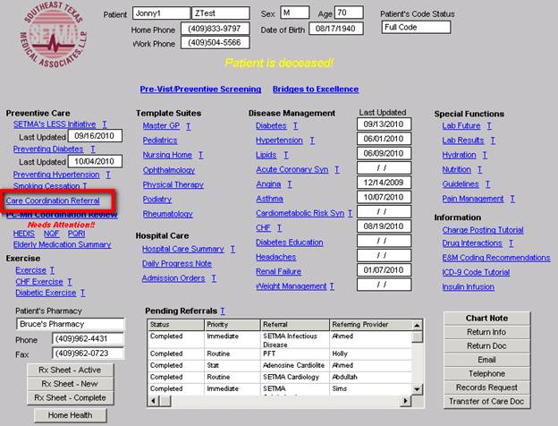
Care Coordination Template

Slide 21
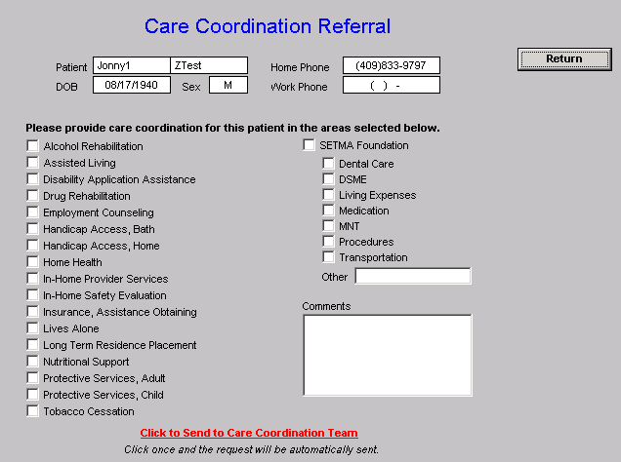
If a provider completes three or more referrals in any given encounter, an e-mail is automatically sent to the Director to allow for the coordination of those referrals to increase convenience and compliance.
The first column allows for the provider to indicate the special needs which the patient has and which would or might benefit from a follow-up contact from the Care coordination team.

Slide 22
A comment box is present which allows for a description of a need not covered by those listed.
The second column allows for the provider to indicate that the patient has financial needs and the service for which that need exists.

Slide 23
Once the provider or nurse checks the needs which exist, the red button entitled “Click to Send to Care Coordination Team” is launched. The button will turn to green which indicates that the e-mail has been sent to the Director of Care Coordination.

