Slide 1
September 14-16, 2011
National Institute for Quality
Improvement and Education
“Moving From Quality Measurement to Continuous Performance Improvement”

Slide 2
CPI at the Point of Care: The Intersection of Clinical Practice, Measurement, Learning and Improvement
September 15, 2011
James L. Holly, MD
CEO, Southeast Texas Medical Associates, LLP
www.jameslhollymd.com

Slide 3
The Future of Healthcare
Since SETMA adopted electronic medical records in 1998, we have come to believe the following about the future of healthcare:
The Substance Evidenced-based medicine and comprehensive health promotion
The Method Electronic Patient Management
The Organization Patient-centered Medical Home
The Funding Capitation with payment for quality

Slide 4
SETMA’s Model of Care
During this time, we have developed the five points of the SETMA’s Model of Care:
Provider Performance Tracking – one patient at a time
Auditing of Performance – by panel or by population
Analysis of Provider Performance – statistical
Public Reporting by Provider Name – www.jameslhollymd.com
Quality Assessment and Performance Improvement

Slide 5
Performance Improvement
SETMA’s “Continuous Performance Improvement” is illustrated by our improvement in diabetes care from 2000 to 2011:
HgbA1C standard deviation improvement from
1.98 to 1.33
HgbA1C mean (average) improvement from
7.48% to 6.54%
Elimination of Ethnic Disparities in Care

Slide 6
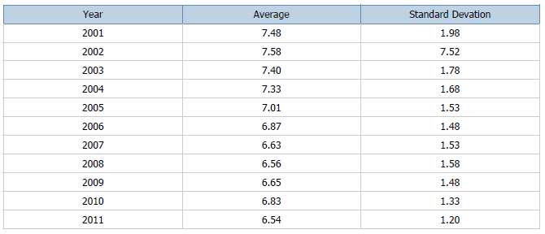
Performance Improvement
SETMA’s HgbA1c Values By Year

Slide 7
Performance Improvement
2000 - Design and Deployment of EHR-based Diabetes Disease Management Tool
HgbA1C improvement 0.3%
2004 - American Diabetes Association certified Diabetes Self Management Education (DSME) Program
HgbA1C improvement 0.3%
2006 - Recruitment of Endocrinologist
HgbA1C improvement 0.25%

Slide 8
Performance Improvement
These steps are examples of:
Clinical decision support which is often the missing link between CME and Performance Improvement
Patient engagement and education which is critical to the medical home model of care
Colleague collaboration which demonstrates the value of a team-approach to healthcare

Slide 9
Performance Improvement
SETMA’s ability to track, audit and analyze data has improved as illustrated by the following NCQA Diabetes Recognition Program audit which takes 16 seconds to complete through SETMA’s Business Intelligence (BI) software deployment.
While quality metrics are the foundation of Continuous Quality Improvement, auditing of performance is often overlooked as a critical component of the process.

Slide 10
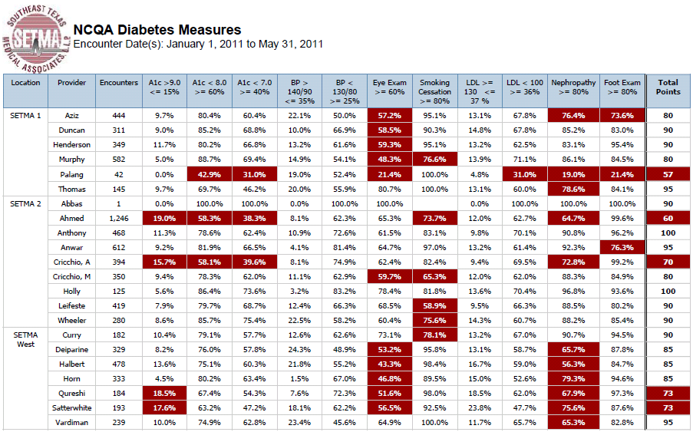
Performance Improvement

Slide 11
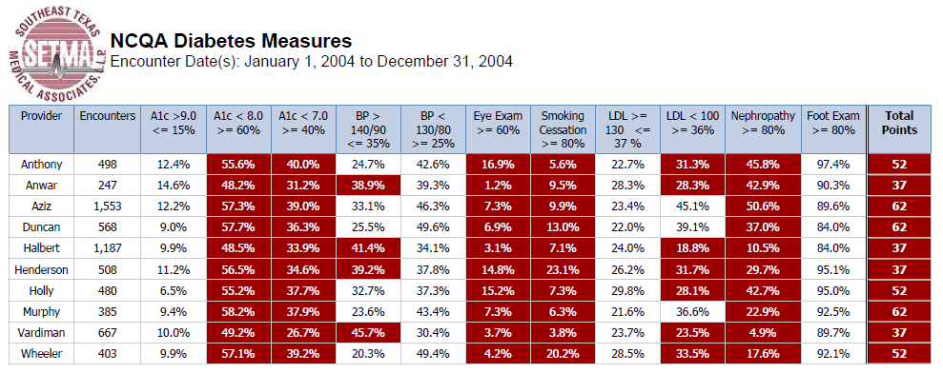
Performance Improvement

Slide 12
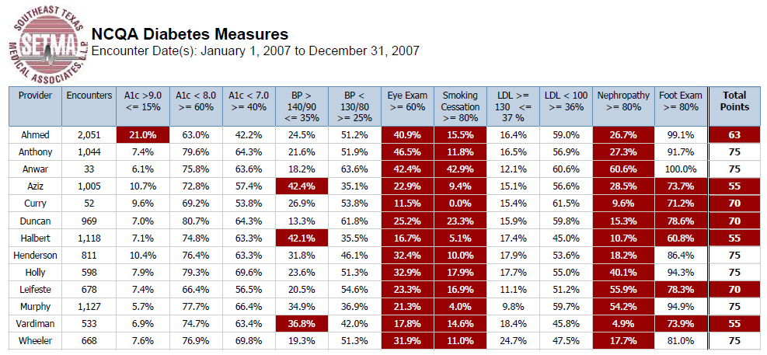
Performance Improvement

Slide 13
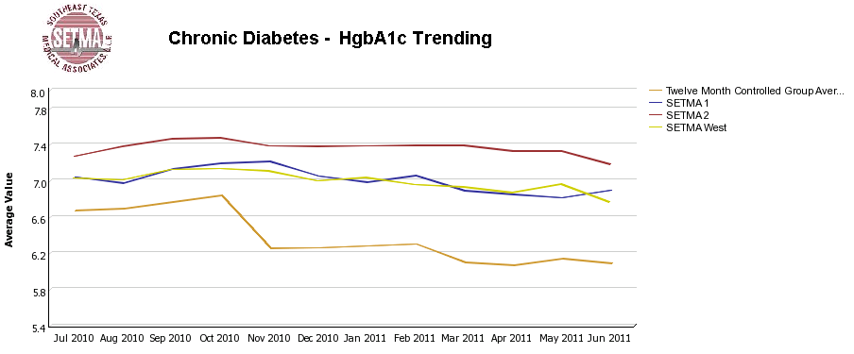
Performance Improvement
SETMA’s use of BI also allows care-outcomes trending such as with HbA1c:

Slide 14
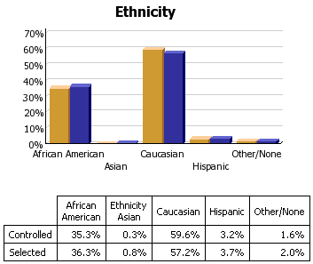
Performance Improvement
SETMA’s goal of eliminating ethnic disparities in care can be substantiated with BI analytics:

Slide 15
Performance Improvement
SETMA’s philosophy of health care delivery includes the concept that every patient encounter ought to be evaluation-al and educational both for the patient and for the provider. The patient and the provider need to be learning if the patient's health and the provider’s healthcare delivery are to be continuously improving.

Slide 16
Performance Improvement
The concept that both the impact of continuous professional development and the process of that development should and must continue in the clinical setting, while implicit in CME, has become a more explicit and expressed object of CME.
Because of its dynamic, creative and sustainable nature, this may be the most significant improvement in CME resulting from PI-CME.

Slide 17
Performance Improvement
Addressing the foundation of Continuous Performance Improvement, the IOM produced a report entitled: “Redesigning Continuing Education in the Health Professions” (Institute of Medicine of National Academies, December 2009). The title page of that report declares:
“Knowing is not enough; we must apply.
Willing is not enough; we must do.”
- Goethe

Slide 18
Performance Improvement
The IOM report stated:
“…it now takes 14-17 years for new evidence to be broadly implemented…Shortening this period is key to advancing the provision of evidence-based care, and will require the existence of a well-trained health professional workforce that continually updates its knowledge.” (p. 16)

Slide 19
Performance Improvement
The tension between “information,” which is inherently static and “learning,” which is dynamic and generative, is the heart of The Fifth Discipline, in which Peter Senge, said:
“Learning is only distantly related to taking in more information…,” which classically has been the foundation of medical education. Traditional CME has perpetuated the idea that “learning” is simply accomplished by “the taking in of more information.”

Slide 20
Performance Improvement
Senge argues that “system thinking,” which is essentially a new way of learning, is needed because for the first time humankind has the capacity to:
“Create far more information than anyone can absorb”
“Foster greater interdependency than anyone can manage”
“Accelerate change faster than anyone’s ability to keep pace”

Slide 21
Performance Improvement
Systems Thinking is:
“A discipline of seeing wholes”
“A framework for seeing interrelationships rather than isolated things”
“For seeing patterns of change rather than static ‘snapshots’”
“A set of general principles spanning (diverse) fields”
Intended for business, systems thinking precisely
addresses major issues in continuous – healthcare --
professional development.

Slide 22
Performance Improvement
Transformation is defined by sustainability and in human endeavor both require “Personal Mastery , which is the discipline of continually clarifying and deepening your personal vision, of focusing your energies, of developing patience, and of seeing reality objectively” (Senge).
The difference between current reality and our personal vision is “creative tension.” And, “the essence of personal mastery is learning how to generate and sustain creative tension in our lives.” (Senge)

Slide 23
Performance Improvement
Those with “personal mastery”
Live in a continual learning mode.
They never ARRIVE!
(They) are acutely aware of their ignorance, their incompetence, their growth areas.
And they are deeply self-confident!
This is “creative tension.” And this is the goal of PI-CME, i.e., the
producing of healthcare professional “creative tension” by
establishing and revealing the difference between where we are and
where we want to be.

Slide 24
Performance Improvement
The change of mind which results in learning rather than simply “taking in more information,” results in “forward thinkers” who are able to create and sustain “creative tension.”
They can be described as “relentless” in the pursuit of the future they have envisioned. They will constantly be declaring:
“I want it done right and
I want it done right now!”

Slide 25
Performance Improvement
In 2005, AHRQ awarded the Johns Hopkins’ Evidence-based Practice Center the task of performing a systematic review of the literature to answer six key questions regarding the effectiveness of CME:
Is there evidence that particular methods of delivering CME are more effective?
Do changes in knowledge, attitudes, skills, practice behavior, or clinical practice outcomes produced by CME persist over time?

Slide 26
Performance Improvement
3. What is the evidence from systematic reviews about the effectiveness of simulation methods in medical education outside of CME?
Which characteristics of the audience influence the effectiveness of certain educational techniques?
Which external factors reinforce the effects of CME in changing behavior?
What is the reported validity and reliability of the methods that have been used for measuring the effects of CME?

Slide 27
Performance Improvement
“The role of PI CME in achieving sustainable change,”
Susan Nedza, MD,
CPPD Report, AMA Continuing Medical Education
Winter 2009/No. 27
“…transformation…will only be successful if national efforts to improve quality:
enable QI where care is provided...
in which) provider tools…make performance measurement a by-product of the care process
(with) a commitment that supports continuous efforts to transform care at the practice level.”

Slide 28
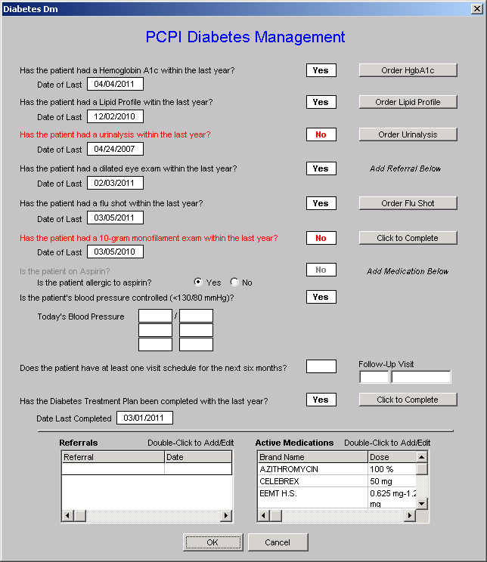
SETMA deployed the PCPI Diabetes set in 2004. This is a copy of the template.
The provider, at the point of care, can measure his/her performance by clicking on the template.
Measures in black have been met; those in red have not.

Slide 29
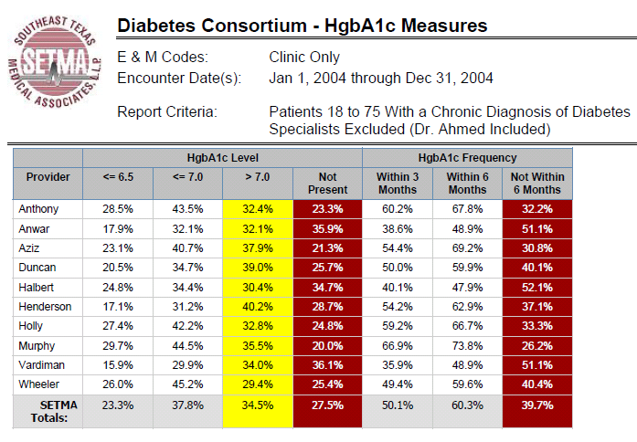
Performance Improvement

Slide 30
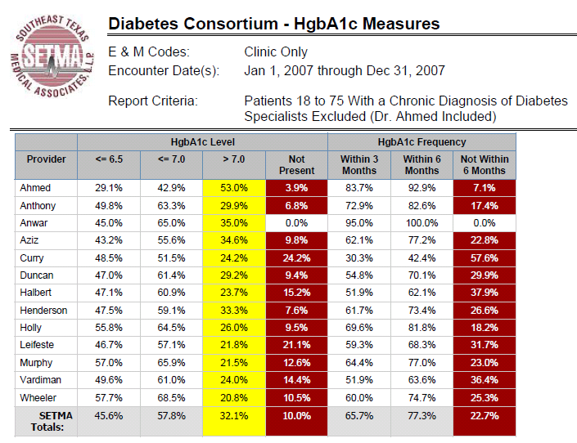
Performance Improvement

Slide 31
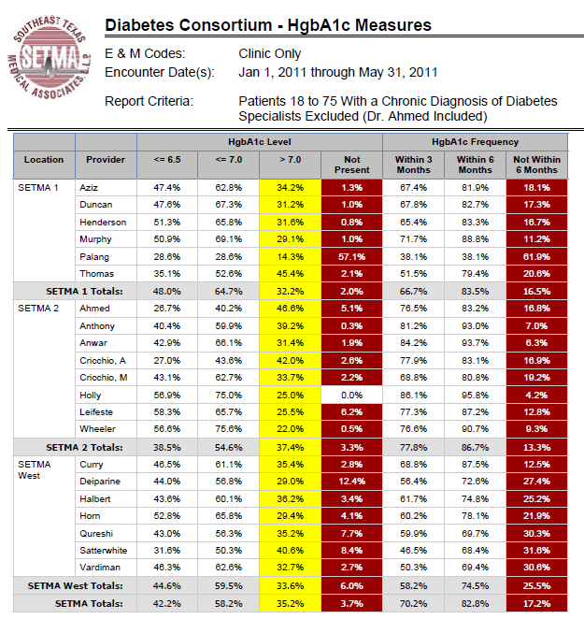

Slide 32
Performance Improvement
SETMA’s Model of Care, actually models PI-CME:
We continually measure our current performance.
The aggregation of quality data is incidental to the delivery of care, requiring no additional effort on the providers’ part.
Monthly, we have nursing and provider meetings to conduct peer review, review treatment strategies and to discuss quality improvement .
We share training material to improve our knowledge.
We have a goal of improving and continue to monitor our performance at the point of care, not only encouraging but demanding improvement of ourselves.

Slide 33
Performance Improvement CME
As the classic lecture-CME setting has increasingly been shown not to change provider behavior, new iterations of CME have been developed.
In 2002, the AAFP introduced evidence-based CME
In 2004, AMA, AAFP and OA changed the measurement of CME from hours to credits.
In 2005, AMA implemented two new formats: Internet point of care (PoC) and performance improvement (PI) CME

Slide 34
Performance Improvement CME
The Steps of Performance Improvement CME (PI-CME)
First stage, assessment of each physician’s current practice using identified evidence-based performance measures. Feedback to physicians compares their performance to national benchmarks and to the performance of peers.
Second stage, implementation of an intervention based on the performance measures assessed in the practice.
Third stage, revaluation of performance in practice including reflection and summarization of outcome changes resulting from the PI CME activity.

Slide 35
Joslin PI-CME GlycoCardio
SETMA is involved with two PI-CME Programs with the Joslin Diabetes Center. The first project focuses upon hemoglobin A1C and the assessment of and the elements of the cardiometabolic risk syndrome.
SETMA has disease management tools for both diabetes and the cardiometabolic risk syndrome. The content of both can be reviewed at www.jameslhollymd.com under “Electronic Patient Management Tools” by clicking on “Disease Management Tools”

Slide 36
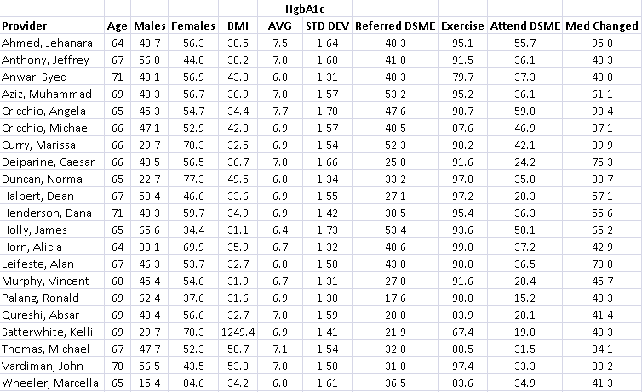
Joslin PI-CME GlycoCardio

Slide 37
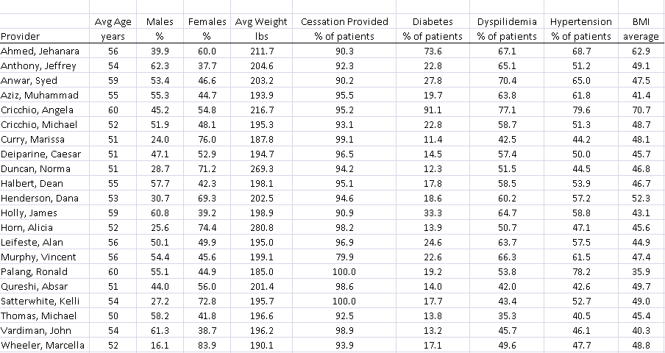
Joslin PI-CME Cardio

Slide 38
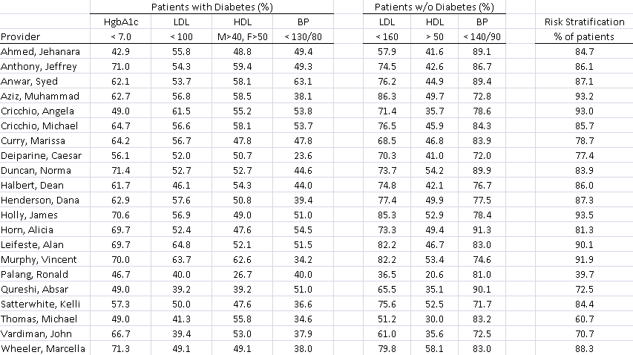
Joslin PI-CME Cardio

Slide 39
Performance Improvement
The 2009 IOM report referenced above further stated:
“….continuing professional development (CPD)…is learner-driven, allowing learning to be tailored to individual needs….
“CPD methods include self-directed learning and organizational and systems factors; and it focuses on both clinical content and other practice-related content, such as communications and business.” (p. 17)

Slide 40
Performance Improvement
“…an effective continual professional development system should ensure that health professionals are prepared to:
“Provide patient-centered care.
Work in inter-professional teams.
Employ evidence-based practice.
Apply quality improvement.
Use health informatics.” (IOM, p. 94)

Slide 41
Clinical Decision Support
CDS is the “missing link” in the incorporation of new
information into a clinician’s workflow learned in PI-
CME.
SETMA had one provider who routinely completed 500
hours of CME a year. He knew more than almost
anybody but his outcomes never changed. He never
incorporated what he knew into his workflow.

Slide 42
Clinical Decision Support
For complex clinical processes, the final step in PI
CME must be the incorporation of the process of
Performance Improvement into the provider’s work
flow through clinical decision support.
The Office of National Coordinator (ONC) of Health
Information Technology (HIT) of Health and Human
Services HHS) through a Rand Corporation grant
named SETMA as one of thirty exemplary practices in
the United States for CDS.

Slide 43
Clinical Decision Support
Texas Department of State Health Services
HIV/ASTD Prevention and Care Branch
Promoting Routine HIV
Screening for ages 13-64
SETMA began this process July 1, 2011. But how do you get this done with five clinics and busy providers who already have a great deal to do?

Slide 44
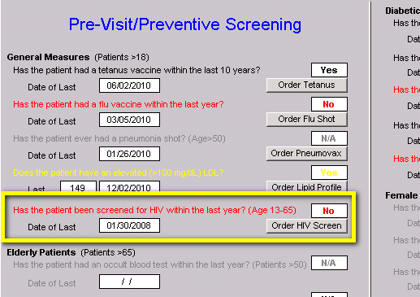
Clinical Decision Support

Slide 45
Clinical Decision Support
Place HIV testing with the discriminators into Preventive Health & Screening protocol.
If the HIV test is black it applies to the patient and has been done.
If the HIV test is grey, it does not apply to the patient.
If the HIV is red, it applies and has not been done.
If the button is red, click it!

Slide 46
Clinical Decision Support
When the button is clicked, the following happens:
Test is ordered
Sends order to the chart, billing and lab
Automatically populates release form with patient information
Prints the consent form for the patient to sign

Slide 47
Clinical Decision Support
Reporting infectious disease to the Texas Department of
Health is complicated.
78 different diseases to be reported.
5 different categories of reporting based on timing
Matching of presumptive diagnoses with confirmatory test
Contacting the State and documenting report to the state.
Auditing the incidence of a diseases and of reporting.

Slide 48
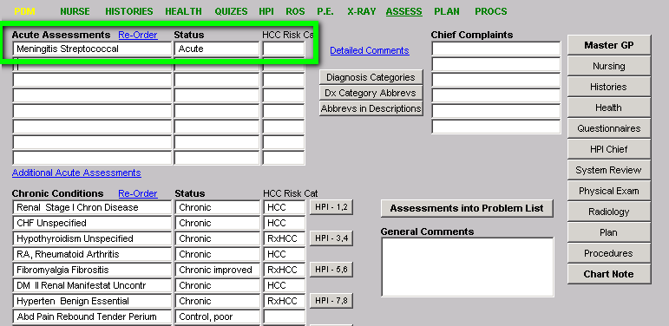
Disease Reporting

Slide 49
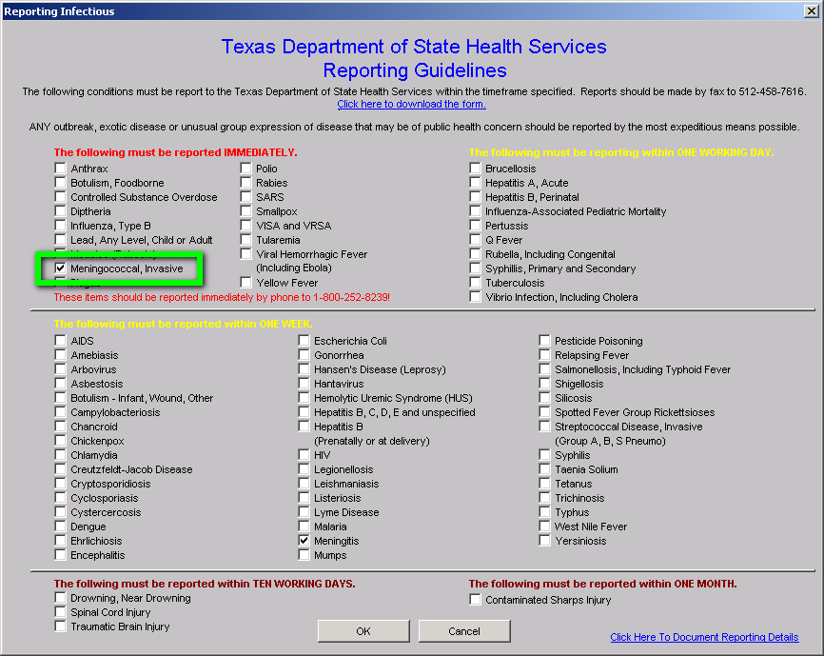

Slide 50
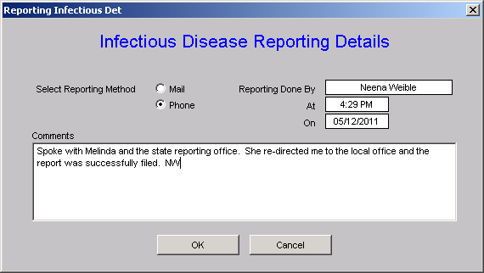
Disease Reporting
Clinical Decision Support

Slide 51
Performance Improvement
Annually, the American Diabetes Association (ADA) publishes a 100-page update on Diabetes standards of care.
Reading it is good, but incorporating it into patient care is the goal.
New information or new standards of care are annually built into clinical CDS (SETMA’s Diabetes Disease Management Tool).
This provides the missing link between CME and sustain provider performance.

Slide 52
Performance Improvement
The key to linking new treatment standards to the providers’ routine workflow is clinical decision support which intuitively integrates the new knowledge into the electronic patient record.
One ”link” of new knowledge to CPI is the identifying of standards of care with quality metric sets with the ability for providers to track and audit quality metrics without adding to their work burden. The ability to do that at the point of and the time of care is critical.

Slide 53
Performance Improvement
SETMA believes that fulfilling a single or several quality metrics does not change outcomes, but that fulfilling “clusters” and “galaxies” of metrics at the point-of-care
will change outcomes.
A “cluster” is seven or more quality metrics for a single condition (i.e. diabetes, hypertension, etc.)
A “galaxy” is multiple clusters for the same patient (i.e. diabetes, hypertension, lipids, CHF, etc.)

Slide 54
Performance Improvement

Slide 55
Performance Improvement

Slide 56
Performance Improvement
The SETMA Model of Care meets all of the needs for Continuous Improvement adding the tool which addresses provider, clinical inertia which is Public Reporting of Provider Performance by Provider Name.
Tracking
Auditing
Analyzing
Reporting
Quality Improvement

Slide 57
Performance Improvement
The tracking on each patient by each provider of their performance on preventive and screening care, and on quality standards for acute and chronic care. Tracking occurs simultaneously with the performing of these services by the entire healthcare team, including the personal provider, nurse, clerk, management, etc. It occurs regardless of the place of care and it occurs at all points of care.

Slide 58
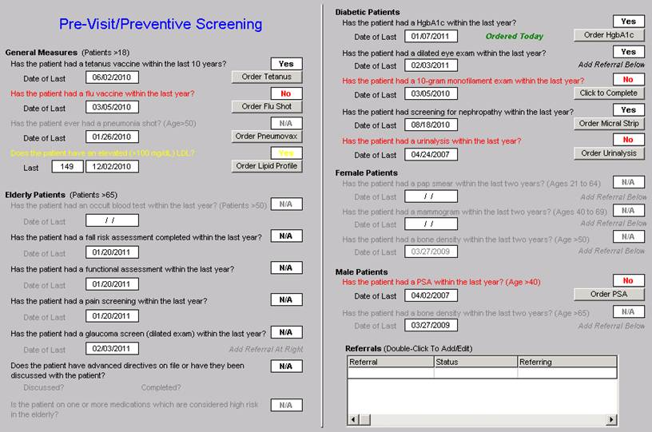
Performance Improvement

Slide 59
Performance Improvement

Slide 60
Performance Improvement
The auditing of provider performance on:
An entire practice
Each individual clinic
Each provider on a population
Each provider on a panel of patients
is critical for quality improvement. SETMA believes this is the piece missing from most healthcare improvement programs and it is a critical part of PI-CME.

Slide 61
Performance Improvement
The aggregation of provider performance results over his/her entire panel of patients carries the process of designing the future of healthcare delivery a further and a critical step.
Most auditing results, such as HEDIS, are presented to the provider 12 to 18 months after the fact. SETMA believes that “real time, auditing and giving of the audit results to providers can change provider behavior and can overcome “treatment inertia.”

Slide 62
Performance Improvement
SETMA is able to analyze if there are patterns to explain why one population or one patient is not to goal and others are. SETMA looks at:
Frequency of visits
Frequency of testing
Number of medications
Change in treatment if not to goal
Attended Education or not
Ethnic disparities of care
Age and Gender variations
Etc.

Slide 63
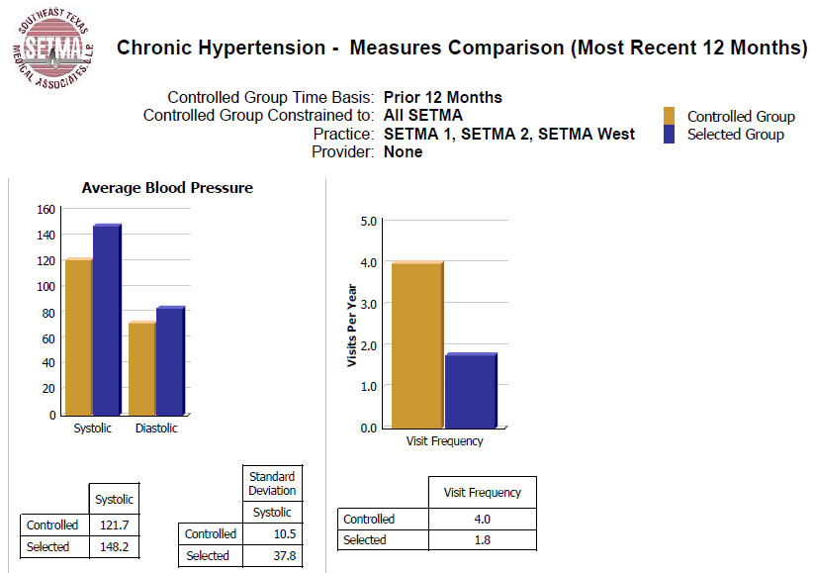
Performance Improvement

Slide 64
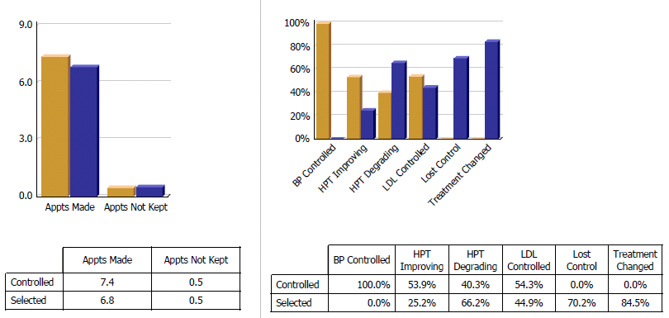
Performance Improvement

Slide 65
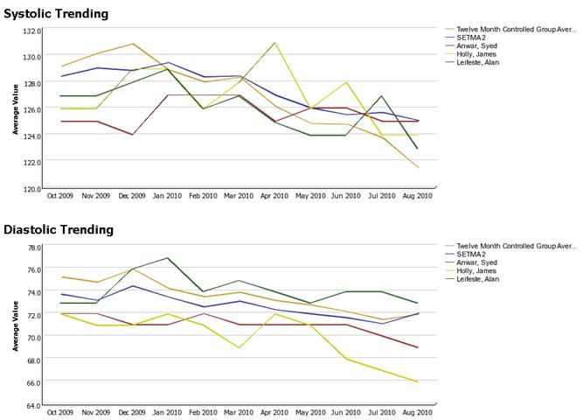
Performance Improvement

Slide 66
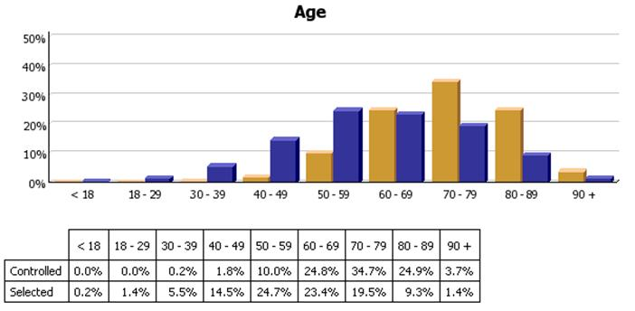
Performance Improvement

Slide 67
Performance Improvement
We are able to present over-time patient results comparing:
Provider to practice
Provider to provider
Provider current to provider over time
Trending of results to see seasonal changes, etc.

Slide 68
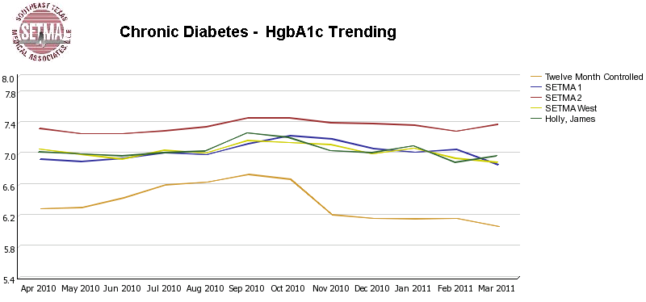
Performance Improvement

Slide 69
Performance Improvement
The statistical analyzing of the above audit performance in order to measure improvement by practice, by clinic or by provider. This includes analysis for ethnic disparities, and other discriminators such as age, gender, payer class, socio economic groupings, education, frequency of visit, frequency of testing, etc.
This allows SETMA to look for leverage points through which to improve care of all patients.

Slide 70
Performance Improvement
Raw data can be misleading. It can cause you to think you are doing a good job when in fact many of your patients are not receiving optimal care.
For instance the tracking of your mean performance in the treatment of diabetes may obscure the fact that a large percentage of your patients are not at goal. The latter will be revealed by the standard deviation.

Slide 71
Performance Improvement
Each of the statistical measurements which SETMA Tracks -the mean, the median, the mode and the standard deviation -- tells us something about our performance, and helps us design quality improvement initiatives for the future. Of particular, and often, of little known importance, is the standard deviation.
A Quality Improvement Initiative which targets the standard deviation will look different than one which focuses upon the mean.

Slide 72
Performance Improvement
The public reporting by provider of performance on hundreds of quality measures places pressure on all providers to improve, and it allows patients to know what is expected of providers.
SETMA public reports quality metrics two ways:
In the patient’s plan of care and treatment plan which is given to the patient at the point of care. This reporting is specific to the individual patient.
On SETMA’s website. Here the reporting is by panels or populations of patients without patient identification but with the provider name given.

Slide 73
Performance Improvement
One of the most insidious problems in healthcare delivery is reported in the medical literature as “treatment inertia.” This is caused by the natural inclination of human beings to resist change.
Often, when care is not to goal, no change in treatment is made. As a result, one of the auditing elements in SETMA’s COGNOS Project is the assessment of whether a treatment change was made when a patient was not treated to goal.

Slide 74
Performance Improvement
Overcoming “treatment inertia” requires the creating of an increased level of discomfort in the healthcare provider and in the patient so that both are more inclined to change their performance.
SETMA believes that one of the ways to do this is the pubic reporting of provider performance. That is why we are publishing provider performance by provider name at www.jameslhollymd.com under Public Reporting.

Slide 75
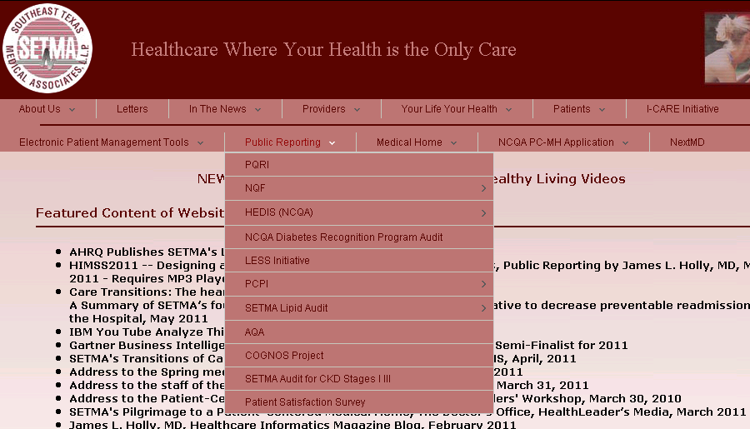
Performance Improvement

Slide 76
Performance Improvement
Once you “open your books on performance” to public scrutiny; the only place you have in which to hide is excellence!

Slide 77
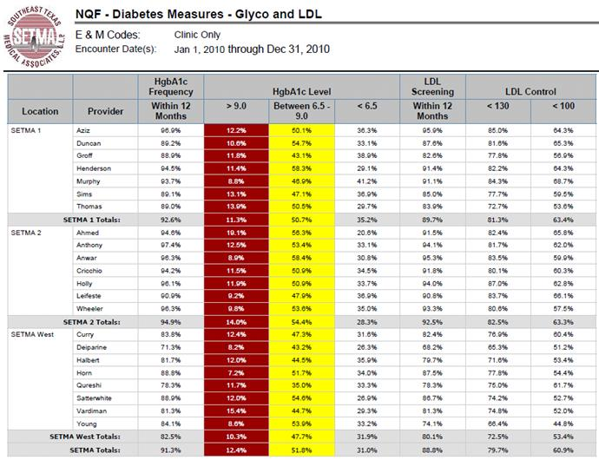
Performance Improvement

Slide 78
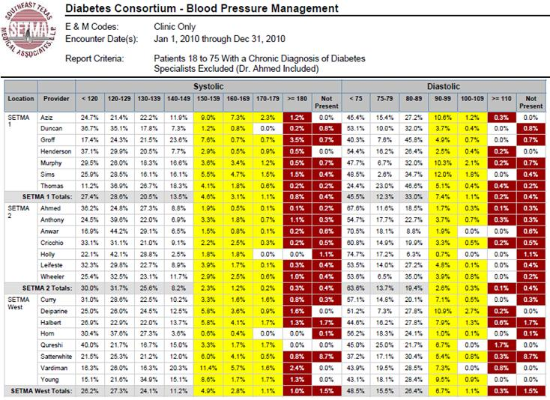
Performance Improvement

Slide 79
Performance Improvement
The Quality Assessment and Performance Improvement (QAPI) Initiatives -- this year SETMA’s initiatives involve the elimination of all ethnic diversities of care in diabetes, hypertension and dyslipidemia. Also, we have designed a program for reducing preventable readmissions to the hospital.

