Slide 1
Future of Health Care Workgroup Texas Health Institute Austin, Texas
Thursday, May 10, 2012

Slide 2
New And Innovative Approach To Medical Care
James (Larry) Holly, MD
CEO, SETMA, LLP
www.jameslhollymd.com
Adjunct Professor
Department of Family and Community Health
School of Medicine
The University of Texas Health Science Center at San Antonio

Slide 3
HIMSS Website Post About SETMA
Segue to Successful Disease Management with Health IT
A 2005 Ambulatory Care Davies Award of Excellence recipient, the Southeast Texas Medical Associates, LLP (SETMA) has focused on disease management during the implementation of the EMR.

Slide 4
About SETMA
In 2004, SETMA was part of an American Medical
Association (AMA) Foundation CARDIO-HIT
study. Of the six practices participating in CARDIO
HIT, which range from academic, university-based
programs to large specialty-based practices, the
AMA staff said that SETMA “has the most expansive
and impressive tools for fulfilling the goals of the
study.” They added, “We have never seen anything
like this anywhere.”

Slide 5
About SETMA
Links to more information from SETMA:
More Than A Transcription Service: The paper, written in 1999, looks at SETMA’s philosophy of “electronic patient management.”
The Less Initiative at SETMA: Read more about the practice’s approach to disease management: Lose Weight – Exercise – Stop – Smoking.
Electronic Patient Management: Read Dr. Holly’s presentation – Spanning the Specialties — at HIMSS2006 to learn about the design of an EMR from the perspective of “electronic patient management” and Dr. Peter Senge’s systems thinking concepts from The Fifth Discipline.

Slide 6
The SETMA Approach
The SETMA Approach to Patient Care (Posted by HIMSS to their website, 2006)
Pursue Electronic Patient Management rather than Electronic Patient Records.
Bring to bear upon every patient encounter what is known rather than what a particular provider knows.
Make it easier to do it right than not to do it at all.
Continually challenge providers to improve their performance.
Infuse new knowledge and decision-making tools throughout an organization instantly.

Slide 7
The SETMA Approach
Establish and promote continuity of care with patient education, information and plans of care.
Enlist patients as partners and collaborators in their own health improvement.
Evaluate the care of patients and populations of patients longitudinally.
Audit provider performance based on the Consortium for Physician Performance Improvement Data Sets.

Slide 8
The SETMA Approach
Create multiple disease-management tools which are integrated in an intuitive and interchangeable fashion giving patients the benefit of expert knowledge about specific conditions while they get the benefit of a global approach to their total health.
This approach became the guiding principles for our development of the EMR and laid the foundation our becoming a Patient-Centered Medical Home in 2010.

Slide 9
Domains of Healthcare Transformation
The Substance -- Evidenced-based medicine and comprehensive health promotion
The Method -- Electronic Patient Management
The Organization -- Patient-centered Medical Home
The Funding -- Capitation with payment for quality outcomes

Slide 10
The SETMA Model of Care
The SETMA Model of Care is comprised of five critical steps:
Tracking
Auditing
Analyzing
Public Reporting
Quality Improvement

Slide 11
Clusters and Galaxies
SETMA believes that fulfilling a single or a few quality metrics does not change outcomes, but fulfilling “clusters” and “galaxies” of metrics at the point-of-care will change outcomes.
A “cluster” is seven or more quality metrics for a single condition (i.e. diabetes, hypertension, etc.)
A “galaxy” is multiple clusters for the same patient (i.e. diabetes, hypertension, lipids, CHF, etc.)

Slide 12
A Cluster
A single patient, at a single visit, for a single condition, will have eight or more quality metrics fulfilled, which WILL change the outcome of a patient’s treatment.

Slide 13
A Galaxy
A single patient, at a single visit, can have multiple clusters of quality metrics and may have as many as 60 or more quality metrics fulfilled in his/her care which WILL change the outcomes.

Slide 14
The SETMA Model of Care
SETMA’s model of care is based on the concepts of “clusters” and “galaxies” of quality metrics and on these principles of healthcare transformation:
Evidence based medicine/health and wellness
Electronic patient management
Patient-Centered Medical Home
Medicare Advantage Payment Method (capitation)

Slide 15
Step 1 –Tracking Quality Metrics
The tracking on each patient by each provider of their performance on preventive and screening care and quality standards for acute and chronic care. Tracking occurs simultaneously with the performing of these services by the entire healthcare team, including the personal provider, nurse, clerk, management, etc.

Slide 16
Step 1 –Tracking Quality Metrics
The PCPI is an organization created by the AMA, CMS, IOM and others to develop measurement sets for quality-care assessment. The intent is to allow healthcare providers to evaluate their own performance at the time they are seeing a patient.
SETMA tracks PCPI measurement sets for Chronic Stable Angina, CHF, Diabetes, Hypertension, and CRD Stages IV & V, ESRD, Adult Weight Management, and Care Transitions.

Slide 17
Step 1 –Tracking Quality Metrics
SETMA also tracks measurement sets endorsed by NQF. NCQA (HEDIS and Medical Home), PQRS, Medicare Advantage STARs, Guidelines Advantage, AQA, and Bridges to Excellence. Also, SETMA designed a Pre-visit quality measures screening and preventive care tool.
This allows a SETMA provider and a patient to quickly and easily assess whether or not the patient has received all of the appropriate preventive health care and the appropriate screening health care which national standards establish as being needed by this patient.

Slide 18
Step 1 –Tracking Quality Metrics
Pre-Visit Preventive/Screening tool
All measures in black apply to the current patient and are fulfilled.
All measures in red apply to the current patient and have not been fulfilled.
All measures in grey do not apply to the current patient.
If a point of care is missing, it can be fulfilled with the single click of a single button.

Slide 19
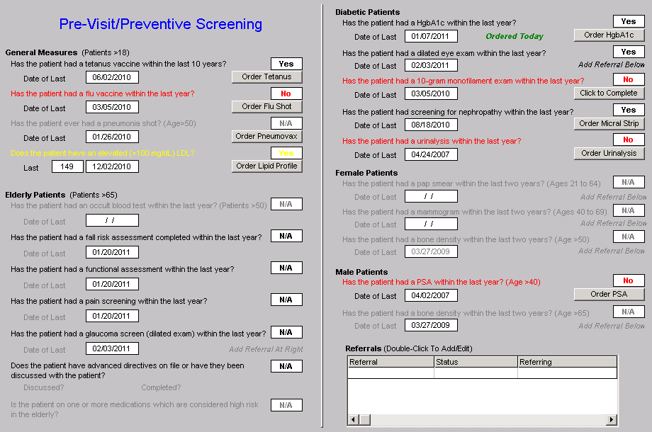
Step 1 –Tracking Quality Metrics

Slide 20
Step 1 –Tracking Quality Metrics
There are similar tracking tools for all of the quality metrics which SETMA providers track each day. Such as this example of NQF-endorsed measures.

Slide 21
Step 1 –Tracking Quality Metrics

Slide 22
Step 1 –Tracking Quality Metrics
In order for the tracking of quality metrics to be valuable to the patient, the patient must know what is being tracked, what it means and what has. or has not been performed in his/her own care.

Slide 23
Passing the Baton
If responsibility for a patient’s healthcare is symbolized by a baton, the healthcare provider carries the baton for 0.68% of the time. The patient carries the baton 99.22% of the time.
Coordination of care between healthcare providers is important but the coordination of the patient’s care between the healthcare provider and the patient is imperative.

Slide 24
Passing the Baton
“Often, it is forgotten that the member of the
healthcare delivery team who carries the ‘baton’ for the
majority of the time is the patient and/or the family
member who is the principal caregiver. If the ‘baton’ is
not effectively transferred to the patient or caregiver,
the patient’s care will suffer.”
--SETMA

Slide 26
The Baton – What Does it Mean?
In all public areas and in every examination room,
SETMA’s “Baton” poster is displayed. It illustrates:
That the healthcare-team relationship, which exists between patient and healthcare provider, is key to the success of the outcome of quality healthcare.
That the plan of care and treatment plan, the “baton,” is the engine through which the knowledge and power of the healthcare team is transmitted and sustained.

Slide 27
The Baton – What Does it Mean?
That the means of transfer of the “baton”, which has been developed by the healthcare team .is a coordinated effort between the provider and the patient.
That typically the healthcare provider knows and understands the patient’s healthcare plan of care and the treatment plan, but without its transfer to the patient, the provider’s knowledge is useless to the patient.
That the imperative for the plan – the “baton” – is that it be transferred from the provider to the patient, if change in the life of the patient is going to make a difference in the patient’s health.

Slide 28
The Baton – What Does it Mean?
That this transfer requires that the patient “grasps” the “baton,” i.e., that the patient accepts, receives , understands and comprehends the plan, and that the patient is equipped and empowered to carry out the plan successfully.
That the patient knows that of the 8,760 hours in the year, he/she will be responsible for “carrying the baton,” longer and better than any other member of the healthcare team.

Slide 29
The Baton – What Does it Mean?
There are numerous points of “care transition” in the patient's care. In the transition of care from the hospital, there are potential eight different types of care transition.
PCPI has published a “Transition of Care Measurement Set,” which is illustrated here.

Slide 30
Transition of Care Measurement

Slide 31
Transition of Care Measurement

Slide 32
Transition of Care Measurement

Slide 33
Transition of Care Measurement

Slide 34
Transition of Care Measurement
The second, third and fourth of the transitions of care involve “follow-up call” scheduling:
The day following discharge from the hospital – this goes to follow-up call nursing staff in our Care Coordination Department. These calls differ from the “administrative calls’ initiated by the hospital which may last for 30 seconds are less. These calls last from 12-30 minutes and involved detailed discussions of patient’s needs and conditions.

Slide 35
Transition of Care Measurement

Slide 36
Step 2 – Auditing Provider Performance
The auditing of provider performance on the entire practice, on each individual clinic, on each provider on a population, or on each provider on a panel of patients is critical for quality improvement. SETMA believes that this is the piece missing from most healthcare improvement programs.

Slide 37
Step 2 – Auditing Provider Performance
The creating of quality measures is a complex process. That Is why it is important for agencies such as the AQA, NCQA, NQF, PQRI and PCPI, among others, to identify, endorse and publish quality metrics.
The provider’s ability to monitor their own performance and the making of those monitoring results available to the patient is important, but it only allows the provider to know how they have performed on one patient.

Slide 38
Step 2 – Auditing Provider Performance
The aggregation of provider performance results over’ his/her entire panel of patients carries the process of designing the future of healthcare delivery a further and a critical step.
Most auditing results, such as HEDIS, are presented to the provider 12 to 18 months after the fact. SETMA believes that “real time, auditing and giving of the audit results to providers can change provider behavior and can overcome “treatment inertia.”

Slide 39
Step 2 – Auditing Provider Performance
Auditing of provider performance allows physicians and nurse practitioners to know how they are doing in the care of all of their patients.
It allows them to know how they are doing in relationship to their colleagues in their clinic or organization, and also how they are performing in relationship to similar practices and providers around the country.

Slide 40
Step 2 – Auditing Provider Performance
SETMA designed auditing tools through IBM’s Business intelligence software, COGNOS. (see SETMA’s COGNOS Project at www.jameslhollymd.com under Your Life Your Health and the iconCOGNOS.)
Through COGNOS, SETMA is able to display outcomes trending which can show seasonal patterns of care and trending comparing one provider with another.

Slide 41
Step 2 – Auditing Provider Performance
It is also possible to look at differences between the care of patients who are treated to goal and those who are not.
Patients can be compared as to socio-economic characteristics, ethnicity, frequency of evaluation by visits and by laboratory analysis, numbers of medication, payer class, cultural, financial and other barriers to care, gender and other differences. This analysis can suggest ways in which to modify care in order to get all patients to goal.

Slide 42
Step 2 – Auditing Provider Performance
Using digital dashboard technology, SETMA analysis provider and practice performance in order to find patterns which can result in improved outcomes practice wide for an entire population of patients. We analyze patient populations by:
Provider Panel
Practice Panel
Financial Class – payer
Ethic Group
Socio-economic groups

Slide 43
Step 2 – Auditing Provider Performance
We are able to analyze if there are patterns to explain why one population or one patient is not to goal and others are. WE can look at:
Frequency of visits
Frequency of testing
Number of medications
Change in treatment
Education or not
Many other metrics

Slide 44
Step 2 – Auditing Provider Performance

Slide 45
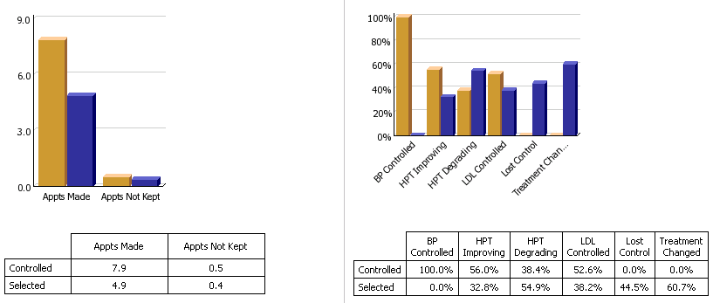
Step 2 – Auditing Provider Performance

Slide 46
Step 2 – Auditing Provider Performance

Slide 47
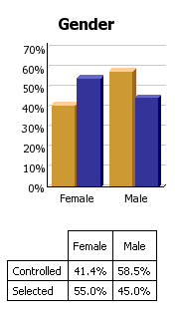
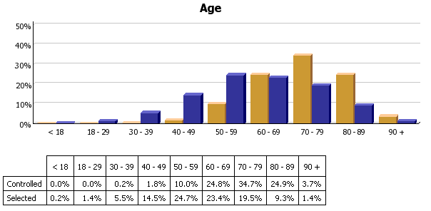
Step 2 – Auditing Provider Performance

Slide 48
Step 2 – Auditing Provider Performance
We are able to present over-time patient results comparing:
Provider to practice
Provider to provider
Provider current to provider over time
Trending of results to see seasonal changes, etc.

Slide 49
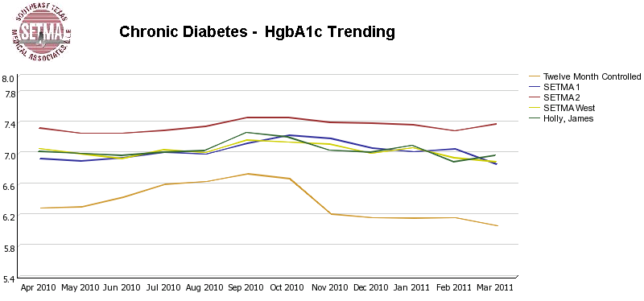
Step 2 – Auditing Provider Performance

Slide 50
Step 3 – Analysis of Provider Performance
The statistical analyzing of the above audit performance in order to measure improvement by practice, by clinic or by provider. This includes analysis for ethnic disparities, and other discriminators such as age, gender, payer class, socio economic groupings, education, frequency of visit, frequency of testing, etc.
This allows SETMA to look for leverage points through which to improve care of all patients.

Slide 51
Step 3 – Analysis of Provider Performance
Raw data can be misleading. It can cause you to think you are doing a good job when in fact many of your patients are not receiving optimal care. For instance the tracking of your mean performance in the treatment of diabetes may obscure the fact that a large percentage of your patients are not at goal.

Slide 52
Step 3 – Analysis of Provider Performance
Each of the statistical measurements which SETMA Tracks -- the mean, the median, the mode and the standard deviation -- tells us something about our performance, and helps us design quality improvement initiatives for the future. Of particular, and often, of little known importance is the standard deviation.

Slide 53
Step 3 – Analysis of Provider Performance
From 2000 to 2010, SETMA has shown annual improvement in the mean (the average) and the median for the treatment of diabetes.
There has never been a year when we did not improve. Yet, our standard deviations revealed that there were still significant numbers of our patients who are not being treated successfully.

Slide 54
Step 3 – Analysis of Provider Performance
From 2008 to 2009, SETMA experience a 9.3% improvement in standard deviation. Some individual SETMA providers had an improvement of over 16% in their standard deviations.
SETMA’s HbA1C standard deviations from 2000 to 2011 have improved from 1.98 to 1.33.

Slide 55
Step 3 – Analysis of Provider Performance
When our standard deviations are below 1 and as they approach 0.8, we can be increasingly confident that all of our patients with diabetes are being treated well.

Slide 56
Step 4 – Public Reporting of Performance
The public reporting by provider of performance on hundreds of quality measures places pressure on all providers to improve, and it allows patients to know what is expected of providers.

Slide 57
Step 4 – Public Reporting of Performance
SETMA public reports quality metrics two ways:
In the patient’s plan of care and treatment plan which is given to the patient at the point of care. This reporting is specific to the individual patient.
On SETMA’s website. Here the reporting is by panels or populations of patients without patient identification but with the provider name given.

Slide 58
Step 4 – Public Reporting of Performance
One of the most insidious problems in healthcare delivery is reported in the medical literature as “treatment inertia.” This is caused by the natural inclination of human beings to resist change.
Often, when care is not to goal, no change in treatment is made. As a result, one of the auditing elements in SETMA’s COGNOS Project is the assessment of whether a treatment change was made when a patient was not treated to goal.

Slide 59
Step 4 – Public Reporting of Performance
Overcoming “treatment inertia” requires the creating of an increased level of discomfort in the healthcare provider and in the patient so that both are more inclined to change their performance.
SETMA believes that one of the ways to do this is the pubic reporting of provider performance. That is why we are publishing provider performance by provider name atwww.jameslhollymd.com under Public Reporting.

Slide 60
Step 4 – Public Reporting of Performance
Once you “open your books on performance” to public scrutiny, the only safe place you have in which to hide is excellence.

Slide 61
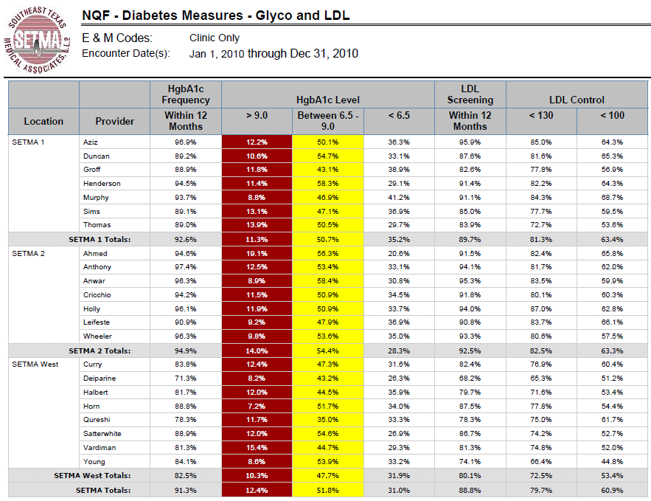
Step 4 – Public Reporting of Performance

Slide 62
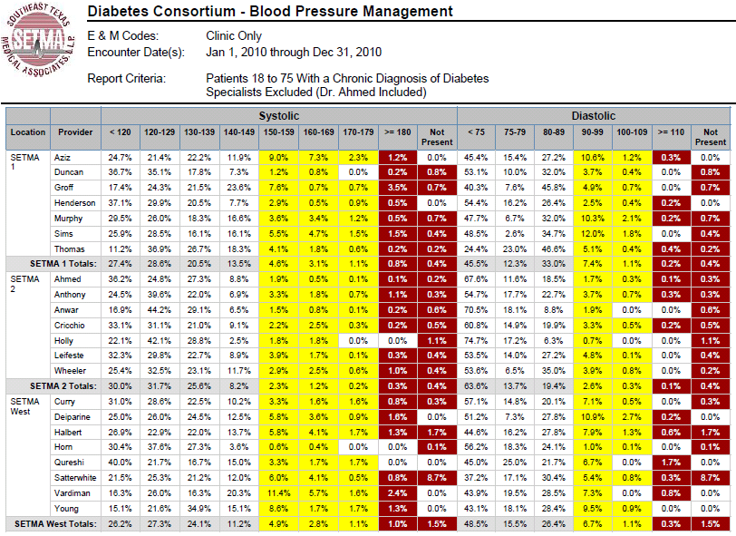
Step 4 – Public Reporting of Performance

Slide 63
Step 5 – Quality Assessment & Performance Improvement
The Quality Assessment and Performance Improvement (QAPI) Initiatives -- this year SETMA’s initiatives involve the elimination of all ethnic diversities of care in diabetes, hypertension and dyslipidemia. Also, we have designed a program for reducing preventable readmissions to the hospital.

Slide 64
Step 5 – Quality Assessment & Performance Improvement
This logical and sequential process is possible and is rewarding for provider and patient. This process has set SETMA on a course for successful and excellent healthcare delivery. Our tracking, auditing, analysis, reporting and design will keep us on that course.

Slide 65
Step 5 – Quality Assessment & Performance Improvement
SETMA’s Model of Care has and is transforming our delivery of healthcare, allowing us to provide cost effective, excellent care with high patient satisfaction. This Model is evolving and will certainly change over the years as will the quality metrics which are at its core.

