Slide 1
NextGen As A Tool For Redesigning Primary Care To Fulfill IHI’s Triple Aim
Dr. James L. Holly, CEO
Southeast Texas Medical Associates, LLP
Adjunct Professor
Department of Family and Community Health
School of Medicine
The University of Texas Health Science Center at San Antonio
NextGen Large Group Users Meeting
May 4, 2012
Dallas, Texas

Slide 2
Overview
The History and Imperative of the Triple Aim
SETMA’s Redesign in Pursuit of the Triple Aim: The SETMA Model of Care
Patient-Centered Medical Home as an “integrator” of The Triple Aim
Accountable Care Organizations as an “integrator” of the Triple Aim
SETMA’s Hospital Readmission Initiative: redesign in pursuit of the Triple Aim through Medicare Advantage, Medical Home & ACO.

Slide 3
Institute for Healthcare Improvement
In October, 2007, the IHI launched the Triple Aim
Initiative which includes the “simultaneous
pursuit of three aims”:
Improving the experience of care
Improving the health of populations
Reducing per capita costs of health care”

Slide 4
Redesign of Primary Care Services and Structures
“(IHI’s)…concept design (included)…an initial set of
components of a system that would fulfill the Triple
Aim. Five of the components are:
Focus on individuals and families
Redesign of primary care services and structures
Population health management
Cost control platform
System integration and execution”
For details see:
(http://www.ihi.org/offerings/Initiatives/TripleAim/Pages/Approach.aspx)

Slide 5
Institute for Healthcare Improvement
“IHI’s Triple Aim is a framework for partnering with local
government agencies, social service organizations,
health plans, faith groups, and other community
stakeholders to achieve three powerful goals
simultaneously…
“(IHI’s)…program is ideal for change agents in health
related organizations who are responsible for
developing strategy, delivering front-line care, or
crafting policy for a specific population.”

Slide 6
The Triple Aim
The IHI Triple Aim restated by CMS
Administrator as:
Improved Care
Improved Health
Decreased Cost
Donald M. Berwick, Thomas W. Nolan and John Whittington
Health Affairs May 2008 vol. 27 no. 3 759-769

Slide 7
The Triple Aim
“Improving U.S. health care system requires simultaneous pursuit
of three aims: improving the experience of care, improving the
health of populations, and reducing per capita costs of health
care.
“Preconditions for this include: enrollment of identified
population, a commitment to universality for its members, and
the existence of an organization (an “integrator”) that accepts
responsibility for all three aims for that population.”
Donald M. Berwick, Thomas W. Nolan and John Whittington
Health Affairs May 2008 vol. 27 no. 3 759-769

Slide 8
The Triple Aim
“Integrator’s role includes…five components:
Partnership with individuals and families
Primary Care Redesign and Structure
Population health management
Financial management
Macro system integration”
Donald M. Berwick, Thomas W. Nolan and John Whittington
Health Affairs May 2008 vol. 27 no. 3 759-769

Slide 9
The Triple Aim
The scope of the Triple Aim was defined by Senator Hubert
Humphrey in 1977; he said:
“The moral test of government is how it treats those who
are In the dawn of life, the children; those who are in the
twilight of life, the aged; and those in the shadows of life,
the sick, the needy and the handicapped.” (November 4, 1977,
Senator Humphrey, Inscribed on the entrance of the Hubert Humphrey building, HHS
Headquarters)
Donald Berwick, “The Moral Test”
Keynote Presentation, December 7, 2011
IHI 23rd Annual National Forum on
Quality Improvement in Health Care

Slide 10
Are You Ready To Be An Integrator?
From the healthcare provider’s perspective, the Triple Aim Integrators are:
Medicare Advantage
Medical Home
Accountable Care Organizations
Each of these “structures” requires primary care redesign in order to be successful.

Slide 11
CMS’ Triple Aim Focus
Strategic Area 3
Help Accountable Care Organizations Thrive
Help Dual Eligible Beneficiaries Get Better Care
Strengthen Medicare Advantage
Increase Utilization of Medical and Health Homes
Don Berwick, Administrator, CMS, January 19, 2011

Slide 12
SETMA as an Integrator
Medicare Advantage – October, 1997 to Present
Patient-Centered Medical Home – June, 2010 to Present (NCQA & AAAHC)
Accountable Care Organization Participation – 2012
Questions
How does NextGen advance the “integrator’s” role?
How SETMA transformed to become an “integrator?”
How is SETMA redesigning to meet the Triple Aim?

Slide 13
As “Integrator” Does the SETMA Model of Care Work?
Diabetes Care Improvements
From 2000 to 2011
HgbA1C standard deviation improvement from
1.98 to 1.33
HgbA1C mean (average) improvement from
7.48% to 6.65%
Elimination of Ethnic Disparities of Care in Diabetes

Slide 14
Diabetes: SETMA’s Redesign Steps
2000 - Design and Deployment of EHR-based Diabetes Disease Management Tool
HgbA1C improvement 0.3%
2004 - Design and Deployment of American Diabetes Association certified Diabetes Self Management Education (DSME) Program
HgbA1C improvement 0.3%
2006 - Recruitment of Endocrinologist
HgbA1C improvement 0.25%

Slide 15
Diabetes: SETMA’s Redesign Steps
Other Steps:
SETMA Foundation, eliminating financial barriers to care – PC-MH Poster Child
Diabetes: Seven Stations for Success
3. Telemeter: Glucometers which report blood glucose electronically and automatically.

Slide 16
Results: NCQA Diabetes Metrics

Slide 17
Results: Elimination of Ethnic Disparities

Slide 18
Trust and Hope
Nevertheless, in the midst of health information technology innovation, we must never forget that the foundations of healthcare change are “trust” and “hope.”
Without these, science is helpless!

Slide 19
SETMA’s Model of Care
Key to SETMA as an “integrator” of the Triple Aim is the Patient
Centered – Medical Home (PC-MH) and key to SETMA’s PC-MH is
SETMA’s Model of Care.
The second of IHI’s five components of The Triple Aim is the Redesign of
“Primary Care” Services and Structures is that “Basic health care services are
provided by a variety of professions: doctors, nurses, mental health clinicians,’
nutritionists, pharmacists, and others.” The steps to this redesign are:
“Have a team for basic services that can deliver at least 70% of the necessary medical and health-related social services to the population.
“Deliberately build an access platform for maximum flexibility to provide
customized health care for the needs of patients, families, and providers.
C. “Cooperate and coordinate with other specialties, hospitals, and community services related to health.” (IHI)

Slide 20
SETMA’s Model of Care
SETMA’s Redesign of Primary Healthcare
involved five steps:
Performance Tracking – one patient at a time
Performance Auditing – by panel or by population
Performance Analytics – statistical analysis
Performance Reporting – publicly by Provider Name – www.jameslhollymd.com under Public Reporting
Quality Assessment & Performance Improvement

Slide 21
Step I - Performance Tracking at Point-of-Care
SETMA currently tracks the following published quality performance measure sets:
HEDIS
NQF
AQA
PQRI
BTE
Each is available to the provider interactively within the EHR at the time of the encounter.

Slide 22
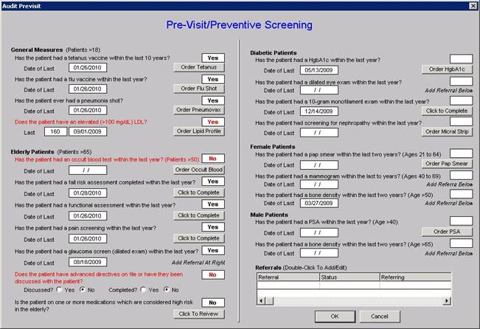
Step I - Performance Tracking at Point-of-Care
A pre-visit screening tool allows each provider to assess quality measures for each patient at each encounter.

Slide 23
Tracking Performance At The Point of Care
HEDIS

Slide 24
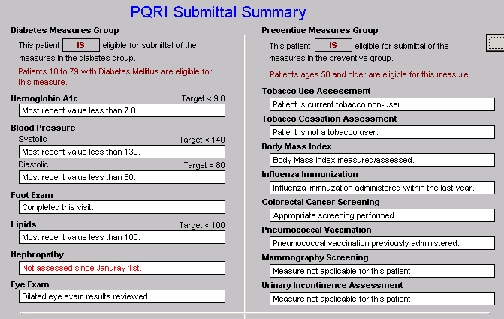
Step I - Performance Tracking at Point-of-Care
PQRI

Slide 25
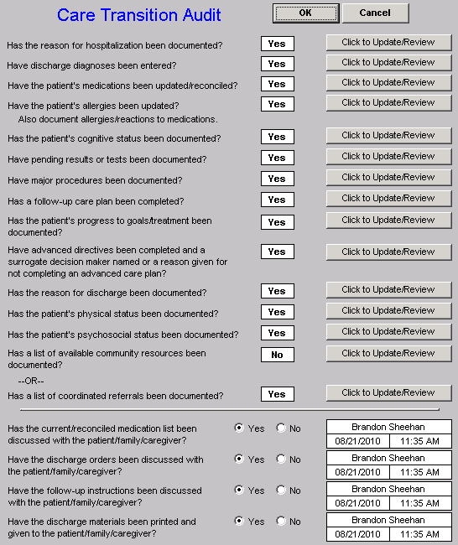
Step I - Performance Tracking at Point-of-Care
Care Transition Audit

Slide 26
Step I - Performance Tracking at Point-of-Care
Bridges to Excellence

Slide 27
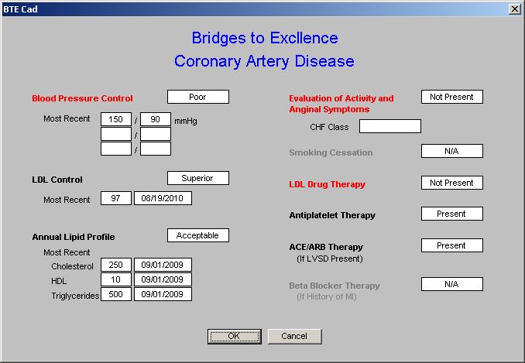
Step I - Performance Tracking at Point-of-Care
Bridges to Excellence

Slide 28
Step I - Provider Performance Tracking
Integrators and Quality Measurement
Medicare Advantage
STARS Program has 50 metrics – this determines the level of reimbursement Five Star is the highest level
Accountable Care Organization
33 quality metrics – if these metrics are not met, there is no shared savings no matter how good the performance
Patient Centered Medical Home
Must report on 10 National Quality Forum endorsed quality metrics; SETMA reports on 50.

Slide 29
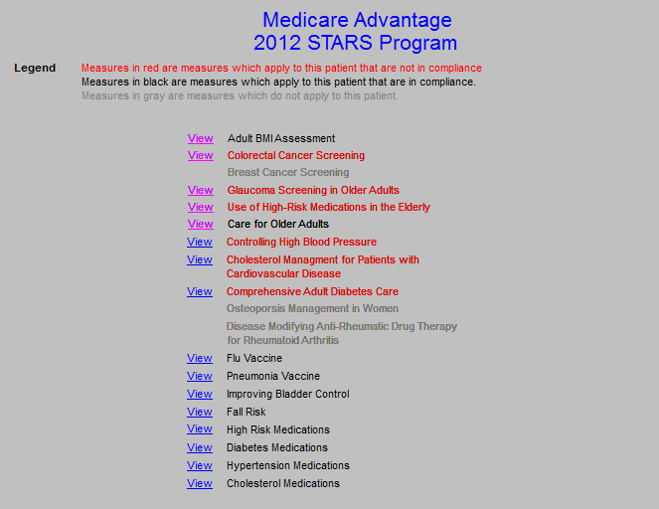
Step I - Provider Performance Tracking
Medicare Advantage STARS Programs

Slide 30
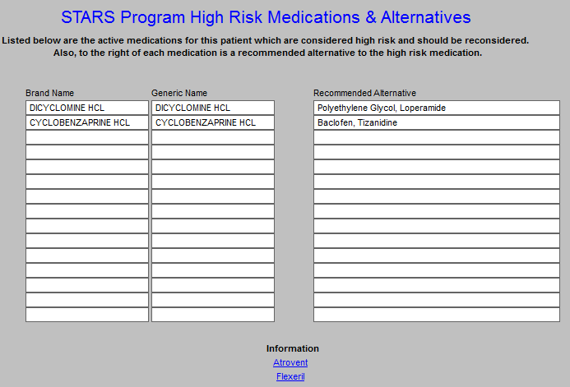
Step I - Provider Performance Tracking
Medicare Advantage STARS Programs

Slide 31
Step I - Provider Performance Tracking
Medicare Advantage STARS
As part of SETMA’s CME program, our Chief Medical Officer, Dr. Syed Anwar, is writing short descriptions of each high risk medication.
Atrovent
The study behind the news analyzed data collected between 1991 and 1993 as part of a large study into the decline of mental functioning in people aged over 65. The new research re-analyzed the participants’ records to look at how their mental decline was linked to their use of drugs with “anticholinergic” side effects (such as dry mouth, reduced mucous secretion and constipation). Anticholinergic drugs block the chemical acetylcholine, which is involved in the transmission of electrical impulses between nerve cells. The drugs in question have a range of applications, from blocking hayfever to improving breathing in some chronic lung conditions. Researchers found that the 4% of people who used drugs with definite anticholinergic effects had a small but significantly greater decline in mental ability compared to people not using these drugs. People using drugs with definite or possible anticholinergic effects had an increased risk of death within the two-year period.

Slide 32
Step I - Provider Performance Tracking
Accountable Care Organization – 33 Quality Metrics and Standards
Preventive Health | Influenza Immunization | NQF #41 AMA-PCPI | GPRO Web Interface
Preventive Health | Pneumococcal Vaccination | NQF #43 NCQA | GPRO Web Interface
Preventive Health | Adult Weight Screening and Follow-up | NQF #421 CMS | GPRO Web Interface
Preventive Health | Tobacco Use Assessment and Tobacco Cessation Intervention | NQF #28 AMA-PCPI | GPRO Web Interface
Preventive Health | Depression Screening | NQF #418 CMS | GPRO Web Interface
Preventive Health | Colorectal Cancer Screening | NQF #34 NCQA | GPRO Web Interface
Preventive Health | Mammography Screening | NQF #31 NCQA | GPRO Web Interface
Preventive Health | Proportion of Adults 18+ who had their Blood Pressure Measured within the preceding 2 years | CMS | GPRO Web Interface
At Risk Population - Diabetes | Diabetes Composite (All or Nothing Scoring): Hemoglobin A1c Control (<8 percent) | NQF #0729 MN Community Measurement | GPRO Web Interface
At Risk Population - Diabetes | Diabetes Composite (All or Nothing Scoring): Low Density Lipoprotein (<100) | NQF #0729 MN Community Measurement | GPRO Web Interface
At Risk Population - Diabetes | Diabetes Composite (All or Nothing Scoring): Blood Pressure <140/90 | NQF #0729 MN Community Measurement | GPRO Web Interface

Slide 33
Step II -- Auditing Provider Performance
Clusters and Galaxies
A single or a few quality metrics do not change outcomes
A cluster – seven or more quality metrics for a single condition, i.e., diabetes, etc.
A galaxy – multiple clusters for the same patient, i.e., diabetes, hypertension, lipids, CHF, etc.

Slide 34
Clusters & Galaxies

Slide 35
Clusters & Galaxies

Slide 36
Clusters & Galaxies
Unlike a single metric, such as “was the blood pressure taken,” which will not improve care, fulfilling a cluster or a galaxy of clusters in the care of a patient WILL improve the outcomes and result in quality care. The only way to “prove” that quality is with auditing.

Slide 37
Quality Metrics
Quality metrics not an end in themselves
Optimal health at optimal cost is the goal of
quality care. Quality metrics are simply “sign
posts along the way.” They give directions to
health.
Metrics are like a healthcare “Global Positioning
System”: it tells you where you are, where you
want to be, and how to get from here to there.

Slide 38
Quality Metrics
Business Intelligence (BI) statistical analytics are
like coordinates to the destination of optimal
health at manageable cost.
Ultimately, the goal will be measured by the well
being of patients, but the guide posts to that
destination are given by the analysis of patient
and population data.

Slide 39
Quality Metrics
There are different classes of quality metrics. No metric alone provides a granular portrait of the quality of care a patient receives, but together, multiple sets of metrics can give an indication of whether the patient’s care is going in the right direction. Some of the categories of quality metrics are:
access,
outcome,
patient experience,
process,
structure and
costs of care.

Slide 40
Quality Metrics
The tracking of quality metrics should be incidental to the care patients are receiving and should not be the object of care. Consequently, the design of the data aggregation in the care process must be as non-intrusive as possible. Notwithstanding, the very act of collecting, aggregating and reporting data will tend to create an Hawthorne effect. Emphasis on the patient's health will overcome any distortion in care of the Hawthorne effect.

Slide 41
Quality Metrics
The power of quality metrics, like the benefit of the
GPS, is enhanced if the healthcare provider and the
patient are able to know the coordinates – their
performance on the metrics -- while care is being
received.
SETMA’s information system is designed so that the
provider can know how she/he is performing at the
point-of-service.

Slide 42
Step II -- Auditing Provider Performance
SETMA employs IBM’s Business Intelligence software, Cognos to audit provider performance and compliance after patient encounters.
Cognos allows all providers to:
Display their performance for their entire patient base
Compare their performance to all practice providers
See outcome trends to identify areas for improvement
See this contemporaneous with care given

Slide 43
SETMA’s COGNOS Project
COGNOS allows SETMA to:
Be confident of the data
See areas which need improvement
Audit and analyze the data to find leverage points with which to design quality improvement initiatives.

Slide 44
Step II -- Auditing Provider Performance

Slide 45
Step III -- Analyzing Performance
Beyond how one provider performs (auditing) SETMA looks look at data as a whole (analyzing) to develop new strategies for improving patient care.
We analyze patterns which may explain why one population is not to goal while another is. Some of the parameters, we analyze are:
Frequency of visits
Frequency of key testing
Number of medications prescribed
Changes in treatments if any, if patient not to goal
Referrals to educational programs

Slide 46
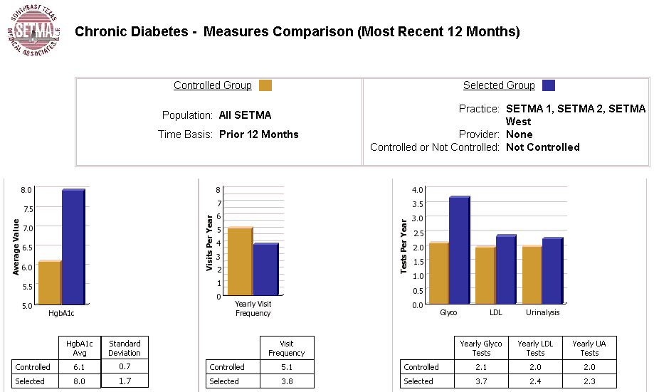
Step III -- Analyzing Performance

Slide 47
Step III -- Analyzing Performance
Raw data can be misleading. For example, with diabetes care, a provider may have many patients with very high HgbA1cs and the same number with equally low HgbA1cs which would produce a misleadingly good average. As a result, SETMA also measures the:
Mean
Median
Mode
Standard Deviation

Slide 48
Analytics Transform Knowledge
Analytics transform knowledge into an agent for change. In reality, without analytics, we will neither know where we are, where we are going or how to sustain the effort to get there.
For transformation to take place through knowledge, we must be prepared to ask the right questions, courageously accept the answers and to require ourselves to change.

Slide 49
Analytics and Transformation
The greatest frustration to transformation is the unwillingness or the inability to face current reality. Often, the first time healthcare provides see audits of their performance, they say, “That can’t be right!”
Through analytics – tracking data, auditing performance, statistical analysis of results – we learn the truth. For that truth to impact our performance, we must believe it.

Slide 50
Analytics and Transformation
Through acknowledging truth, privately and publicly, we empower sustainable change, making analytics a critical aspect of healthcare transformation.

Slide 51
Step III -- Analyzing Performance
SETMA’s average HgbA1c as been steadily improving for the last 10 years. Yet, our standard deviation calculations revealed that a small subset of our patients were not being treated successfully and were being left behind.
As we have improved our treatment and brought more patients to goal, we have skewed our average.
By analyzing the standard deviation of our HgbA1c we have been able to address the patients whose values fall far from the average of the rest of the clinic.

Slide 52
Mean Versus Standard Deviation

Slide 53
Diabetes Audit - Trending

Slide 54
The Value of Trending
In 2009, SETMA launched a Business Intelligence
software solution for real-time analytics. Trending
revealed that from October-December,2009, many
patients were losing HbA1C control. Further
analysis showed that these patients were being
seen and tested less often in this period than those
who maintained control.

Slide 55
The Value of Trending
A 2010 Quality Improvement Initiative included writing all patients with diabetes encouraging them to make appointments and get tested in the last quarter of the year.
A contract was made, which encouraged celebration of holidays while maintaining dietary discretion, exercise and testing.
In 2011, trending analysis showed that the holiday-induced loss of control had been eliminated.

Slide 56
Step IV - Public Reporting of Performance
One of the most insidious problems in healthcare delivery is reported in the medical literature as “treatment inertia.” This is caused by the natural inclination of human beings to resist change. As a result, when a patient’s care is not to goal, often no change in treatment is made.
To help overcome this “treatment inertia,” SETMA publishes all of our provider auditing (both the good and the bad) as a means to increase the level of discomfort in the healthcare provider and encourage performance improvement (Boiled Frog Analogy).

Slide 57
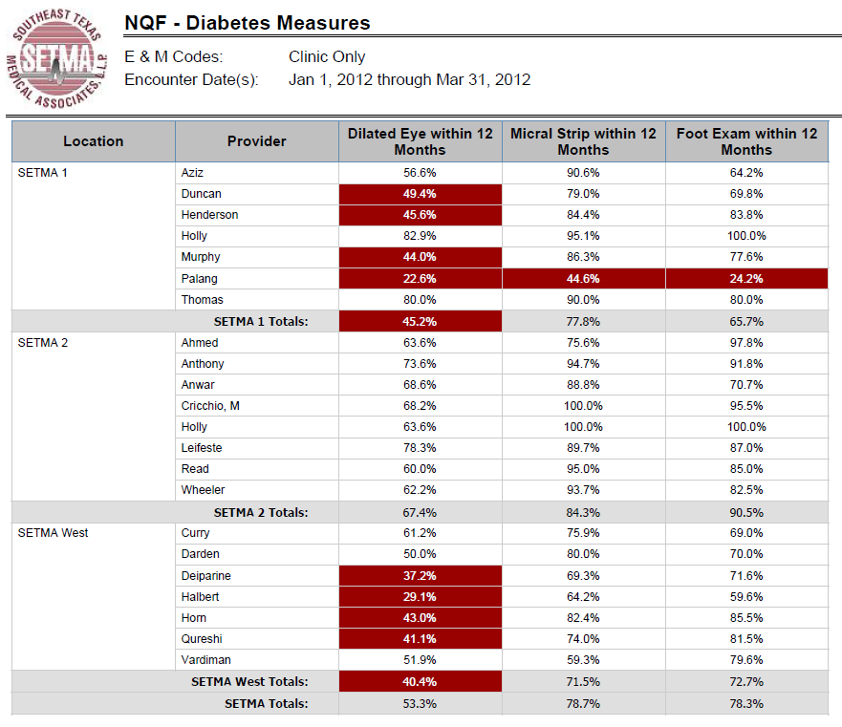
Step IV - Public Reporting of Performance
NQF
Diabetes
Measures

Slide 58
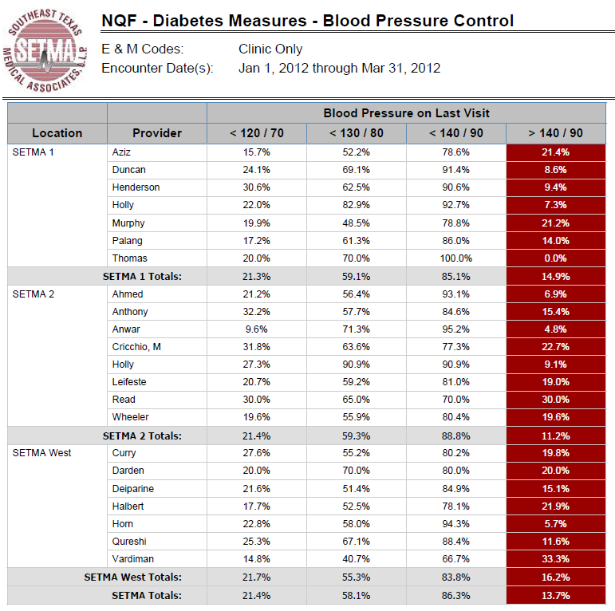
Step IV - Public Reporting of Performance
NQF
Diabetes
Measures

Slide 59
Step IV - Public Reporting of Performance
At www.jameslhollymd.com under Public Reporting, SETMA’s quality performance on
over 250 quality metrics can be reviewed. The following are for the Physician
Consortium for Performance Improvement Diabetes Measurement Set.
2012 - Diabetes Consortium - Blood Pressure Management
2011 - Diabetes Consortium - Blood Pressure Management
2010 - Diabetes Consortium - Blood Pressure Management
2009 - Diabetes Consortium - Blood Pressure Management
2012 - Diabetes Consortium - HgbA1c Measures
2011 - Diabetes Consortium - HgbA1c Measures
2010 - Diabetes Consortium - HgbA1c Measures
2009 - Diabetes Consortium - HgbA1c Measures
2012 - Diabetes Consortium - Lipid Measures
2011 - Diabetes Consortium - Lipid Measures
2010 - Diabetes Consortium - Lipid Measures
2009 - Diabetes Consortium - Lipid Measures
2012 - Diabetes Consortium - Smoking Cessation
2011 - Diabetes Consortium - Smoking Cessation
2010 - Diabetes Consortium - Smoking Cessation
2009 - Diabetes Consortium - Smoking Cessation
2012 - Diabetes Consortium - Urinalysis, Microalbumin, Dilated Eye, Flu Shot, Foot Exam and Aspirin
2011 - Diabetes Consortium - Urinalysis, Microalbumin, Dilated Eye, Flu Shot, Foot Exam and Aspirin
2010 - Diabetes Consortium - Urinalysis, Microalbumin, Dilated Eye, Flu Shot, Foot Exam and Aspirin

Slide 60
Step IV - Public Reporting of Performance
Public reporting of quality metrics by provider name must not be a novelty in healthcare but must be the standard.
Even with the acknowledgment of the Hawthorne effect, the improvement in healthcare outcomes achieved with public reporting is real. Nothing overcomes clinical inertia as does performance transparency through public reporting of quality performance by provider name.

Slide 61
Step V -- Quality Assessment & Performance Improvement
Quality Assessment and Performance Improvement (QAPI) is SETMA’s roadmap for the future. With data in hand, we can begin to use the outcomes to design quality initiatives for our future.
We can analyze our data to identify disparities in care between
Ethnicities
Socio-Economic Groups
Age Groups
Gender

Slide 62
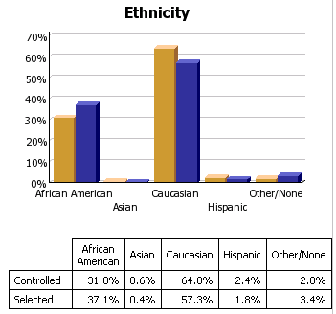
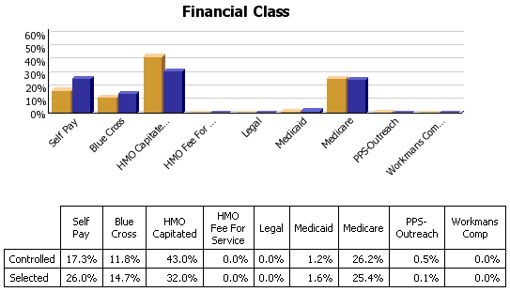
Step V -- Quality Assessment & Performance Improvement

Slide 63
Summary - SETMA Model of Care
With the evidenced-based, science foundation of SETMA’s Model of Care, Coordination and integration of Care, with the deployment of NextGen’s NextMD @ and Health Information Exchange@, continue to place the patient at the center of all healthcare delivery in SETMA’s PC-MH.

Slide 64
Domains of Healthcare Transformation
The Substance -- Evidenced-based medicine and comprehensive health promotion
The Method -- Electronic Patient Management
The Organization -- Patient-centered Medical Home
The Funding -- Capitation with payment for quality outcomes

Slide 65
Integrator: Medical Home
Medical Home prepares you for the future by helping
you recapture the best of the past
The foundations of health care are trust and hope.
Today, patients have more trust in technology than in their healthcare provider.
PC-MH helps you engage the patient as a part of their healthcare team and helps them take charge of their own care with the trust and hope that “making a change will make a difference.”

Slide 66
Integrator: Medical Home
You are the healthcare generation which is bridging the health science revolution with health delivery transformation. Medical Home is the substance, structure and support of that bridge.
Future generations of healthcare providers will not experience the quality chasm which has motivated the Medical Home movement and they will not see a “bridge,” only a continuum of care.

Slide 67
Integrator: Medical Home
In the Medical Home the care is “coordinated.” While this process traditionally has referred to scheduling, i.e., that visits to multiple providers with different areas of responsibility are “scheduled” on the same day for patient convenience, it has come to mean much more to SETMA.
Because many of our patients are elderly and some have limited resources, the quality of care they receive very often depends upon this “coordination.” It is hard for the frail elderly to make multiple trips to the clinic. It is impossible for those who live at a distance on limited resources to afford the fuel for multiple visits to the clinic.

Slide 68
Integrator: Medical Home
Convenience is the new word for quality:
Convenience for the patient which
Results in increased patient satisfaction which contributes to
The patient having confidence that the healthcare provider cares personally which
Increases the trust the patient has in the provider, all of which,
Increases compliance in obtaining healthcare services recommended which,
Promotes cost savings in travel, time and expense of care which
Results in increased patient safety and quality of care.

Slide 69
Integrator: Medical Home
Scheduling procedures or other tests spontaneously on that same day when a patient is seen and a need is discovered.
Recognizing when patients will benefit from case management, or disease management, or other ancillary services and working to resources those needs.
Connecting patients who need help with medications or other health expenses to be connected with the resources to provide those needs such as The SETMA Foundation, or sources.
Time, energy, and expense are conserved with these efforts
in addition to increasing adherence, thus improving
outcomes!

Slide 70
Integrator: Medical Home
Continuity of care in the modern electronic age means not only personal contact but it means the availability of the patient’s record at every point-of-care
SETMA’s NextGen Health Information Exchange will provide patient records to providers and facilities throughout the community
SETMA’s NextMD provides patients access to maintain and review their own records

Slide 71
Integrator: Medical Home
As SETMA has continued to develop its Patient-Centered Medical Home, we have worked with the guidance of the standards published by CMS, NCQA and AAAHC, as well as the medical literature. We have also worked independent of the published materials to develop our concept of Care Coordination in our efforts to achieve Coordinated Care.
At www.jameslhollymd.com, under Your Life Your Health, there are over 100 articles on PC-MH, Care Coordination, and Care Transitions. Produced by SETMA, this material represents our efforts to redesign the structures and processes of primary care in order to meet The Triple Aim.

Slide 72
Medical Home Template

Slide 73
Care Coordination Referral
If a provider completes three or more referrals in any given encounter, an e-mail is automatically sent to the Director to allow for the coordination of those referrals to increase convenience and compliance.
The first column allows for the provider to indicate the special needs which the patient has and which would or might benefit from a follow-up contact from the Care coordination team.

Slide 74
Becoming an Integrator
Get started!
In my life, I have started many things which I never finished, but I have never finished anything I didn’t start. No matter how daunting the task, the key to success is to start.
Compete with yourself, not others!
“I do not try to dance better than anyone else. I only try to dance better than myself “– Mikhail Baryshnikov.
It doesn’t matter what someone else is or is not doing; set your goal and pursue it with a passion. Measure your success by your own advancement and not by whether someone else is ahead or behind you.

Slide 75
Becoming an Integrator
Don’t give up!
The key to success is the willingness to fail successfully. Every story of success is filled with times of failure but is also characterized by the relentlessness of starting over again and again and again until you master the task.. When we started our IT project, we told people about what we are doing. We call that our “Cortez Project”. Like Cortez, we scuttled our ships so there was no going back. We had to succeed.

Slide 76
Becoming an Integrator
Have fun! Celebrate! Enjoy what you are doing and celebrate where you are.
In May of 1999, my co-founding partner of SETMA lamented about our EMR work; he said, “We are not even crawling yet.” I said, “You are right but let me ask you a question. ‘When your son turned over in bed, did you shout and say to your wife, “this retard, dimwitted brat can’t even crawl, all he can do is turn over in bed?” Or, did you shout to your wife, “He turned over in bed?” Did you celebrate his turning over in bed?” He smiled and I added, “I am going to celebrate that we have begun. If in a year, we aren’t doing more, I will join your lamentation, but today I celebrate!”

Slide 77
Integrator: Accountable Care Organization
Description of an ACO
"…(An ACO) is a local health care organization that is accountable for 100 percent of the expenditures and care of a defined population of patients. Depending on the sponsoring organization, an ACO may include primary care physicians, specialists and, typically, hospitals, that work together to provide evidence-based care in a coordinated model.”

Slide 78
Integrator: Accountable Care Organization
“Collaborations of primary care and other health
service providers…Organized around the capacity
to improve health outcomes &…quality of care
while slowing the growth in costs for…patients
cared for by a well-defined group of primary care
professionals…Capable of measuring
improvement in performance and receiving
payments that increase when such
improvements occur.”
(Engelberg Center for Health Care Reform, The Dartmouth Institute, page 8, January, 2011)

Slide 79
Integrator: Accountable Care Organization
Key Design Features of an ACO:
Local Accountability
Legal Structure
Primary Care Focus
Sufficient Size in Patient Population
Investment in Delivery System Improvements
Shared Savings
Performance Measures
(Engelberg Center for Health Care Reform, The Dartmouth Institute, page 9, January, 2011)

Slide 80
Integrator: Accountable Care Organization
With greater experience and…technical progress,
ACO care…(is) expected to become more
sophisticated (i.e. with) more comprehensive
care improvement activities, better performance
measures -- such as more meaningful outcome
measures, including patient experience measures – and payment systems and other incentives
that rely more on performance than volume,
intensity, or other factors unrelated – or often
inversely related – to value. IBID, Engleberg

Slide 81
Integrator: Accountable Care Organization
To be successful an ACO must be built:
upon multiple Medical Homes
an existing infrastructure
without a hospital as a partner
as a bridge to Medicare Advantage
with patient engagement and agreement
With the realization that without the above five
elements, ACOs may not succeed.

Slide 82
Integrator: Accountable Care Organization
Some ACO functions are like those of traditional insurance. The differences are that Medicare still pays the bills rather than the ACO and Medicare is liable for paying all costs whether they exceed a budget or not. The ACO may increase its portion of the shared savings by increasing its liability for cost overruns.
In Medicare Advantage programs, Medicare transfers its risk to the HMO which allows Medicare to budget its cost for each member. No matter what the actual cost of care is, Medicare will never pay the HMO more than the contracted per member payment.

Slide 83
Integrator: Accountable Care Organization
Traditional insurance defines its risk by contract.
Medicare Advantage defines its risk by its “bid,”
which is a contractual relationship with CMS which
defines benefits in addition to the regular Medicare
benefits. In both cases, insurance companies and
Medicare Advantage plans have no Protection from
“down-side” risk, i.e., the potential for the care of a
patient or client costing more than what the
insurance company is paid.

Slide 84
Integrator: Accountable Care Organization
The highest probability of success may occur in
integrated delivery networks that already have an
electronic infrastructure which can be adapted to the
functions needed for ACO accountability and
accounting and have strong relationships with IPAs.
The principle reason for the higher potential of success
is that the HMO/IPA partnership already has a model for
the sharing of revenue. This will be one of the biggest
hurdles for other ACOs.

Slide 85
Integrator: Accountable Care Organization
As noted above, most patients have more confidence in technology than a personal relationship with physicians, which means that the principle way to decrease the cost of care is to ration care. But, the most effective way to change the cost curve is to restore patient’s trust in their doctor so that their counsel is sought before a test is ordered.
This is the reason why, any ACO which has the least potential for success must be built upon healthcare providers who not only have the designation but who are also actually functioning in a patient-centered medical home.

Slide 86
Integrator: Accountable Care Organization
In a compassionate, comprehensive, coordinated and
collaborative relationship, it possible to recreate the
trust bond which supersedes technology in the
healthcare-decision-making equation. In that
relationship, wise decisions can be made about
watchful waiting, appropriate end-of-life care and a
balance between life expectance with and without
expensive but unhelpful care. Increasingly, we have to
wonder if technological advances are actually resulting
in a decreased rather than an increased quality of life.

Slide 87
Integrator: Accountable Care Organization
IBNR stands for “incurred but not received” and refers to
services which have been provided but for which the bill has
not yet been presented. Financial planning for a successful
ACO must take into account fluctuations in results.
Careful cash management with adequate capitalization
initially can help the ACO weather revenue shortfalls and
benefit from positive results in the good times. The first step
is to anticipate multi-year reconciliation and to build a
business model on that expectation.

Slide 88
Integrator: Accountable Care Organization
Inherent in this entire discussion is the fact that the
ACO is a public-policy initiative which has no inherent
value to the patient but only to the ACO and to CMS.
In reality, in the ACO, there is no structural benefit for
the patient. This can be resolved by the policies of the
ACO which concentrates on comprehensive,
preventative health with wellness metrics and with
coordination of care. In this way, the patient returns
to the central of all care delivery whether or not the ACO
“makes money.”

Slide 89
Strengths & Weaknesses of Payment Models
Accountable Care Organization | Primary Care Medical Home | Bundled Payments | Partial Capitation | Full Capitation
Providers are accountable for total per-capita costs. Does not require patient “lock-in.” Reinforced by other reforms that promote coordinated, lower-cost care. | Supports new efforts of primary care physicians to coordinate care, but does not provide accountability for total per-capita costs. | Promotes efficiency and care coordination within an episode, but does not provide accountability for total per-capita costs. | By combining FFS and prospective fixed payment, it provides “upfront” payments that can be used to improve infrastructure and process, but provides accountability only for services/ providers. May be viewed as risky by many providers. | Provides “upfront” payments for infrastructure and process improvement and makes providers accountable for per-capita costs. Requires patient “lock-in.” May be viewed as risky by many providers.
*Accountable Care Organization Learning Network Toolkit (www.acolearningnetwork.org)

Slide 90
Do Payment Models Strengthen Primary Care Directly or Indirectly?
Accountable Care Organization | Primary Care Medical Home | Bundled Payments | Partial Capitation | Full Capitation
Yes – Provides incentive to focus on disease management. Can be strengthened by adding medical home or partial capitation payments to primary care physicians. | Yes – Changes care delivery model for primary care physicians, allowing for better care coordination and disease management. | Yes/No – Only for bundled payments that result in greater support for primary care physicians. | Yes – When primary care services are included in a partial capitation model, it can allow for infrastructure and process improvement, and a new model for care delivery. | Yes – It gives providers “upfront” payments and changes the care delivery model for primary care physicians.
*Accountable Care Organization Learning Network Toolkit (www.acolearningnetwork.org)

Slide 91
Do Payment Models Foster Coordination Among All Participating Providers?
Accountable Care Organization | Primary Care Medical Home | Bundled Payments | Partial Capitation | Full Capitation
Yes – Significant incentive to coordinate among participating providers. | No – Specialists, hospitals and other providers are not incentivized to participate in care coordination. | Yes (for those included in the bundled payment) – Depending on how the payment is structured, it can improve care coordination. | Yes – Strong incentive to coordinate and take other steps to reduce overall costs. | Yes – Strong incentive to coordinate and take other steps to reduce overall costs.
*Accountable Care Organization Learning Network Toolkit (www.acolearningnetwork.org)

Slide 92
Do Payment Models Remove Payment Incentives To Increase Volume?
Accountable Care Organization | Primary Care Medical Home | Bundled Payments | Partial Capitation | Full Capitation
Yes – Incentives are based on value, not volume. | No – There is no incentive in the medical home to decrease volume. | No – For payments outside the bundle. There are strong incentives to increase the number of bundles and to shift costs outside the bundle. | Yes – Strong efficiency incentive to the degree that prospective fixed payment is weighted in overall payment. | Yes – Very strong efficiency incentive.
*Accountable Care Organization Learning Network Toolkit (www.acolearningnetwork.org)

Slide 93
Do Payment Models Foster Accountability For Total Per-Capita Costs?
Accountable Care Organization | Primary Care Medical Home | Bundled Payments | Partial Capitation | Full Capitation
Yes – In the form of shared savings based on total per-capita costs. | No – Incentives are not aligned across providers. No global accountability. | No – For payments outside the bundle. No accountability for total per-capita cost. | Yes – Strong efficiency incentive to the degree that prospective fixed payment is weighted in overall payment. | Yes – Very strong accountability for per-capita cost.
*Accountable Care Organization Learning Network Toolkit (www.acolearningnetwork.org)

Slide 94
Do Payment Models Require Providers To Bear Risks For Excess Cost?
Accountable Care Organization | Primary Care Medical Home | Bundled Payments | Partial Capitation | Full Capitation
Limited risk – While there might be risk-sharing in some models, the model does not require providers to take risks. | No - No risks for providers who continue to increase volume and intensity. | Yes, within the episode – Providers are given a fixed payment per episode and bear the risk of costs within the episode being higher than the payment. | Yes – To the degree that prospective fixed payment is weighted in overall payment. | Yes – Providers are responsible for costs that are greater than the payment.
*Accountable Care Organization Learning Network Toolkit (www.acolearningnetwork.org)

Slide 95
Do Payment Models Require “Lock-In” Of Patients To Specific Providers?
Accountable Care Organization | Primary Care Medical Home | Bundled Payments | Partial Capitation | Full Capitation
No – Patients are assigned based on previous care patterns. There are incentives to provide services within participating providers. | Yes – In order to give providers a PMPM payment, patients must be assigned. | No – Bundled payments are for a specific duration or procedure and do not require patient “lock-in.” | Likely – Depending on the model, patients might need to be assigned to a primary-care physician. | Yes – To calculate appropriate payments, patients must be assigned.
*Accountable Care Organization Learning Network Toolkit (www.acolearningnetwork.org)

Slide 96
ACO Integrator: Exercise in Accountability
The following discussion addresses how SETMA
which participates in Medicare Advantage
capitation, Patient-Centered Medical Home and
in a federally qualified ACO, addresses one of the
biggest challenges to success which is decreasing
preventable readmissions to the hospital.

Slide 97
Preventable Hospital Readmissions Public Policy
Care planning that begins with an assessment at admission — nurse care managers representing the insurer, the hospital, and the primary providers must collaborate.
Clear discharge instructions with particular attention to medication management — incorporating the input of the inpatient and outpatient pharmacist has proven effective.
Discharge to a proper setting of care — Hospital case management screenings should determine rehab/skilled nursing requirements before discharge to outpatient care.

Slide 98
Preventable Hospital Readmissions Public Policy
Timely physician follow-up visits — with primary care provider and appropriate specialists; preferably the appointment should be scheduled prior to discharge.
Appropriate use of palliative care and end-of-life planning should be built into the hospital discharge process. Palliative specialists and hospice expertise need to be integrated components of post-hospital planning.

Slide 99
SETMA’s Hospital Discharges
Total Discharges Readmission Rate (Days) 30 60
2009 – 2995 -- --
2010 – 3001 16.5% 21.9%
2011 – 4194 17.4% 24.6%
2012 * – 946 -- --
Total – 11055 -- --
*Jan, Feb 2012

Slide 100
CMS Fee For Service Medicare Study –Medical Homes vs. Benchmarks

Slide 101
Care Transition Audit
Quarterly and annually, SETMA audits each provider’s performance on these measures and publishes that audit on our website under “Public Reporting,” along with over 200 other quality metrics which we track routinely.
The following is the care transition audit results by provider name for 2011.

Slide 102
Care Transition Audit

Slide 103
Care Transition Audit

Slide 104
Hospital Care Summary and Post Hospital Plan of Care and Treatment Plan

Slide 105
Hospital Care Summary and Post Hospital Plan of Care and Treatment Plan
Hospital Care Summary completed at the time the patient is discharged from the hospital:
Year Completion (%)
2010 98.8
2011 97.7
2012* 92.1
Cumulative 97.7
* January 1, 2010 to date

Slide 106
Hospital Readmission Reporting

Slide 107
Hospital Readmission Reporting

Slide 108
Hospital Readmission Reporting

Slide 109
Hospital Readmission Reporting

Slide 110
Hospital Readmission Strategies

Slide 111
All Readmissions Are Not Preventable
“Critical to the analysis of readmissions is appropriateness. Some readmissions may be unavoidable. Other readmissions may be avoidable, but nevertheless occur, due to a lack of follow-up care coordination or some other problem. Obtaining a readmissions rate of zero is not feasible and may even indicate poor quality care, as many readmissions are medically appropriate due to an unavoidable change in condition or a new condition. For example, physicians may provide patient centered care by discussing early discharge with patients, with the mutual understanding that readmission may be necessary.”

Slide 112
Risk of Readmissions
Recent studies continue to suggest the risk of readmission can be quantified based on a patient's risk factors and therefore are an important tool in establishing evidence-based best practices.

Slide 113
Risk of Readmissions
The Journal of Hospital Medicine recently published a pair of studies in which researchers analyzed data from California and Austria to determine the risk factors of hospital readmission.
Medicare
Medicaid
Black Race
Inpatient use of narcotics
Inpatient use of corticosteroids
Cancer with and without metastasis
Renal Failure
Congestive Heart Failure
Weight loss

Slide 114
Risk of Readmissions

Slide 115
Managing High Risk Patients
When a person is identified as a high risk for readmissions, SETMA’s Department of Care Coordination is alerted. The following ten steps are then instituted:
Hospital Care Summary and Post Hospital Plan of Care and Treatment Plan is given to patient, care giver or family member.
The post hospital, care coaching call, which is done the day after discharge, goes to the top of the queue for the call – made the day after discharge by SETMA’s Care Coordination Department. It is a 12-30 minute call.

Slide 116
Managing High Risk Patients
Medication reconciliation is done at the time of discharge, is repeated in the care coordination call the day after discharge and is repeated at the follow-up visit in the clinic.
MSW makes a home visit for need evaluation, including barriers and social needs for those who are socially isolated.
A clinic follow-up visit within three days for those at high risk for readmission.

Slide 117
Managing High Risk Patients
A second care coordination call in four days.
Plan of care and treatment plan discussed with patient, family and/or care giver at EVERY visit and a written copy with the patient’s reconciled medication list, follow-up instructions, state of health, and how to access further care needs.
MSW documents barriers to care and care coordination department designs a solution for each.

Slide 118
Managing High Risk Patients
The patient’s end of life choices and code status are discussed and when appropriate hospice is recommended.
Referral to disease management is done when appropriate, along with telehealth monitoring measures.

Slide 119
Managing High Risk Patients
Currently, SETMA’s determination of whether patients are high risk for readmissions is intuitively determined, i.e., at discharged based on experience and judgment, a patient is designated as potentially high risk for readmission. SETMA is designing a “predictive model” for identifying patients at high risk for readmissions and instituting the above plan for interdicting a readmission. This is an attempt to quantify the most effective opportunities for decreasing preventable readmissions.

Slide 120
Managing High Risk Patients
There is a significant body of science associated with “predictive modeling.” It is clear that tradition models of care delivery will not “work” in a sustainable program for decreasing readmissions. Traditional disease management will not result in changing the patterns of care. In a January/February, 2012 Professional Care Management Journal article, the following abstract addressed changes needed to affect a decrease in preventable readmissions:

Slide 121
Managing High Risk Patients
“Purpose/Objectives: The move to the Accountable Care Organization model of care calls for broad-sweeping structural, operational, and cultural changes in our health care systems. The use of predictive modeling as part of the discharge process is used as a way to highlight just one of the common processes that will need to be transformed to maximize reimbursement under the Accountable Care Organization model. The purpose of this article is to summarize what has been learned about predictive modeling from the population health management industry perspective, to discuss how that knowledge might be applied to discharge planning in the Accountable Care Organization model of patient care, and then to outline how the Accountable Care Organization environment presents various challenges, opportunities, and implications for the case management role.”

Slide 122
Managing High Risk Patients
“Findings/Conclusions: The development of predictive models to identify patients at risk for readmission and can positively impact the discharge planning process by lowering readmission rates. Examples of the structural, operational, cultural, and case management role changes necessary to maximize the benefits of an Accountable Care Organization are critical.”
“Implications for Case Management Practice: There is a growing need for advanced practice nurses to fill the leadership, resource management, analytical, informatics-based, and organizational development roles that are sorely needed to advance the Accountable Care Organization model of care. Case managers are well-positioned to lend their expertise to the development efforts, but they will need to be educationally prepared for the many advanced practice roles that will emerge as our nation evolves this new system of health care delivery.”

Slide 123
National Priorities Partnership
Focus in care coordination by NPP are the links between:
Care Transitions - …continually strive to improve care by … considering feedback from all patients and their families… regarding coordination of their care during transitions between healthcare systems and services, and…communities.
Preventable Readmissions - …work collaboratively with patients to reduce preventable 30-day readmission rates.

Slide 124
Hospital Care Summary
Once the Care Transition issues are completed, The Hospital Care-Summary-and-Post- Hospital-Plan-of Care-and Treatment-Plan document is generated and printed. It is given to the patient and/or to the patient’s family and to the hospital.

Slide 125
An Integrator’s Tool: The Baton
The following picture is a portrayal of the “plan of care and treatment plan” which is like the “baton” in a relay race.

Slide 126
An Integrator’s Tool: The Baton
“The Baton” is the instrument through which responsibility for a patient’s health care is transferred to the patient or family. Framed copies of this picture hang in the public areas of all SETMA clinics and a poster of it hangs in every examination room. The poster declares:
Firmly in the provider’s hand --The baton -- the care and treatment plan Must be confidently and securely grasped by the patient, If change is to make a difference 8,760 hours a year.

Slide 127
An Integrator’s Tool: The Baton
The poster illustrates:
That the healthcare-team relationship, which exists between the patient and the healthcare provider, is key to the success of the outcome of quality healthcare.
That the plan of care and treatment plan, the “baton,” is the engine through which the knowledge and power of the healthcare team is transmitted and sustained.
That the means of transfer of the “baton,” which has been developed by the healthcare team, is a coordinated effort between the provider and the patient.

Slide 128
An Integrator’s Tool: The Baton
That typically the healthcare provider knows and understands the patient’s healthcare plan of care and the treatment plan, but without its transfer to the patient, the provider’s knowledge is useless to the patient.
That the imperative for the plan – the “baton” – is that it must be transferred from the provider to the patient, if change in the life of the patient is going to make a difference in the patient’s health.

Slide 129
An Integrator’s Tool: The Baton
That this transfer requires that the patient “grasps” the “baton,” i.e., that the patient accepts, receives, understands and comprehends the plan, and that the patient is equipped and empowered to carry out the plan successfully.
That the patient knows that of the 8,760 hours in the year, he/she will be responsible for “carrying the baton,” longer and better than any other member of the healthcare team.

Slide 130
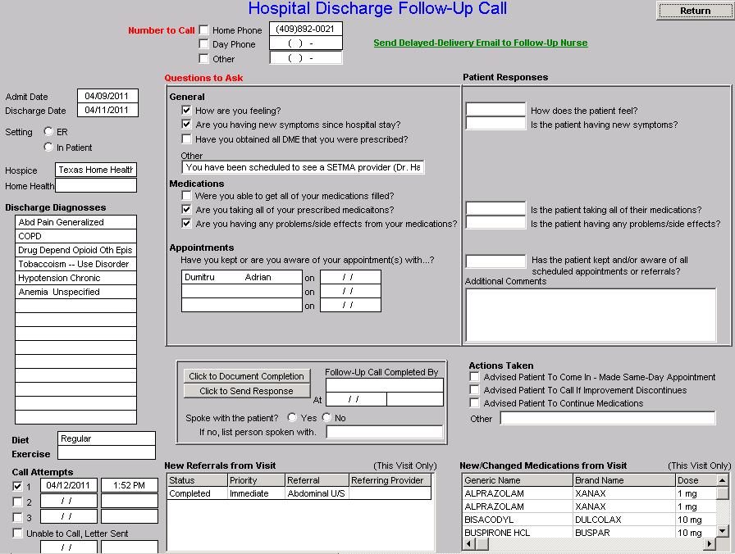
An Integrator’s Tool: The Baton
After the care transition audit is completed and the document is generated, the provider completes the Hospital-Follow-up-Call document:

Slide 131
An Integrator’s Tool: The Baton
During that preparation of the “baton,” the provider checks off the questions which are to be asked the patient in the follow-up call.
The call order is sent to the Care Coordination Department electronically. The day following discharge, the patient is called.
The call is the beginning of the “coaching” of the patient to help make them successful in the transition from the inpatient setting.

Slide 132
Preventing Hospital Readmission
The problem of readmissions will not be solved by more care: more medicines, more tests, more visits, etc.
The problem will be solved by redirecting the patient’s attention for a safety net away from the emergency department.
The problem will be solved by our having more proactive contact with the patient.

Slide 133
Preventing Hospital Readmission
The problem will be solved by more contact with the patient and/or care giver in the home: home health, social worker, provider house calls.
The problem will be solved by the patient and/or care giver having more contact electronically (telephone, e-mail, web portal, cell phone) with the patient giving immediate if not instantaneous access.

