Slide 1
Pearls In Internal Medicine
“Transitioning From Solo or Small Group Practice to a Large Group”
James L. Holly, MD
Adjunct Professor
University of Texas Health Science Center San Antonio School of Medicine
September 28, 2013
New Haven, Connecticut

Slide 2
Motivations
May, 1995, four physicians met to discuss merging
five practices. Motivating factors:
Managed Care presented new challenges requiring more resources – population management
Complexities of technology – laboratory, etc.
Team approach to medicine and the power of collaboration
Negotiating strength with payers
Increasing Federal regulations
Synergism of collegiality with fully aligned incentives

Slide 3
Principles
Equal sharing of assets and liabilities in the formation of the group
Transition to common record system (numerical vs. alphabetical)
Transition to common billing and management system
Common business philosophy surrounding three principles: ethical, equitable, eternal
Common professional philosophy surrounding excellence of care and the caring for those in greatest need

Slide 4
Communication – The SETMA Sentinel
The SETMA Sentinel was originally conceived as an in-house publication for the building of team spirit and for the making of one office out of five different medical practices. It evolved to be a means of communicating the core values, the philosophy, the growth, the vision and the mission of SETMA.
The Sentinel facilitated the development of SETMA into a “learning organization,” and consequently into a team, which created opportunities for growth and development of individuals.
Perhaps the intent of the Sentinel was best expressed by a statement from Peter Senge’s The Fifth Discipline:

Slide 5
Communication
Max de Pree, retired CEO of Herman Miller, speaks of a ‘covenant’ between organization and individual, in contrast to the traditional ‘contract’ (‘an honest day’s pay in exchange for an honest day’s work’).
‘Contracts,’ says De Pree, ‘are a small part of a relationship. A complete relationship needs a covenant…a covenantal relationship rests on a shared commitment to ideas, to issues, to values, to goals, and to management processes…Covenantal relationships reflect unity and grace and poise. They are expressions of the sacred nature of relationships.’ (The Fifth Discipline, p. 145)
SETMA wished for everyone to rediscover the sacred in business relationships based on mutual respect, common goals and a commitment to common values.
The Sentinel Staph

Slide 6
Communication
In 1998, SETMA began publishing a weekly column in a local newspaper on health affairs. All of those articles are posted on our website.
SETMA documented our progress and development and transparently shared our growth with the community.
On February 16, 2009, we began published articles on PC-MH and since we have published over 100 articles on the subject.

Slide 7
Mission Statement
“To build a multi-specialty clinic in Southeast Texas which is worthy of the trust of every patient who seeks our help with their health, and to promote excellence in healthcare delivery by example.”

Slide 8
SETMA’s Mottos
Public Motto
Healthcare Where Your Health is the Only Care
Private Motto
Doing Good While We Do Well

Slide 9
Challenges
December 2, 1995, a partner, two broken legs.
March, 1996, Health Insurance purchased, one employee to cost an addition $10,000 a year.
October 16,1996, one partner filed an injunction against the others.
October, 1997, SETMA determined to transition to electronic medical records.
March, 2006, another partner filed injunction.
April 12, 2007, two partners resigned (July 30, 2007, 8 physicians left SETMA)
Principle: Every time a physician left SETMA, SETMA was strengthened and improved.

Slide 10
EMR Pilgrimage Transition
October 10, 1997 - Attended MGMA meeting and examined 35 EMR vendors’ products
March 30, 1998 - Purchased NextGen EMR and EPM
August, 1998 - Launched Enterprise Practice Management
January 22, 1999 - Launched Electronic Medical Record
May, 1999 - Electronic Patient Management
February, 2012 – Award HIMSS Davies Award
June, 2010 – NCQA and AAAHC PC-MH

Slide 11
Four Seminal Events Number One
In May, 1999, four seminal events transformed SETMA’s healthcare vision and delivery.
First, EMR was too hard and too expensive if all we gained was the ability to document an encounter electronically. EMR was only “worth it,” if:
Improved care for each patient
Improved care for panels and populations
Eliminated errors which were dangerous to the health of our patients
Developed electronic functionalities for improving the health and the care of our patient.
Helped decrease that cost while improving care.

Slide 12
Seminal Events Number One
We began designing disease management and population health tools, including “follow-up documents,” allowing SETMA providers to summarize patients’ healthcare goals with personalized steps of action through which to meet those goals.
We transformed our auditing vision from how many x-rays and lab tests were done and how many patients were seen, to measurable standards of excellence of care and to actions for the reducing of the cost of care.
We learned that excellence and expensive are not synonyms.

Slide 13
Seminal Event Number Two
Second, from Peter Senge’s The Fifth Discipline, we defined the principles which guided our development of an EHR and the steps of our practice transformation:
Pursue Electronic Patient Management rather than Electronic Patient Records
Bring to every patient encounter what is known, not what a particular provider knows
Make it easier to do “it” right than not to do it at all
Continually challenge providers to improve their performance.
Infuse new knowledge and decision-making tools throughout an organization instantly

Slide 14
Seminal Event Number Two
Promote continuity of care with patient education, information and plans of care
Enlist patients as partners and collaborators in their own health improvement
Evaluate the care of patients and populations of patients longitudinally
Audit provider performance based on endorsed quality measurement sets
Integrate electronic tools in an intuitive fashion giving patients the benefit of expert knowledge about specific conditions

Slide 15
Seminal Event Number Three
The third seminal event was the preparation of a philosophical base for our future; developed in May, 1999, this blueprint was published in October, 1999. It was entitled, More Than a Transcription Service: Revolutionizing the Practice of Medicine With Electronic Health Records which Evolves into Electronic Patient Management.
This document is published on our website under Your Life Your Health under Your Life Your Health, under icon Medical Records.

Slide 16
Seminal Event Number Four
Fourth, in May, 1999, a partner lamented that we were not crawling yet with our use of the EMR. I agreed but asked him, “When your son first turned over in bed, did you complain that he could not walk, or did you celebrate this first milestone of muscular coordination of turning over in bed?” He smiled, and I added:
“We may not be crawling yet, but we have started. If in a year, we are doing only what we are currently doing, I will join your lamentation, but today I am celebrating that we have begun.”

Slide 17
Achievements and Milestones
January, 2003 - Physician Practice Magazine names SETMA Southwest Region clinic of the Year
February, 2003 - SETMA named one of 50 Exemplary Primary Care Practices by the American Board of Internal Medicine Foundation
January 2004 - Physician Practice Magazine named SETMA Runner-up National Clinic of the Year
February, 2004 - Microsoft Healthcare Users Group named SETMA Clinic of the Year
February, 2006 - SETMA was awarded the HIMSS Davies Award for excellence in EMR use

Slide 18
Achievements and Milestones
January, 2007 - Established the SETMA Foundation which helps pay for the care of our patients when they cannot afford it. Partners have given 2.5 millions dollars to the Foundation. None of this money can be paid to or profit SETMA.
February, 2007 - The SETMA Model of Care defined and described
February, 2007 - World Healthcare Innovation and Healthcare Congress, Innovation to Transform Awards, Group Practice Runner-up, SETMA. WHIT 3.0 1st Annual Editors Choice Awards

Slide 19
Achievements and Milestones
October, 2008 - A team from Joslin Diabetes Center at Harvard visited SETMA
February 16, 2009 - SETMA attended lecture in Houston to learn about Patient-Centered Medical Home - over the next 16 weeks, SETMA wrote a weekly article about Medical Home
October, 2009 - Began public reporting by provider name over quality metrics at www.jameslhollymd.com
February, 2010 - SETMA’s Pier Reviewed Stories of Success published by HIMSS as a Tier I (with highest honor)

Slide 20
Achievements and Milestones
August, 2010 - SETMA establishes the Department of Care Coordination
November, 2010 - SETMA became a Joslin Diabetes Affiliate - the first multi-specialty, primary-care dominated affiliate
November, 2010 - All SETMA Providers successfully completed Joslin Program and designated as Certified Joslin Primary Care Providers
March, 2011 - SETMA named one of 30 Exemplary Practices for Clinical Decision Support by the Office of National Coordinator

Slide 21
Achievements and Milestones
June, 2010 - SETMA recognized by NCQA as a Tier III PC-MH, renewed for three years in 2013
August, 2010 - SETMA accredited by AAAHC as a Medical Home and for Ambulatory Care, renewed in 2011 for three years
August, 2010 - SETMA recognized by NCQA for Diabetes Care Excellence; recognition renewed in 2013 for three years
July, 2013 -SETMA recognized by NCQA for Heart/Stroke Excellence

Slide 22
Achievements and Milestones
January, 2012 - Dr. & Mrs. James L. Holly Distinguished Professorship for PC-MH established UTHSC San Antonio School of Medicine
January, 2012 – Primary Care Institute endowed by Dr. and Mrs. Holly
2012 - W. E. Bellue and W. R. Holly Distinguished Lectureship in PC-MH established at UTHSC San Antonio School of Medicine
2012 - SETMA CEO named Distinguished Alumnus
2012 - SETMA CEO, named HIMSS Physician IT Leader of the Year
August, 2012 - SETMA selected by Robert Wood Johnson Foundation, LEAP Study (Learning from Exemplar Ambulatory Practices)

Slide 23
Transforming Healthcare
In Abraham Lincoln's famous 1856, "House Divided” speech,“ he said, ‘If we could first know where we are, and whither we are tending, we could better judge what to do, and how to do it.”
In any human enterprise, if the participants are unwilling to objectively and honestly face where they are, it is improbable that they will ever get to where they want to be, let alone to where they should be.
The above was the introduction to a note to SETMA providers which included the daily audit of provider performance.
SETMA is committed to improving the quality of healthcare and we believe that quality metrics are one of the keys to that improvement.

Slide 24
Quality Metrics Philosophy
SETMA’s approach to quality metrics and public reporting is driven by these assumptions:
Quality metrics are not an end in themselves; optimal health at optimal cost is the goal of quality care.
Quality metrics are simply “sign posts along the way.” They give directions to health. And the metrics are like a healthcare “Global Positioning Service”: it tells you where you want to be; where you are, and how to get from here to there.
The auditing of quality metrics gives providers a coordinate of where they are in the care of a patient or a population of patients.

Slide 25
Quality Metrics Philosophy
SETMA’s approach to quality metrics and public reporting is driven by these assumptions, continued:
Statistical analytics are like coordinates along the way to the destination of optimal health at optimal cost.
Ultimately, the goal will be measured by the well-being of patients, but the guide posts to that destination are given by the analysis of patient and patient-population data.
There are different classes of quality metrics. No metric alone provides a granular portrait of the quality of care a patient receives, but all together, multiple sets of metrics can give an indication of whether the patient’s care is going in the right direction or not. Some of the categories of quality metrics are: access, outcome, patient experience, process, structure and costs of care.

Slide 26
Quality Metrics Philosophy
The collection of quality metrics should be incidental to the care patients are receiving and should not be the object of care.
Consequently, the design of the data aggregation in the care process must be as non-intrusive as possible. Notwithstanding, the very act of collecting, aggregating and reporting data will tend to create a Hawthorne effect.
The power of quality metrics, like the benefit of the GPS, is enhanced if the healthcare provider and the patient are able to know the coordinates while care is being received.
Public reporting of quality metrics by provider name must not be a novelty in healthcare but must be the standard. Even with the acknowledgment of the Hawthorne effect, the improvement in healthcare outcomes achieved with public reporting is real.
Quality metrics are not static. New research and improved models of care will require updating and modifying metrics.

Slide 27
The Limitations of Quality Metrics
The New York Times Magazine of May 2, 2010, published an article entitled, "The Data-Driven Life," which asked the question, "Technology has made it feasible not only to measure our most basic habits but also to evaluate them. Does measuring what we eat or how much we sleep or how often we do the dishes change how we think about ourselves?"
Further, the article asked, "What happens when technology can calculate and analyze every quotidian thing that happened to you today?“
Does this remind you of Einstein's admonition, "Not everything that can be counted counts, and not everything that counts can’t be counted?"

Slide 28
Technology Can Deal With Disease But Cannot Produce Health
In our quest for excellence, we must not be seduced by technology with its numbers and tables. This is particularly the case in healthcare. In the future of medicine, the tension - not a conflict but a dynamic balance - must be properly maintained between humanity and technology.
Technology can contribute to the solving of many of our disease problems but ultimately cannot solve the "health problems" we face.
The entire focus and energy of "health home" is to rediscover the trusting bond between patient and provider. In the "health home," technology becomes a tool to be used and not an end to be pursued.
The outcomes of technology alone are not as satisfying as those where trust and technology are properly balanced in healthcare delivery.

Slide 29
What To Do and How To Do It
Physician hubris or stubbornness may reject quality metrics for a while, but patient and societal demands will rightly press for change.
Caring in the 21st Century will no longer be measured by personality or friendliness; it will be measured by competence which will increasingly be an objective measurement. To reject that reality is to prepare oneself for obsolescence.
Quality metrics tells us where we are and they tell us where we are “tending to go.” If tracked, audited, analyzed and publicly reported, quality metrics will help us “judge what to do and how to do it.”

Slide 30
SETMA’s Model of Care
Key to our PC-MH is SETMA’s Model of Care:
Personal Performance Tracking – one patient at a time
Auditing of Performance – by panel or by population
Analysis of Provider Performance -- statistical
Public Reporting by Provider Name – www.jameslhollymd.com
Quality Assessment and Performance Improvement

Slide 31
Step I - Provider Performance Tracking
SETMA currently tracks the following Physician Consortium for Performance Improvement (PCPI) measurement sets:
Chronic Stable Angina
Congestive Heart Failure
Diabetes
Hypertension
Chronic Renal Disease
Weight Management
Care Transitions

Slide 32
Step I - Provider Performance Tracking
SETMA also currently tracks the following published quality performance measure sets:
HEDIS
NQF
AQA
PQRI
BTE
Each is available to the provider interactively within the EHR at the time of the encounter.

Slide 33
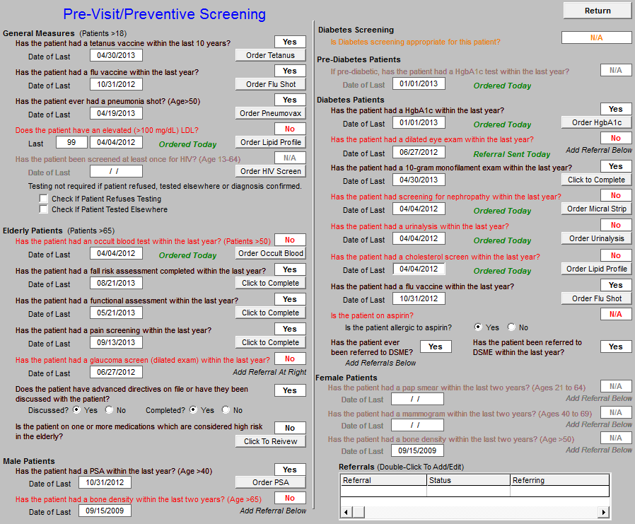
Step I - Provider Performance Tracking
A pre-visit screening tool allows each provider to assess quality measures for each patient at each encounter.

Slide 34
Step I - Provider Performance Tracking
HEDIS

Slide 35
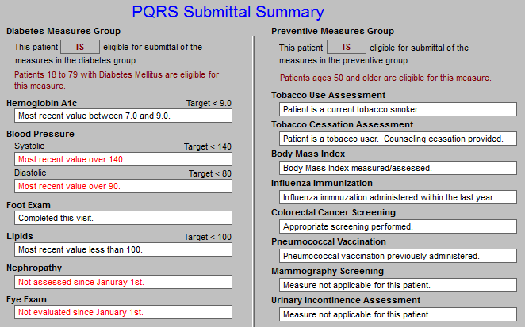
Step I - Provider Performance Tracking
PQRS

Slide 36
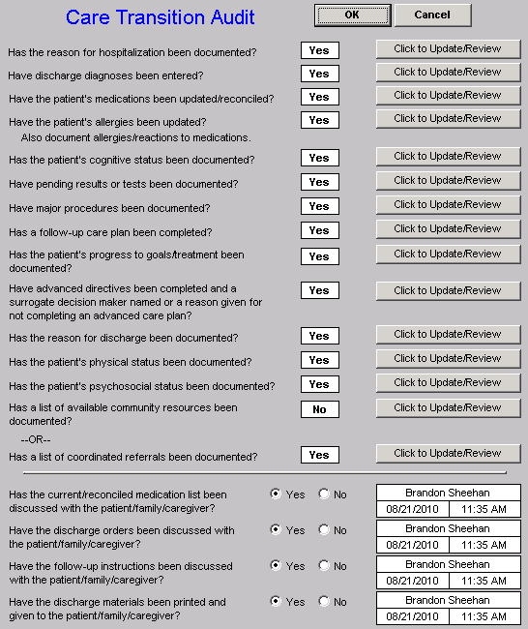
Step I - Provider Performance Tracking
Care Transition Audit

Slide 37
Step I - Provider Performance Tracking
Bridges to Excellence

Slide 38
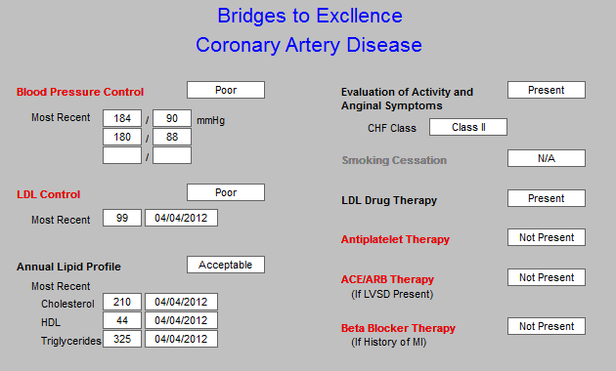
Step I - Provider Performance Tracking
Bridges to Excellence

Slide 39
Step II -- Auditing Provider Performance
SETMA employed Business Intelligence software to audit provider performance and compliance after patient encounters.
Business Intelligence allows all providers to:
Display their performance for their entire patient base
Compare their performance to all practice providers
See outcome trends to identify areas for improvement

Slide 40
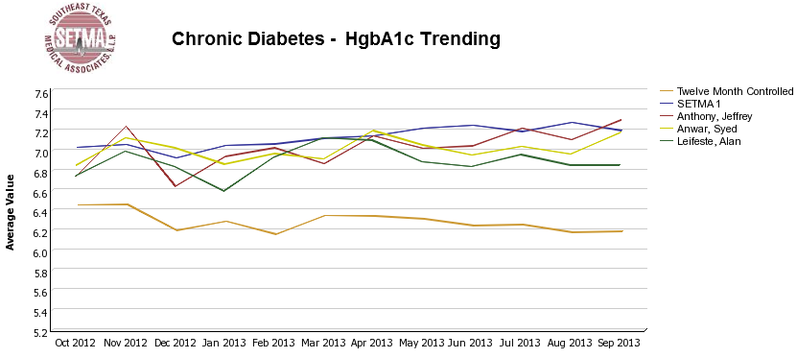
Step II -- Auditing Provider Performance

Slide 41
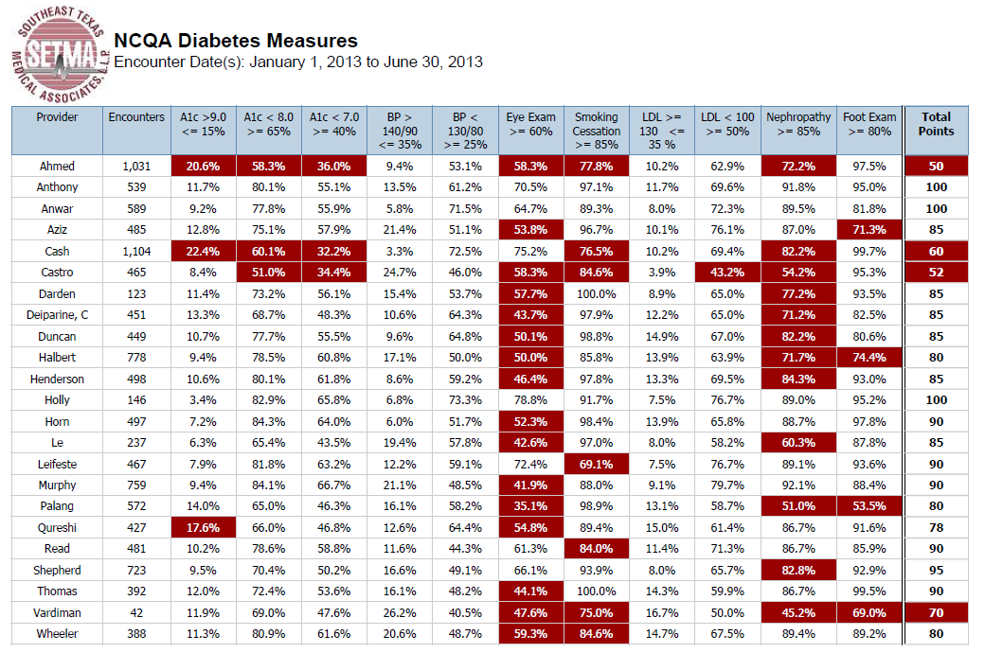
Step II -- Auditing Provider Performance

Slide 42
Step III -- Analyzing Performance
Beyond how one provider performs (auditing) we look at data as a whole (analyzing) to develop new strategies for improving patient care.
We analyze patterns which may explain why one population is not to goal while another is. Some of the parameters, we analyze are:
Frequency of visits
Frequency of key testing
Number of medications prescribed
Changes in treatments if any, if patient not to goal
Referrals to educational programs

Slide 43
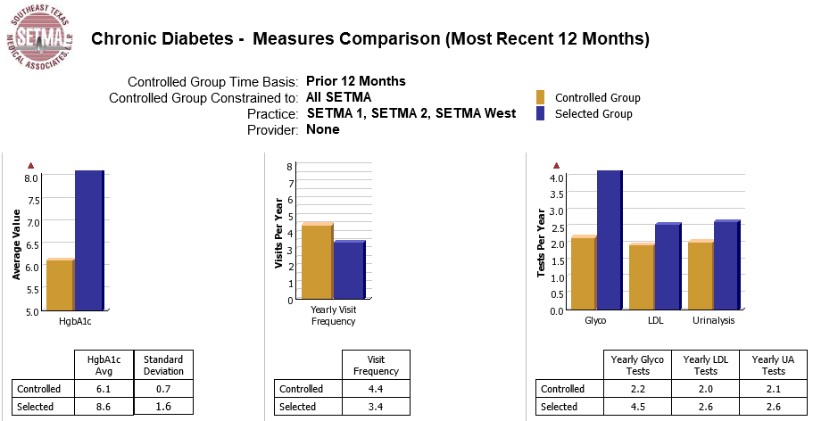
Step III -- Analyzing Performance

Slide 44
Step III -- Analyzing Performance
Raw data can be misleading. For example, with diabetes care, a provider may have many patients with very high HgbA1cs and the same number with equally low HgbA1cs which would produce a misleadingly good average. As a result, SETMA also measures the:
Mean
Median
Mode
Standard Deviation

Slide 45
Step III -- Analyzing Performance
SETMA’s average HgbA1c as been steadily improving for the last 10 years. Yet, our standard deviation calculations revealed that a small subset of our patients were not being treated successfully and were being left behind.
As we have improved our treatment and brought more patients to compliant levels, we have skewed our average.
By analyzing the standard deviation of our HgbA1c we have been able to address the patients whose values fall far from the average of the rest of the clinic.

Slide 46
Step IV - Public Reporting of Performance
One of the most insidious problems in healthcare delivery is reported in the medical literature as “treatment inertia.” This is caused by the natural inclination of human beings to resist change. As a result, when a patient’s care is not to goal, often no change in treatment is made.
To help overcome this “treatment inertia,” SETMA publishes all of our provider auditing (both the good and the bad) as a means to increase the level of discomfort in the healthcare provider and encourage performance improvement.

Slide 47
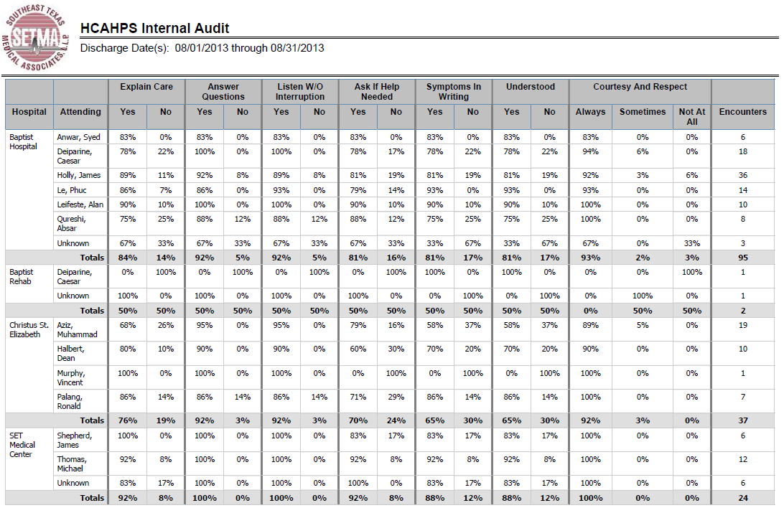
Step IV - Public Reporting of Performance
HCAPS

Slide 48
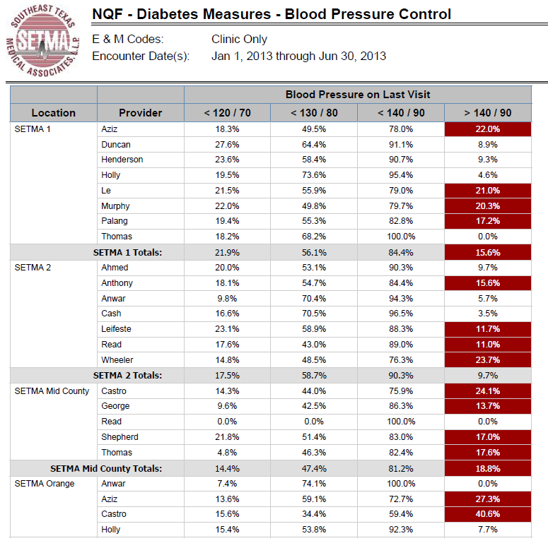
Step IV - Public Reporting of Performance
NQF Diabetes Measures

Slide 49
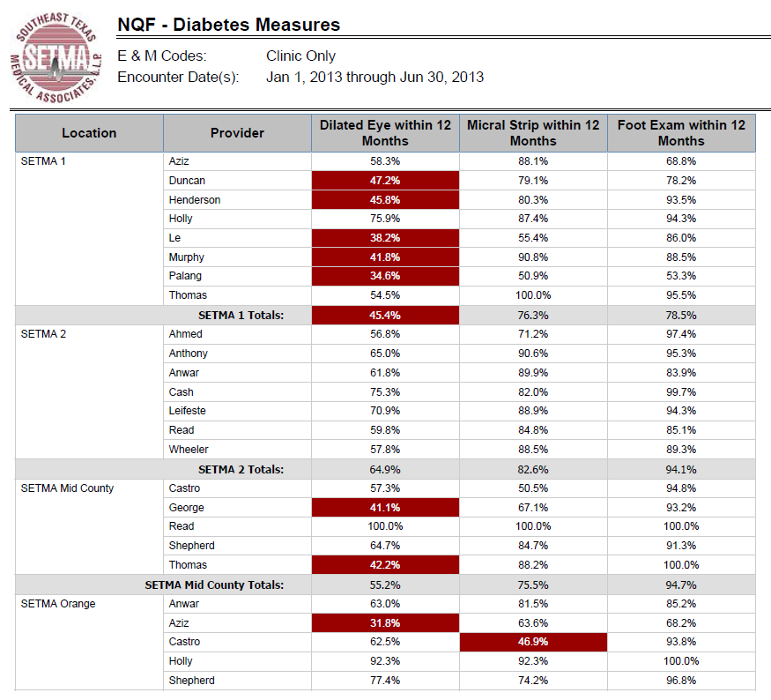
Step IV - Public Reporting of Performance
NQF Diabetes Measures

Slide 50
Step V -- Quality Assessment & Performance Improvement
Quality Assessment and Performance Improvement (QAPI) is SETMA’s roadmap for the future. With data in hand, we can begin to use the outcomes to design quality initiatives for our future.
We can analyze our data to identify disparities in care between
Ethnicities
Socio-Economic Groups
Age Groups
Genders

Slide 51
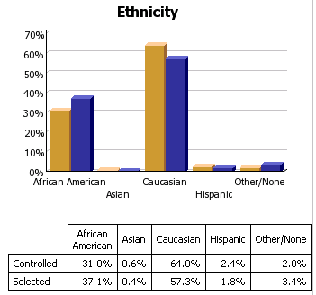
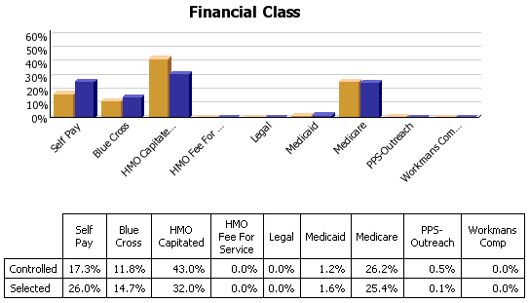
Step V -- Quality Assessment & Performance Improvement

Slide 52
Coordination of Care
“Coordination” has come to mean to SETMA, “specialized scheduling” which translates into:
Convenience for the patient, which
Results in increased patient satisfaction, which contributes to
The patient having confidence that the healthcare provider cares personally, which
Increases the trust the patient has in the provider, all of which,

Slide 53
Coordination of Care
5. Increases compliance in obtaining healthcare services recommended which,
Promotes cost savings in travel, time and expense of care which
Results in increased patient safety and quality of care.

Slide 54
Director of Coordinated Care
SETMA’s Director of Coordinated Care is responsible for building a Department of Care Coordination.
This could be called the “Marcus Welby Department,” as it recognizes the value of each patient as an individual, and has as its fundamental mission the meeting of their healthcare needs and helping them achieving the degree of health which each person has determined to have.
The driving force of care coordination is to make each patient feel as if they are SETMA’s ONLY patient where all their questions are answered, all their needs are met and their care meets all quality standards presently known.

Slide 55
The Transformation
SETMA’s Model of Care is the power source of SETMA’s Patient-Centered Medical Home. We believe this model will transform our delivery of healthcare and is a model worthy of being adopted by others.

Slide 56
Where We Are Headed
The Automated Team
How many tasks can you get a provider to complete at each patient encounter?
“If you make a change will it make a difference?”
Benefiting from new opportunities: transitions of care management codes and annual wellness examinations
A team of colleagues
How to be successful

