Slide 1
Performance Improvement CME
Dr. James L. Holly, CEO
Southeast Texas Medical Associates, LLP
Society For Academic CME
April 8, 2011
New York, New York

Slide 2
Index to Slide Deck
Slide 5 Introduction – History of SETMA and of Treatment of Diabetes
Slide 13 Continual Profession Development Mission Link Clinical Decision Support
Slide 25 Medical Information – Peter Senge
Slide 42 Circular Causality
Slide 44 SETMA Ten Principles of Designing EHR
Slide 47 Quality Metrics – Clusters and Galaxies

Slide 3
Index to Slide Deck
Slide 51 SETMA Model of Care Steps 1-5
Slide 52 Step 1 Tracking One Patient at a Time
Slide 60 Passing the Baton
Slide 64 Transitions of Care
Slide 70 Step 2 Auditing

Slide 4
Index to Slide Deck
Slide 87 Step 3 Statistical Analysis
Slide 93 Step 4 Public Reporting
Once you “open your books on performance” to public scrutiny, the only safe place you have in which to hide is excellence.
Slide 100 Step 5 Quality Improvement

Slide 5
SETMA Achievements
July 2010 - NCQA PC-MH Tier Three
July 2010 – Joslin Diabetes Center Affiliate
August 2010 - NCQA Diabetes Recognition Program
August 2010 - AAAHC Medical Home
August 2010 - AAAHC Ambulatory Care
March 2011 – Address staff of ONC of HIT, HHS
www.jameslhollymd.com

Slide 6
Diabetes Care Improvements
From 2000 to 2011
HgbA1C standard deviation improvement from
1.98 to 1.33
HgbA1C mean (average) improvement from
7.48% to 6.65%
Elimination of Ethnic Disparities of Care in Diabetes

Slide 7
Diabetes Care Initiatives and Results
2000 - Design and Deployment of EHR-based Diabetes Disease Management Tool
HgbA1C improvement 0.3%
2004 - Design and Deployment of American Diabetes Association certified Diabetes Self Management Education (DSME) Program
HgbA1C improvement 0.3%
2006 - Recruitment of Endocrinologist
HgbA1C improvement 0.25%

Slide 8
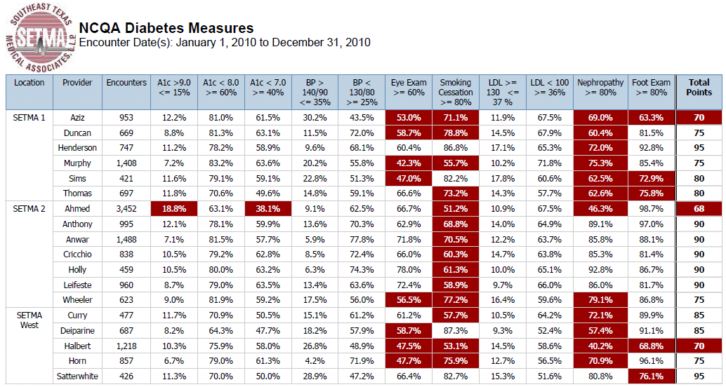
SETMA’s 2010 NCQA Diabetes Metrics

Slide 9
COGNOS Diabetes Audit - Trending

Slide 10
COGNOS Diabetes Audit – Ethnicity

Slide 11
Trust and Hope
In the midst of health-information-technology
innovation, we must never forget that the
foundations of healthcare change are
“trust” and “hope.”
Without these, science is helpless!

Slide 12
Domains of Healthcare Transformation
The Substance
Evidenced-based medicine and comprehensive health promotion
The Method
Electronic Patient Management
The Organization
Patient-centered Medical Home
The Funding
Capitation with payment for quality

Slide 13
Continuing Professional Development
REDESIGNING CONTINUING EDUCATION
HEALTH PROFESSIONS
Institute of Medicine of National Academies (IOM)
December 2009
“Knowing is not enough; we must apply.
Willing is not enough; we must do.”
- Goethe

Slide 14
Continuing Professional Development
“On average, it now takes 14-17 years for new evidence to be broadly implemented (Balas and Boren, 2000). Shortening this period is key to advancing the provision of evidence-based care, and will require the existence of a well-trained health professional workforce that continually updates its knowledge.”
(p. 16)

Slide 15
Continuing Professional Development
“In recent years, a broader concept, called continuing professional development (CPD), has been emerging that 1ncorporates CE as one modality while adding other important features. CPD is learner-driven, allowing learning to be tailored to individual needs. CPD uses a broader variety of learning methods and builds on a broader set of theories than CE. CPD methods include self-directed learning and organizational and systems factors; and it focuses on both clinical content and other practice-related content, such as communications and business.” (p. 17)

Slide 16
Continuing Professional Development
“…an effective CPD system should ensure that health
professionals are prepared to:
“Provide patient-centered care.
Work in inter-professional teams.
Employ evidence-based practice.
Apply quality improvement.
Use health informatics.” (p. 94)

Slide 17
The Dr. and Mrs. James L. Holly Distinguished Professorship
A Permanent Endowment…will promote
a model of patient-centered primary care and interdepartmental and interdisciplinary education.
“…a distinguished professorship to promote patient-centered medical
homes, the future of healthcare and the vision we share for the care of
which your School of Medicine will be known….your vision…will create
the first-in-the-country academic endowment focused on the patient
centered medical home model, a notable milestone in the history of the
Health Science Centered.”
William L. Henrich, MD, M.A.C.P,
President, University of Texas Health Science Center, San Antonio

Slide 18
Missing Link in CME
The “missing link” in CME is the incorporation of the new information into a clinician’s active and intentional workflow.
SETMA had one provider who routinely completed 500 hours of CME a year. He knew more than almost anybody but his outcomes never changed. He never incorporated what he knew into his workflow.

Slide 19
Linking That Which is Missing
Annually, the American Diabetes Association (ADA) publishes a 100-page update on the standards of care in diabetes.
Reading it is good, but incorporating it into patient care is the goal.
New information or new standards of care built into clinical decision support, provides the missing link between CME and performance.
Annually, SETMA’s Diabetes Disease Management Tool is updated with the ADA Standards.

Slide 20
Quality Initiative & Workflow
Texas Department of State Health Services
HIV/ASTD Prevention and Care Branch
Promoting Annual HIV
Screening for ages 13-64
SETMA has agreed to participate. But how do you get this done with five clinics and busy providers who already have a great deal to do?

Slide 21
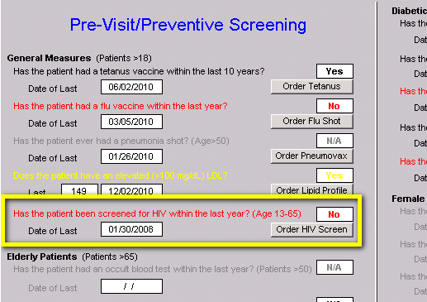
HIV Screening Initiative

Slide 22
Quality Initiative & Workflow
Place HIV testing with the discriminators into Preventive Health & Screening protocol.
If the HIV test is black it applies to the patient and has been done
If the HIV test is grey, it does not apply t the patient
If the HIV is red, it applies and has note been done
If the button is red, click it!

Slide 23
Quality Initiative & Workflow
When the button is clicked, the following happens:
Test is ordered
Sends order to the chart, billing and lab
Determines whether the patient's insurance will pay for test, or if bill goes to state grant
Automatically populates release form giving with patient information
Prints the consent form for the patient to sign

Slide 24
Quality Initiative & Workflow
Before starting the program audit all charts to see what percentage of patients had an HIV test in the past year. That number will be very low.
Quarterly, audit patients seen as to what percentage had an HIV test done and what percent refused.
Post notices requesting that patients allow testing.
Send letters encouraging patients to be tested.
Do a survey among those who refuse and to why.

Slide 25
Knowledge and Practice
Acquiring and applying medicine’s complex knowledge base effectively will require a fundamental shift in physician approach to information.
Electronic medical records provides the means for that shift but does not dictate that such a shift will take place.

Slide 26
Peter Senge, The Fifth Discipline
“Learning has come to be synonymous with
‘taking in information’…(which) is only distantly
related to real learning.” Today healthcare can:
Create more information than anyone can absorb
Foster greater interdependency than anyone can manage
Accelerate change faster than anyone’s ability to keep pace.”

Slide 27
Complexity Undermines Confidence and Responsibility
Confidence is undermined when the vastness of available, valuable and applicable information is such that it appears futile to the individual to try and “keep up.”
Without confidence, responsibility is surrendered as healthcare providers tacitly ignore best practices, substituting experience as a decision-making guide.

Slide 28
Primary Care Literature
“How Much Effort is needed to keep up with the literature relevant to primary care?”
341 journals relevant to primary care
7,287 articles published monthly
627.5 hours per month to read and evaluate these articles.

Slide 29
Knowledge and Access
Without medical knowledge, quality-of-care initiatives will falter, but the volume of medical knowledge is so vast that it can overwhelm healthcare providers.
The good news: the state of our current knowledge is excellent. The bad news: the form in which that knowledge is stored.

Slide 30
Creating Discomfort
Patient change will be achieved by enhancing the capability of a provider to create discomfort in the patient in order To effect change which will benefit the patient in the long run.
Creation of discomfort in the provider via self-auditing at the point of care allowing the provider to measure his/her performance against an accepted standard and then public reporting by provider name.

Slide 31
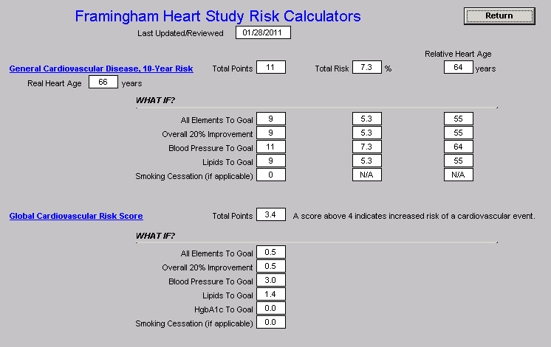
Framingham Risk Scores – What If Scenario

Slide 32
Point of Leverage
Most healthcare analysis focuses upon multiple variables and a plethora of data. This is “detail complexity.”
The greatest opportunity for effecting change in an organization or an organism is in what Senge calls “dynamic complexity.”

Slide 33
Dynamic Complexity and Data Display
Dynamic complexity occurs when “cause and effect are subtle, and where the effects over time of interventions are not obvious.”
Data display can obscure effective management if it simply presents more detail while ignoring, or further obscuring, the dynamic interaction of one part of a biological system with another.

Slide 34
Seeing Circles of Causality
“Reality is made up of circles, but we see straight lines …Western languages…are Biased toward a linear view. If we want to see system-wide interrelationships, we need a language of interrelationships, a language of circles.”
(The Fifth Disciple)

Slide 35
Dynamic Interaction
Healthcare is improved when the organization of information creates a dynamic interaction between the provider, the patient, the consultant and all other members of the healthcare team, as well as creating the simultaneous integration of that data across disease processes and across provider perspectives, i.e., specialties.

Slide 36
Dynamic Changes
Healthcare delivery is not necessarily improved when an algorithm for every disease process is produced and made available on a handheld pocket computer device but it is improved when the data and decision-making tools are structured and displayed in a fashion which dynamically changes as the patient’s situation and need change.

Slide 37
Impact of Data
Healthcare delivery also improves when data and information processed in one clinical setting are simultaneously available in all settings.
This improvement does not only result from efficiency but from the impact the elements contained in that data set exert upon multiple aspects of a patient’s health.

Slide 38
Quality at the Point of Care
Healthcare is improved when evaluation of the quality of care as measured by evidenced-based criteria is automatically determined at the point of. Healthcare is improved when the data display makes it simple for the provider to comply with the standards of care, if the evaluation demonstrates a failure to do so.

Slide 39
Data Longitudinally
Healthcare is also improved when data can be displayed longitudinally, demonstrating to the patient over time how their efforts have affected their global well-being.
This is circular rather than linear thinking:
A person begins at health.
Aging and habits result in the relative lack of health.
Preventive care and positive steps preserve, or restore health.

Slide 40
Dynamic Auditing Tools
Healthcare improvement via systems will require dynamic auditing tools giving providers and patients immediate feedback on the effectiveness of their healthcare delivery.

Slide 41
EMR Power
How can electronic patient records and/or electronic patient management help solve these problems and make it possible for healthcare providers to remain current and fulfill their responsibility of caring for patients with the best treatments available?

Slide 42
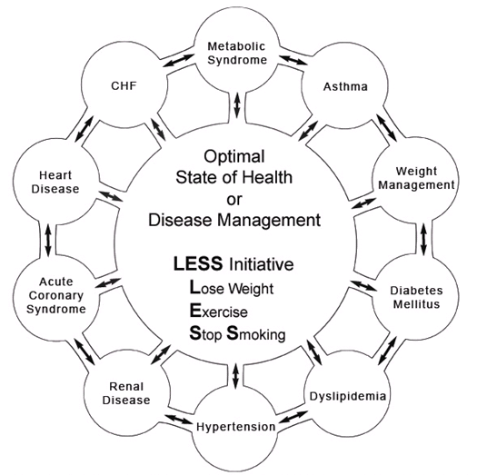
Circular Causality

Slide 43
Data Flow
To and from the patient’s core information, and to and from interactive disease management capabilities:
Acute condition data
Longitudinal data
Standards of care which reflect a positive state of health
Automatically-populated-treatment reflecting best practices based on random controlled trials
Auditing tools which reflect provider excellence
Automatically-populated-patient follow-up instructions
Automatically-created-patient education

Slide 44
SETMA’s Ten Principles of EHR Design
Pursue Electronic Patient Management rather than Electronic Patient Records
Bring to bear upon every patient encounter what is known rather than what a particular provider knows.
Make it easier to do it right than not to do it at all.
Continually challenge providers to improve their performance.
Infuse new knowledge and decision-making tools throughout an organization instantly.

Slide 45
SETMA’s Ten Principles of EHR Design
Establish and promote continuity of care with patient education, information and plans of care.
Enlist patients as partners in their health improvement.
Evaluate the care of patients longitudinally.
Audit provider performance based on the Consortium for Physician Performance Improvement Data Sets.
Create multiple disease-management tools which are integrated in an intuitive and interchangeable fashion giving patients the benefit of expert knowledge about specific conditions while they get the benefit of a global approach to their total health.

Slide 46
SETMA’s Ten Principles of EHR Design
These principles define the nature of EHR tools which
are designed as electronic-patient-management tools
and they define nature of effective clinical-decision-
support tools.

Slide 47
Clusters and Galaxies
SETMA believes that fulfilling a single or a few quality
metrics does not change outcomes, but fulfilling
“clusters” and “galaxies” of metrics at the point-of-care
will change outcomes.
A “cluster” is seven or more quality metrics for a single condition (i.e. diabetes, hypertension, etc.)
A “galaxy” is multiple clusters for the same patient (i.e. diabetes, hypertension, lipids, CHF, etc.)

Slide 48
A Cluster
A single patient, at a single visit, for a single condition, will have eight or more quality metrics fulfilled, which WILL change the outcome of a patient’s treatment.

Slide 49
A Galaxy
A single patient, at a single visit, can have multiple clusters of quality metrics and may have as many as 60 or more quality metrics fulfilled in his/her care which WILL change the outcomes.

Slide 50
The SETMA Model of Care

Slide 51
The SETMA Model of Care
SETMA’s model of care is based on the concepts of
“clusters” and “galaxies” of quality metrics and on
these principles of healthcare transformation:
Evidence based medicine/health and wellness
Electronic patient management
Patient-Centered Medical Home
Medicare Advantage Payment Method (capitation)

Slide 52
Step 1 –Tracking Quality Metrics
The tracking on each patient by each provider of their
performance on preventive and screening care and
quality standards for acute and chronic care. Tracking
occurs simultaneously with the performing of these
services by the entire healthcare team, including the
personal provider, nurse, clerk, management, etc.

Slide 53
Step 1 –Tracking Quality Metrics
The PCPI is an organization created by the AMA, CMS, IOM and others to develop measurement sets for quality-care assessment. The intent is to allow healthcare providers to evaluate their own performance at the time they are seeing a patient.
SETMA tracks PCPI measurement sets for Chronic Stable Angina, CHF, Diabetes, Hypertension, and CRD Stages IV & V, ESRD, Adult Weight Management, and Care Transitions.

Slide 54
Step 1 –Tracking Quality Metrics
SETMA also tracks measurement sets endorsed by NQF. NCQA (HEDIS and Medical Home), PQRI, AQA, and Bridges to Excellence. Also, SETMA designed a Pre-visit quality measures screening and preventive care tool.
This allows a SETMA provider and a patient to quickly and easily assess whether or not the patient has received all of the appropriate preventive health care and the appropriate screening health care which national standards establish as being needed by this patient.

Slide 55
Step 1 –Tracking Quality Metrics
Pre-Visit Preventive/Screening tool
All measures in black apply to the current patient and are fulfilled.
All measures in red apply to the current patient and have not been fulfilled.
All measures in grey do not apply to the current patient.
If a point of care is missing, it can be fulfilled with the single click of a single button.

Slide 56
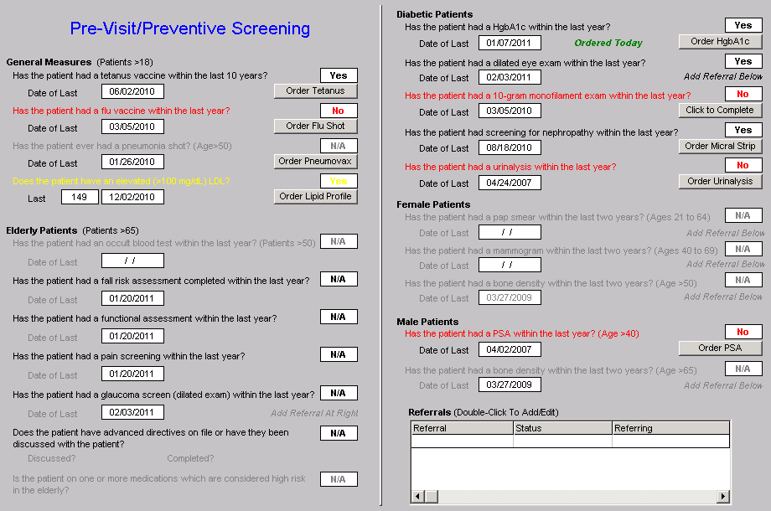
Step 1 –Tracking Quality Metrics

Slide 57
Step 1 –Tracking Quality Metrics
There are similar tracking tools for all of the quality metrics which SETMA providers track each day. Such as this example of NQF-endorsed measures.

Slide 58
Step 1 –Tracking Quality Metrics

Slide 59
Step 1 –Tracking Quality Metrics
In order for the tracking of quality metrics to be valuable to the patient, the patient must know what is being tracked, what it means and what has or has not been performed in their own care.

Slide 60
Passing the Baton
If responsibility for a patient’s healthcare is symbolized by a baton, the healthcare provider carries the baton for 0.68% of the time. The patient carries the baton 99.22% of the time.
Coordination of care between healthcare providers is important but the coordination of the patient’s care between the healthcare provider and the patient is imperative.

Slide 61
Passing the Baton
“Often, it is forgotten that the member of the healthcare delivery team who carries the ‘baton’ for the majority of the time is the patient and/or the family member who is the principal caregiver. If the ‘baton’ is not effectively transferred to the patient or caregiver, the patient’s care will suffer.”

Slide 63
The Baton – What Does it Mean?
In all public areas and in every examination room,
SETMA’s “Baton” poster is displayed. It illustrates:
That the healthcare-team relationship, which exists between patient and healthcare provider, is key to the success of the outcome of quality healthcare.
That the plan of care and treatment plan, the “baton,” is the engine through which the knowledge and power of the healthcare team is transmitted and sustained.

Slide 64
The Baton – What Does it Mean?
That the means of transfer of the “baton”, which has been developed by the healthcare team .is a coordinated effort between the provider and the patient.
That typically the healthcare provider knows and understands the patient’s healthcare plan of care and the treatment plan, but without its transfer to the patient, the provider’s knowledge is useless to the patient.
That the imperative for the plan – the “baton” – is that it be transferred from the provider to the patient, if change in the life of the patient is going to make a difference in the patient’s health.

Slide 65
The Baton – What Does it Mean?
That this transfer requires that the patient “grasps” the “baton,” i.e., that the patient accepts, receives , understands and comprehends the plan, and that the patient is equipped and empowered to carry out the plan successfully.
That the patient knows that of the 8,760 hours in the year, he/she will be responsible for “carrying the baton,” longer and better than any other member of the healthcare team.

Slide 66
The Baton – What Does it Mean?
There are numerous points of “care transition” in the patient's care. In the transition of care from the hospital, there are potential eight different types of care transition.
PCPI has published a “Transition of Care Measurement Set,” which is illustrated here.

Slide 67
Transition of Care Measurement

Slide 68
Transition of Care Measurement

Slide 69
Transition of Care Measurement

Slide 70
Transition of Care Measurement

Slide 71
Transition of Care Measurement
The second, third and fourth of the transition s of care involve “follow-up call” scheduling:
The day following discharge from the hospital – this goes to follow-up call nursing staff in our Care Coordination Department. These calls differ from the “administrative calls’ initiated by the hospital which may last for 30 seconds are less. These calls last from 12-30 minutes and involved detailed discussions of patient’s needs and conditions.

Slide 72
Transition of Care Measurement

Slide 73
Step 2 – Auditing Provider Performance
The auditing of provider performance on the entire practice, on each individual clinic, on each provider on a population, or on each provider on a panel of patients is critical for quality improvement. SETMA believes that this is the piece missing from most healthcare improvement programs.

Slide 74
Step 2 – Auditing Provider Performance
The creating of quality measures is a complex process. That Is why it is important for agencies such as the AQA, NCQA, NQF, PQRI and PCPI, among others, to identify, endorse and publish quality metrics.
The provider’s ability to monitor their own performance and the making of those monitoring results available to the patient is important, but it only allows the provider to know how they have performed on one patient.

Slide 75
Step 2 – Auditing Provider Performance
The aggregation of provider performance results over’ his/her entire panel of patients carries the process of designing the future of healthcare delivery a further and a critical step.
Most auditing results, such as HEDIS, are presented to the provider 12 to 18 months after the fact. SETMA believes that “real time, auditing and giving of the audit results to providers can change provider behavior and can overcome “treatment inertia.”

Slide 76
Step 2 – Auditing Provider Performance
Auditing of provider performance allows physicians and nurse practitioners to know how they are doing in the care of all of their patients.
It allows them to know how they are doing in relationship to their colleagues in their clinic or organization, and also how they are performing in relationship to similar practices and providers around the country.

Slide 77
Step 2 – Auditing Provider Performance
SETMA designed auditing tools through IBM’s Business intelligence software, COGNOS. (see SETMA’s COGNOS Project at www.jameslhollymd.com under Your Life Your Health and the iconCOGNOS.)
Through COGNOS, SETMA is able to display outcomes trending which can show seasonal patterns of care and trending comparing one provider with another.

Slide 78
Step 2 – Auditing Provider Performance
It is also possible to look at differences between the care of patients who are treated to goal and those who are not.
Patients can be compared as to socio-economic characteristics, ethnicity, frequency of evaluation by visits and by laboratory analysis, numbers of medication, payer class, cultural, financial and other barriers to care, gender and other differences. This analysis can suggest ways in which to modify care in order to get all patients to goal.

Slide 79
Step 2 – Auditing Provider Performance
Using digital dashboard technology, SETMA analysis provider and practice performance in order to find patterns which can result in improved outcomes practice wide for an entire population of patients. We analyze patient populations by:
Provider Panel
Practice Panel
Financial Class – payer
Ethic Group
Socio-economic groups

Slide 80
Step 2 – Auditing Provider Performance
We are able to analyze if there are patterns to explain why one population or one patient is not to goal and others are. WE can look at:
Frequency of visits
Frequency of testing
Number of medications
Change in treatment
Education or not
Many other metrics

Slide 81
Step 2 – Auditing Provider Performance

Slide 82
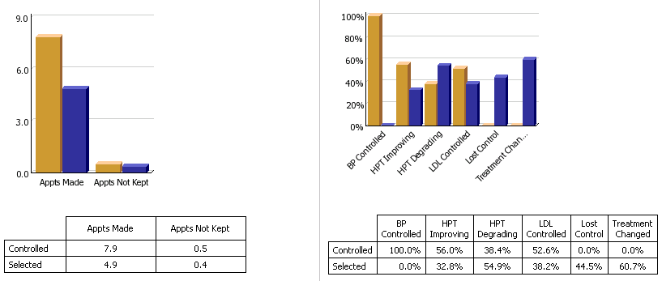
Step 2 – Auditing Provider Performance

Slide 83
Step 2 – Auditing Provider Performance

Slide 84
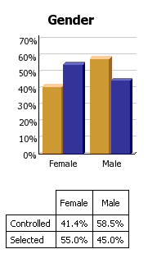
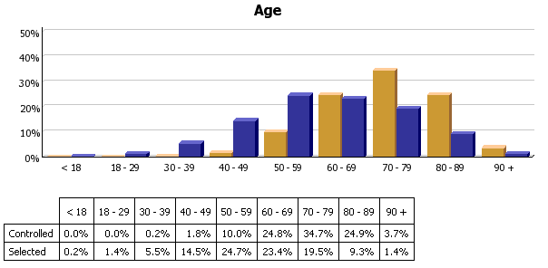
Step 2 – Auditing Provider Performance

Slide 85
Step 2 – Auditing Provider Performance
We are able to present over-time patient results comparing:
Provider to practice
Provider to provider
Provider current to provider over time
Trending of results to see seasonal changes, etc.

Slide 86
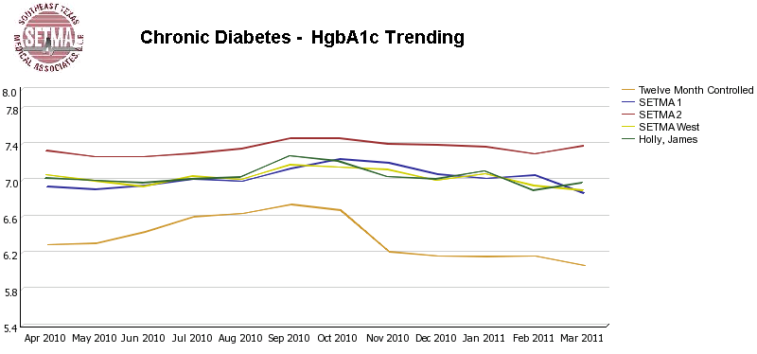
Step 2 – Auditing Provider Performance

Slide 87
Step 3 – Analysis of Provider Performance
The statistical analyzing of the above audit performance in order to measure improvement by practice, by clinic or by provider. This includes analysis for ethnic disparities, and other discriminators such as age, gender, payer class, socio economic groupings, education, frequency of visit, frequency of testing, etc.
This allows SETMA to look for leverage points through which to improve care of all patients.

Slide 88
Step 3 – Analysis of Provider Performance
Raw data can be misleading. It can cause you to think you are doing a good job when in fact many of your patients are not receiving optimal care. For instance the tracking of your mean performance in the treatment of diabetes may obscure the fact that a large percentage of your patients are not at goal.

Slide 89
Step 3 – Analysis of Provider Performance
Each of the statistical measurements which SETMA Tracks -- the mean, the median, the mode and the standard deviation -- tells us something about our performance, and helps us design quality improvement initiatives for the future. Of particular, and often, of little known importance is the standard deviation.

Slide 90
Step 3 – Analysis of Provider Performance
From 2000 to 2010, SETMA has shown annual improvement in the mean (the average) and the median for the treatment of diabetes.
There has never been a year when we did not improve. Yet, our standard deviations revealed that there were still significant numbers of our patients who are not being treated successfully.

Slide 91
Step 3 – Analysis of Provider Performance
From 2008 to 2009, SETMA experience a 9.3% improvement in standard deviation. Some individual SETMA providers had an improvement of over 16% in their standard deviations.
SETMA’s HbA1C standard deviations from 2000 to 2011 have improved from 1.98 to 1.33.

Slide 92
Step 3 – Analysis of Provider Performance
When our standard deviations are below 1 and as they approach 0.8, we can be increasingly confident that all of our patients with diabetes are being treated well.

Slide 93
Step 4 – Public Reporting of Performance
The public reporting by provider of performance on hundreds of quality measures places pressure on all providers to improve, and it allows patients to know what is expected of providers.

Slide 94
Step 4 – Public Reporting of Performance
SETMA public reports quality metrics two ways:
In the patient’s plan of care and treatment plan which is given to the patient at the point of care. This reporting is specific to the individual patient.
On SETMA’s website. Here the reporting is by panels or populations of patients without patient identification but with the provider name given.

Slide 95
Step 4 – Public Reporting of Performance
One of the most insidious problems in healthcare delivery is reported in the medical literature as “treatment inertia.” This is caused by the natural inclination of human beings to resist change.
Often, when care is not to goal, no change in treatment is made. As a result, one of the auditing elements in SETMA’s COGNOS Project is the assessment of whether a treatment change was made when a patient was not treated to goal.

Slide 96
Step 4 – Public Reporting of Performance
Overcoming “treatment inertia” requires the creating of an increased level of discomfort in the healthcare provider and in the patient so that both are more inclined to change their performance.
SETMA believes that one of the ways to do this is the pubic reporting of provider performance. That is why we are publishing provider performance by provider name atwww.jameslhollymd.com under Public Reporting.

Slide 97
Step 4 – Public Reporting of Performance
Once you “open your books on performance” to public scrutiny, the only safe place you have in which to hide is excellence.

Slide 98
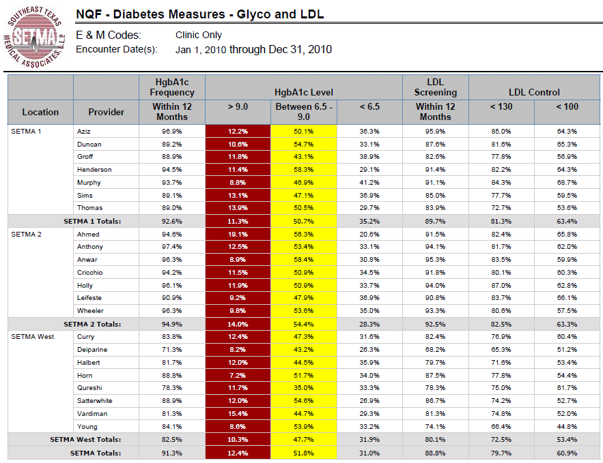
Step 4 – Public Reporting of Performance

Slide 99
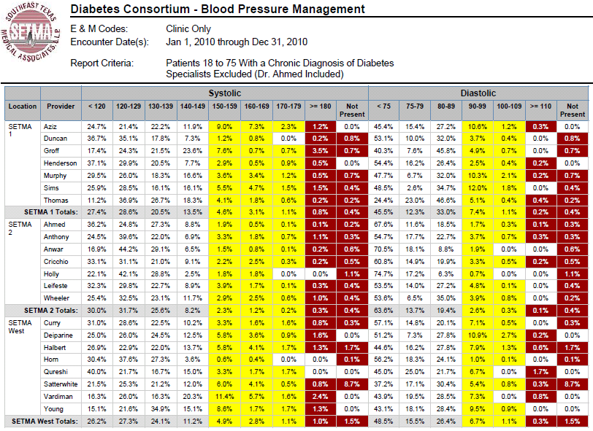
Step 4 – Public Reporting of Performance

Slide 100
Step 5 – Quality Assessment & Performance Improvement
The Quality Assessment and Performance Improvement (QAPI) Initiatives -- this year SETMA’s initiatives involve the elimination of all ethnic diversities of care in diabetes, hypertension and dyslipidemia. Also, we have designed a program for reducing preventable readmissions to the hospital.

Slide 101
Step 5 – Quality Assessment & Performance Improvement
This logical and sequential process is possible and is rewarding for provider and patient. This process has set SETMA on a course for successful and excellent healthcare delivery. Our tracking, auditing, analysis, reporting and design will keep us on that course.

Slide 102
Step 5 – Quality Assessment & Performance Improvement
SETMA’s Model of Care has and is transforming our delivery of healthcare, allowing us to provide cost effective, excellent care with high patient satisfaction. This Model is evolving and will certainly change over the years as will the quality metrics which are at its core.

