Slide 1
SETMA Monthly Staff Training March 28, 2012
Preventable Hospital Readmissions Policy, Problems, Processes

Slide 2
Preventable Hospital Readmissions Public Policy
HEALTHCARE REFORM: PENDING CHANGES TO REIMBURSEMENT FOR 30-DAY READMISSIONS (reference for slides 3-6)
AUGUST 2010
David Foster, PhD, MPH
Chief Scientist
Center for Healthcare Improvement

Slide 3
Preventable Hospital Readmissions Public Policy
High readmission rates have long been considered a marker of lower quality care. In its 2008 recommendation to Congress, the Medicare Payment Advisory Commission (MedPAC) reported that
in 2005, 17.6 percent of admissions were readmitted within 30 days of discharge. That same year, readmissions accounted for $15 billion in Medicare spending, of which $12 billion was related to potentially preventable readmissions, equating to an average payment of about $7,000 per case.
Congress has taken notice and acted. Lawmakers specifically addressed the issue in the healthcare reform legislation, the Patient Protection and Affordable Care Act, with the intent of holding care providers responsible and of managing healthcare spending.

Slide 4
Preventable Hospital Readmissions Public Policy
With regard to readmissions, areas of improvement are often focused around:
Better quality care during hospitalizations — effective use of diagnosis-specific clinical decision support tools embedded into the workflow has demonstrated effectiveness.
Improved communication among providers and with patients and caregivers — particularly between the inpatient and outpatient providers of care.

Slide 5
Preventable Hospital Readmissions Public Policy
Care planning that begins with an assessment at admission — nurse care managers representing the insurer, the hospital, and the primary providers must collaborate.
Clear discharge instructions with particular attention to medication management — incorporating the input of the inpatient and outpatient pharmacist has proven effective.
Discharge to a proper setting of care — Hospital case management screenings should determine rehab/skilled nursing requirements before discharge to outpatient care.

Slide 6
Preventable Hospital Readmissions Public Policy
Timely physician follow-up visits — with primary care provider and appropriate specialists; preferably the appointment should be scheduled prior to discharge.
Appropriate use of palliative care and end-of-life planning should be built into the hospital discharge process. Palliative specialists and hospice expertise need to be integrated components of post-hospital planning.

Slide 7
SETMA’s Hospital Discharges
Total Discharges Readmission Rate (Days)
30 60
2009 – 2995 -- --
2010 – 3001 16.5% 21.9%
2011 – 4194 17.4% 24.6%
2012 * – 946 -- --
Total – 11055 -- --
*Jan, Feb 2012

Slide 8
CMS Fee For Service Medicare Study –Medical Homes vs. Benchmarks

Slide 9
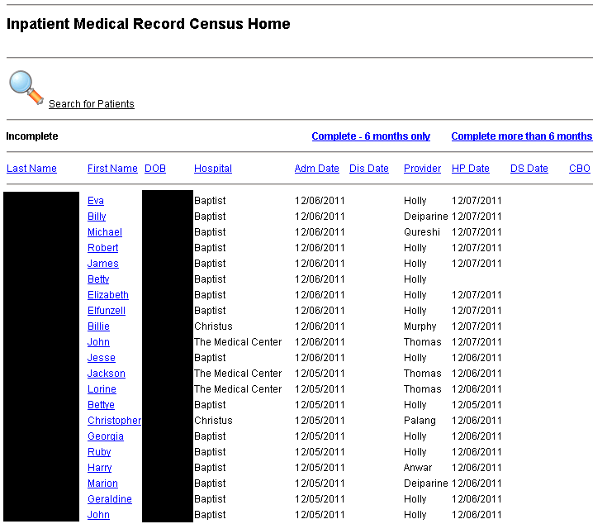

Slide 10
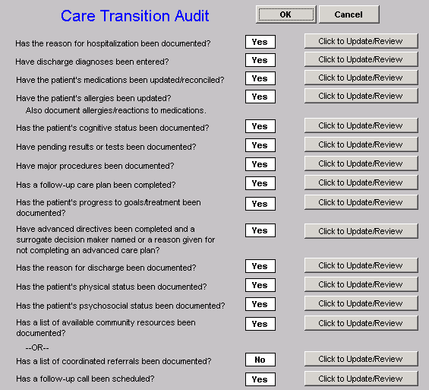

Slide 11
Care Transition Audit
Quarterly and annually, SETMA audits each provider’s performance on these measures and publishes that audit on our website under “Public Reporting,” along with over 200 other quality metrics which we track routinely.
The following is the care transition audit results by provider name for 2011.

Slide 12
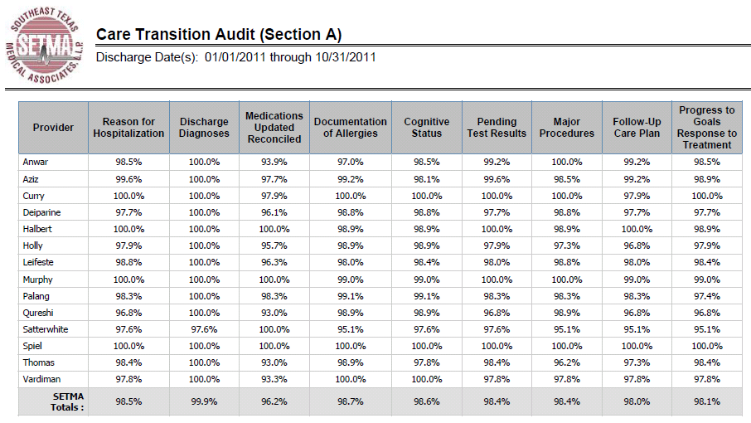
Care Transition Audit

Slide 13
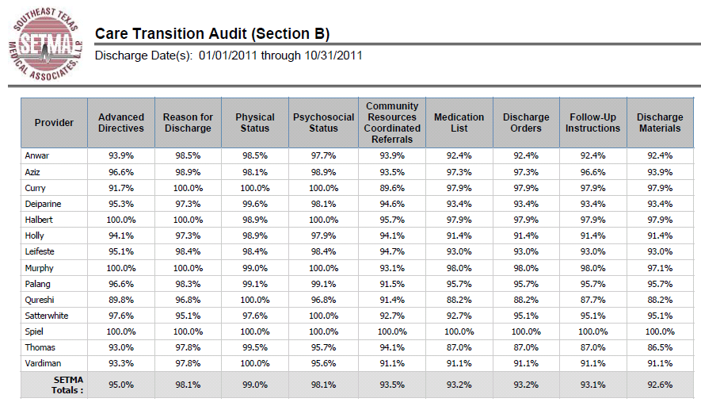
Care Transition Audit

Slide 14
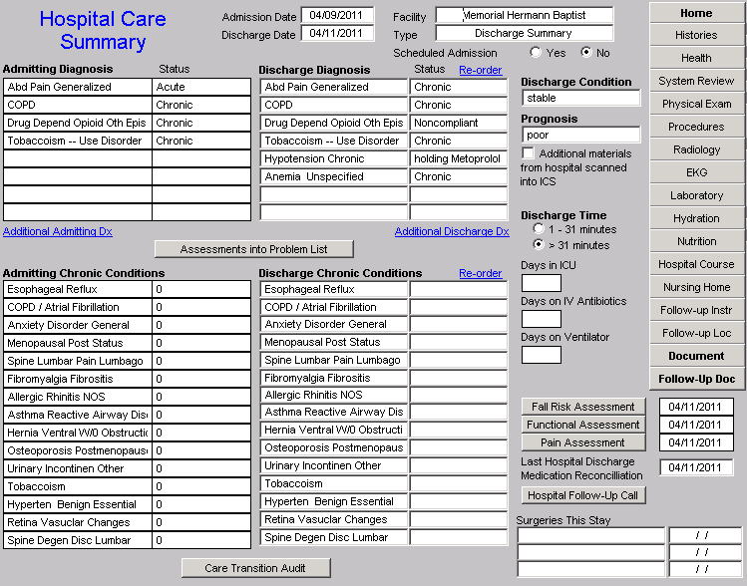
Hospital Care Summary and Post Hospital Plan of Care and Treatment Plan

Slide 15
Hospital Care Summary and Post Hospital Plan of Care and Treatment Plan
Hospital Care Summary completed at the time the patient is discharged from the hospital:
Year Completion (%)
2010 98.8
2011 97.7
2012 (to date) 92.1
Cumulative 97.7
* January 1, 2010 to date

Slide 16
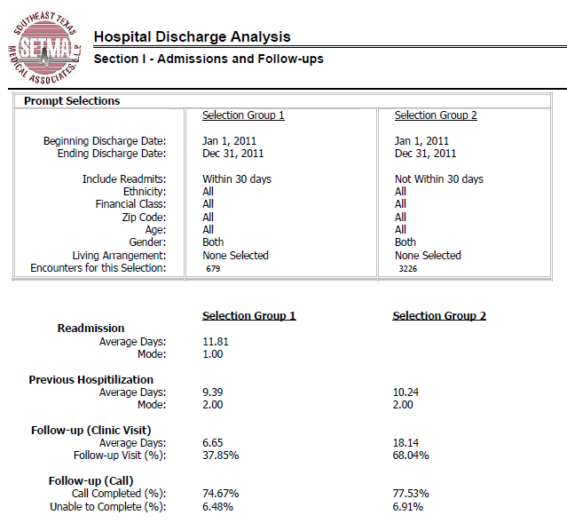

Slide 17
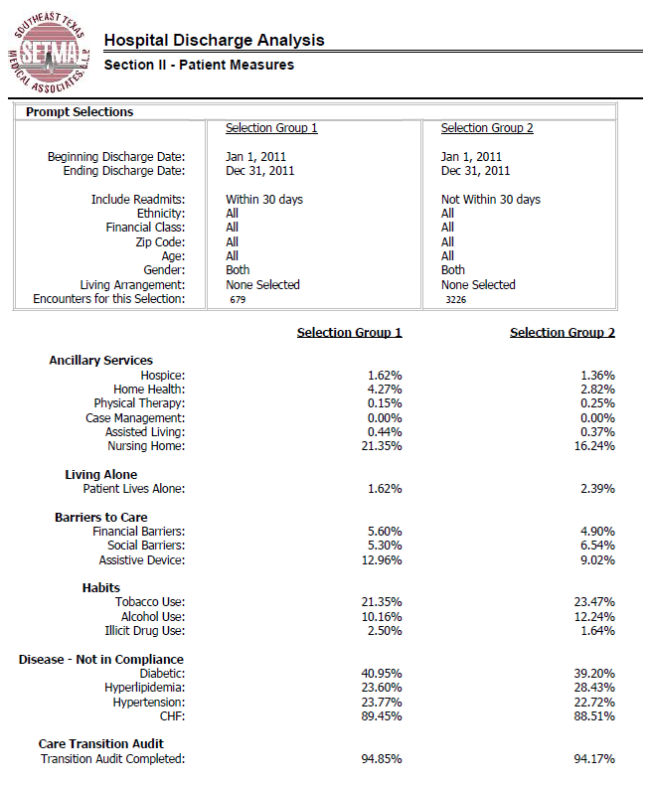

Slide 18
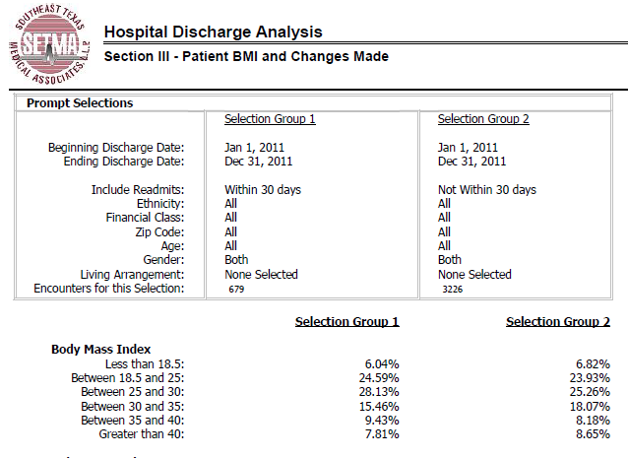

Slide 19
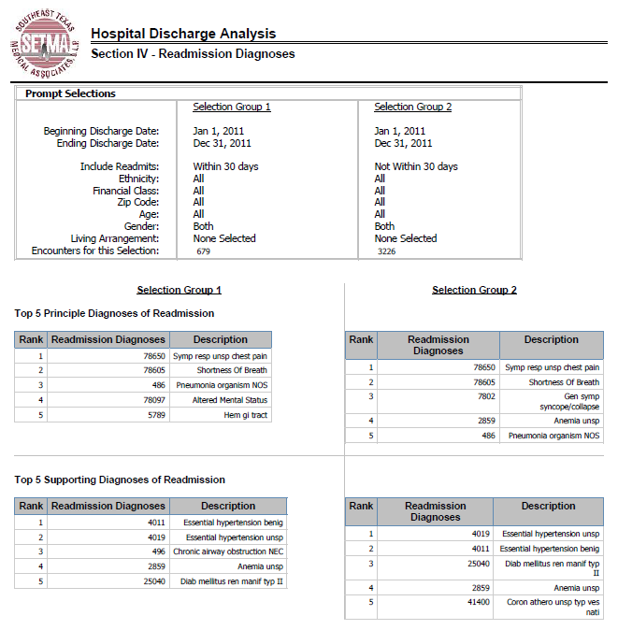

Slide 21
All Readmissions Are Not Preventable
“Critical to the analysis of readmissions is appropriateness. Some readmissions may be unavoidable. Other readmissions may be avoidable, but nevertheless occur, due to a lack of follow-up care coordination or some other problem. Obtaining a readmissions rate of zero is not feasible and may even indicate poor quality care, as many readmissions are medically appropriate due to an unavoidable change in condition or a new condition. For example, physicians may provide patient centered care by discussing early discharge with patients, with the mutual understanding that readmission may be necessary.”

Slide 22
All Readmissions Are Not Preventable
“Behavioral choices, such as non-compliance with dietary recommendations, may also trigger an avoidable readmission despite proper outpatient care coordination.”
“Other readmissions may occur as a result of a medical error or adverse event that occurred during the initial hospitalization or as a result of a lack of social support, follow up care, understanding of discharge instructions, or communication following discharge. These avoidable readmissions that occur as a result of a breakdown along the care continuum were the focus of meeting discussion and of this brief.”

Slide 23
Strategies For Reducing Readmissions
Provide better, safer care during the inpatient stay. According to one study, hospital readmission rates doubled—from 14 percent to 28 percent—when initial hospitalizations involved adverse patient safety events, such as anesthesia complications and infections. Evidence-based care practices—such as giving blood thinners after joint replacement surgery—can also reduce complications that tend to occur after discharge, resulting in readmission.
Source: 2007 Report to Congress: Reforming the Delivery System, Medicare Payment Advisory Committee, 2008. (Available at www.medpac.gov.)

Slide 24
Strategies For Reducing Readmissions
Attend to a patient’s medication needs at discharge. Sixty-six percent of the patients who experienced an adverse event within three weeks of hospital discharge suffered an adverse drug event. Physicians and nurses at one hospital improved the appropriate use of medications—and reduced readmissions—for cardiovascular patients by using a checklist of indications and contraindications for five life-saving medications, including beta blockers and warfarin.
Source: 2007 Report to Congress: Reforming the Delivery System, Medicare Payment Advisory Committee, 2008. (Available at www.medpac.gov.)

Slide 25
Strategies For Reducing Readmissions
Improve communication with patients before and after discharge. Philadelphia hospitals reduced readmissions by 45 percent by having nurses meet frequently with high-risk patients both in the hospital and after discharge to discuss medication management, diet, symptom management, etc. Even ensuring that all patients receive complete instructions about how to take care of themselves after discharge has been shown to reduce readmissions.
Source: 2007 Report to Congress: Reforming the Delivery System, Medicare Payment Advisory Committee, 2008. (Available at www.medpac.gov.)

Slide 26
Strategies For Reducing Readmissions
Improve communication with other providers. For example, California-based Healthcare Partners has established the goal of getting discharge summaries to primary care physicians within one business day of their patients’ discharges.
Review practice patterns. Some practice patterns may influence the likelihood of readmission. Examples include keeping patients an extra day in the hospital and providing physicians with comparative data on their readmission rates.
Source: 2007 Report to Congress: Reforming the Delivery System, Medicare Payment Advisory Committee, 2008. (Available at www.medpac.gov.)

Slide 27
Risk of Readmissions
Recent studies continue to suggest the risk of readmission can be quantified based on a patient's risk factors and therefore are an important tool in establishing evidence-based best practices.

Slide 28
Risk of Readmissions
The Journal of Hospital Medicine recently published a pair of studies in which researchers analyzed data from California and Austria to determine the risk factors of hospital readmission.
Medicare
Medicaid
Black Race
Inpatient use of narcotics
Inpatient use of corticosteroids
Cancer with and without metastasis
Renal Failure
Congestive Heart Failure
Weight loss

Slide 29
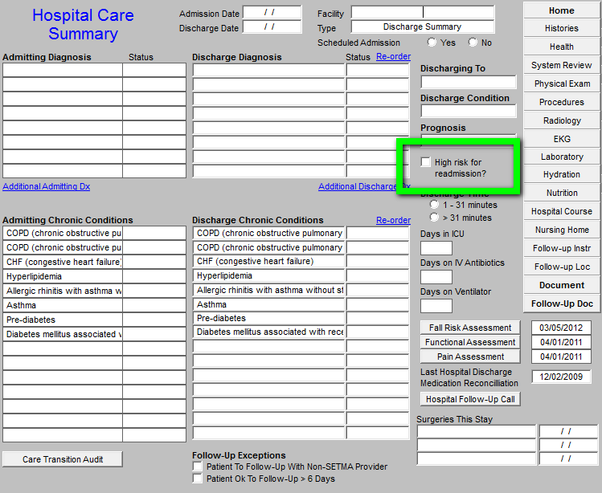

Slide 30
Managing High Risk Patients
When a person is identified as a high risk for readmissions, SETMA’s Department of Care Coordination is alerted. The following ten steps are then instituted:
Hospital Care Summary and Post Hospital Plan of Care and Treatment Plan is given to patient, care giver or family member.
The post hospital, care coaching call, which is done the day after discharge, goes to the top of the queue for the call – made the day after discharge by SETMA’s Care Coordination Department. It is a 12-30 minute call.

Slide 31
Managing High Risk Patients
Medication reconciliation is done at the time of discharge, is repeated in the care coordination call the day after discharge and is repeated at the follow-up visit in the clinic.
MSW makes a home visit for need evaluation, including barriers and social needs for those who are socially isolated.
A clinic follow-up visit within three days for those at high risk for readmission.

Slide 32
Managing High Risk Patients
A second care coordination call in four days.
Plan of care and treatment plan discussed with patient, family and/or care giver at EVERY visit and a written copy with the patient’s reconciled medication list, follow-up instructions, state of health, and how to access further care needs.
MSW documents barriers to care and care coordination department designs a solution for each.

Slide 33
Managing High Risk Patients
The patient’s end of life choices and code status are discussed and when appropriate hospice is recommended.
Referral to disease management is done when appropriate, along with tetehealth monitoring measures.

Slide 34
Managing High Risk Patients
Currently, SETMA’s determination of whether patients are high risk for readmissions is intuitively determined, i.e., at discharged based on experience and judgment, a patient is designated as potentially high risk for readmission. SETMA is designing a “predictive model” for identifying patients at high risk for readmissions and instituting the above plan for interdicting a readmission. This is an attempt to quantify the most effective opportunities for decreasing preventable readmissions.

Slide 35
Managing High Risk Patients
There is a significant body of science associated with “predictive modeling.” It is clear that tradition models of care delivery will not “work” in a sustainable program for decreasing readmissions. Traditional disease management will not result in changing the patterns of care. In a January/February, 2012 Professional Care Management Journal article, the following abstract addressed changes needed to affect a decrease in preventable readmissions:

Slide 36
Managing High Risk Patients
“Purpose/Objectives: The move to the Accountable Care Organization model of care calls for broad-sweeping structural, operational, and cultural changes in our health care systems. The use of predictive modeling as part of the discharge process is used as a way to highlight just one of the common processes that will need to be transformed to maximize reimbursement under the Accountable Care Organization model. The purpose of this article is to summarize what has been learned about predictive modeling from the population health management industry perspective, to discuss how that knowledge might be applied to discharge planning in the Accountable Care Organization model of patient care, and then to outline how the Accountable Care Organization environment presents various challenges, opportunities, and implications for the case management role.”

Slide 37
Managing High Risk Patients
“Findings/Conclusions: The development of predictive models to identify patients at risk for readmission and can positively impact the discharge planning process by lowering readmission rates. Examples of the structural, operational, cultural, and case management role changes necessary to maximize the benefits of an Accountable Care Organization are critical.”
“Implications for Case Management Practice: There is a growing need for advanced practice nurses to fill the leadership, resource management, analytical, informatics-based, and organizational development roles that are sorely needed to advance the Accountable Care Organization model of care. Case managers are well-positioned to lend their expertise to the development efforts, but they will need to be educationally prepared for the many advanced practice roles that will emerge as our nation evolves this new system of health care delivery.”

Slide 38
Care Transitions
In SETMA’s Model of Care -- Care Transition involves:
Evaluation at admission -- transition issues: “lives alone,” barriers, DME, residential care, or other needs
Fulfillment of PCPI Transitions of Care Quality Metric Set
Hospital Care Summary and Post Hospital Plan of Care and Treatment Plan
Post Hospital Follow-up Coaching -- a 12-30 minute call made by members of SETMA’s Care Coordination Department and additional support
Follow-up visit with primary provider

Slide 39
National Priorities Partnership
Focus in care coordination by NPP are the links between:
Care Transitions - …continually strive to improve care by … considering feedback from all patients and their families… regarding coordination of their care during transitions between healthcare systems and services, and…communities.
Preventable Readmissions - …work collaboratively with patients to reduce preventable 30-day readmission rates.

Slide 40
Hospital Care Summary
Once the Care Transition issues are completed, The Hospital Care-Summary-and-Post- Hospital-Plan-of Care-and Treatment-Plan document is generated and printed. It is given to the patient and/or to the patient’s family and to the hospital.

Slide 41
The Baton
The following picture is a portrayal of the “plan of care and treatment plan” which is like the “baton” in a relay race.

Slide 42
The Baton
“The Baton” is the instrument through which responsibility for a patient’s health care is transferred to the patient or family. Framed copies of this picture hang in the public areas of all SETMA clinics and a poster of it hangs in every examination room. The poster declares:
Firmly in the provider’s hand --The baton -- the care and treatment plan Must be confidently and securely grasped by the patient, If change is to make a difference 8,760 hours a year.

Slide 43
The Baton
The poster illustrates:
That the healthcare-team relationship, which exists between the patient and the healthcare provider, is key to the success of the outcome of quality healthcare.
That the plan of care and treatment plan, the “baton,” is the engine through which the knowledge and power of the healthcare team is transmitted and sustained.
That the means of transfer of the “baton,” which has been developed by the healthcare team, is a coordinated effort between the provider and the patient.

Slide 44
The Baton
That typically the healthcare provider knows and understands the patient’s healthcare plan of care and the treatment plan, but without its transfer to the patient, the provider’s knowledge is useless to the patient.
That the imperative for the plan – the “baton” – is that it must be transferred from the provider to the patient, if change in the life of the patient is going to make a difference in the patient’s health.

Slide 45
The Baton
That this transfer requires that the patient “grasps” the “baton,” i.e., that the patient accepts, receives, understands and comprehends the plan, and that the patient is equipped and empowered to carry out the plan successfully.
That the patient knows that of the 8,760 hours in the year, he/she will be responsible for “carrying the baton,” longer and better than any other member of the healthcare team.

Slide 46
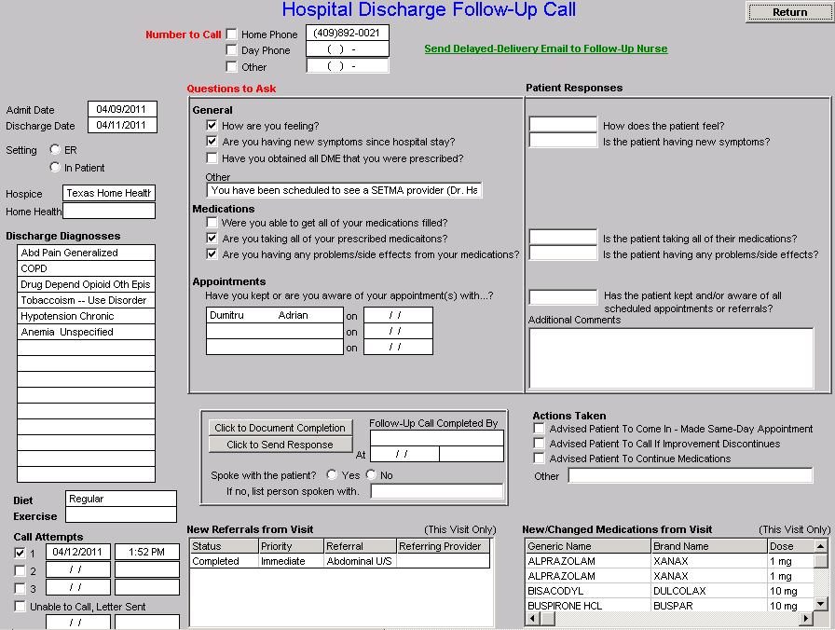
Hospital Follow-Up Call
After the care transition audit is completed and the document is generated, the provider completes the Hospital-Follow-up-Call document:

Slide 47
Follow-Up Call
During that preparation of the “baton,” the provider checks off the questions which are to be asked the patient in the follow-up call.
The call order is sent to the Care Coordination Department electronically. The day following discharge, the patient is called.
The call is the beginning of the “coaching” of the patient to help make them successful in the transition from the inpatient setting.

Slide 48
Conclusions
The problem of readmissions will not be solved by more care: more medicines, more tests, more visits, etc.
The problem will be solved by redirecting the patient’s attention for a safety net away from the emergency department.
The problem will be solved by our having more proactive contact with the patient.

Slide 49
Conclusions
The problem will be solved by more contact with the patient and/or care giver in the home: home health, social worker, provider house calls.
The problem will be solved by the patient and/or care giver having more contact electronically (telephone, e-mail, web portal, cell phone) with the patient giving immediate if not instantaneous access.

Slide 50
Keys to Success
Seamless Collaboration Between:
Hospital Care Team
Care Coordination Department
I-Care (Nursing Home) Team
Healthcare Providers
Clinic Staff

