Slide 1
Primary Care: The Future Primary Care Progress (PCP) UTHSCSA Chapter Town Hall Meeting March 21, 2012
James L. Holly, MD
CEO, SETMA, LLP
Adjunct Professor
Family & Community Medicine
University of Texas HSC San Antonio
School of Medicine

Slide 2
Conflict of Interest Disclosure
James L. Holly, MD CEO, Southeast Texas Medical Associates, LLP
Has no real or apparent
conflicts of interest to report.

Slide 3
Future of Primary Care: People
A typical scene in my professional life: “Dr.
Holly, I am pleased to meet you. What is
your specialty?” Dr. Holly’s response:
”People!
Stories:
Patient-Centered Medical home Poster Child!
Does he have a gun?
I want you to give a $4,000 donation to the SETMA Foundation!
Brilliant Diagnostician and Diabetes!

Slide 4
The Future of Primary Care
The Future: People
The Future: Four Domains
The Future: Information Explosion
The Future: Systems Thinking
The Future: Electronic Solution Design
The Future: Primary Care Practice Model
The Future: SETMA As An Example
The Future: Personal Mastery
The Future: Flexibility
The Future: Financing of Primary Care

Slide 5
The Future: Four Domains
Transformation of healthcare involves:
Method: electronic patient management
Content: evidenced-based medicine
Structure and organization: patient-centered medical home
Payment methodology: capitation with payment for quality

Slide 6
Future of Primary Care: SETMA
NCQA Tier III Patient-Centered MH
AAAHC Accredited Ambulatory Care
AAAHC Accredited Medical Home
Joslin Diabetes Center Affiliate
NCQA Diabetes Recognition
AHRQ Published SETMA’s LESS Initiative
Innovator of the Year 2011
Exemplary Practice ONC for CDS

Slide 7
The Future: Information Explosion
Depending upon how you count, there are
between 4,000 and 7,000 medically
related journals presently being
published. There are over 1,000 medically
related journal articles published each
day.

Slide 8
The Future: Information Explosion
In 2004, The Journal of the Medical Library
Association published an article
entitled, “How much effort is needed to
keep up with the literature relevant to
primary care?”

Slide 9
The Future: Information Explosion
Here are the authors’ conclusions:
There are 341 currently active journals which are relevant to primary care.
These journals publish approximately 7,287 articles monthly.
It would take physicians trained in epidemiology an estimated 627.5 hours per month to read and evaluate these articles. That translates into 21 hours a day, seven days a week, every month.

Slide 10
The Future: Information Explosion
In 1997, The British Medical Journal stated that there are over 10,000,000 medically-related articles on library shelves of which about 1/3rd are indexed in the Medline database compiled by the National Library of Medicine. If a healthcare provider receives only an average of 8 journals, including those which are free, it can be seen how overwhelming the problem of information is.

Slide 11
The Future: Information Explosion
This is the level of the problem for individual physicians, but what about collaborative efforts to organize medical data?
The Cochrane Collaboration was started in 1992 following Dr. Archie Cochrane’s 1979 statement in which he opined “It is surely a great criticism of our profession that we have not organized a critical summary, by specialty or subspecialty, adapted periodically, of all relevant randomized controlled trials.”

Slide 12
The Future: Information Explosion
There are now fifteen Cochrane Centers around the world with 1,098 complete reviews and 866 protocols (reviews in progress). It is estimated that it will take 30 years to complete reviews on random-controlled studies (RCTs) in all fields of medicine which presently exist.
At the end of those 30 years, nothing would have been done on the RCTs which will have been completed in the intervening 30 years.

Slide 13
The Future: Information Explosion
And if this review does not convince you, think about the millions of pieces of information the genome is going to bring to clinical medicine within your medical career. It is truly more information than anyone can possibly learn, leaving electronic patient management as the only option.

Slide 14
The Future: Information Explosion
Without medical knowledge, quality-of-care initiatives will falter, but the volume of medical knowledge is so vast that it can overwhelm healthcare providers. Stated a different way, the good news about healthcare today is the state of our current knowledge; it is excellent. The bad news is the form in which that knowledge is stored and/or accessed. The solution is “a shift of mind.”

Slide 15
The Future: Systems Thinking
In his seminal work, The Fifth Discipline, Dr. Peter Senge addressed “systems thinking.” While the term does not refer to computer systems, the principles apply to health care delivery via an electronic medical record as legitimately as to other business enterprises.

Slide 16
The Future: Systems Thinking
“Learning has come to be synonymous with ‘taking in information.’…Yet, taking in information is only distantly related to real learning.” Classically, healthcare has focused upon “taking in information” in the form of facts.
The hurdle required to enter medicine as a physician is the proven ability to absorb and retain tens of thousands of isolated pieces of information and then to be able to repeat that information in a test format.

Slide 17
The Future: Systems Thinking
“Clinical training” attempts to take the static database created by facts and to transform it into a dynamic tool which can provide answers to complex disease-process questions.
How do you take a fact-based data set and transform it into a dynamic, interactive decision-making tool?

Slide 18
The Future: Systems Thinking
“System thinking is needed more than ever because for the first time in history, humankind has the capacity:
To create far more information than anyone can absorb,
To foster far greater interdependency than anyone can manage
To accelerate change far faster than anyone’s ability to keep pace.”

Slide 19
The Future: Systems Thinking
“Complexity can easily undermine confidence and responsibility.”
Confidence is undermined when the vastness of available, valuable and applicable information is such that it appears futile to the individual to try and ‘keep up.’
In healthcare, once confidence is undermined, responsibility is surrendered as providers tacitly ignore best practices, substituting experience as a decision-making guide.

Slide 20
The Future: Systems Thinking
No intellectual discipline is more illustrative
of Peter Senge’s principle of undermining
confidence/responsibility than is the
knowledge base required to perform
excellently in the delivery of primary
healthcare.

Slide 21
The Future: Systems Thinking
Detail Complexity – there are many variables – this complexity is created by classical medical education; the solution is electronic health records (EHR).
Dynamic Complexity – cause and effect are subtle, and effects over time of interventions are not obvious -- dealing with this complexity will transform healthcare by morphing HER into electronic patient management.

Slide 22
The Future: Systems Thinking
How can electronic patient records and
electronic patient management – a
systems approach to healthcare – help
solve these problems and make it possible
for healthcare providers to remain current
and fulfill their responsibility of caring for
patients with the best treatments
available?

Slide 23
The Future: Systems Thinking
Detail complexity and electronic patient records leads to Linear Thinking.

Slide 24
The Future: Systems Thinking
Circular Complexity leads to electronic patient management, leveraging the power of electronic functionalities to improve care.

Slide 25
Data flow to and from the patient’s core information, and to and from interactive disease management capabilities:
Acute condition data
Longitudinal data
Standards of care which reflect a positive state of health
Automatically-populated-treatment reflecting best practices based on random controlled trials
Auditing tools which reflect provider excellence
Automatically-populated-patient follow-up instructions
Automatically-created-patient education

Slide 26
The Future: Systems Thinking
Electronic patient management:
Makes complex tasks simple (Infectious disease reporting, HIV screening, Screening and Preventive care, promoting healthy behaviors, Framingham)
Restores the joy of learning to an otherwise impossible task.
Extends healthcare teamwork to knowledge acquisition and deployment with Clinical Decision Support tools

Slide 27
The Future: Systems Thinking
Whether process, outcomes or content,
electronic patient management,
eliminates the inefficiency and expense of
paper-patient management and gives the
primary-care provider confidence that he
and she are giving the best care, every
time to every patient with the ability to
validate that performance.

Slide 28
The Future: Electronic Solution Design
Pursue Electronic Patient Management rather than Electronic Patient Records.
Bring to every patient encounter what is known, not what a particular provider knows.
Make it easier to do “it” right than not to do it at all (turning complex tasks into simply processes).

Slide 29
The Future: Electronic Solution Design
Continually challenge providers to improve their performance.
Infuse new knowledge and decision-making tools throughout an organization instantly (Clinical Decision Support).
Promote continuity of care with patient education, information and plans of care.

Slide 30
The Future: Electronic Solution Design
Enlist patients as participants, partners and collaborators in their own health improvement.
Evaluate the care of patients and populations of patients longitudinally with transparent public reporting of provider performance by name.

Slide 31
The Future: Electronic Solution Design
Audit provider performance based on endorsed quality measurement sets
Integrate electronic tools in an intuitive fashion giving patients the benefit of expert knowledge about specific conditions

Slide 32
The Future: Primary Care Practice Model
Tracking quality metrics at the point-of-care, one patient at a time.
Auditing populations of patients by provider name.
Statistical analysis of practice performance to find leverage points for improvement of care.
Public Reporting of provider performance by name.
Continuous quantity improvement based on the first four steps.

Slide 33
The Future: Primary Care Practice Model
The key to this Model is the real-time ability of providers to measure their own performance at the point-of-care. This is done with multiple displays of quality metric sets, with real-time aggregation of performance, incidental to excellent care.

Slide 34
The Future: Primary Care Practice Model
" The May 2, 2010, New York Times Magazine published, "The Data-Driven Life," which asked the question, "Technology has made it feasible…to measure our most basic habits…What happens when technology can calculate and analyze every quotidian thing that happened to you today?" Does this remind you of Einstein's admonition, "Not everything that can be counted counts, and not everything that counts can be counted?

Slide 35
The Future: Primary Care Practice Model
Bioethicist, Onora O'Neill, said, "In theory again the new culture of accountability and audit makes professionals and institutions more accountable for good performance… But beneath this admirable rhetoric the real focus is on performance indicators chosen for ease of measurement and control rather than because they measure accurately what the quality of performance is."

Slide 36
The Future: Primary Care Practice Model
Primary Care Providers must whole
heartedly embrace technology and
science, while retaining the sense of
person in our daily responsibilities of caring
for persons. Quality metrics will make us
better healthcare providers. The public
reporting of our performance of those
metrics will made us better clinician/
scientist. But what will make us better
healthcare providers will be our caring for
people.

Slide 37
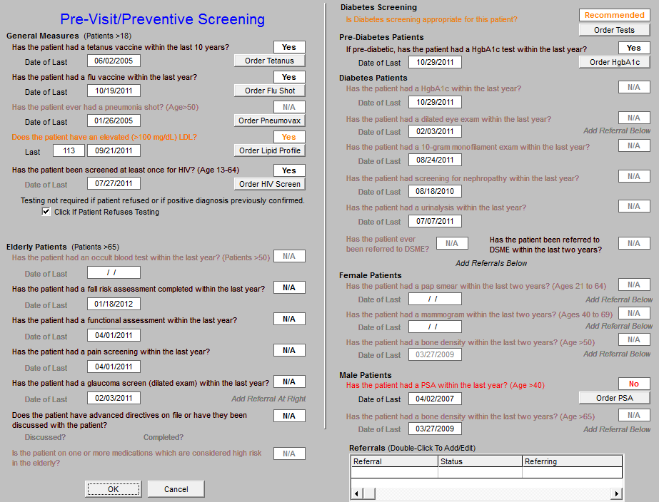
The Future: SETMA as an Example

Slide 38
The Future: SETMA as an Example

Slide 39
The Future: SETMA as an Example
SETMA is able to look at differences between the care of patients who are treated to goal and those who are not. Patients can be compared as to socio-economic characteristics, ethnicity, frequency of evaluation by visits, and by laboratory analysis, numbers of medications, payer class, cultural, financial and other barriers to care, gender and other differences.
This analysis can suggest ways in which to modify care in order to get all patients to goal.

Slide 40
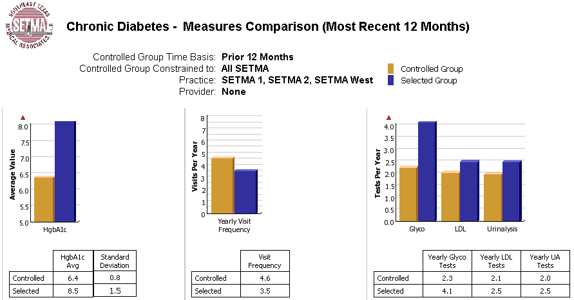
The Future: SETMA as an Example

Slide 41
The Future: SETMA as an Example

Slide 42
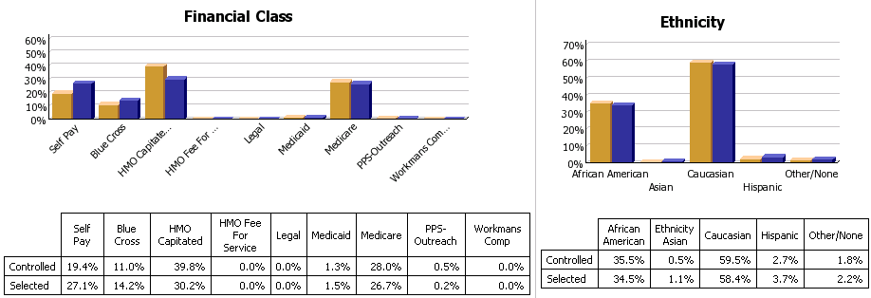
The Future: SETMA as an Example

Slide 43
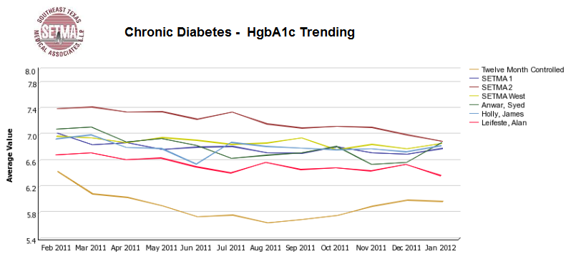
The Future: SETMA as an Example
SETMA can also compare different providers and clinics with one another:

Slide 44
The Future: SETMA as an Example
SETMA’s provider performance is benchmarked against published, evidence-based, national standards of care. Because SETMA has deployed a robust Business Intelligence (BI, COGNOS) solution for data auditing and analytics, and because we have bought multiple licenses, practice leadership, informatics staff and healthcare providers can review performance outcomes.

Slide 45
The Future: SETMA as an Example
SETMA also has monthly peer-review sessions with all providers. The clinic is closed for a morning, and performance on quality metrics, patient satisfaction and gaps in care are discussed openly among all providers. Collegial relationships and an organizational-cultural commitment to excellence make it possible for SETMA to be specific about needs for improvement in these monthly meetings.

Slide 46
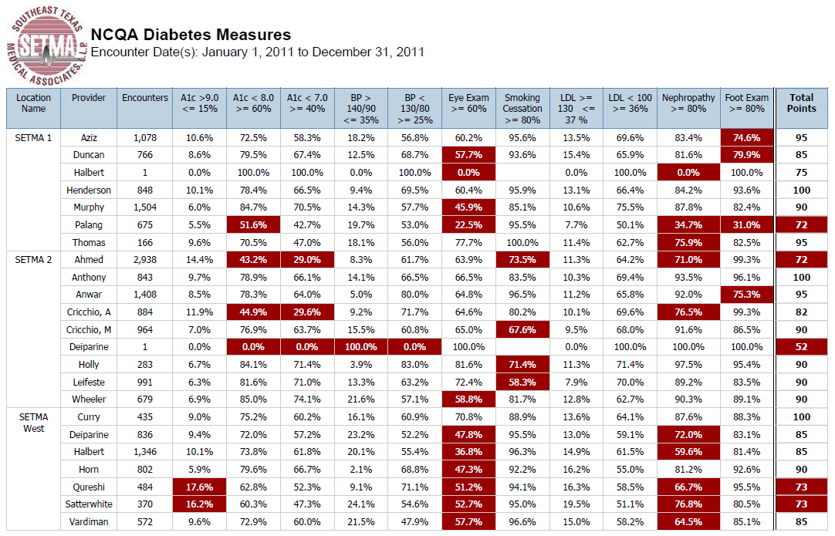
The Future: SETMA as an Example

Slide 47
The Future: SETMA as an Example
Specific dashboards, such as the one above, have also been developed for programs such as the NCQA Diabetes Recognition Program. All SETMA clinics and providers qualified for this recognition in 2010-2013.
Quarterly and annually, we now measure this standard so as to make sure that we continue to improve. As can be seen below, the dashboard gives the metric, the benchmark, the provider’s performance and the aggregate score required for recognition.

Slide 48
The Future: SETMA as an Example
This material is given to the provider and it is posted on our website at www.jameslhollymd.com under Provider Performance, NCQA Diabetes Recognition Program Audit.
Because all deficiencies in care are displayed in “red,” SETMA providers have developed their own commitment to “get the RED out.”

Slide 49
The Future: SETMA as an Example
SETMA also tracks the following published quality performance measure sets:
HEDIS
NQF
AQA
PQRI
BTE
Each is available to the provider, interactively at each patient encounter.

Slide 50
The Future: SETMA as an Example

Slide 51
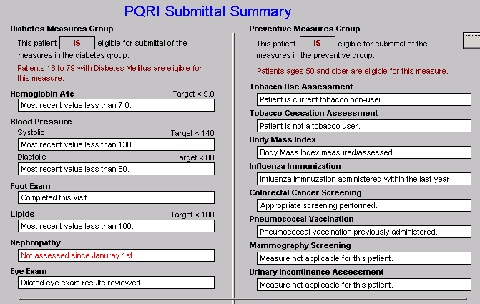
The Future: SETMA as an Example
PQRI

Slide 52
The Future: SETMA as an Example
A “cluster” is seven or more quality metrics for a single condition, i.e., diabetes, hypertension, etc.
A “galaxy” is multiple clusters for the same patient, i.e., diabetes, hypertension, lipids, CHF, etc.
Fulfilling a single or a few quality metrics does not change outcomes, but fulfilling “clusters” and “galaxies” of metrics at the point-of-care can and will change outcomes.

Slide 53
The Future: SETMA as an Example

Slide 54
The Future: SETMA as an Example

Slide 55
The Future: SETMA as an Example
Unlike a single metric, such as “was the blood pressure taken,” which will not improve care, fulfilling and then auditing a “cluster” or a “galaxy of clusters” in the care of a patient will improve treatment outcomes and will result in quality care.

Slide 56
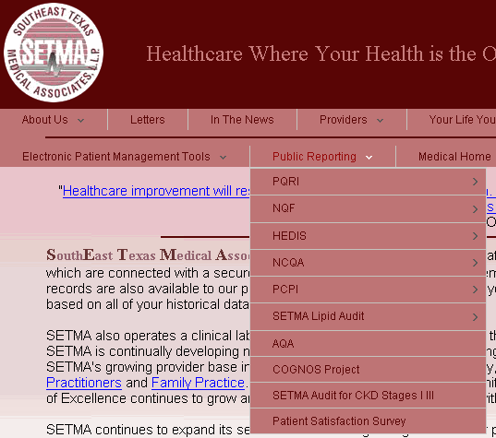
The Future: SETMA as an Example
What is most often missing in quality improvement initiative is real-time, auditing with comparative display of results, and public reporting.

Slide 57
The Future: SETMA as an Example
SETMA employed Business Intelligence (BI) software to audit provider performance and compliance.
SETMA’s BI Project allows all providers to:
Display their performance for their entire patient base
Compare their performance to all practice providers
See outcome trends to identify areas for improvement
See this at the point-of-care

Slide 58
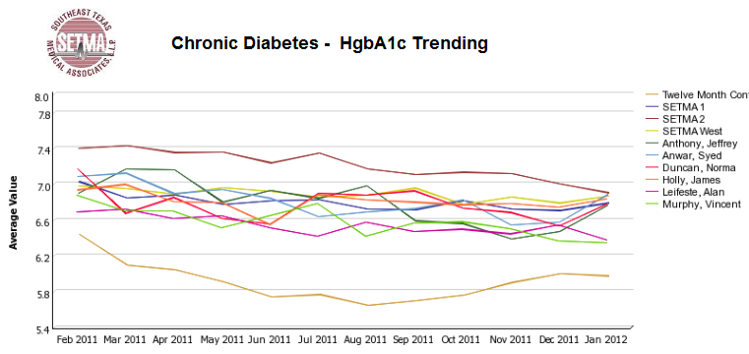
The Future: SETMA as an Example

Slide 59
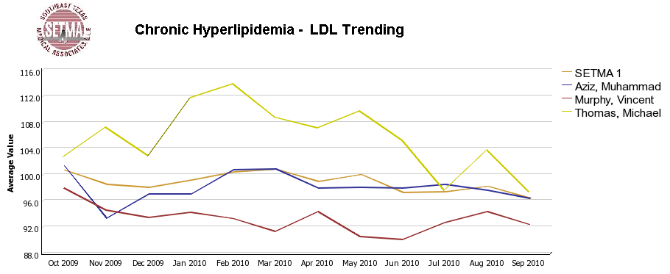
The Future: SETMA as an Example

Slide 60
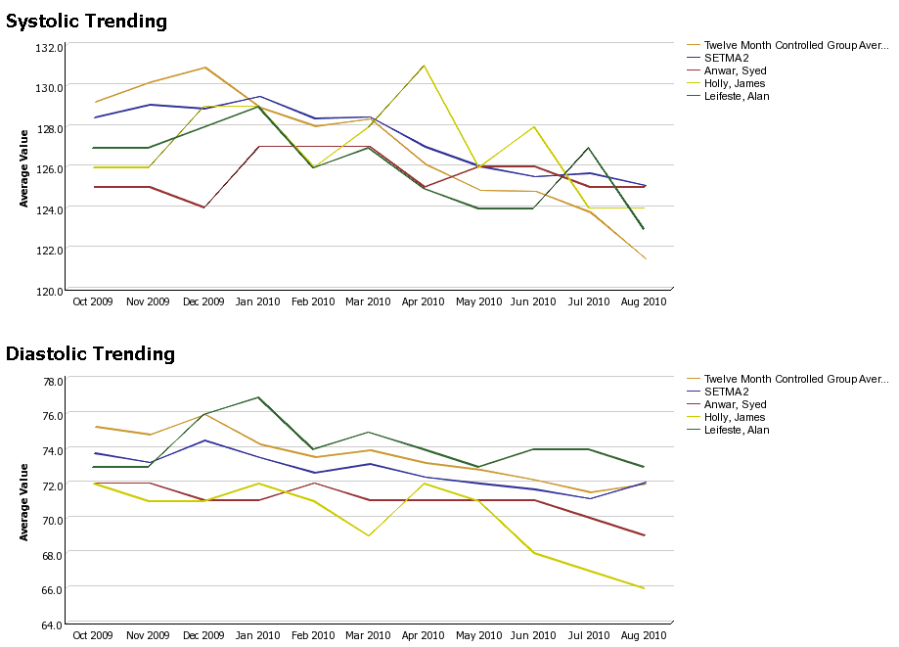
The Future: SETMA as an Example

Slide 61
Auditing Performance After The Visit
Beyond how one provider performs (tracking and auditing), SETMA looks at data as a whole (analyzing) from which to develop new strategies for improving patient care.
We analyze patterns which may explain why one population is not to goal while another is. Some of the parameters, we analyze are:
Frequency of visits
Frequency of key testing
Number of medications prescribed
Were changes in treatments made, if patient not to goal
Referrals to educational programs
Etc.

Slide 62
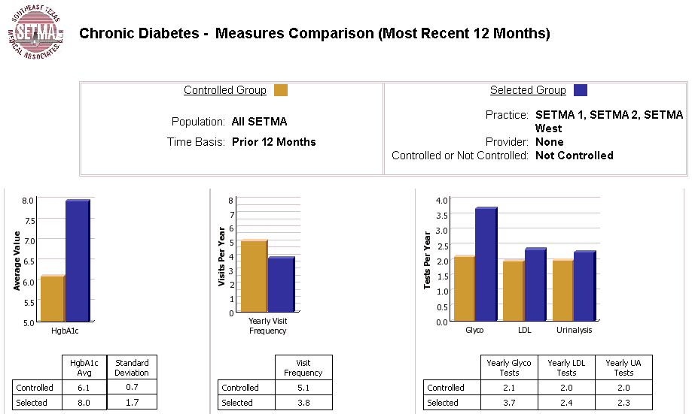
Analyzing Provider Performance

Slide 63
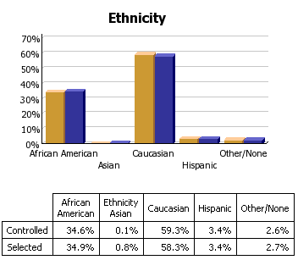
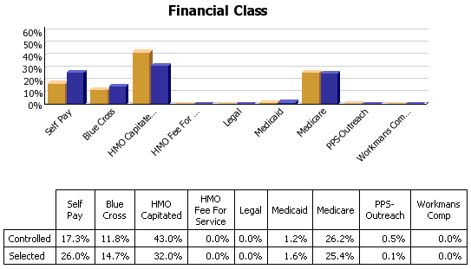
Analyzing Provider Performance

Slide 64
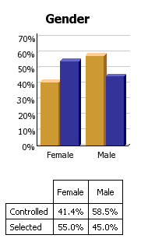
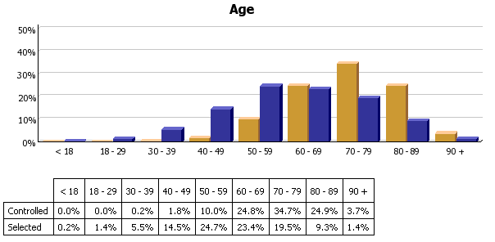
Analyzing Provider Performance

Slide 65
The Future: SETMA as an Example
Raw data can be misleading. For example, with diabetes care, a provider may have many patients with very high HgbA1cs and the same number with equally low HgbA1cs which would produce a misleadingly good average. As a result, SETMA also measures the:
Mean
Median
Mode
Standard Deviation

Slide 66
The Future: SETMA as an Example
SETMA’s average HgbA1c as been steadily improving for the last 10 years. Yet, our standard deviation calculations revealed that a subset of our patients were not being treated successfully and were being left behind.
By analyzing the standard deviation of our HgbA1c we have been able to address the patients whose values fall far from the average of the rest of the clinic.

Slide 67
The Future: SETMA as an Example
One of the most insidious problems in healthcare delivery is reported in the medical literature as “treatment inertia.” This is caused by the natural inclination of human beings to resist change. As a result, when a patient’s care is not to goal, often no change in treatment is made.
To help overcome this “treatment inertia,” SETMA publishes all of our provider auditing (both the good and the bad) as a means to increase the level of discomfort in the healthcare provider and encourage performance improvement.

Slide 68
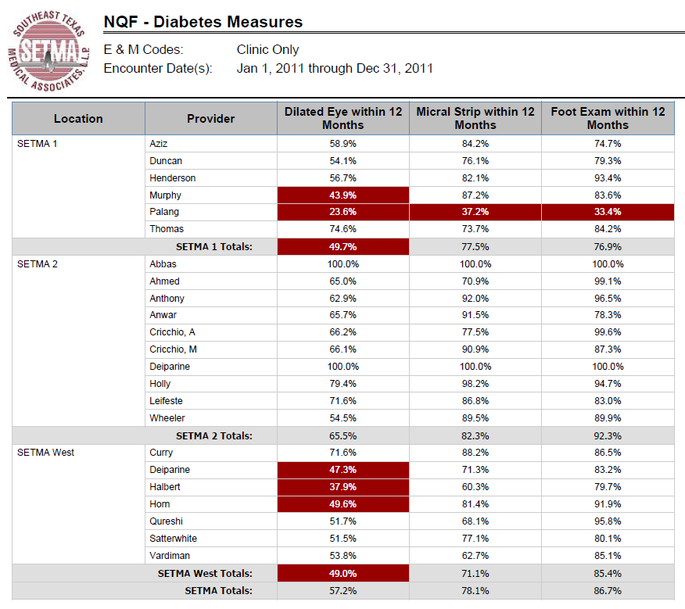
The Future: SETMA as an Example
NQF
Diabetes
Measures

Slide 69
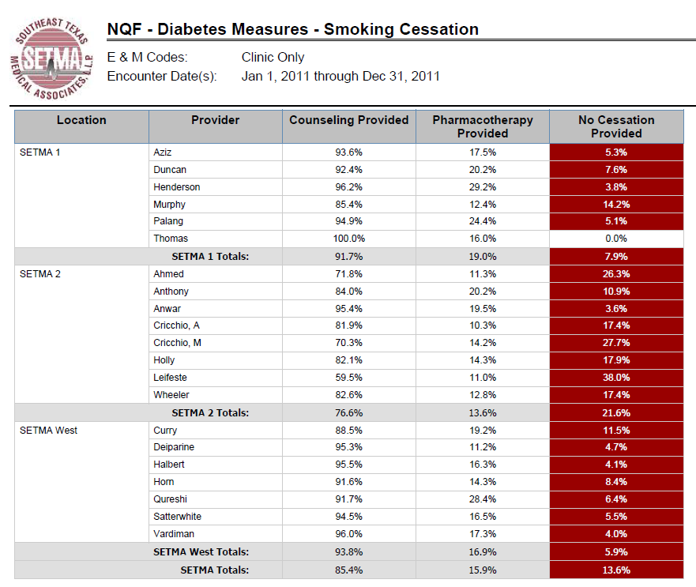
The Future: SETMA as an Example
NQF
Diabetes
Measures

Slide 70
The Future: SETMA as an Example
NCQA Diabetes Recognition

Slide 71
The Future: Personal Mastery
Personal Mastery – the discipline of continually clarifying and deepening our personal vision, of focusing our energies, of developing patience, and of seeing reality objectively – the learning organization’s spiritual foundation. (Peter Senge)
“The essence of personal mastery is learning how to generate and sustain creative tension in our lives.”

Slide 72
The Future: Personal Mastery
“The juxtaposition of vision (what we want) and a clear picture of current reality (where we are relative to what we want) generates what we call ‘creative tension’: a force to bring them together, caused by the natural tendency of tension to seek resolution.”
The willingness to examine where we are in practice quality is the first step to improvement of care.

Slide 73
The Future: Personal Mastery
Quality metrics are a sort of Medical Global Positioning System (GPS).
Outcomes metrics tell us where we want to go.
Performance Audit tells us where we are.
Process metrics gives us guide posts to our goal.

Slide 74
The Future: Personal Mastery
People with a high level of personal mastery share several basic characteristics:
The have a special sense of purpose that lies behind their vision and goals. For such a person, a vision is a calling rather than simply a good idea.
They see current reality as an ally, not an enemy. They have learned how to perceive and work with forces of change rather than resist those forces.

Slide 75
The Future: Personal Mastery
They are deeply inquisitive, committed to continually seeing reality more and more accurately.
They feel connected to others and to life itself.
Yet, they sacrifice none of their uniqueness.
They feel as if they are part of a larger creative process, which they can influence but cannot unilaterally control. (p. 142)

Slide 76
The Future: Personal Mastery
Live in a continual learning mode.
They never ARRIVE!
(They) are acutely aware of their ignorance, their incompetence, their growth areas.
And they are deeply self-confident!

Slide 77
The Future: Flexibility
Few things are as inviting in the future of Primary Care as the ability for groups of healthcare providers to find creative ways in which to balance personal and professional responsibilities.
This is true at all stages of one’s career.

Slide 78
The Future: Flexibility
SETMA has mothers who work part time while they are raising their children.
SETMA has physicians nearing their 80th birthday who still have satisfying and productive careers with flexible hours.
SETMA physicians can participate in all areas of care, or choose to focus on one area, such as the clinic or hospital.
As the roles of informatics, the genome, care management and care coordination grow there will be new opportunities for growth and development.

Slide 79
The Future: Flexibility
SETMA encourages physicians and other healthcare providers to continue their careers as long as they retain the joy of being a physician and as long as they want to partner with patients to improve care, improve health and decrease cost of care.
There has never been a time when the role of the primary-care specialist has been more needed and more professionally satisfying.

Slide 80
The Future: Financing
SETMA is:
Debt Free
Spent more than $7,000,000 on IT infrastructure
Contributes $500,000 a year to the SETMA Foundation through which to pay for the care of our patients who cannot afford it
Has significant cash reserves for capital investments and/or financial needs
Has contingency plans for how to respond to decreasing reimbursement

Slide 81
The Future
It is a great time to be a
healthcare provider and
particularly to be a primary
care provider!!! We can do
more for and with patients than
ever before and in a patient
centered medical home we
are truly doing it together!

