Slide 1
Provider Training Review of Institute For Health Improvement Reducing of Avoidable Rehospitalizations Materials
June 26, 2012
Southeast Texas Medical Associates, LLP

Slide 2
Outline of Presentation
Slides 3 – 85
A review of the four leverage points of IHI’s Transitions of Care for Reducing Rehospitalizations
Slides 86 – 92
SETMA’s tools for fulfilling IHI’s Transitions of Care for Reducing Rehospitalizations
Slides 93 – 101
SETMA’s Points of Leverage

Slide 3
Introduction
The slides which are direct quotes from the IHI document are noted as “(IHI)”. Quotation marks are not used for convenience in this “not-for-publication,” in-house presentation.
Slides that do not have that designation are either conclusions based on the IHI work, or a part of SETMA’s experience.

Slide 4
IHI How-To Guides
IHI also provides additional How-to Guides for:
How-to Guide: Improving Transitions from the Hospital to Post-Acute Care Settings to Reduce Avoidable Rehospitalizations
How-to Guide: Improving Transitions from the Hospital to Skilled Nursing Facilities to Reduce Avoidable Rehospitalizations
How-to Guide: Improving Transitions from the Hospital to Home Health Care to Reduce Avoidable Rehospitalizations (IHI)

Slide 5
Summary of SETMA’s Performance on IHI Standards
During SETMA’s Provider Training in July, August and
September, 2012, we will review each of these in turn. At
the end of this process, we will have a good
understanding of the processes of rehospitalizations.
As we go through the IHI document, I believe, everyone
will be pleased that we had already identified the areas
of maximum leverage for addressing rehospitalizations
detailed by IHI.
We have much to learn but we have also learned much.
We have much to do but we have also done much.
With pride in what we have done and with a relentless
commitment to excellence, we move forward.

Slide 6
Introduction
Improving Transitions from the Hospital to The Clinical Office Practice to Reduce Avoidable Rehospitalizations
Reference: Schall M, Coleman E, Rutherford P, Taylor J. How-to Guide: Improving Transitions from the Hospital to the Clinical Office Practice to Reduce Avoidable Rehospitalizations. Cambridge, MA: Institute for Healthcare Improvement; June 2012. Available at www.IHI.org.

Slide 7
Reducing Rehospitalizations
Poor coordination of care across settings too often results in rehospitalizations, many of which are avoidable. Importantly, working to reduce avoidable rehospitalizations is one tangible step toward achieving broader delivery system transformation.(IHI)
Care Coordination and preventable readmissions are closely linked in national studies, initiatives and in SETMA’s experience.

Slide 8
Reducing Rehospitalizations
Hospitalizations account for nearly one third of the total $2 trillion spent on health care in the United States. In the majority of cases, hospitalization is necessary and appropriate…experts estimate that 20 percent of US hospitalizations are rehospitalizations within 30 days of discharge. (IHI)

Slide 9
Avoidable Rehospitalizations
According to an analysis conducted by the Medicare Payment Advisory Committee (MedPAC), up to 76 percent of rehospitalizations occurring within 30 days in the Medicare population are potentially avoidable. (IHI)
Avoidable hospitalizations and rehospitalizations are frequent, potentially harmful, and expensive, and represent a significant area of waste and inefficiency in the current delivery system. (IHI)

Slide 10
Avoidable Rehospitalizations
It may be possible to reduce the total readmission of a Medicare Population by 15.2% of the current 20%, making the effective readmission rate 4.8%.

Slide 11
Avoidable Rehospitalizations
Research shows that one-quarter to one-third of these patients return to the hospital due to complications that could have been prevented. (IHI)
Unplanned rehospitalizations may signal a failure in:
hospital discharge processes,
patients’ ability to manage self-care, and/or
the quality of care in the next community setting (such as office practices, home health care, and skilled nursing facilities). (IHI)

Slide 12
Reducing Rehospitalizations
Patients are especially vulnerable to adverse events in the period immediately following discharge, and they need immediate access to a trusted clinician who can answer questions, provide advice, and help ensure that their clinical condition remains stable. (IHI)
Too often, patients find themselves on their own after discharge, struggling to manage their medications, monitor their conditions, and follow instructions received at the hospital. (IHI)
Immediate post-discharge contact with providers is crucial for preventing an avoidable readmission, especially among patients with multiple conditions or complicated medication and treatment plans, and those with limited capacity for self-care or access to family or community support. (IHI)

Slide 13
IHI’s Roadmap for Improving Transitions in Care After Hospitalization and Reducing Avoidable Rehospitalizations (IHI)

Slide 14
Process Changes to Achieve an Ideal Transition from Hospital to the Clinical Office Practice (IHI)

Slide 15
Creating an Ideal Transition to the Clinical Office Practice (IHI)
Four recommended changes for improving the transition for the patient from the hospital to the clinical office practice setting by mitigating the typical failures or problem areas associated with this transition”
Provide timely access to care following a hospitalization;
Prior to the visit, prepare the patient and the clinical team;
During the visit, assess the patient and initiate a new care plan or revise an existing care plan; and
At the conclusion of the visit, communicate and coordinate the ongoing care plan. (IHI)

Slide 16
1. Timely Access To Care
Provide Timely Access to Care Following a Hospitalization
Review on a daily basis information received from the hospital about admissions and anticipated discharges.
Provide appropriate level and type of follow-up for high-risk, moderate-risk, and low- risk discharged patients. (IHI)

Slide 17
2. Prior To The Visit
Prior to the Visit: Prepare Patient and Clinical Team
Review the discharge summary.
Clarify outstanding questions with sending physician(s).
Place a reminder call to patient or family caregiver to help them prepare for the visit.
Coordinate care with home health care nurses and case managers if appropriate. (IHI)

Slide 18
3. During The Visit
During the Visit: Assess Patient and Initiate New Care Plan or Revise Existing Plan
Ask the patient about his/her goals for the visit, what factors contributed to hospital admission or ED visit, and what medications he/she is taking and on what schedule.
Perform medication reconciliation with attention to the pre-hospital regimen.
Determine need to adjust medications or dosages, follow up on test results, do monitoring or testing; discuss advance directives; discuss specific future treatments.

Slide 19
3. During The Visit
During the Visit: Assess Patient and Initiate New Care Plan or Revise Existing Plan
Instruct patient in self-management; have patient repeat back.
Explain warning signs and how to respond; have patient repeat back.
Provide instructions for seeking emergency and non-emergency after-hours care. (IHI)

Slide 20
4. At The Conclusion Of The Visit
At the Conclusion of the Visit: Communicate and Coordinate Ongoing Care Plan
Print reconciled, dated medication list and provide a copy to the patient, family, home health care nurse, and case manager, if appropriate.
Communicate revisions of the care plan to the patient, family caregiver, home health care nurse, and case manager, if appropriate.
Ensure that the next appointment is made, as appropriate. (IHI)

Slide 21
1. Timely Access To Care
Recommended Changes:
Provide timely access to care following a hospitalization.
Review on a daily basis information received from the hospital about admissions and anticipated discharges.
Provide appropriate level and type of follow-up for high-risk, moderate-risk, and low-risk discharged patients. (IHI)

Slide 22
1. Timely Access To Care
Nine Typical Failures
Primary or specialty care physician does not know his or her patient has been admitted or discharged because of the lack of an alert system from hospital to office;
Hospital physicians cannot easily reach the office practice physicians because the outpatient physicians are busy with patients in the office or have difficulties with phone access and leaving messages;
Lack of person-to-person contact between hospital and office practice staff is caused by an absence of identified individuals to coordinate communication on each end;

Slide 23
1. Timely Access To Care
Nine Typical Failures
Patient is told to schedule an appointment with his or her primary or specialty care provider, but is confused about whom he or she should see, by when, and why;
Knowledge gap for those patients whose condition rapidly deteriorates with respect to whom to contact for help.
Lack of agreement and clarity about whether hospital or office practice staff are responsible for providing post-discharge phone contact and scheduling home health care services;

Slide 24
1. Timely Access To Care
Nine Typical Failures
Lack of open appointments in the office practice schedule for post-discharge visits within 48 hours;
Information from the primary care physician (i.e., feed forward) about a newly admitted patient is often unavailable to the hospital staff doing the initial admission assessment and medication reconciliation;
Patient discharge information is not standardized with respect to data elements, format, and mode of transmission; each physician may provide different information about the patient at discharge. (IHI)

Slide 25
Diagnostic Worksheet - 1

Slide 26
Diagnostic Worksheet - 2

Slide 27
Check List – Post-Hospital Follow-Up Visits

Slide 28
Laying the Foundation
We recommend that office practices lay the foundation for optimal patient follow-up by:
Jointly designing the discharge summary document with hospital and emergency department physicians
Creating capacity in their clinic schedules to anticipate the need for post-discharge appointments. (IHI)

Slide 29
Joint Design
The primary care practice and the hospitalists and/or other hospital-based clinicians should agree on the content of information about the patient that needs to be shared, the format of the document, and the preferred methods for communication.
The communication system should be designed as a two-way system so that information from the practice to the hospital can occur upon admission and as needed throughout the hospital stay (e.g., medications, prior treatment plans, social support information, etc.) and from the hospital to the practice upon admission, throughout the hospitalization (as needed), and at discharge. (IHI)

Slide 30
Joint Design
The following elements can be included in the agreement or protocol between the two parties:
The timing of communication concerning admission and discharge
How the information will be sent or transmitted (e.g., fax, cell phone, secure e-mail, pager, directly from information system)
Who is responsible for scheduling the post-hospital follow-up visit
What specific information will be included by each party on admission, during hospitalization, and upon discharge in the hospital discharge summary or ED visit summary
Practice and hospital clinicians and/or care-team members may wish to visit each other’s locations as a way to share information about their respective processes and to clarify and refine any communication issues. (IHI)

Slide 31
1. Creating Access
To provide timely access to care following a hospitalization, providers in an office practice must anticipate the needs of each patient and have capacity in their clinic schedules for the appropriate level of contact.
Practices can use a number of strategies for creating capacity in their clinic schedules to anticipate the need for post-discharge appointments. Practices with advanced clinic access systems have open appointment slots each day in their scheduling system to meet the same- day needs of all their patients, including those recently discharge from the hospital. Information on advanced access systems is available at (IHI)

Slide 32
1. Creating Access
Making Changes
Once the practice has systematized communications and
ensured its ability to schedule patients for follow-up visits,
it can then design an optimal system for:
actually providing timely and appropriate care following a hospitalization, and
coordinating with other clinicians and support services for ongoing care. (IHI)

Slide 33
Making Changes in Access
Review on a daily basis information received from the hospital about admissions and anticipated discharges.
Check electronic transmission of information from the hospital or initiate daily contact with a designated hospital contact to obtain and act on information about hospitalized patients;
Contact the designated hospital contact person to (a) clarify any information about patients’ clinical status and needs at discharge, especially patients at high or moderate risk for readmission; and (b) provide any additional information that might be needed about the patient to the hospitalist or hospital-based clinicians; and

Slide 34
Making Changes in Access
Include the hospital report in the patient medical record and share information during daily huddles with the physician and other members of the care team in preparation for the post-discharge visit.

Slide 35
Making Changes in Access
Explore how the primary care physician might participate in the discharge process, e.g., attending the discussions about the patient’s care plan before or during discharge, either in person or remotely.
Explore how the practice can proactively provide the hospital(s) with a list of its high-risk patients so that staff at the hospital(s) can notify the practice on admission.
Schedule regular meetings for the office practice and the hospital key contact to review individual cases and ensure coordination and communication.

Slide 36
Making Changes in Access
Place a liaison from the practice in the hospital. At Family Care Network in Whatcom County, WA, the liaison facilitates the coordination of care by sharing information about the patient with the hospital team, flags the admission in the practice information system, triages anticipated post-discharge issues to the office practice nurse, makes the patient follow-up appointment, and notifies the practice when the patient is discharged. (IHI)

Slide 37
Making Changes in Access
Provide appropriate level and type of follow-up for high-risk, moderate-risk, and low-risk discharged patients. Patients who have been identified by the hospital clinicians as being at:
High risk for readmission should be seen by home health care or a primary care provider within 48 hours after discharge.
Moderate-risk patients should receive a follow-up phone call within 48 hours and be seen by a physician (or other provider) within five days.
Low risk for readmissions, an office visit should be scheduled per order of the discharging physician. (IHI)

Slide 38
Categorization of Risk
High-Risk Patients
Patient has been admitted two or more times in the past year.
Patient is unable to teach back, or the patient or family caregiver has a low degree of confidence to carry out self-care at home.
Moderate-Risk Patients
Patient has been admitted once in the past year.
Patient or family caregiver has a moderate degree of confidence to carry out self-care at home, based on Teach Back results.
Low-Risk Patients
Patient has had no other hospital admissions in the past year.
Patient or family caregiver has high degree of confidence and can teach back how to carry out self-management (IHI)

Slide 39
Post-Discharge Phone Calls
Many hospitals as well as health care plans, home health care agencies, and others are now conducting post-discharge follow-up phone calls with their patients.
An office practice should know who is reaching out to their patients and avoid duplication.
Patient information and educational materials across providers should be consistent, redundant calls reduced, and patients made aware of who will be contacting them, for what purpose, and within what time period. (IHI)

Slide 40
Post-Discharge Phone Calls
A call from a primary care provider ensures that patients are contacted by someone they know and with whom they have a relationship.
This communication provides an opportunity:
To adjust the risk assessment received from the hospital;
Establishes accountability of the practice for the patient;
Ensures continuity in the patient education process that began in the hospital and will now continue in the outpatient setting. (IHI)

Slide 41
Post-Discharge Phone Calls
At Cambridge Health Alliance clinics (Cambridge Health
Alliance, Case Studies, page 66), a primary care practice
nurse contacts high-risk patients within 12-18 hours
following discharge and moderate-risk patients within 48
hours to:
Assess the patient’s medical status,
Review the patient discharge information,
Elicit patient questions and concerns,
Confirm the scheduled follow-up appointment (made while the patient was in the hospital), and
Address other issues, such as medication refills or urgent appointments, as needed. (IHI)

Slide 42
Post-Discharge Appointment
Ideally, patients are given their follow-up appointment before they leave the hospital. To accomplish this, the hospital can notify the practice about the need for an appointment and/or the primary care practice can contact the patient directly while he or she is in the hospital. The latter approach requires informing the practice that one of their patients is in the hospital and will require a follow-up appointment. This can be done through electronic communication, phone, or fax notification. (IHI)

Slide 43
Post-Discharge Appointment Measure
Use this measure to determine the reliability of your processes for providing patients and their outpatient care providers with timely and appropriate care following a hospitalization:
Percent of patients who are seen in an appropriate time frame following a hospitalization:
High Risk -- 24-48 hours
Moderate Risk – 5 days
Low-Risk – at provider discretion (IHI)

Slide 44
2. Prior To The Visit
Review the discharge summary.
Clarify outstanding questions with sending physician(s).
Place a reminder call to the patient or family caregiver to help them prepare for the visit.
Coordinate care with home health care nurses and case managers if appropriate. (IHI)

Slide 45
2. Prior To The Visit
At the time of the first post-discharge office visit, the physician checks that: the treatment plan and medications ordered at discharge match his or her assessment of the patient’s current clinical condition.
The physician and care team also ensure that the patient and family members are actively engaged in creating the care plan and capable of implementing it after discharge. (IHI)

Slide 46
2. Prior To The Visit
Seven Typical Failures
Primary or specialty care physician does not have the patient record, discharge summary, or medication list at hand for follow-up visit;
Outpatient physician may have trouble reaching the hospital-based physician in order to clarify information about the patient’s condition, outstanding tests, and/or treatment plan;
Office practice team may not be aware of barriers for the patient to keeping their appointment (e.g., transportation, reliance on family members, etc.) (IHI)

Slide 47
2. Prior To The Visit
Seven Typical Failures
Outpatient physician does not always coordinate care with case managers or other community-based providers such as home health care nurses;
Patients do not know whom or when to call if their condition worsens;
Patients may not fully understand the importance of the first post-hospital visit; and
Patients have only a partial understanding of what they need to do and why, despite the use of methods to engage them during their hospital stays in learning about their care. (IHI)

Slide 48
2. Prior To The Visit
Recommended Changes
Review the discharge summary.
To adequately re-evaluate the patient’s clinical status, the outpatient physician needs key pieces of information from the discharge summary in preparation for the first post-discharge visit. He or she also needs to be able to obtain additional information from the discharging physician. (IHI)

Slide 49
2. Prior to the Visit
Recommended Changes
Clarify questions with sending physician(s).
As the office practice physician or clinician reviews the discharge information, he/she may have questions for the sending physician. The office practice clinician and the hospitalist or other hospital-based provider should establish a mutually agreed upon method of communication to facilitate the transfer of clarifying information to the office practice physician or other clinician. ..The discussion about the preferred method of communication can occur at the same time that agreement is reached about the transfer of the discharge summary information. (IHI)

Slide 50
2. Prior to the Visit
Recommended Changes
Coordinate care with home health care nurses and case managers if appropriate.
The reminder call to the patient can be made by the physician or another member of the care team. The purpose of the call is to:
Emphasize the importance of the visit and ensure that the patient will be able to come to the office on the day of the appointment (e.g., the patient has transportation, etc.). (IHI)

Slide 51
2. Prior to the Visit
Recommended Changes
Coordinate with home health and case managers
Remind the patient to bring his or her list of medications as well as the medications themselves, both over-the-counter and prescription medications that he or she is currently taking. Short of visiting patients at home, having them bring their medications to the office is the best way to reconcile what the physician thinks they are taking with what they really are taking everyday.
The physician or other care team member can also use the review of the medications to explore patients’ understanding of their medications and reinforce teaching.
Make sure that patients know whom to contact for an emergency or to ask a question about their medications. (IHI)

Slide 52
2. Prior to the Visit
Recommended Changes
Review the discharge summary
In addition to reviewing the discharge information from the hospital, the
office practice physician or clinician may want to obtain information
from home health care nurses or non-clinic-based case managers.
The home health care nurse may have information about the patient’s condition and medications prior to hospitalization,
He or she may have conducted the patient’s first post-hospital visit.
Case managers would also have additional information about the patient’s status at discharge, ability for self-care, and any family or social issues that would affect the physician’s assessment of the patient’s needs.
As with the hospitalist or hospital-based clinician, there should be a process to easily share information between the office practice physician or other care team members and home health care, case managers, and/or other community-based providers or services. (IHI)

Slide 53
2. Prior to the Visit: Suggested Measures
Use these measures to determine the reliability of your
processes for preparing the clinical team prior to the
first post-hospital visit:
Percent of first post-hospital visits when the physician had the discharge summary available at the time of the visit.
Percent of patients who received a reminder call prior to their first post-hospital office visit. (IHI)

Slide 54
3. During The Visit
The first post-hospital visit is a key touch point for patients with their primary care provider (or specialist, depending on the clinical condition and the needs of the patient).
The evidence is mixed concerning the effect of post discharge follow-up visits on readmission rates.
While some studies report that post-discharge visits contribute to lower readmission rates others have not.

Slide 55
3. During The Visit
Recommended Changes
Ask the patient about his/her goals for the visit; what factors contributed to hospital admission or ED visit; and what medications he/she is taking and on what schedule.
Perform medication reconciliation with attention to the pre-hospital regimen.
Determine need to adjust medications or dosages, follow up on test results; do monitoring or testing; discuss advance directives; discuss specific future treatments and/or additional care support that may be needed.
Instruct patient in self-management (repeat back)
Explain warning signs and response (have repeat back.)
Provide instructions for seeking emergency and non-emergency after-hours care. (IHI)
Percent of first post-hospital visits when the physician had the discharge summary available at the time of the visit.
Percent of patients who received a reminder call prior to their first post-hospital office visit.

Slide 56
3. During The Visit
Nine Typical Failures
Primary or specialty care physician does not have the patient record, discharge summary, or medication list at hand for follow-up visit;
Medications are not reconciled during the first post-discharge office visit;
Patients are not involved in decisions about their treatment plan and medications;

Slide 57
3. During The Visit
Nine Typical Failures
Patients are not provided with a comprehensive care plan that they understand and are confident they can follow;
Patients don’t know whom and when to call if their condition worsens in the time after their appointment;
Lack of standardization between the hospital and office practice in information provided and in teaching methods;

Slide 58
3. During The Visit
Nine Typical Failures
Patient education focuses only on medications and excludes other concerns of the patient such as when and how to start exercising and diet;
Patients have only a partial understanding of what they need to do and why, despite the use of methods to engage patients in learning about their care; and
Failure of the office practice care team to recognize and provide support for patients with a low capacity for self-care due to low health literacy, financial barriers, other social problems, alternative health beliefs, substance abuse, or mental illness. (IHI)

Slide 59
3. During The Visit
Recommended Changes
Ask the patient:
About his/her goals for the visit
What contributed to hospital admission or ED(ED) visit
What medications he/she is taking and on what schedule
Starting the visit by asking the patient what is important to him/her helps the physician and the care team to develop a care plan with the patient that will meet his/her needs and that the patient and/or family members have had a role in creating.
The discharge summary does not usually contain information from the patient’s perspective about what contributed to the hospital admission or ED visit. (IHI)

Slide 60
3. During The Visit
Recommended Changes
Perform medication reconciliation with attention to the pre-hospital regimen. During the post-discharge visit, the physician uses information from:
the patient and
the clinical exam, and
relevant information from the patient discharge information
to create a treatment plan and medication list.
Medication reconciliation is an especially important part of this process. Failure to build a reliable process for medication reconciliation that involves the patient and family members can contribute to medication errors and can increase the risk of readmission to the hospital.

Slide 61
3. During The Visit
Recommended Changes
Perform medication reconciliation with attention to the pre-hospital regimen.
A comprehensive medication reconciliation should begin with the physician or nurse practitioner asking the patients to say in their own words what medicines they are taking and when they are taking them.
This is often the best way for the clinician to get accurate information, rather than relying on the discharge medications.
The clinician can identify and address discrepancies based on all relevant information: what the patient says he/she is taking, what was ordered at discharge, and what the medication regimen was prior to the hospitalization.

Slide 62
3. During The Visit
Recommended Changes
Determine need to
Adjust medications or dosages,
Follow up on test results;
Do monitoring or testing;
Discuss advance directives;
Discuss specific future treatments.
The physician creates a treatment and medication plan and with the patient and/or family members, develops a care plan. Based on the discharge summary, the medication reconciliation process, and the clinical exam, the physician will determine the need to adjust medications or dosages, follow up on test results, and order additional monitoring or testing. (IHI)

Slide 63
3. During The Visit
Recommended Changes
Instruct patient in self-management; have patient repeat back. Studies have shown that patients who are actively engaged in managing their care have:
fewer hospitalizations,
enjoy an improved quality of life, and
experience better clinical outcomes.
Engaging and partnering with patients with heart failure can help improve care. Provider assessment and understanding of the patient’s wishes and ability for self-care are crucial steps in engaging patients. The ability to understand and follow the instructions to take medications as prescribed, manage diet and other daily activities, and know when to ask for additional help is an essential component of patient engagement. (IHI)

Slide 64
Teach Back
Teach Back involves asking patients or family caregivers to recall and restate in their own words what they heard during education or other instructions:
The clinician asks in a non-shaming way for the individual to explain in his or her own words what he/she understands.
Once a gap in understanding is identified, the clinician offers additional teaching or explanation followed by a second request for Teach Back.
“Return demonstration” or “show back” is another form of “closing the loop,” in which the clinician asks the patient to demonstrate how he or she will do what was taught. This technique is used routinely in diabetic education and physical therapy. (IHI)

Slide 65
Teach Back
Teach Back involves asking patients or family caregivers to recall and restate in their own words what they heard during education or other instructions:
The clinician assesses the patient’s ability and confidence to perform self-care practices, including use of medications, diet, nutrition, symptom awareness and management, tobacco and alcohol use, activity, and reasons to call the physician (e.g., pain, weight gain, difficulty breathing, or exhaustion).
The clinician documents and communicates information about the patient or family member’s understanding and goals to the care team and incorporates them into the patient’s overall care plan. (IHI)

Slide 66
3. During The Visit
Recommended Changes
Explain warning signs and how to respond; have patient repeat back.
The warning signs that patients should be aware of will differ from condition to condition. Providing patients and family members with easy-to-read instructions and tools can help patients safely monitor their symptoms and know when to contact the physician’s office when appropriate. (IHI)

Slide 67
3. During The Visit
Recommended Changes
Provide instructions for seeking emergency and non-emergency after-hours care.
Patients must not only know when to contact a physician for medical attention; they also need clear instructions on how to do so.
For after-hours care, patients should know who to call and how to communicate that they are in an emergency situation.
If the patient is being seen by multiple providers (e.g., specialists, palliative care, etc.), the providers should coordinate their instructions to the patient in order to eliminate any confusion for the patient and/or family members.
Care team members may consider using what they learn about the patient’s ability to repeat back these instructions for after-hours care as one indication of the patient’s overall ability to self-manage. (IHI)

Slide 68
3. During the Visit: Suggested Measures
Use these measures to determine the reliability of your
processes for conducting the first post-hospital office
visit.
Percent of patients who can teach back the medications they should take at home, including dosage and time.
Percent of patients who can teach back the warning signs they should watch for and how to respond. (IHI)

Slide 69
4. At The Conclusion Of The Visit
Recommended Changes
Communicate and Coordinate the Ongoing Care Plan
Print reconciled, dated medication list and provide a copy to the patient, family caregiver, home health care nurse, and case manager, if appropriate.
Communicate revisions of the care plan to patient, family caregiver, home health care nurse, and case manager, if appropriate.
Ensure that the next appointment is made, as appropriate. (IHI)

Slide 70
4. At The Conclusion Of The Visit
Six Typical Failures
associated with communicating and coordinating the ongoing care plan with patients and across outpatient providers and settings include the following:
Patients leave the office visit with questions about what they should do when they get home (e.g., medications, eating plan, etc.);
Primary care physicians who lack the time or confidence to sufficiently manage the care of patients with complex medical conditions after discharge (e.g., adjusting medications for patients after a specialist visit or consultation or following a hospitalization); (IHI)

Slide 71
4. At The Conclusion Of The Visit
Six Typical Failures
Lack of agreement between specialists and primary care physicians about which physicians are responsible for managing the patient’s condition in the short or long term;
Lack of communication to providers when their patients with multiple conditions are discharged from the hospital;
Poly-pharmacy issues due to prescriptions by multiple providers and a lack of oversight of the patient’s overall medication regimen or treatment plan; and
Home health care agencies, skilled nursing facilities and other supportive services are not provided with an updated care plan for their past/current patients. (IHI)

Slide 72
4. At The Conclusion Of The Visit
What are your typical failures and opportunities for improvement?
Review the findings from Section IV, Step 3 in Identifying Opportunities for Improvement, page 43. Periodically repeat Step 3 to continually learn about opportunities for improvement. Use the Observation Guide: Observing Current Processes for the First Post-Hospital Visit (How-to Guide Resources, page 75).
Tip: Use your findings from the third section of the Observation Guide, which focuses on what happens at the conclusion of the visit. What did you learn? (IHI)

Slide 73
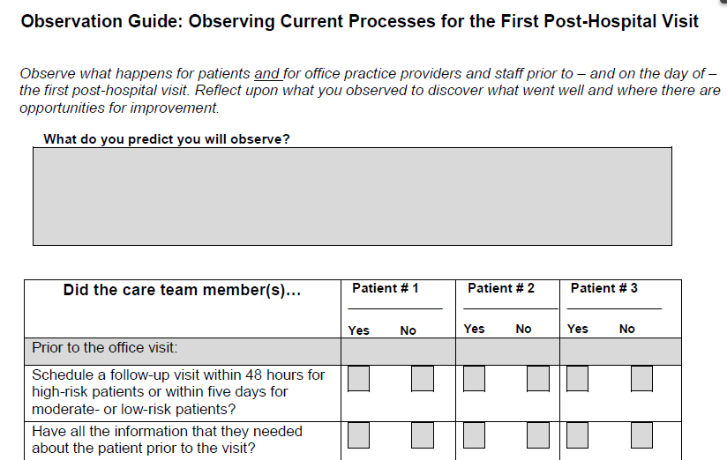
Observation Guide

Slide 74
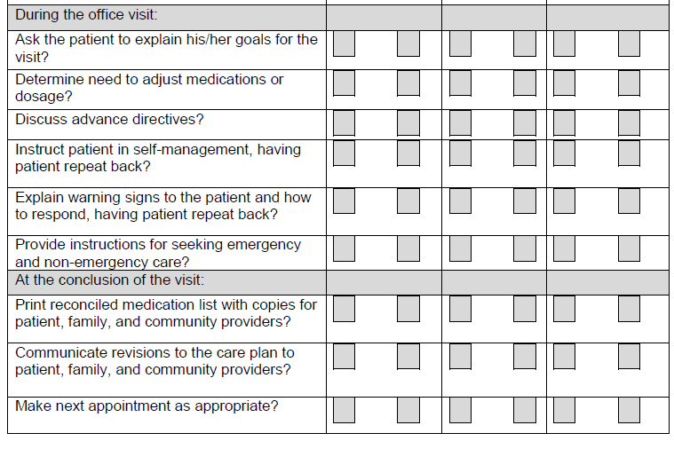
Observation Guide

Slide 75
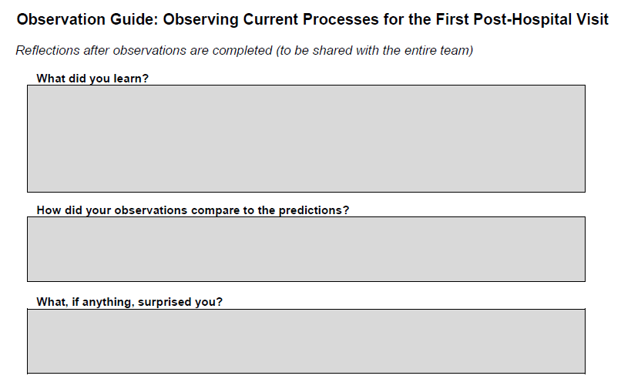
Observation Guide

Slide 76
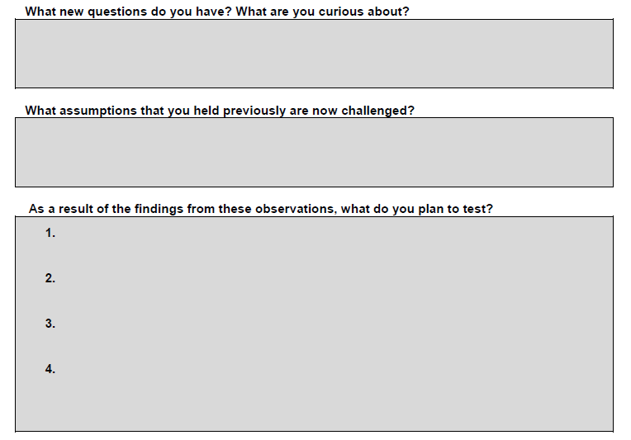
Observation Guide

Slide 77
4. At The Conclusion Of The Visit
Recommended Changes
Print reconciled, dated medication list and provide a copy to the patient, family caregiver, home health care nurse, and case manager, if appropriate.
The reconciliation of medications that the patient was
taking before and after discharge is an important
component of what happens during the office. (IHI)

Slide 78
4. At The Conclusion Of The Visit
Recommended Changes
Communicate revisions to the care plan to the patient, family caregiver, home health care nurse, and case manager, if appropriate. Patients at high risk of readmission often:
have multiple clinical conditions and
are treated by a number of different clinicians.
Following the post-discharge visit, send updated
information about the patient’s treatment plan and
medications, especially any changes in the patient’s
condition and ability to care for him/herself, to all providers
caring for the patient. (IHI)

Slide 79
4. At The Conclusion Of The Visit
Recommended Changes
Communicate revisions to the care plan to the patient, family caregiver, home health care nurse, and case manager, if appropriate.
The office practice should designate a team member to be
responsible for sending the care plan developed at the first
post-discharge office visit as well as the reconciled medical
list to other clinicians and providers in the community,
highlighting any changes in medications since discharge.
Some considerations in developing this process include: (IHI)

Slide 80
4. At The Conclusion Of The Visit
Recommended Changes
Communicate revisions to the care plan to the patient, family caregiver, home health care nurse, and case manager, if appropriate.
Ensure that primary care providers and specialists (and/or others who will be receiving the care plan) agree on a preferred method of communication (e.g., fax, secure e-mail, etc.). More information at.
There should also be a mutually agreed upon method of communication for providers to follow up with each other with questions after the receipt of the care plan. (IHI)

Slide 81
4. At The Conclusion Of The Visit
Recommended Changes
Communicate revisions to the care plan to the patient, family caregiver, home health care nurse, and case manager, if appropriate.
Ensure that all providers agree on a timeframe for the physician who is conducting the post-discharge exam to send an updated care plan the day of the visit.
If the patient is has difficulty reading or understanding instructions, ensure that the physician conducting the post-discharge exam notifies other providers so they can be prepared to better assist the patient during the next interaction. (IHI)

Slide 82
4. At The Conclusion Of The Visit
Recommended Changes
Ensure that the next appointment is made, as appropriate.
At the conclusion of the office visit, the patient should also receive an appointment for his/her next office visit or phone contact.
The care team should also arrange for any additional support services that might be needed following the visit (e.g., behavioral health or substance abuse services, meals on wheels, social support, financial assistance, housing assistance, or help with transportation) and inform the patient of the scheduled services. (IHI)

Slide 83
4. At The Conclusion Of The Visit: Suggested Measures
Use these measures to determine the reliability of your
processes for concluding the first post-hospital office visit:
Percent of patients who leave the first post-hospital visit with a printed and reconciled medication list
Percent of patients who leave the first post-hospital visit with a printed care plan (IHI)

Slide 84
Suggested Process Measures

Slide 85
Flow Chart of Key Changes

Slide 86
SETMA’s Tools for Fulfilling IHI’s Strategy
SETMA has been working on tools for improving care for seventeen years. At HIMSS 2012, my presentation linked below detailed the development of those tools.
http://www.jameslhollymd.com/HiMSS2012-Care-Transitions-The-Heart-of-Patient-Center-Medical-Home.cfm
The tools specifically relevant to IHI’s work are:
1. Hospital Service Team
One or more team members are in the hospital full-time (24/7) to establish continuity of care.
Electronic health record used in the clinic is used in the hospital, emergency department, nursing home, home health, hospice, etc.
Communication with all providers is via a common date base, iPhones, iPads, pagers, telephone, secure web portal and health information exchange.

Slide 87
SETMA’s Tools for Fulfilling IHI’s Strategy
2. Hospital Admission Plan of Care
This is a personalized document which is completed and
given to the appropriate person: patient, family member,
medical power of attorney and/or primary care giver. It consists of:
Reason for Admission
Admission Diagnoses
Estimated Length of Hospitalization
Plan of Care while in Hospital
How to contact Hospital Service Team while in Hospital
This document is automatically generated and is a step in improving patient understanding, engagement and trust in their care.

Slide 88
SETMA’s Tools for Fulfilling IHI’s Strategy
3. Hospital Care Summary and Post Hospital Plan of Care and Treatment Plan (previously called the “Discharge Summary”)
This document is explained at www.jameslhollymd.com under Electronic Patient Management Tools, Hospital Based Tools, Discharge Summary Tutorial.
This document is given to the patient/family/care giver at the time of discharge from the hospital, 98.7% of the time.
This document includes a reconciled medication list, follow-up appointments, instructions for self-care, etc.
This document assesses the patient’s risk of readmission.

Slide 89
SETMA’s Tools for Fulfilling IHI’s Strategy
4. Care Coordination
A Care-Coaching call with further follow-up calls as appropriate is completed the day following discharge from the hospital – 12-30 minute call. This call is scheduled by the hospital service team.
SETMA Foundation resources available for patients who cannot afford medications, co-pays, DME, etc., in order to eliminate financial barriers to care.
Other community resources arranged by Care Coordination Department as needed.
When patient is designated as high-risk for readmission a ten-step process is instituted for supporting the patient.

Slide 90
SETMA’s Tools for Fulfilling IHI’s Strategy
5. Business Intelligence (BI) Analytics
SETMA has adapted a BI product to analyze hospitalized patients, contrasting those who are not readmitted and those who are. This allows the identification of points of leverage for eliminating preventable readmissions. Some of the analytics looks at ethnicity, morbidities, co-morbidities, socio-economic, gender, age, etc.

Slide 91
SETMA’s Tools for Fulfilling IHI’s Strategy
6. Identification of High Risk Patients
Once SETMA, identifies a patient as high-risk for readmission, he/she is entered into a treatment program with ten steps. Slides 30-33 at the following link give the details of that program.
http://www.jameslhollymd.com/Preventable-Hospital-Readmissions-Policy-Problems-Processes.cfm

Slide 92
SETMA’s Tools for Fulfilling IHI’s Strategy
7. PCPI (Physician Consortium for Performance Improvement, AMA) Care Transitions Measurement Set
14 data points and 4 action items make up this quality metric set.
SETMA deployed it in June 2009, when it was published.
SETMA continues to complete 98.7% of the Hospital Care Summary and Post Hospital
Plan of Care at the time the patient leaves the hospital (in 40 months over 13,000 admissions and discharges)

Slide 93
SETMA’s Points of Leverage
The problem of readmissions will not be solved by more care: more medicines, more tests, more visits, etc.
The problem will be solved by redirecting the patient’s attention for a safety net away from the emergency department.
The problem will be solved by our having more proactive contact with the patient.

Slide 94
SETMA’s Points of Leverage
The problem will be solved by more contact with the patient and/or care giver in the home: home health, social worker, provider house calls.
The problem will be solved by the patient and/or care giver having more contact electronically (telephone, e-mail, web portal, cell phone) with the patient giving immediate if not instantaneous access.

Slide 95
SETMA’s Points of Leverage
Seamless Collaboration Between:
Hospital Care Team
Care Coordination Department
I-Care (Nursing Home) Team
Healthcare Providers
Clinic Staff
The key to success is the building of a great
team.

Slide 96
SETMA’s Points of Leverage
Barriers to Deploying some IHI’s Recommendations
Requirements for addition cost in time, personnel and money.
Primary Care Provider attending hospital patient planning conferences
Complexity of getting over-stressed families involved in patients’ care.

Slide 97
SETMA’s Points of Leverage
Changes Based on IHI Recommendations:
Place a follow-up-visit-reminder call to all patients discharged in addition to their care coaching call
Get family actively involved in care before patient leaves the hospital.
Improve the quality of hospital follow-up visits.
Utilize the Observation Guide for Observation of Current Processes for the First Post-Hospital visit to improve the quality and content of that visit.

Slide 98
SETMA’s Points of Leverage
When a person is identified as a high risk for readmissions, SETMA’s Department of Care Coordination is alerted. The following ten steps are then instituted:
Hospital Care Summary and Post Hospital Plan of Care and Treatment Plan is given to patient, care giver or family member.
The post hospital, care coaching call, which is done the day after discharge, goes to the top of the queue for the call – made the day after discharge by SETMA’s Care Coordination Department. It is a 12-30 minute call.

Slide 99
SETMA’s Points of Leverage
Medication reconciliation is done at the time of discharge, is repeated in the care coordination call the day after discharge and is repeated at the follow-up visit in the clinic.
MSW makes a home visit for need evaluation, including barriers and social needs for those who are socially isolated.
A clinic follow-up visit within three days for those at high risk for readmission.

Slide 100
SETMA’s Points of Leverage
A second care coordination call in four days.
Plan of care and treatment plan discussed with patient, family and/or care giver at EVERY visit and a written copy with the patient’s reconciled medication list, follow-up instructions, state of health, and how to access further care needs.
MSW documents barriers to care and care coordination department designs a solution for each.

Slide 101
SETMA’s Points of Leverage
The patient’s end of life choices and code status are discussed and when appropriate hospice is recommended.
Referral to disease management is done when appropriate, along with tele-health monitoring measures.

