Slide 1
SETMA's Initiative to Reduce Preventable Readmissions Readmission Web Summit August 23, 2012
Dr. James L. Holly, CEO
Southeast Texas Medical Associates, LLP
Adjunct Professor, Family/Community Medicine
University of Texas Health Science Center
San Antonio, School of Medicine

Slide 2
National Priorities Partnership
Addressing the fourth NPP goal, the NQF report to HHS stated that in regard to care coordination:
“Healthcare should guide patients and families through their healthcare experience, while respecting patient choice, offering physical and psychological supports, and encouraging strong relationships among patients and the healthcare professionals accountable for their care….”

Slide 3
National Priorities Partnership
Focus in care coordination by NPP are the links between:
Care Transitions— …continually strive to improve care by … considering feedback from all patients and their families… regarding coordination of their care during transitions between healthcare systems and services, and…communities.
Preventable Readmissions— …work collaboratively with patients to reduce preventable 30-day readmission rates.

Slide 4
Care Transitions
SETMA’s Care Transition involves:
1. Evaluation at admission -- transition issues: “lives alone,” barriers, DME, residential care, medication reconciliation, or other needs
2. Fulfillment of Care Transitions Quality Metric Set
3. Hospital Care Summary and Post Hospital Plan of Care and Treatment Plan at discharge
4. Post Hospital Follow-up Coaching -- a 12-30 minute call made by members of SETMA’s Care Coordination Department and additional support
5. Follow-up visit with primary provider – the last and critical step in Care Transitions

Slide 5
1. Evaluation At Admission
Barriers to Care including support requirements – does the patient live alone
Activities of Daily Living
Hospital Plan of Care given to patient/family -- includes potential for re-hospitalization, estimated length of stay, why hospitalized, expected length of hospitalization, procedures and tests planned, contact information for how to call hospital-team members.
Establishes communication with all who are involved in patient's care

Slide 6
2. Fulfillment of Quality Metric Sets
June 2009, PCPI published Transitions of Care Quality Metric Set (14-4)
SETMA has completed “Discharge Summaries “ in ambulatory EMR since the year 2000.
Adopted Measurement set immediately
Public reporting by provider name at www.jameslhollymd.com of performance on quality metric sets for 2009, 2010, 2011 and 2012.
In 2011 completed research project with AMA to determine if SETMA fulfilling measures.

Slide 7
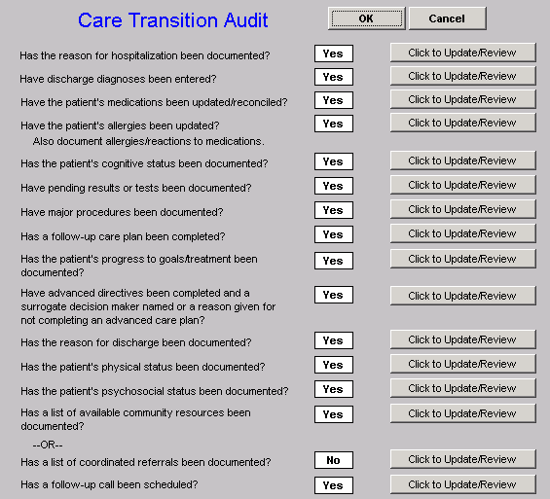
Care Transition Audit

Slide 8
Care Transition Audit

Slide 9
3. Hospital Care Summary & Post-Hospital Plan of Care and Treatment Plan
Changed name of “discharge summary,” September, 2010
Includes follow-up appointments, reconciled medication lists (4 reconciliations: admission, discharge, care coaching call, follow-up appointment.)
Over 14,000 discharges since June 2009; 98.7% of time, document given to patient at time of discharge.
This is the tool – the Baton – transferring care to patient.

Slide 10
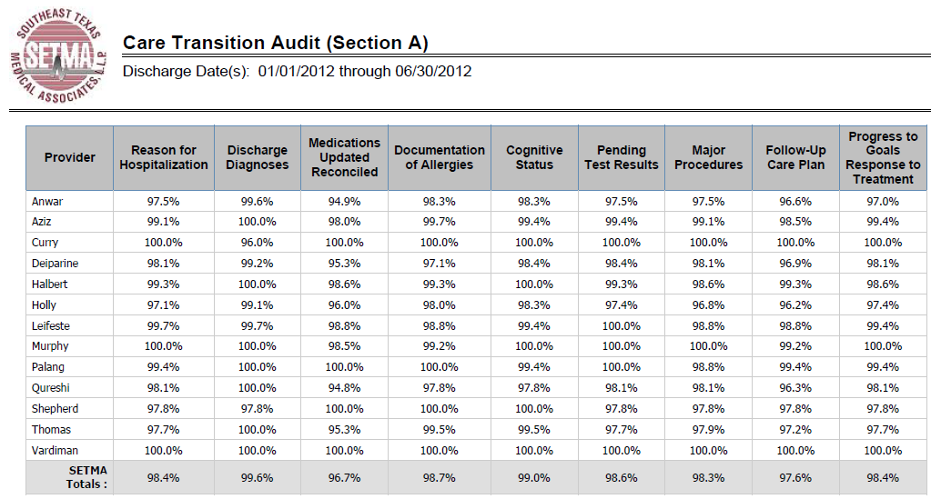
Care Transition Audit

Slide 11
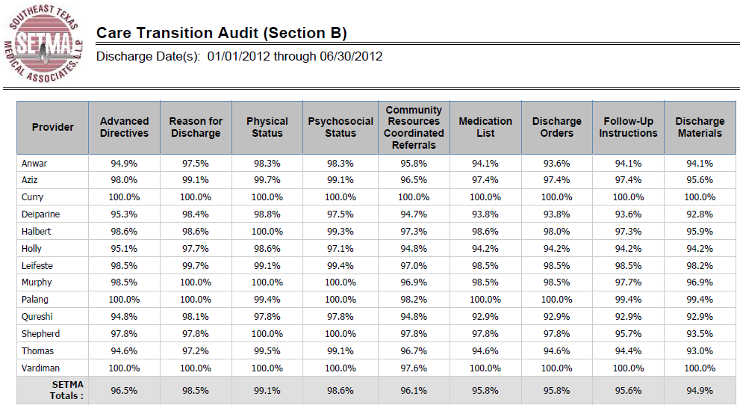
Care Transition Audit

Slide 12
4. Hospital Follow-Up Call
A 12-30 minute call made by members of SETMA’s Care Coordination Department the day after discharge
If after three telephone attempts, contact is not made a letter is automatically generated for mailing to the patient.
Additional phone calls, or other interventions can be scheduled by care coordination department
Results of the follow-up phone call are sent back to the healthcare provider.
If problems are discovered, immediate appointment is given.

Slide 13
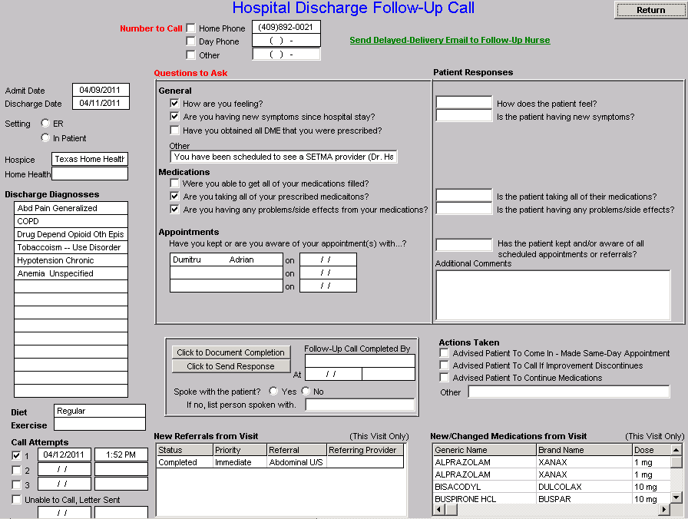
Hospital Follow-Up Call
After the care transition audit is completed and the document is generated, the provider completes the Hospital-Follow-up-Call template.

Slide 14
5. Follow-Up Visit with Primary Care Provider
Care Transition is not complete until patient seen by primary care physician within 3-6 days
If patient misses the appointment they are immediately contacted by Care Coordination.
Two things appear to contribute to improvement in re-hospitalization rates: coaching call and timely follow-up visit.
If patient is vulnerable and anxious a call from the primary care physician can be made before the first visit.

Slide 15
IHI Reference
Rutherford P, Nielsen GA, Taylor J, Bradke P, Coleman E. How-to Guide: Improving Transitions from the Hospital to Community Settings to Reduce Avoidable Re-hospitalizations. Cambridge, MA: Institute for Healthcare Improvement; June 2012.
Available at www.IHI.org

Slide 16
Improved Transition & Reception
Institute for Healthcare Improvement
An improved transition out of the hospital (and from post-acute care and rehabilitation facilities) as well as
An activated and reliable reception into the next setting of care such as a primary care practice, home health care agency, or a skilled nursing facility.

Slide 17
Activated Receivers
Institute for Healthcare Improvement
An example of an activated receiver is a physician‘s office with a specified process for scheduling post-hospital follow-up visits within 2 to 4 days of discharge.
Although the care that prevents re-hospitalization occurs largely outside of the hospital, it starts in the hospital.

Slide 18
Key Changes to Improve Transitions
Institute for Healthcare Improvement
Perform an Enhanced Assessment of Post-Hospital Needs
Involve the patient, family caregiver(s), and community provider(s) as full partners in completing a needs assessment of the patient‘s home-going needs.
Reconcile medications upon admission.
Create a customized discharge plan based on the assessment.

Slide 19
Key Changes to Improve Transitions
Institute for Healthcare Improvement
Ensure Post-Hospital Care Follow-Up
Assess the patient‘s medical and social risk for readmission and finalize the customized discharge plan.
Prior to discharge, schedule timely follow-up care and initiate clinical and social services as indicated from the assessment of post-hospital needs and the capabilities of patients and family caregivers.

Slide 20
Key Changes to Improve Transitions
Provide Real-Time Handover Communications
Give patient and family members a patient-friendly post-hospital care plan that includes a clear medication list.
Provide customized, real-time critical information to the next clinical care provider(s).
For high-risk patients, a clinician calls the individual(s) listed as the patient‘s next clinical care provider(s) to discuss the patient‘s status and plan of care.

Slide 21
Risk of Readmissions
The Journal of Hospital Medicine recently published a pair of studies in which researchers analyzed data from California and Austria to determine the risk factors of hospital readmission.
Medicare
Medicaid
African American Race
Inpatient use of narcotics
Inpatient use of corticosteroids
Cancer with and without metastasis
Renal Failure
Congestive Heart Failure
Weight loss

Slide 22
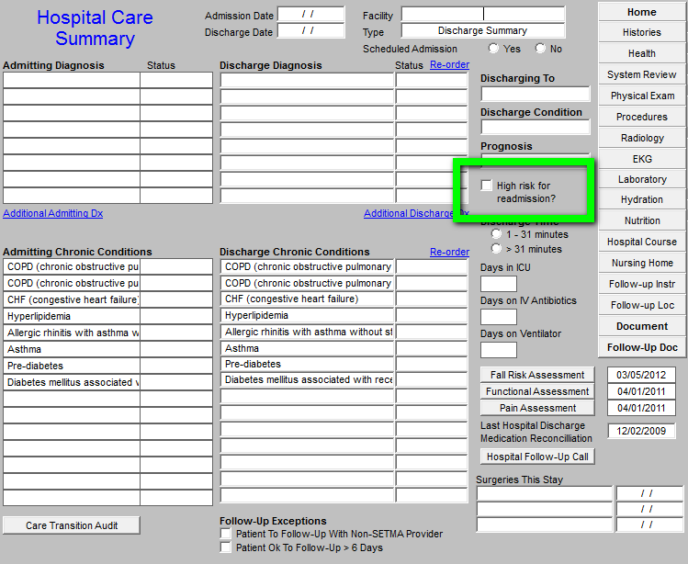
Hospital Care Summary

Slide 23
Managing High Risk Patients
When a person is identified as a high risk for readmissions, SETMA’s Department of Care Coordination is alerted. The following ten steps are then instituted:
Hospital Care Summary and Post Hospital Plan of Care and Treatment Plan is given to patient, care giver or family member.
The post hospital, care coaching call, which is done the day after discharge, goes to the top of the queue for the call – made the day after discharge by SETMA’s Care Coordination Department. It is a 12-30 minute call.

Slide 24
Managing High Risk Patients
Medication reconciliation is done at the time of discharge, is repeated in the care coordination call the day after discharge and is repeated at the follow-up visit in the clinic.
MSW makes a home visit for need evaluation, including barriers and social needs for those who are socially isolated.
A clinic follow-up visit within three days for those at high risk for readmission.

Slide 25
Managing High Risk Patients
A second care coordination call in four days.
Plan of care and treatment plan discussed with patient, family and/or care giver at EVERY visit and a written copy with the patient’s reconciled medication list, follow-up instructions, state of health, and how to access further care needs.
MSW documents barriers to care and care coordination department designs a solution for each.

Slide 26
Managing High Risk Patients
The patient’s end of life choices and code status are discussed and when appropriate hospice is recommended.
Referral to disease management is done when appropriate, along with telehealth monitoring measures.

Slide 27
Managing High Risk Patients
Currently, SETMA’s determination of whether patients are high risk for readmissions is based on an algorithm published by IHI, which is principally based on frequency of admissions.
SETMA is designing a “predictive model” for identifying patients at high risk for readmissions and instituting the above plan for interdicting a readmission. This is an attempt to quantify the most effective opportunities for decreasing preventable readmissions.

Slide 28
Managing High Risk Patients
SETMA has deployed a business intelligence software program to contrast and compare patients who are readmitted with those who are not for:
Age
Gender
Diagnoses and co morbidities
Socio-economic circumstances
Ethnicity
Follow-up visit within six days or not
Care Coaching call completed, etc.
.

Slide 29
The Baton
The following picture is a portrayal of the “plan of care and treatment plan” which is like the “baton” in a relay race.

Slide 30
The Baton
“The Baton” is the instrument through which responsibility for a patient’s health care is transferred to the patient or family. Framed copies of this picture hang in the public areas of all SETMA clinics and a poster of it hangs in every examination room. The poster declares:
Firmly in the provider’s hand --The baton -- the care and treatment plan Must be confidently and securely grasped by the patient, If change is to make a difference 8,760 hours a year.

Slide 31
The Baton
The poster illustrates:
That the healthcare-team relationship, which exists between the patient and the healthcare provider, is key to the success of the outcome of quality healthcare.
That the plan of care and treatment plan, the “baton,” is the engine through which the knowledge and power of the healthcare team is transmitted and sustained.
That the means of transfer of the “baton,” which has been developed by the healthcare team, is a coordinated effort between the provider and the patient.

Slide 32
The Baton
That typically the healthcare provider knows and understands the patient’s healthcare plan of care and the treatment plan, but without its transfer to the patient, the provider’s knowledge is useless to the patient.
That the imperative for the plan – the “baton” – is that it must be transferred from the provider to the patient, if change in the life of the patient is going to make a difference in the patient’s health.

Slide 33
The Baton
That this transfer requires that the patient “grasps” the “baton,” i.e., that the patient accepts, receives, understands and comprehends the plan, and that the patient is equipped and empowered to carry out the plan successfully.
That the patient knows that of the 8,760 hours in the year, he/she will be responsible for “carrying the baton,” longer and better than any other member of the healthcare team.

Slide 34
Hospital Follow-Up Call
After the care transition audit is completed and the document is generated, the provider completes the Hospital-Follow-up-Call template.

Slide 35
Follow-Up Call
During that preparation of the “baton,” the provider checks off the questions which are to be asked the patient in the follow-up call.
The call order is sent to the Care Coordination Department electronically. The day following discharge, the patient is called.
The call is the beginning of the “coaching” of the patient to help make them successful in the transition from the inpatient setting.

Slide 36
Conclusions
The problem of readmissions will not be solved by more care: more medicines, more tests, more visits, etc.
The problem will be solved by redirecting the patient’s attention for a safety net away from the emergency department.
The problem will be solved by our having more proactive contact with the patient.

Slide 37
Conclusions
The problem will be solved by more contact with the patient and/or care giver in the home: home health, social worker, provider house calls.
The problem will be solved by the patient and/or care giver having more contact electronically (telephone, e-mail, web portal, cell phone) with the patient giving immediate if not instantaneous access.

Slide 38
Keys to Success
Seamless Collaboration Between:
Hospital Care Team
Care Coordination Department
I-Care (Nursing Home) Team
Healthcare Providers
Clinic Staff
Hospital In-Patient Staff

