Slide 1
The SETMA Model of Patient-Centered Medical Home
Steps of Designing the Future
Dr. James L. Holly, MD
CEO, Southeast Texas Medical Associates, LLP
August 25, 2010

Slide 2
SETMA’s Steps
Key to our PC-MH is SETMA’s Model of Care:
Personal Performance Tracking – one patient at a time
Auditing of Performance – by panel or by population
Analysis of Provider Performance -- statistical
Public Reporting by Provider Name – www.jameslhollymd.com
Quality Assessment and Performance Improvement

Slide 3
Step I - Provider Performance Tracking
SETMA currently tracks the following Physician Consortium for Performance Improvement (PCPI) measurement sets:
Chronic Stable Angina
Congestive Heart Failure
Diabetes
Hypertension
Chronic Renal Disease
Weight Management
Care Transitions

Slide 4
Step I - Provider Performance Tracking
SETMA also currently tracks the following published quality performance measure sets:
HEDIS
NQF
AQA
PQRI
BTE
Each is available to the provider interactively within the EHR at the time of the encounter.

Slide 5
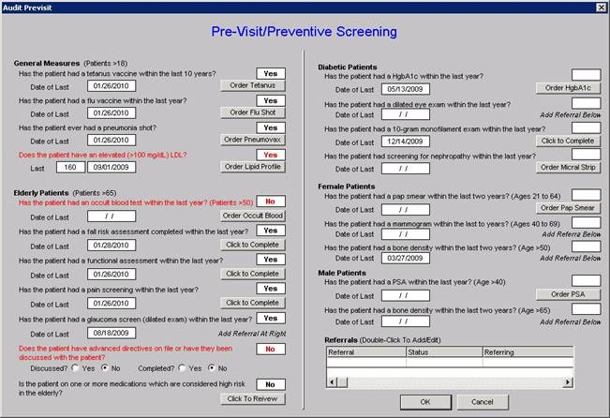
Step I - Provider Performance Tracking
A pre-visit screening tool allows each provider to assess quality measures for each patient at each encounter.

Slide 6
Step I - Provider Performance Tracking
HEDIS

Slide 7
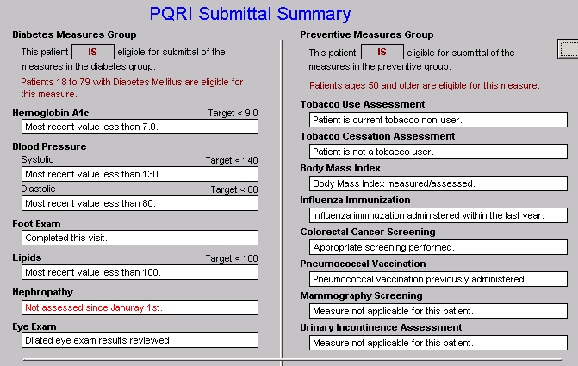
Step I - Provider Performance Tracking
PQRI

Slide 8
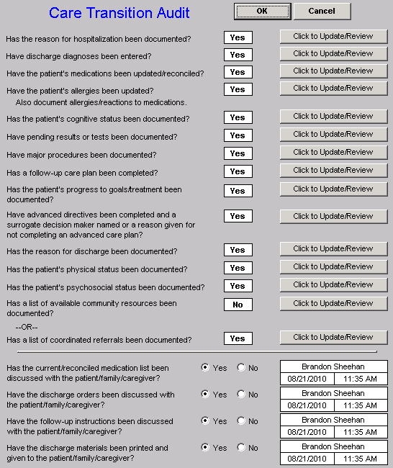
Step I - Provider Performance Tracking
Care
Transition
Audit

Slide 9
Step I - Provider Performance Tracking
Bridges to Excellence

Slide 10
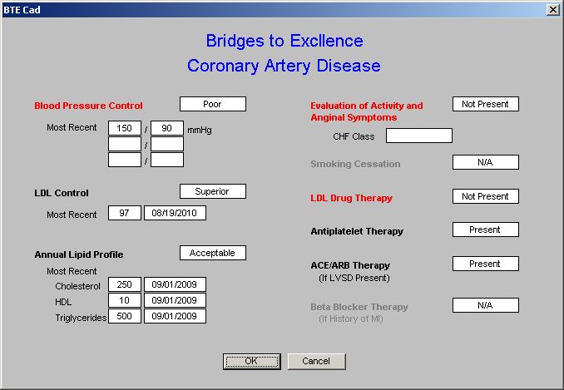
Step I - Provider Performance Tracking
Bridges to Excellence

Slide 11
Step II -- Auditing Provider Performance
SETMA employed IBM’s Business Intelligence software, Cognos to audit provider performance and compliance after patient encounters.
Cognos allows all providers to:
Display their performance for their entire patient base
Compare their performance to all practice providers
See outcome trends to identify areas for improvement

Slide 12
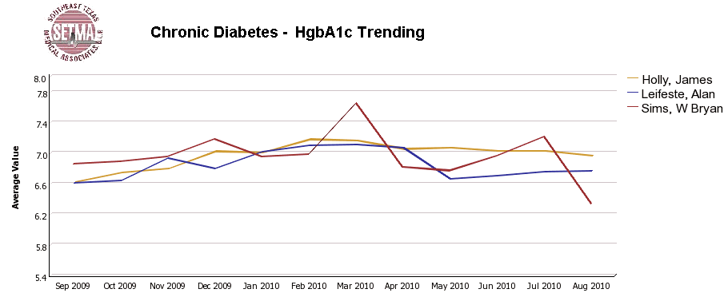
Step II -- Auditing Provider Performance

Slide 13
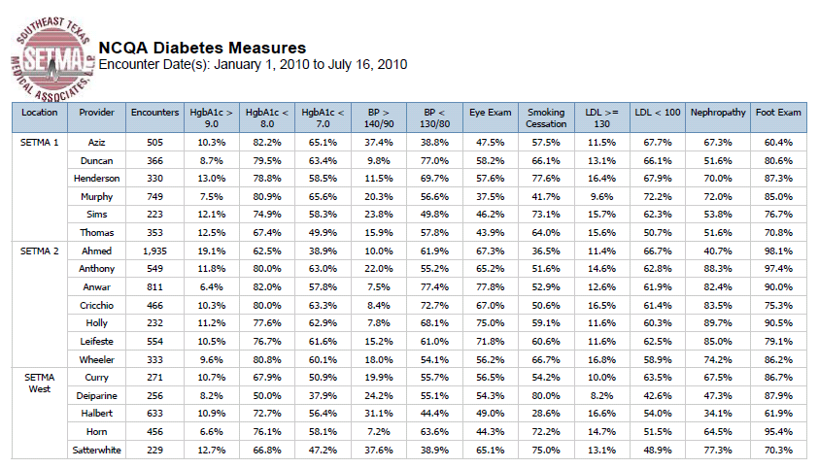
Step II -- Auditing Provider Performance

Slide 14
Step III -- Analyzing Performance
Beyond how one provider performs (auditing) we look at data as a whole (analyzing) to develop new strategies for improving patient care.
We analyze patterns which may explain why one population is not to goal while another is. Some of the parameters, we analyze are::
Frequency of visits
Frequency of key testing
Number of medications prescribed
Changes in treatments if any, if patient not to goal
Referrals to educational programs

Slide 15
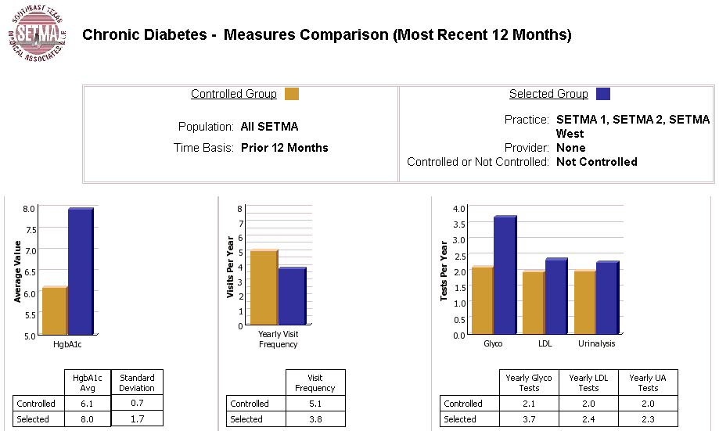
Step III -- Analyzing Performance

Slide 16
Step III -- Analyzing Performance
Raw data can be misleading. For example, with diabetes care, a provider may have many patients with very high HgbA1cs and the same number with equally low HgbA1cs which would produce a misleadingly good average. As a result, SETMA also measures the:
Mean
Median
Mode
Standard Deviation

Slide 17
Step III -- Analyzing Performance
SETMA’s average HgbA1c as been steadily improving for the last 10 years. Yet, our standard deviation calculations revealed that a small subset of our patients were not being treated successfully and were being left behind.
As we have improved our treatment and brought more patients to compliant levels, we have skewed our average.
By analyzing the standard deviation of our HgbA1c we have been able to address the patients whose values fall far from the average of the rest of the clinic.

Slide 18
Step IV - Public Reporting of Performance
One of the most insidious problems in healthcare delivery is reported in the medical literature as “treatment inertia.” This is caused by the natural inclination of human beings to resist change. As a result, when a patient’s care is not to goal, often no change in treatment is made.
To help overcome this “treatment inertia,” SETMA publishes all of our provider auditing (both the good and the bad) as a means to increase the level of discomfort in the healthcare provider and encourage performance improvement.

Slide 19
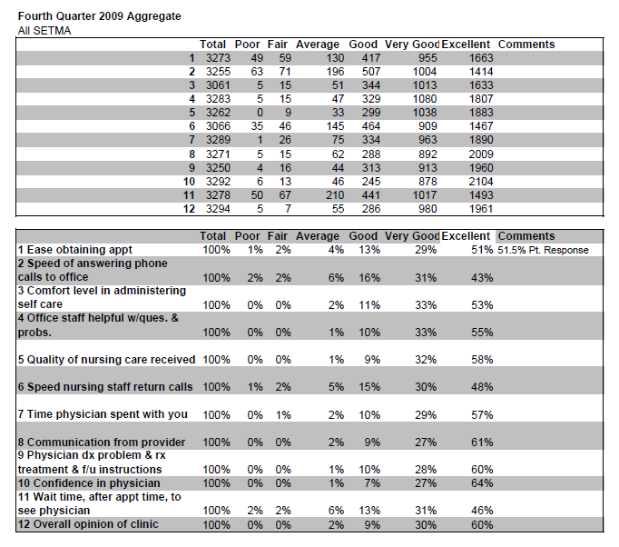
Step IV - Public Reporting of Performance
Published patient satisfaction survey results.

Slide 20
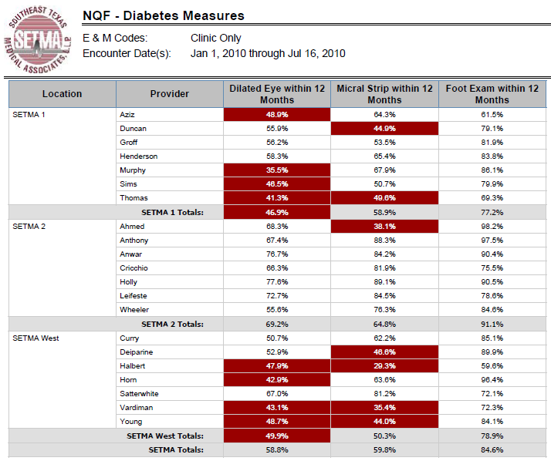
Step IV - Public Reporting of Performance
NQF
Diabetes
Measures

Slide 21
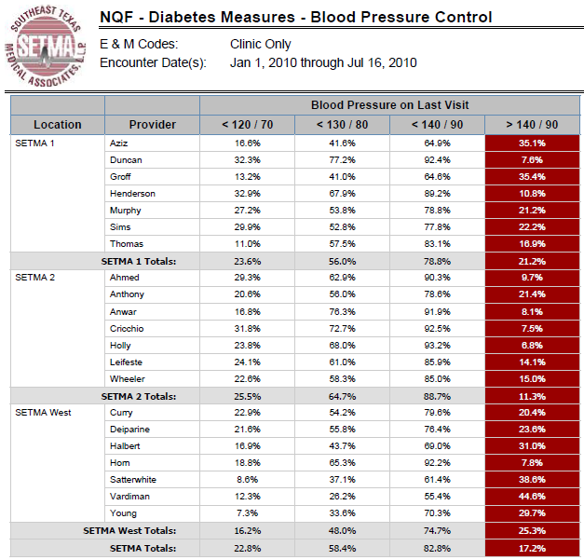
Step IV - Public Reporting of Performance
NQF
Diabetes
Measures

Slide 22
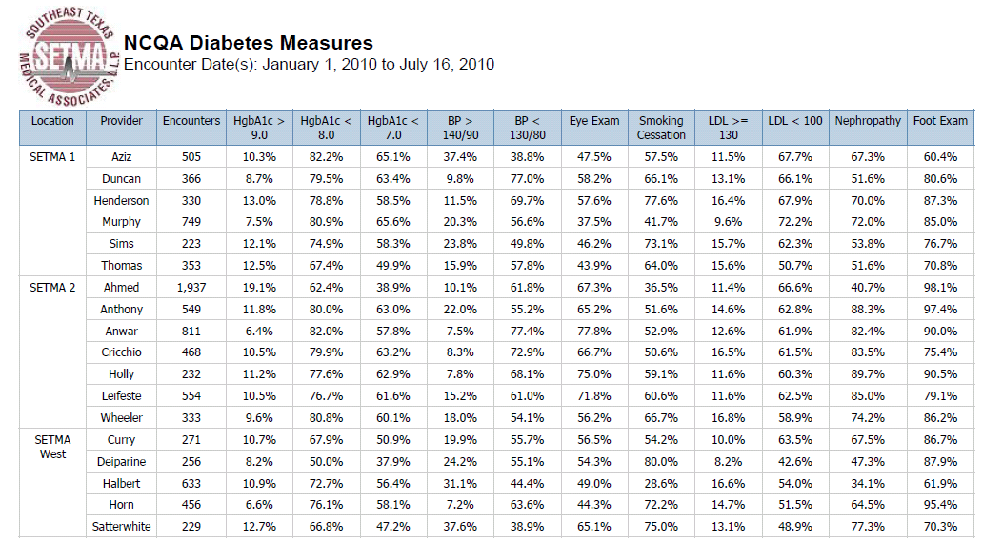
Step IV - Public Reporting of Performance
NCQA Diabetes Recognition

Slide 23
Step V -- Quality Assessment & Performance Improvement
Quality Assessment and Performance Improvement (QAPI) is SETMA’s roadmap for the future. With data in hand, we can begin to use the outcomes to design quality initiatives for our future.
We can analyze our data to identify disparities in care between
Ethnicities
Socio-Economic Groups
Age Groups
Genders

Slide 24
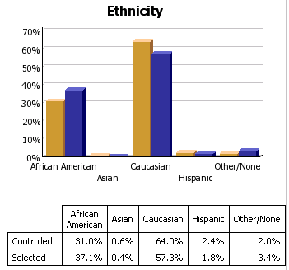
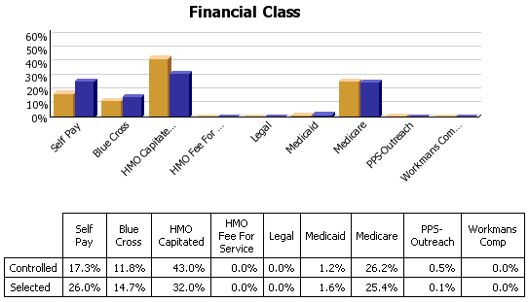
Step V -- Quality Assessment & Performance Improvement

Slide 25
Summary - SETMA Model of Care
With the evidenced-based, science foundation of
SETMA’s Model of Care, Coordination and Integration
of Care, with the deployment of NextGen’s NextMD @
and Health Information Exchange@, continue to
place the patient at the center of all healthcare delivery
in SETMA’s PC-MH.

Slide 26
Coordination of Care
“Coordination” has come to mean to SETMA,
“specialized scheduling” which translates into:
Convenience for the patient, which
Results in increased patient satisfaction, which contributes to
The patient having confidence that the healthcare provider cares personally, which
Increases the trust the patient has in the provider, all of which,

Slide 27
Coordination of Care
5. Increases compliance in obtaining healthcare services recommended which,
Promotes cost savings in travel, time and expense of care which
Results in increased patient safety and quality of care.

Slide 28
Director of Coordinated Care
SETMA’s Director of Coordinated Care is responsible for
building a Department of Care Coordination.
This could be called the “Marcus Welby Department,” as it recognizes the value of each patient as an individual, and has as its fundamental mission the meeting of their healthcare needs and helping them achieving the degree of health which each person has determined to have.
The driving force of care coordination is to make each patient feel as if they are SETMA’s ONLY patient where all their questions are answered, all their needs are met and their care meets all quality standards presently known.

Slide 29
The Transformation
SETMA’s Model of Care is the power source of
SETMA’s Patient-Centered Medical Home. We
believe this model will transform our delivery of
healthcare and is a model worthy of being
adopted by others.
The Partners, Providers and Staff
SETMA, LLP
www.jameslhollymd.com

