Slide 1
The Convergence of Public Health Ethics and Primary Care
Routine HIV Testing in Healthcare
Bexar County HIV Routine Testing Summit
Thursday, June 6, 2013
The Bright Shawl
819 Augusta Street, San Antonio Texas 78215
James L. Holly, MD
CEO SETMA, LLP
www.jameslhollymd.com

Slide 2
Ethics and Economics
The World Health Organization addressed the so-called 10:90 divide, whereby less than 10% of medical research is devoted to diseases that account for more than 90% of the global burden of disease.
Driving this agenda is a concern for the most disadvantaged populations, which are disproportionately affected by infectious diseases.

Slide 3
Infectious Disease and Survival
“…infectious disease warrants more attention from bioethicists.
The 'Black Death' eliminated one third of the European population during the 14th Century;
The 1989 flu killed between 20 and 100 million people; and,
In the 20th Century smallpox killed perhaps three times more people than all the wars of that period…
AIDS, multi-drug resistant tuberculosis, and emerging infectious diseases such as SARS) continue to have dramatic consequences. “
Bioethics. 2005 Jun;19(3):272-89.Ethics and infectious disease. Centre for Value, Ethics & Law in Medicine, Sydney, Australia.

Slide 4
Public Safety, Security and Liberty
“A second reason why the topic of infectious disease deserves further attention is that it raises difficult ethical questions of its own.
While infected individuals can threaten the health of other individuals and society as a whole, for example, public health care measures such as surveillance, isolation, and quarantine can require the infringement of widely accepted basic human rights and liberties.” (IBID)

Slide 5
Utilitarian and Libertarian
An important and difficult ethical question asks how
to strike a balance between:
utilitarian aim of promoting public health, on the one hand, and
libertarian aims of protecting privacy and freedom of movement, on the other, in contexts involving
diseases that are--to varying degrees—contagious, deadly, or otherwise dangerous.

Slide 6
Infectious Disease and Justice
The burden of infectious diseases is most heavily shouldered by the poor (in developing countries); therefore, infectious diseases involve issues of justice--which should be a central concern of ethics.

Slide 7
Victim and Vector
“…practice and policy must recognize that a patient with a communicable infectious disease is not only a victim of that disease, but also a potential vector - someone who may transmit an illness that will sicken or kill others.”
“Bioethics has failed to see…that the patient is both victim and vector at one and the same time.”
The Patient as Victim and Vector: Ethics and Infectious Disease Margaret P Battin, Leslie P Francis, Jay A Jacobson and Charles B Smith

Slide 8
The History
Since the emergence of HIV in the late 1970s, a major public health focus has been the identification of individuals who are positive for HIV in order to control its spread.
What has not been so obvious is that there is an ethical and moral imperative for the screening and diagnosis of HIV.

Slide 9
Prevention Is Best
As with any disease, prevention is the best strategy for the control of HIV infection; the good news is that with proper treatment HIV-positive individuals are living normal lives. In addition, the stereotype that only homosexuals and drug users can “get” HIV and that they all die quickly is not true.

Slide 10
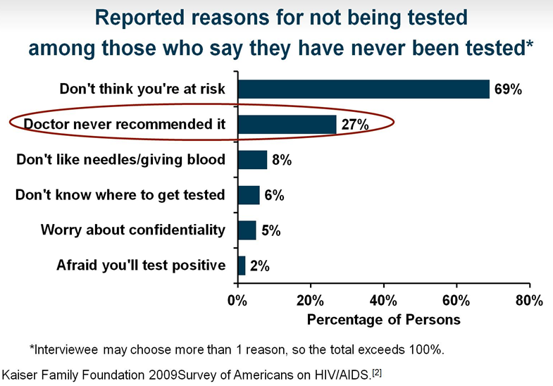
Why Do People Not Get Tested?

Slide 11
Ethics of HIV Screening
Public Health initiatives will not succeed without the participation of all members of the public.
Ethics involves making right and wrong, i.e., moral, choices.
Particularly, in regard to HIV testing, ethics dictates that everyone should be screened.
In regard to HIV screening, the moral behavior is to be tested.

Slide 12
How do ethics and morals differ
Ethics and morals both relate to “right” and “wrong” conduct.
However, ethics refer to the series of rules provided to an individual by an external source. e.g. their profession.
On the other hand, morals refer to an individual’s own principles regarding right and wrong.

Slide 13
Ethics and Morals
Ethics
The rules of conduct recognized in respect to a particular class of human actions or a particular group, culture, etc. It defines how thing are according to the rules. External (social system)
Morals
Principles or habits with respect to right or wrong conduct. It defines how things should work according to an individuals' ideals and principles.
/External Internal (individual)

Slide 14
Public Health Implications
Regardless of your age, you should be screened for HIV and after age 13 your children should be screened. This is not only important for your children’s health in the off chance…they could have contracted the infection, but it is also important, because in being tested and in having your children tested, you contribute to an important pubic health need.

Slide 15
CDC: HIV Screening Recommendations
For patients in all healthcare settings:
HIV screening is recommended for patients in all healthcare settings after the patient is notified that testing will be performed unless the patient declines (opt-out screening).
Persons at high risk for HIV infection should be screened for HIV at least annually.
Separate written consent for HIV testing should not be required; general consent for medical care should be considered sufficient to encompass consent for HIV testing.
Repeat screening of persons not likely to be at high risk for HIV should be performed on the basis of clinical judgment.
Branson BM, et al.

Slide 16
Routine Testing Benefits Everyone
No one has the right to act unethically and everyone is obligated to conduct their health in a way that contributes to the good of the community.
By being tested and by allowing your children to be tested, you advance the good of all.
Even when you are negative for HIV, your participation in screening adds to the public health.

Slide 17
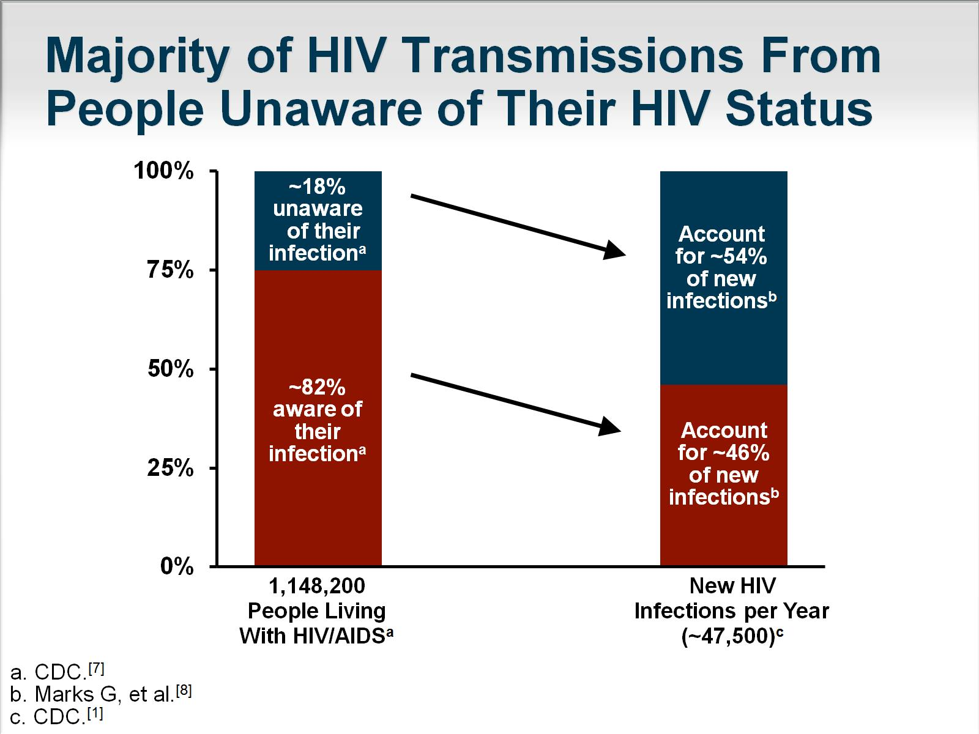
Majority of HIV Transmissions From People Unaware of Their HIV Status

Slide 18
Evolving Approach to HIV Screening
Approach to HIV screening in healthcare setting has evolved over the past 5 to 7 years.
One example: local EDs -- Mid-1990s, 50% testing under special circumstances; 3% had routine testing;
More recent large surveys (2009-2010) -- >80% provide testing; Nearly 25% of all EDs have systematic testing
But barriers still exist at patient, provider, and systems levels.

Slide 19
Barriers to HIV Screening:
Patient Perspective
Most patients accept HIV screening in accordance with 2006 CDC recommendations
  Patient self-requested and physician recommendation highly associated with being tested
  Stefan MS, et al.
Patients may not perceive a need for HIV testing despite engaging in high-risk behaviors
  Highlights need for patient education to increase awareness of HIV-related risk factors and benefits of universal screening
  Pisculli ML, et al.

Slide 20
Barriers to HIV Screening:
Provider Perspective
Increased incorporation of HIV screening into practice in recent years, but barriers still exist:
Concerns about lack of time to offer the test, counsel and link patient to care
Concerns about ability to facilitate linkage to care
Educational gaps
  Lack of communication skills to offer the test or deliver a positive test result
  Insufficient knowledge about the HIV prevalence in patient population
  Korthuis PT, et al.

Slide 21
Barriers to HIV Screening:
System’s Needs Barriers
Champions to build support for routine testing at institutional level
Provider and administrator education to understand importance and value of HIV screening
Legal constraints -- documentation, testing regulations, laboratory process
Fractured healthcare system impedes efficient linkage to care
Financial constraints

Slide 22
A New Task for SETMA’s Providers
Texas Department of State Health Services
HIV/ASTD Prevention and Care Branch
In Collaboration with the
Center for Disease Control
Promoting Annual HIV
Screening for ages 13-64

Slide 23
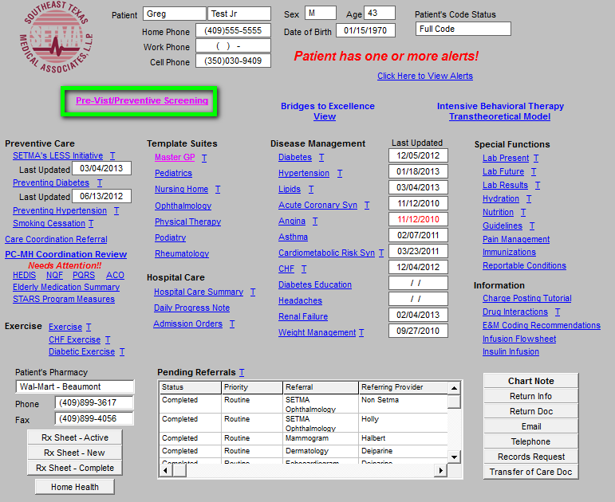
HIV Screening Tool in EMR

Slide 24
HIV Screening Tool in EMR
When the button outlined in green above is deployed, it launches SETMA’s Pre Visit Screening and Prevention template.
This is where every visit at SETMA begins. The legend is:
Any item in red applies to the patient and has not been done.
Any item in black applies to the patient and has been done.
Any item in grey does not apply to the patient.

Slide 25
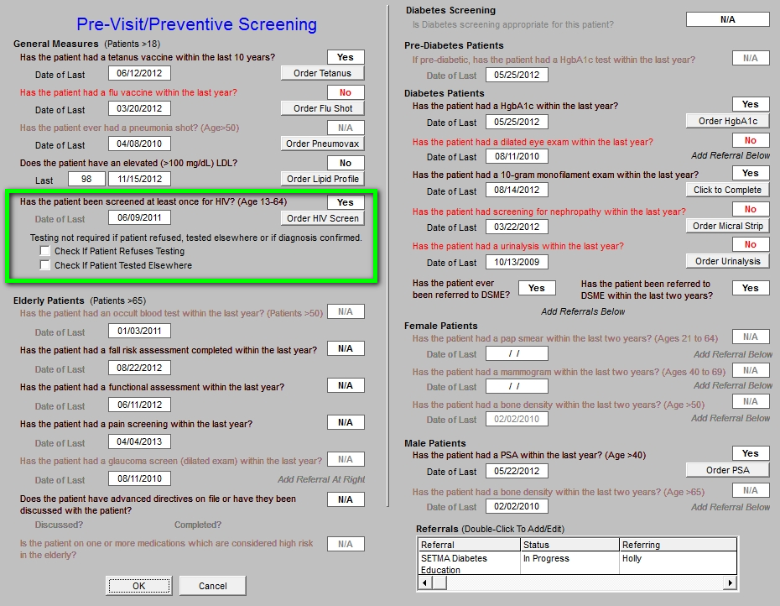
HIV Screening Tool in EMR

Slide 26
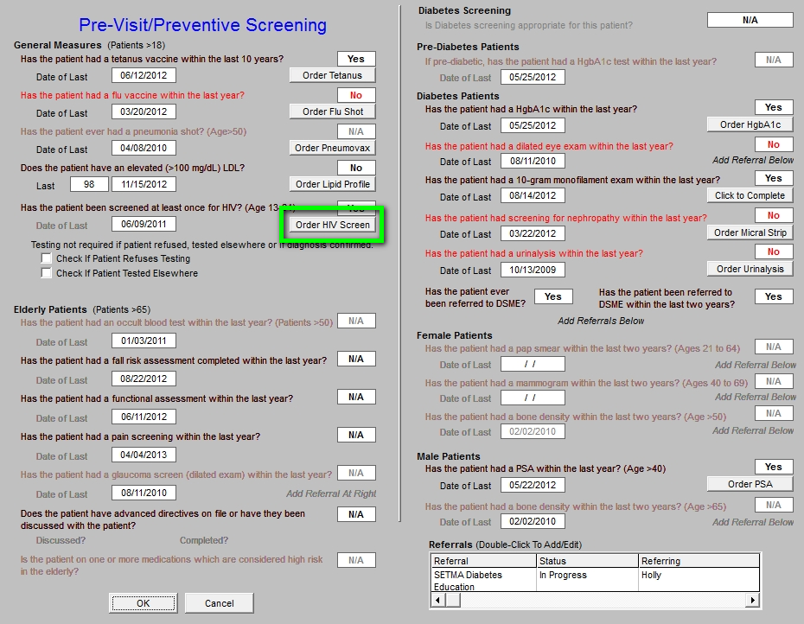
HIV Screening Tool in EMR

Slide 27
HIV Screening Tool in EMR
On the template above, when the button outlined in green is clicked, the following happens:
    The HIV test is ordered.
    The order is sent to the chart, billing and the lab.
    Determines whether the patient's insurance will pay for test, or if bill goes to state grant (this was prepared when it was still thought that SETMA would participate in the CDC program).
    Release is automatically populated with patient information.
    The consent form is printed.

Slide 28
HIV Screening Tool in EMR
Outlined in green below is a function whereby the provider can denote that the patient refuses HIV testing, or that the patient has been tested in the past.
When the patient has previously been tested, the patient’s report of the result is recorded and an effort is made to obtain the documentation of the laboratory result.

Slide 29
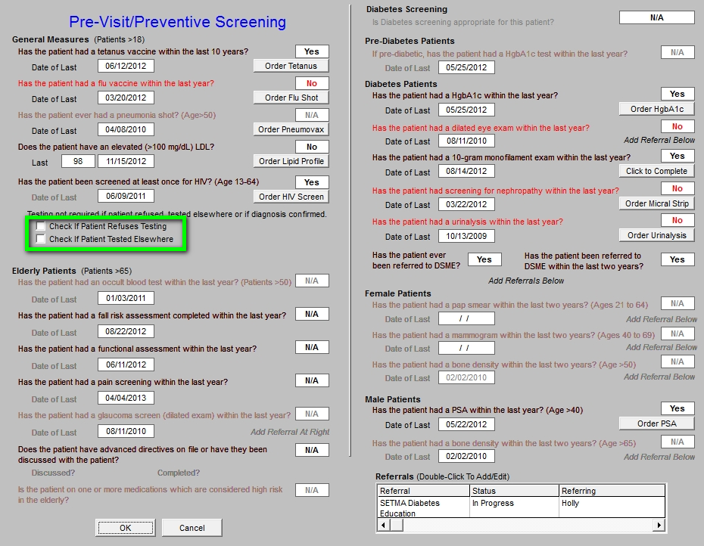
HIV Screening Tool in EMR

Slide 30
HIV Screening Tool in EMR
SETMA uses the same EMR and database in the hospital and clinic, and one of our major hospitals participates in the screening program, therefore, we capture HIV testing done outside of SETMA.
This eliminates redundant testing and increases provider compliance with the screening protocol.
The following slides show the method by which hospital-HIV testing is captured so that it interacts actively with SETMA’s entire data base, i.e., HIV test done at Baptist Hospital will be captured in SETMA’s audit of performance.

Slide 31
HIV Screening Tool in EMR
In September, 2010, SETMA changed the name of the “discharge summary” to “Hospital Care Summary and Post Hospital Plan of Care and Treatment Plan.” In the past 3 years, SETMA has discharged over 14,000 patients from the hospital. 98.7% of the time the Summary and Plan has been received by the patient prior to leaving the hospital.
In the template above and those to follow, we demonstrate how test results are captured in SETMA’s EMR from the hospital for continuity of care including HIV Screening.

Slide 32
Texas State Reportable Conditions
Simultaneously, with the development and deployment of the HIV Clinical Decision Support tool, SETMA developed a tool for enhancing our compliance with Texas State Reportable Conditions.
Two of those reportable conditions are HIV and AIDS.
This tool is the link between HIV Screening and provider responsibility to report confirmed positive outcomes to the Texas Department of State Health Services.

Slide 33
Texas State Reportable Conditions
April 30, 2011, Dr. Edward J. Sherwood, Professor of Medicine at the Texas A&M School of Medicine delivered a CME lectured entitled, “The Ethics of Infectious Disease.”* He distributed a publication of the Texas Department of State Health Services
which detailed 78 reportable conditions. The list included HIV and AIDS.
Rather than ask providers to memorize 78 conditions, SETMA designed a Clinical Decision Support tool to do this reporting electronically.
*This lecture was the best CME lecture I have ever heard.

Slide 34
Texas State Reportable Conditions
SETMA’s Information Technology department was charged with designing a functionality which would:
Display the reportable conditions for provider review.
Detail the time frame for reporting each disease.
Automatically, denote on the reportable conditions template the diagnosis which is identified by the provider when it is documented on the assessment template in the EMR.
Simultaneously, with number three, send an e-mail to SETMA’s Care Coordination Department which would report the condition to the State.
The fact that the reporting requirement has been completed will be reported to the provider and will be stored in the EMR in a searchable fashion.

Slide 35
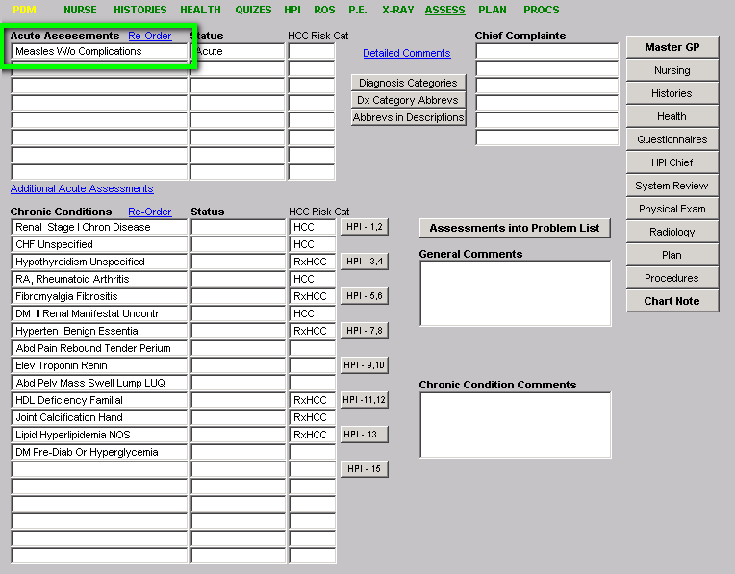
Texas State Reportable Conditions

Slide 36
Texas State Reportable Conditions
As seen above, outlined in green, the provider completes the assessment of the patient.
When that assessment documents a reportable condition, including HIV or AIDS, the provider’s responsibility for complying with Texas Reportable Conditions is done.
The following template shows the diagnoses of “measles” documented on SETMA’s electronic version of the Texas State Department of Health Services Reporting Guidelines.

Slide 37
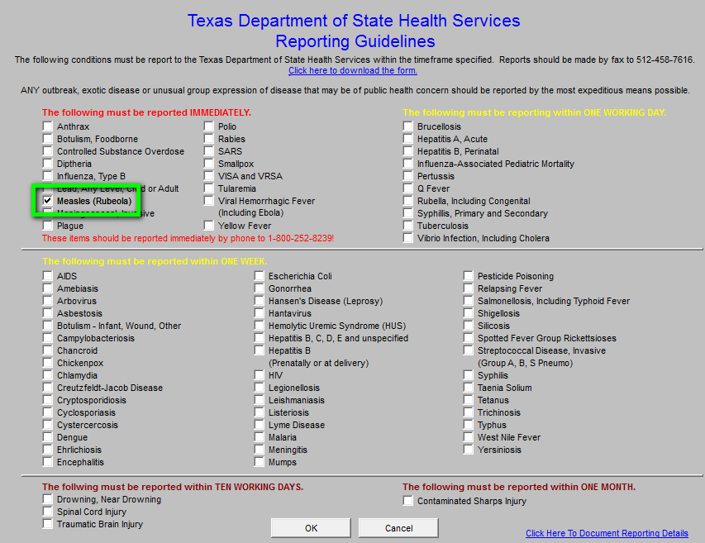
Texas State Reportable Conditions

Slide 38
Texas State Reportable Conditions
The checking of “measles” was done automatically when the ICD-9 code (soon to be ICD-10) was selected in the assessment of the patient.
SETMA’s electronic version of the Texas State Department of Health Services Reporting Guidelines is also an excellent educational tool as the provider can review the reportable-conditions template without a diagnosis.
Principle: What a healthcare provider must remember, i.e., 78 reportable conditions, can often be forgotten; however, when the provider does not have to remember those conditions, they often don’t forget them.

Slide 39
Texas State Reportable Conditions
When the button on SETMA’s AAA Home template, outlined in green below, is deployed, the Texas State Department of Health Services Reporting Guidelines template appears.
The template can be used as a review for providers or nurses of what needs to be reported and/or to note that the diagnosed infectious condition, in this case “measles,” has been automatically checked as a result of the provider having selected this diagnoses on the assessment template.

Slide 40
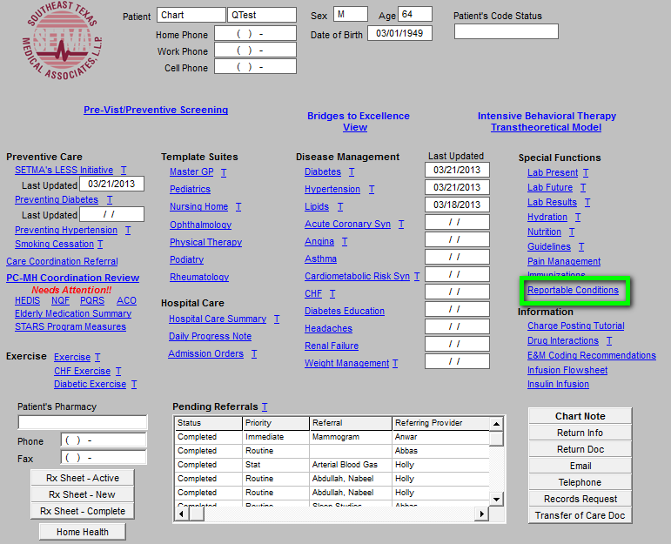
Texas State Reportable Conditions

Slide 41
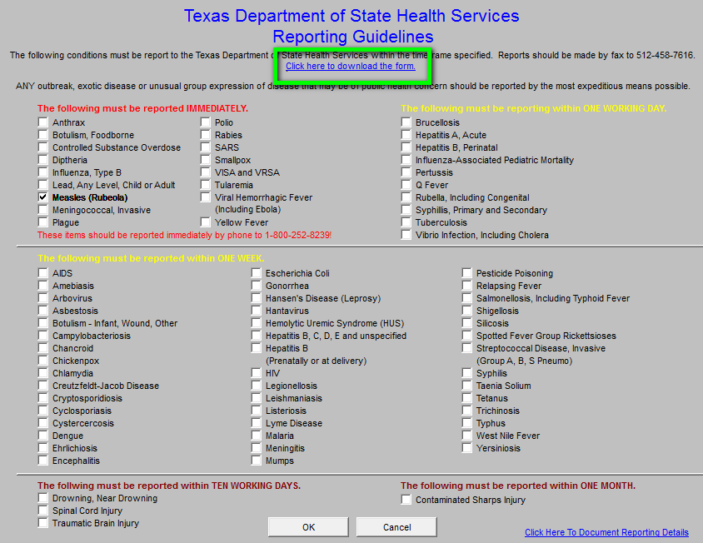
Texas State Reportable Conditions

Slide 42
Texas State Reportable Conditions
To review, when the reportable diagnosis is selected:
The system automatically checks the diagnosed disease on the Texas Department of State Health Services Reporting Guidelines template where the list of 78 reportable conditions are displayed.
A message is sent to the Care Coordination Department.
The message appears in the workflow of the Care Coordination team.
Once the report to the state is made, a note is added to the patient’s chart noting that Health Department notification has been done and the provider is notified of that fact.
The beauty of this solution is that the provider simply diagnoses a suspected reportable condition and the process is completed without further action by the provider.

Slide 43
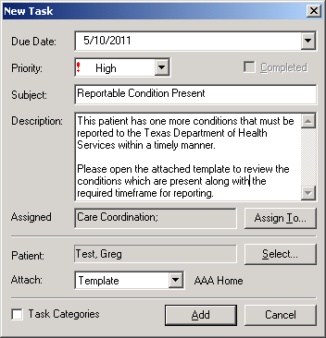
Texas State Reportable Conditions
This is the Care Coordination telephone alert which is automatically sent to SETMA’s Care Coordination Department when the reportable diagnosis is made.

Slide 44
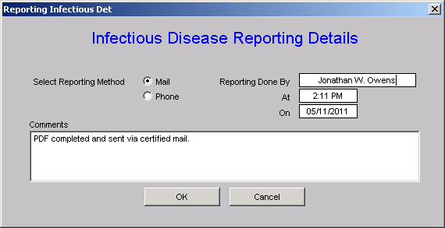
Texas State Reportable Conditions
When the Care Coordination department reports the infection, this template allows for the documentation of that report and for sending notice of the report to the treating provider.

Slide 45
Texas State Reportable Conditions
To print the Department of Health reporting form, SETMA’s Care Coordination Department goes to SETMA’s electronic version of the Texas Department of State Health Services Reporting Guidelines template and clicks on the link which is outlined in green.
This deploys a printable version of the Initial Provider Disease Reporting form.

Slide 46
Texas State Reportable Conditions

Slide 47
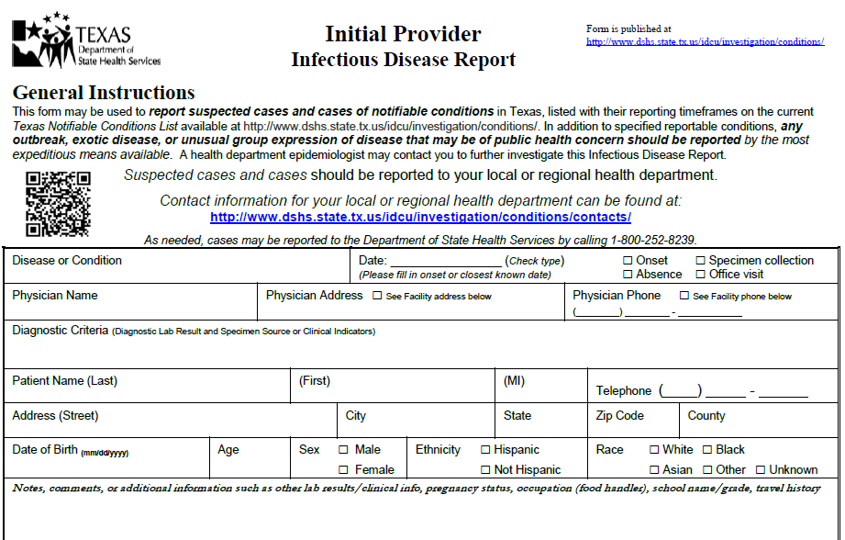
Texas State Reportable Conditions

Slide 48
SETMA’s Public Health Journey
For May 26th and June 2, 2011, my weekly
newspaper columns were about SETMA’s HIV
Screening project. They can be read at:
http://www.jameslhollymd.com/your-life-your-health/hiv-why-should-i-be-tested
http://www.jameslhollymd.com/your-life-your-health/texas-state-reportable-infectious-disease
“

Slide 49
SETMA’s Public Health Journey
In close collaboration with the Texas Department of State Health Services, but without a contractual relationship, SETMA set a start date of July 1, 2011, for the routine screening of HIV.
Our progress was slower than expected but has gained momentum, so that it is now a sustainable part of our work flow, our quality improvement and our auditing and reporting activities.
As we approach the second anniversary of our launch date, we look forward to meeting our expectation of exceeding an 80% compliance with the standards of our program by the end of our third year in July, 2014.

Slide 50
Deployment Events: Provider Response
“I have found every patient in the age groups amenable to the testing – no resistance at all.” June 30, 2011 (While the official program began July 1, 2011, some providers started addressing this with patients before that date.)
July, 2011 – first month of reporting -- 2,600 eligible patients only 152 were tested but one unknown HIV patient was found. (August 10, 2011)
E-mail sent to all providers, “May I appeal to you to initiate the HIV testing on all patients 13-64. (August 10, 2011)

Slide 51
Deployment Events: Provider Response
“One of the questions the patients are asking is who is paying for the testing. We are getting a lot of refusals if the patient has to pay for the test.” (August 11, 2011)
“They don’t; if insurance doesn't pay, SETMA will write off the cost.” (SETMA’s CEO, August 11, 2011)
On public television in October, 2011, and in a personal letter to all patients who refused the testing, SETMA’s commitment to screening for HIV without a personal cost to patients was repeated.

Slide 52
August 23, 2011 – Who’s Paying?
SETMA’s Central Billing Office reported that we are receiving reimbursement from the majority of the larger commercial insurances.
Aetna
BCBS
Humana
Humana Military
Health Select
Medicare if we have a payable diagnosis
Medicaid

Slide 53
The Results
In our first month, while the overall result was not wonderful, we did discover one previously unknown positive result. We were all pleased to be able to intervene successfully in that patient’s life for it is a fact that as in all areas of life, so in having HIV and not knowing it:
THE ONLY THING WHICH CAN HURT YOU IS WHAT YOU DON’T KNOW!

Slide 54
The Results

Slide 55
Following-Up On Those Who Refuse Testing
In October, 2011, SETMA sent a letter to all patients who had declined HIV testing. It stated:
“I grew up hearing an adage which stated, ‘What you don’t know can’t hurt you.’…In healthcare what you don’t know can kill you…The good news is that with the right medical management HIV can be treated and a person who is HIV positive can live a normal life…If your insurance company does not pay for the HIV Screening…SETMA will pay for your testing. That’s how much we care for you. If there is a co-pay for the testing we will pay the fee. You will pay nothing for being screened for HIV.”

Slide 56
Public Appeal
SETMA sponsored three television segments on HIV Screening.
In October, SETMA’s CEO had his blood drawn for HIV screening on live television. He announced that the following week, he would disclose his result.
The following week, a SETMA partner announced that Dr. Holly was not going to reveal his results. The reasons are explained in a video which is to follow.

Slide 57

Dr. Holly’s HIV Test Drawn On Live TV

Slide 58
Dr. Holly’s HIV Results On Live TV

Slide 59
Barriers To Patient Participation
I have been somewhat surprised at how difficult it has been to get general acceptance of the screening, although it is improving. The following are the barriers, we have experienced:
Patients do not want to pay anything for the test so if there is any doubt, they will decline testing. We have remedied this by our willingness to pay for the cost if their insurance does not.

Slide 60
Barriers To Patient Participation
We have had some examples of a provider who thought it was easier to simply say the patient refused than it was to get their permission. We have remedied this by sending a letter every three months to the patients who declined and making sure they knew they did not have to pay for the test and inviting them to come in at no charge to have the HIV screening test.

Slide 61
Barriers To Patient Participation
Because there have only been two positives, some providers harbor an unspoken prejudice that the value of the screening is less than other matters which vie for their attention.
We are remedying this by reinforcing that there is good scientific evidence supporting the value of HIV screening.
Each month, SETMA closes its office for a half day for practice-wide conferences where we review quality performance, healthcare transformation and the use of clinical decision support. Our HIV Screening is a part of those sessions.

Slide 62
The Cost
SETMA started reporting patient HIV results done in SETMA’s in-house lab on July 1, 2011. To date, we have completed 4549 HIV tests in house. Cost to perform each test is $12.88 cost per reportable.
Between July, 2011 and March, 2013, the HIV Screening project has cost SETMA $58,591.
In that time, SETMA has been reimbursed for 1534 tests for a total reimbursement of $54,102.68. This shows a monthly direct cost to SETMA of $224.41.
In that SETMA originally allocated $60,000 of revenue to this project when we determined not to work with the CDC, this is an outstanding return.

Slide 63
The Future
HIV Screening is now a part of SETMA’s healthcare DNA. We will continue this program until we can report that 100% of those who look to SETMA for healthcare have been screened. By our own example – my grandchildren were tested when they visited SETMA – and by evidenced-based medicine, we will continue this program.
Nothing speaks more to our commitment than the statement, “Even if you don’t want to pay or can’t, we want you to be tested such that SETMA will pay the cost.” We continue that commitment.

