Slide 1
The Use of Business Intelligence in the Process of Designing Quality Improvement Initiatives
Dr. James L. Holly, MD
CEO, Southeast Texas Medical Associates, LLP
University of Health Science Center at San Antonio School of Medicine
Alumni Weekend Continuing Medical Education
October 23, 2010

Slide 2
About SETMA
Southeast Texas Medical Associates, LLP (SETMA) was
founded August 1, 1995.
SETMA currently has 29 healthcare providers in the following
specialties:
Internal Medicine
Family Practice
Pediatrics
Nurse Practitioners
Cardiology
Neurology
Infectious Disease
Ophthalmology

Slide 3
SETMA’s Landmarks
March 1998 – Acquired Electronic Health Records (EHR)
January 1999 – All patients seen using EMR
May 1999 – Began thinking in terms of “Electronic Patient Management” (EPM), rather than EHR
October 2009 – Began “Business Intelligence Project”
June 2010 – NCQA Tier 3 Patient-Centered Medical Home (PCMH)
August 2010 – Affiliate of Joslin Diabetes Center, an Affiliate of Harvard Medical School
August 2010 – NCQA Diabetes Recognition

Slide 4
Systems Thinking and Health
“Systems-thinking” (Senge, The Fifth Discipline) and the data display designed on those principles allow the provider to “see” the patient as a whole: as a “granular portrait”, rather than as a faceless “silhouette.”

Slide 5
Data Display
Data display can obscure effective management, if it simply presents more detail while ignoring or obscuring the dynamic interaction of one part of a biological system with another.

Slide 6
Seeing Circles of Causality
“Reality is made up of circles, but we see straight lines…Western languages…are biased toward a linear view. If we want to see system-wide interrelationships…we need a language of interrelationships, a language of circles.”
(The Fifth Disciple, Dr. Peter Senge)

Slide 7
Linear Thinking

Slide 8
Circular Causality

Slide 9
SETMA’s Diabetes Management

Slide 10
SETMA’s Model of Care
Performance Tracking – one patient at a time
Performance Auditing – by panel or population
Analysis of Provider Performance Data
Public Reporting by Provider Name
Quality Assessment/Performance Improvement

Slide 11
Tracking Performance At The Point of Care
SETMA tracks multiple Physician Consortium for Performance Improvement (PCPI) measurement sets:
Chronic Stable Angina
Congestive Heart Failure
Diabetes
Hypertension
Chronic Renal Disease
Weight Management
Care Transitions

Slide 12
Tracking Performance At The Point of Care
SETMA also tracks the following published quality performance measure sets:
HEDIS
NQF
AQA
PQRI
BTE
Each is available to the provider, interactively at each patient encounter.

Slide 13
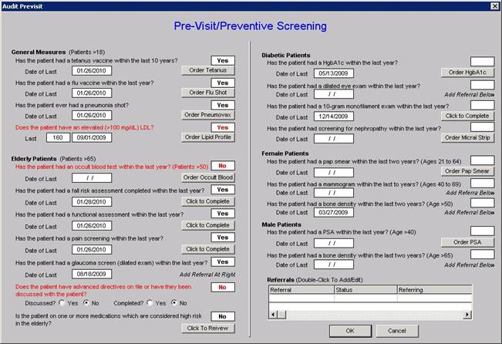
Tracking Performance At The Point of Care
This tool allows the provider to assess comprehensive quality measures for “screening” and “prevention” of each patient.

Slide 14
Tracking Performance At The Point of Care

Slide 15
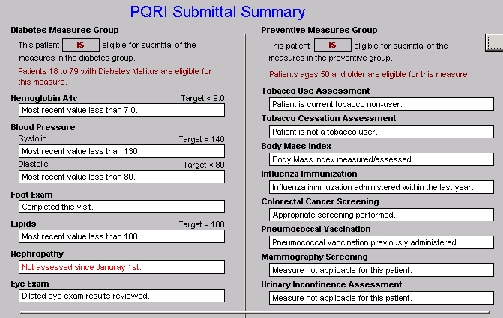
Tracking Performance At The Point of Care
PQRI

Slide 16
Clusters and Galaxies
A “cluster” is seven or more quality metrics for a single condition, i.e., diabetes, hypertension, etc.
A “galaxy” is multiple clusters for the same patient, i.e., diabetes, hypertension, lipids, CHF, etc.
Fulfilling a single or a few quality metrics does not change outcomes, but fulfilling “clusters” and “galaxies” of metrics at the point-of-care can and will change outcomes.

Slide 17
Auditing Performance After the Visit

Slide 18
Auditing Performance After the Visit

Slide 19
Auditing Performance After the Visit
Unlike a single metric, such as “was the blood pressure taken,” which will not improve care, fulfilling and then auditing a “cluster” or a “galaxy of clusters” in the care of a patient will improve treatment outcomes and will result in quality care.

Slide 20
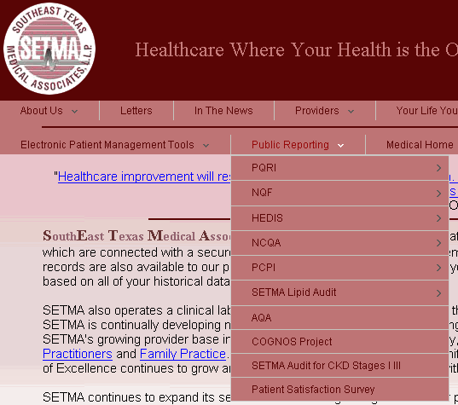
Auditing Performance After the Visit
What is most often missing in quality improvement initiative is real-time, auditing with comparative display of results, and public reporting.

Slide 21
Auditing Performance After the Visit
SETMA employed Business Intelligence (BI) software to audit provider performance and compliance.
SETMA’s BI Project allows all providers to:
Display their performance for their entire patient base
Compare their performance to all practice providers
See outcome trends to identify areas for improvement
See this at the point-of-care

Slide 22
Auditing Performance After the Visit
SETMA contracted with a Business Intelligence consulting firm to build our auditing tools.
The consultants designed a data warehouse to minimize the impact on our production servers.

Slide 23
Analyzing Provider Performance
The consultant used SQL Server Integration Services (SSIS) to clean and scrub the hundreds of data points we needed for our audit rather than having to process the millions of data points contained in our EHR.
SSIS scrubs and preloads our EHR data into the warehouse, which gives us both speed in reporting and confidence in the results in our Business Intelligence reports.

Slide 24
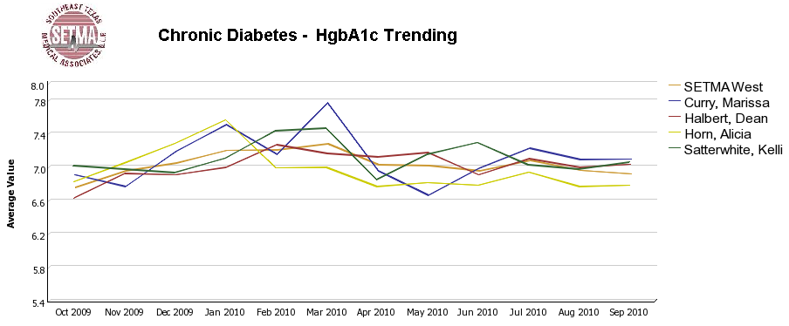
Auditing Performance After the Visit

Slide 25
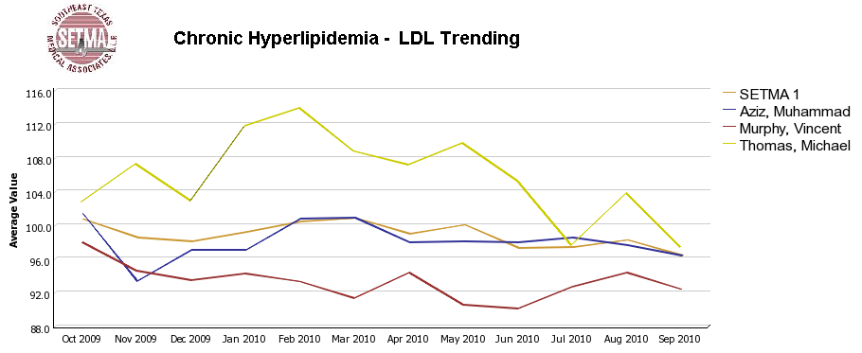
Auditing Performance After the Visit

Slide 26
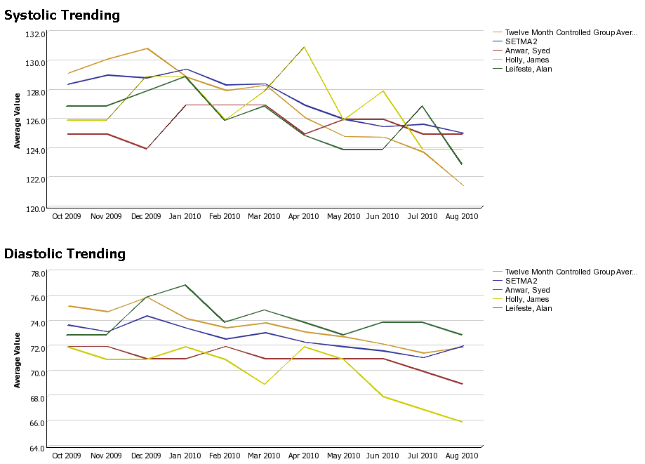
Auditing Performance After the Visit

Slide 27
Auditing Performance After the Visit
Beyond how one provider performs (tracking and auditing), SETMA looks at data as a whole (analyzing) from which to develop new strategies for improving patient care.
We analyze patterns which may explain why one population is not to goal while another is. Some of the parameters, we analyze are:
Frequency of visits
Frequency of key testing
Number of medications prescribed
Were changes in treatments made, if patient not to goal
Referrals to educational programs
Etc.

Slide 28
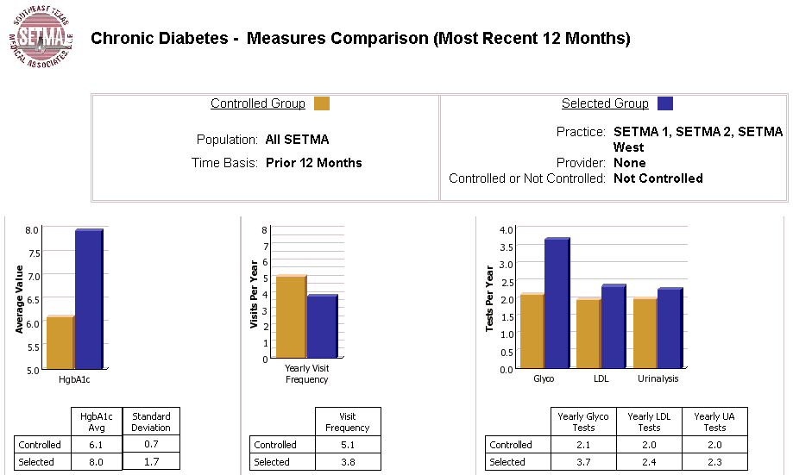
Analyzing Provider Performance

Slide 29
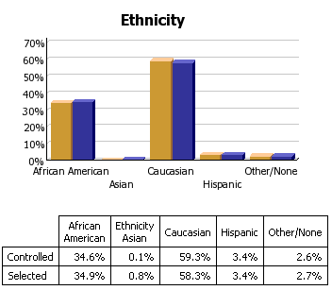
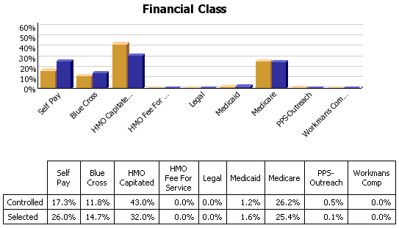
Analyzing Provider Performance

Slide 30
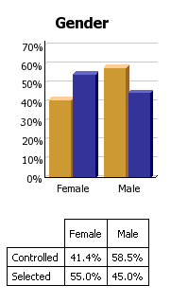
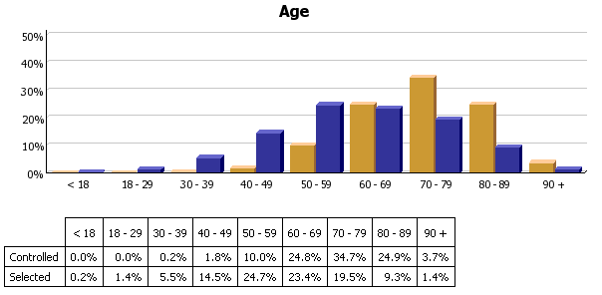
Analyzing Provider Performance

Slide 31
Analyzing Provider Performance
Raw data can be misleading. For example, with diabetes care, a provider may have many patients with very high HgbA1cs and the same number with equally low HgbA1cs which would produce a misleadingly good average. As a result, SETMA also measures the:
Mean
Median
Mode
Standard Deviation

Slide 32
Analyzing Provider Performance
SETMA’s average HgbA1c as been steadily improving for the last
10 years. Yet, our standard deviation calculations revealed that
a subset of our patients were not being treated successfully and
were being left behind.
By analyzing the standard deviation of our HgbA1c we have
been able to address the patients whose values fall far from the
average of the rest of the clinic.

Slide 33
Public Reporting of Performance
One of the most insidious problems in healthcare delivery is reported in the medical literature as “treatment inertia.” This is caused by the natural inclination of human beings to resist change. As a result, when a patient’s care is not to goal, often no change in treatment is made.
To help overcome this “treatment inertia,” SETMA publishes all of our provider auditing (both the good and the bad) as a means to increase the level of discomfort in the healthcare provider and encourage performance improvement.

Slide 34
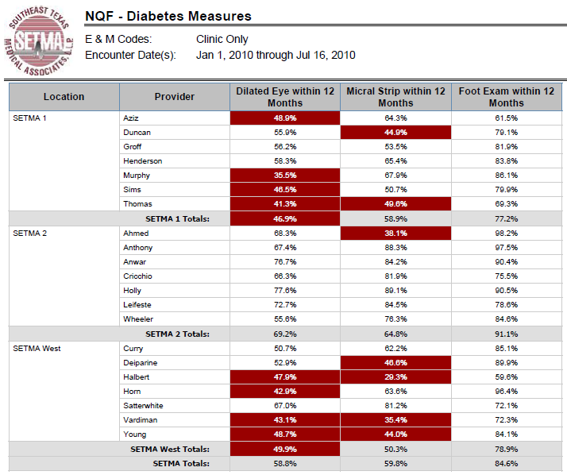
Public Reporting of Performance
NQF
Diabetes
Measures

Slide 35
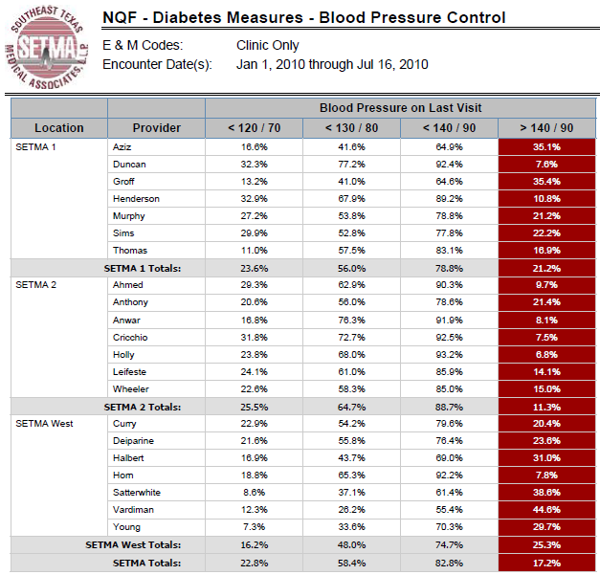
Public Reporting of Performance
NQF
Diabetes
Measures

Slide 36
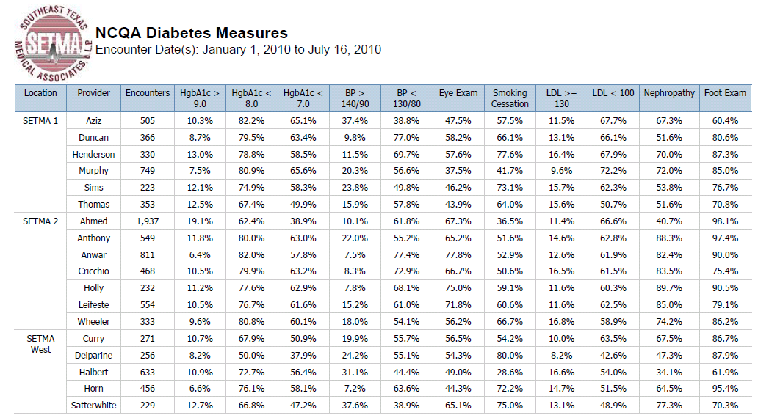
Public Reporting of Performance
NCQA Diabetes Recognition

Slide 37
Quality Assessment & Performance Improvement
Quality Assessment and Performance Improvement (QAPI) is SETMA’s roadmap for the future. With data in hand, we can begin to use the outcomes to design quality initiatives for our future.
We can analyze our data to identify disparities in care between
Ethnicities
Socio-Economic Groups
Age Groups
Genders

Slide 38
Quality Assessment & Performance Improvement
SETMA’s Model of Care along with Business Intelligence Software -- this pairing of medicine and technology -- can transform the delivery of healthcare and is worthy of being adopted by others.

Slide 39
Quality Assessment & Performance Improvement
By expanding SETMA’s Business Intelligence Project, we are also designing a quality improvement initiative for the elimination of preventable readmissions to the hospital.

Slide 40
www.jameslhollymd.com
Please visit us at www.jameslhollymd.com where you will find all of our public reporting, electronic patient management and medical home materials.

Slide 41
www.jameslhollymd.com

Slide 42
www.jameslhollymd.com

Slide 43
The Future
The future of quality metrics and the auditing of provider performance are constantly evolving. SETMA’s BI Project allows us to both participate in the future and to define it; and, ultimately to pay attention to the things that matter and the things that will result in improved health for all of our patients.

