Slide 1
SETMA's Transitions of Care Initiative to Reduce Preventable Readmissions Institute for Healthcare Improvement STAAR -- Shining the Spotlight Call May 31, 2013
Dr. James L. Holly, CEO
Southeast Texas Medical Associates, LLP
Adjunct Professor, Family/Community Medicine
University of Texas Health Science Center
San Antonio, School of Medicine

Slide 2
Introduction
Medium sized multi-specialty practice in SE Texas
Adopted EMR, March 30, 1998
Saw first patient on EMR, January 26, 1999
Morphed to Electronic Patient Management, May, 1999
First Disease Management Tool deployed, January, 2000
Same EMR data base utilized at all points of service, October, 2000
HIMSS Davies Award Winner, January, 2005
BI Analytics & Public Reporting, October. 2009
NCQA Tier III Medical Home, July, 2010
NCQA Diabetes Recognition, August, 2010
AAAHC Medical Home & Ambulatory Care, August, 2010
Joslin Diabetes Affiliate, September, 2010
Named one of 30 Exemplary Practices by Robert Wood Johnson Foundation for LEAP Study, September, 2012
HIMSS 2012 Physician IT Leadership Award, 2012, February, 2013

Slide 3
OBJECTIVEES
Examine link between Care Transitions and Readmissions
Review SETMA’s Model of Care
Review SETMA’s Care Transition
Address Risk of Readmission – High Risk
BI Analytics to find leverage points for improvement
30 Day Readmission Rates
Care Coordination and SETMA Foundation
Transition of Care Management Codes
Appendix – IHI Support: “The Baton”

Slide 4
SETMA’s Model of Care
http://www.jameslhollymd.com/the-setma-way/setma-model-of-care-pc-mh-healthcare-innovation-the-future-of-healthcare
This link is to a description of the SETMA Model of Care:
Tracking of 300 quality metrics at POC on all patients.
Auditing performance by populations and/or by panel of patients
Statistically analyzing process and outcomes metrics looking for leverage points for performance improvement
Public Reporting by provider name of performance.
Designing Quality Improvement on the basis of these four steps.

Slide 5
National Priorities Partnership
The focus in care coordination addressed by NPP are the links between:
Care Transitions— …continually strive to improve care by…considering feedback from all patients and their families…regarding coordination of their care during transitions between healthcare systems and services, and…communities.
Preventable Readmissions— …work collaboratively with patients to reduce preventable 30-day readmission rates.

Slide 6
SETMA’s Care Transitions
SETMA’s Care Transition involves:
Evaluation at admission – transition issues: “lives alone,” barriers, DME, residential care, medication reconciliation, or other needs
Fulfillment of PCPI Care Transitions Quality Metric Set
Hospital Care Summary and Post Hospital Plan of Care and Treatment Plan at discharge
Post Hospital Follow-up Coaching – a 12-30 minute call made by members of SETMA’s Care Coordination Department and additional support
Follow-up visit with primary provider within in 2-4 days, which is the last critical step in Care Transitions

Slide 7
1. Evaluation At Admission
Barriers to Care including support requirements
Does the patient live alone? (ICD-9 V603; ICD-10 Z602; SNOMED “Lives Alone – No Help Available”)
Activities of Daily Living – is the patient safe to live independently
Hospital Plan of Care a document given to patient/family at admission -- includes potential for re-hospitalization, estimated length of stay, why hospitalized, expected length of hospitalization, procedures and tests planned, contact information for how to call hospital-team members.
Establishes communication with all who are involved in patient's care: attending, nursing staff, hospital service team, family.
Links ambulatory patient activation to inpatient activation.

Slide 8
2. Fulfillment of Quality Metric Sets
SETMA has completed “Discharge Summaries “ in ambulatory EMR since the year 2000.
June, 2009, PCPI published Transitions of Care Quality Metric Set
SETMA adopted PCPI Measurement Set immediately
SETMA’s Quality Metrics Philosophy
The Limitations of Quality Metrics
SETMA began Public reporting by provider name at www.jameslhollymd.com of performance on quality metric sets for 2009-First Quarter 2013.
In 2011 completed research project with AMA to determine if SETMA’s fulfillment of measures is valid. The answer? “Yes.”

Slide 9
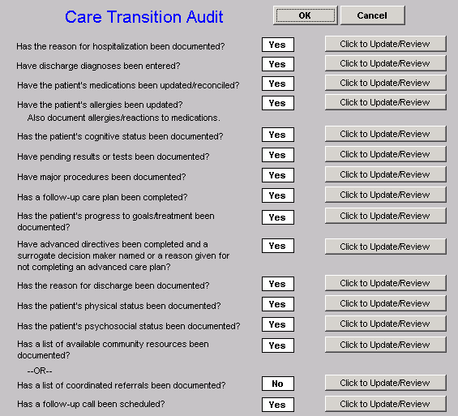
Care Transition Audit
The PCPI Measurement Set involves 14 actions which are audited. SETMA’s deployment is such that if at the end of the documentation of the Hospital Care Summary, any of the metrics not met (appear in red), the “Click to Update/review” button can be depressed. This will take the provider to the point in the document where that element should be documented.

Slide 10
Care Transition Audit
The PCPI Measurement Set also involves 4 actions which must be completed. These actions are documented by the provider who completes the Hospital Care Summary by entering his/her name and the time and date of completion.

Slide 11
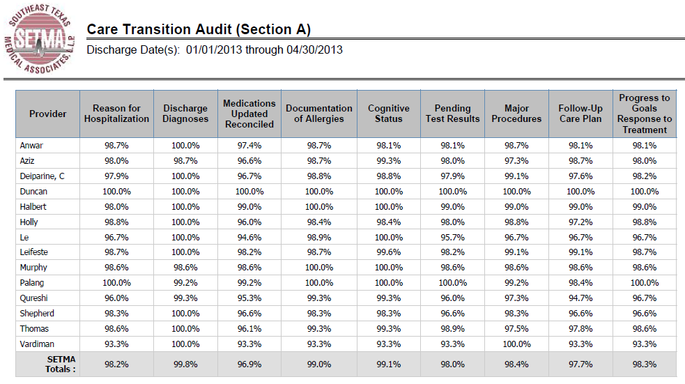
Care Transition Audit Publicly reported at www.jameslhollymd.com

Slide 12
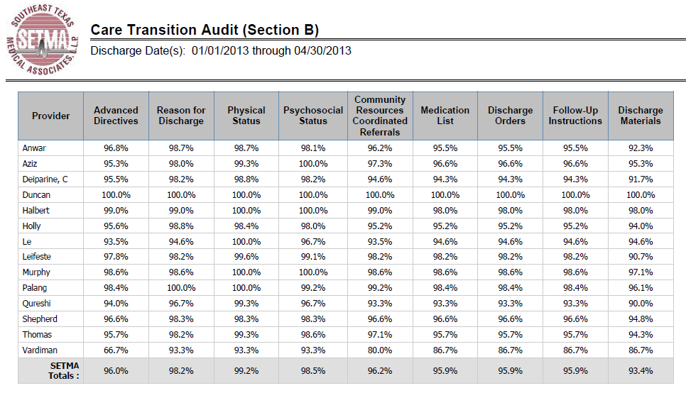
Care Transition Audit Publicly reported at www.jameslhollymd.com

Slide 13
3. Hospital Care Summary & Post-Hospital Plan of Care and Treatment Plan
At NQF Care Transitions Conference, October, 2010, changed name of “discharge summary.”
Includes follow-up appointments, reconciled medication lists (4 reconciliations: admission, discharge, care coaching call, follow-up appointment), plan of care and treatment plan.
In last 48 months, completed 16,828 discharges.
98.7% of time, document given to patient, hospital, care giver, nursing home, etc., at discharge.
This is the tool which transfers responsibility for care to the patient. SETMA calls it the Baton.

Slide 14
The Baton
This picture is a portrayal of the “plan of care and treatment plan” which is like the “baton” in a relay race. As in the race, if the “baton” is dropped, or if it is not “passed” in the allotted time, no matter how good the members of the team, the race is lost.

Slide 15
The Baton
“The Baton” is the instrument through which responsibility for a patient’s health care is transferred to the patient or family. Framed copies of this picture hang in the public areas of all SETMA clinics and a poster of it hangs in all 160 examination rooms. The poster declares:
Firmly in the provider’s hand
--The baton -- the care and treatment plan
Must be confidently and securely grasped by the patient,
If change is to make a difference
8,760 hours a year.

Slide 16
Three Inpatient Batons
The Hospital Admission Plan of Care
The Hospital Care Summary and Post Hospital Plan of Care and Treatment Plan
Post Hospital Plan of Care and Treatment Plan
The link below is to de-identified examples of these three documents from a real patient here.
http://www.jameslhollymd.com/Presentations/Transitions-of-Care-Initiative-to-Reduce-Preventable-Readmissions-Institute-for-Healthcare-Improvement

Slide 17
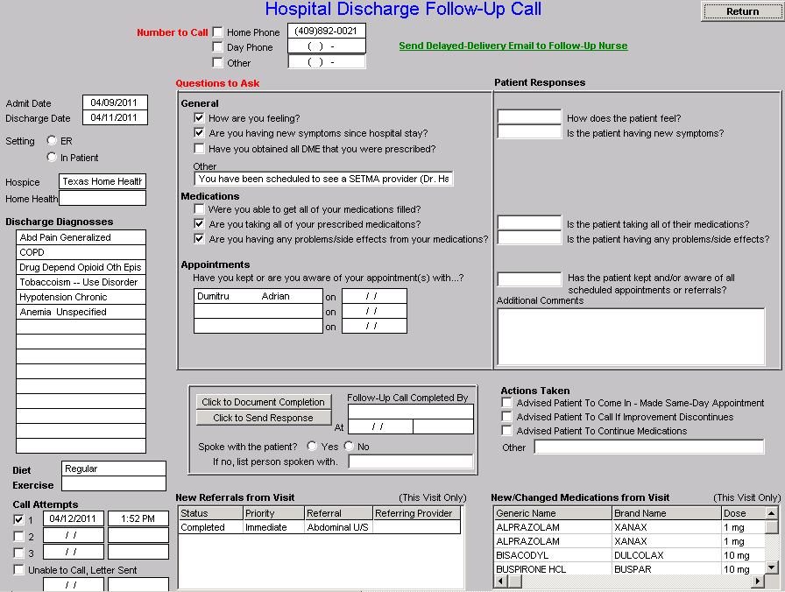
Hospital Follow-Up Call
After the care transition audit is completed and the “baton” document is generated, the provider completes the Hospital-Follow-up-Call template.
All of the data is automatically entered. The provider checks off questions to be asked and additional queries to be made and sends the call request.

Slide 18
Hospital Follow-Up Call
During the preparation of the “baton” handoff, the provider checks off the questions which are to be asked the patient in the follow-up call.
The call order is sent to the Care Coordination Department electronically. The day following discharge, the patient is called.
The call is the beginning of the “coaching” of the patient to help make them successful in the transition from the inpatient setting.

Slide 19
4. Hospital Follow-Up Call
A 12-30 minute call made by members of SETMA’s Care Coordination Department the day after discharge
If after three attempts, contact is not made, a letter is automatically generated for mailing to the patient.
Additional phone calls, or other interventions can be scheduled by the care coordination department
Results of the follow-up phone call are sent back to the healthcare provider.
If problems are discovered, immediate appointment is given or other appropriate intervention is initiated, including a home visit.

Slide 20
Hospital Follow-Up Call
SETMA’s Care Coordination Department is currently completing over 3,300 calls to patients monthly. Our analytics shows that the patient receiving or not receiving a care coaching call is one of the key predictors for readmission to the hospital. This includes hospital and clinic follow-up calls, missed appointment calls and follow-up calls generated by the department itself.
Monthly, SETMA closes our offices for one-half day during which time all providers meet for training and review of performance. In those meetings, we have reviewed many IHI papers on Care Transitions.

Slide 21
Hospital Follow-Up Calls
In the first quarter of 2013, SETMA’s Care Coordination department received 1,687 hospital follow-up calls to complete.
All calls were completed within one day of discharge.
Patients discharged on a Friday were called the same day if they were discharged before 11:30 AM or the next business day if they were discharged after 11:30 AM.

Slide 22
Hospital Follow-Up Calls
The Care Coordination member making the coaching call
Verifies that the patient is aware of all follow-up appointments
Verifies that the patient has transportation to keep follow-up appointments and arranges transportation if necessary
Reviews medications with the patients to ensure patients have started all new medications and stopped any medications which were discontinued
Ensures the patient has the support system in place to access care

Slide 23
Hospital Follow-Up Calls
Of the 1,687 follow-up call referrals that were completed in the first quarter of 2013, 556 were for patients considered “high-risk” for readmission.
Those high-risk patients, each received a second care coaching within three to five days after the first call.
They also were placed in a 10-step program described below.

Slide 24
5. Follow-Up Visit with Primary Care Provider
Care Transition is not complete until the patient is seen by his/her primary care physician within 2-4 days
If patient misses follow-up appointment they are immediately contacted by Care Coordination. An automated report is prepared daily for all patients missing important visits, including hospital follow-up visits.
Two things appear to contribute to improvement in re-hospitalization rates: coaching call and timely follow-up visit.
If patient is vulnerable, a call from the primary care physician can be made before the first visit, or an RN or MSW home visit can be made.
If the appointment was missed due to a barrier to care, the Care Coordination Department can intervene and get the patient seen.

Slide 25
Intermission
If there are any questions about the material we have covered thus far, we can take them now.

Slide 26
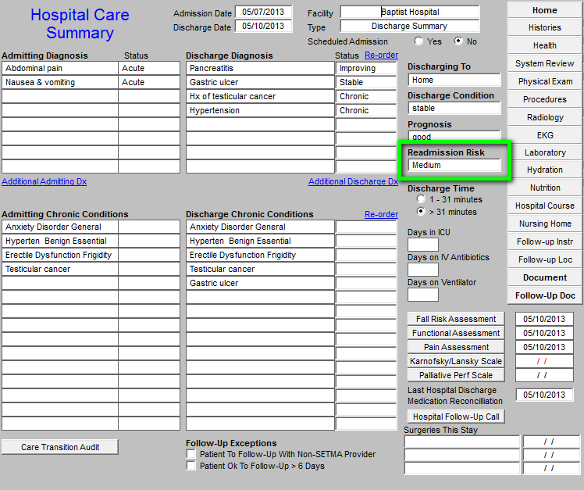
Hospital Care Summary Risk of Readmission

Slide 27
Managing High Risk Patients
When SETMA first began stratifying risk of readmission, we included so many elements, ALL patients were determined to be at high risk.
SETMA is designing a “predictive model” for identifying patients at high risk for readmissions and instituting the above plan for interdicting a readmission. This is an attempt to quantify the most effective opportunities for decreasing preventable readmissions.

Slide 28
Predicting Readmission Risk
We use history of previous hospitalizations to determine a patients risk for readmission.
High Risk – 2 or more hospitalizations within the previous 12 months
Medium Risk – 1 hospitalization within the previous 12 months
Low Risk – No history of hospitalization within the previous 12 months
If necessary, staff can manually elevate the level if they feel a patient has risk factors which place them at a higher risk than designated by the algorithm.

Slide 29
Managing High Risk Patients
When a person is identified as a high risk for readmissions, SETMA’s Department of Care Coordination is alerted. The following ten steps are then instituted:
Hospital Care Summary and Post Hospital Plan of Care and Treatment Plan is given to patient, care giver or family member.
The post hospital, care coaching call, which is done the day after discharge, goes to the top of the queue for the call – made the day after discharge by SETMA’s Care Coordination Department. It is a 12-30 minute call.

Slide 30
Managing High Risk Patients
Medication reconciliation is done at the time of discharge, is repeated in the care coordination call the day after discharge and is repeated at the follow-up visit in the clinic.
MSW makes a home visit for need evaluation, including barriers and social needs for those who are socially isolated.
A clinic follow-up visit within two days for those at high risk for readmission.

Slide 31
Managing High Risk Patients
A second care coordination call in four days.
Plan of care and treatment plan discussed with patient, family and/or care giver at EVERY visit and a written copy with the patient’s reconciled medication list, follow-up instructions, state of health, and how to access further care needs.
MSW documents barriers to care and care coordination department designs a solution for each.

Slide 32
Managing High Risk Patients
The patient’s end of life choices and code status are discussed and when appropriate hospice is recommended.
Referral to disease management is done when appropriate, along with telehealth monitoring measures.

Slide 33
BI -- Leverage Points
In order to find leverage points for decreasing preventable readmissions, SETMA has deployed a business intelligence software program to contrast and compare patients who are readmitted with those who are not for:
Age
Gender
Diagnoses and co morbidities
Socio-economic circumstances
Ethnicity
Follow-up visit within six days or not
Care Coaching call completed, etc.

Slide 34
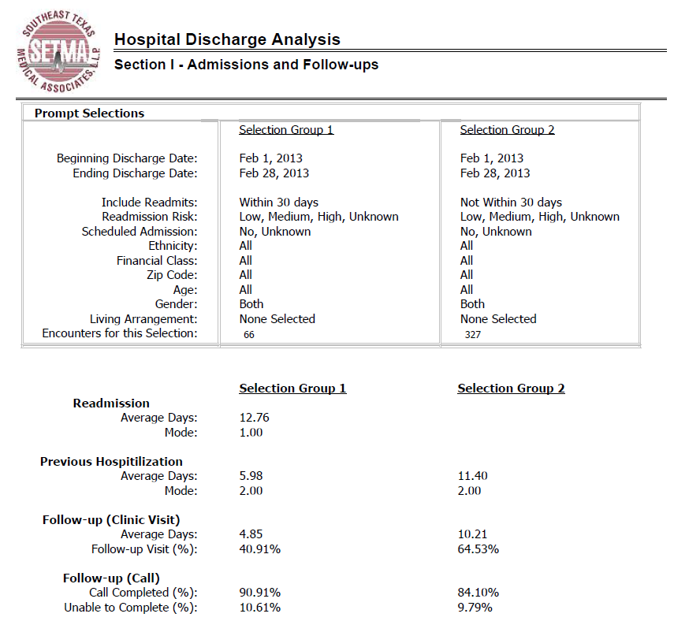
Cognos (BI) Analysis

Slide 35
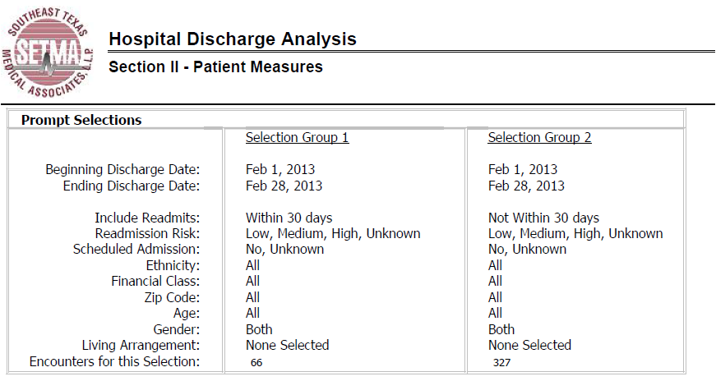
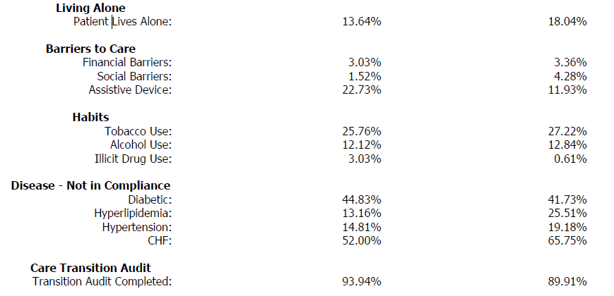
Cognos (BI) Analysis

Slide 36
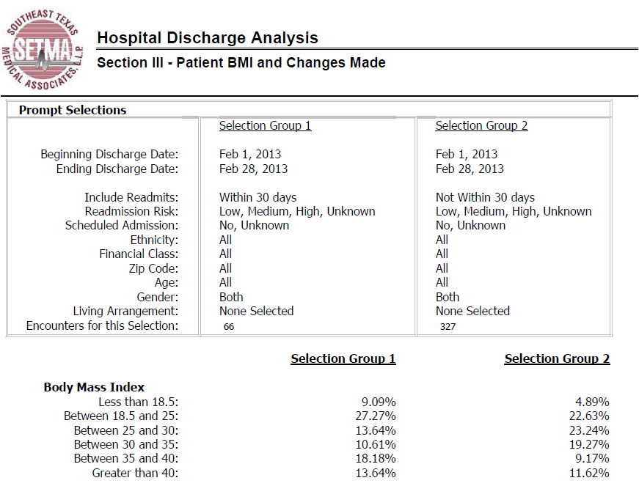
Cognos (BI) Analysis

Slide 37
SETMA & Baptist Hospital
At any given time, SETMA manages 20-40% of the inpatient census at Baptist Hospital.
The average daily census for Baptist Hospital is 250-300 patients.
In addition to managing the patients assigned to us, we also care for 25% of the indigent, uninsured and unassigned patients in Baptist Hospital.

Slide 38
30-Day Readmission Rates Any DRG
In 2009, SETMA began taking care of 25% of the uninsured and indigent patients admitted to Baptist Hospital. The complexity of transitions of care in this group caused an increase in readmissions. Hopefully, we have solved this.

Slide 39
30-Day Readmission Rates PN, Any DRG

Slide 40
30-Day Readmission Rates PN, FFS Medicare

Slide 41
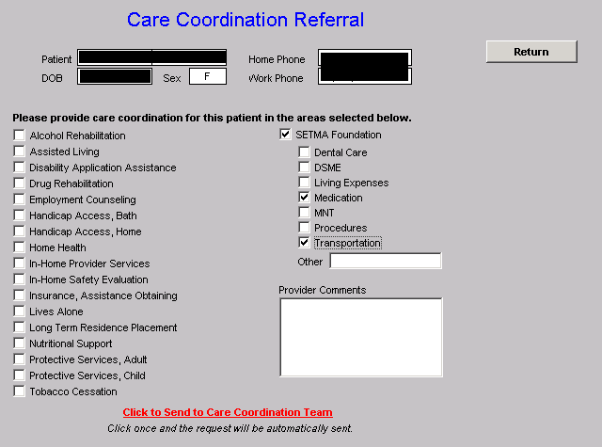
Care Coordination Referral

Slide 42
SETMA Foundation
Under the Medical Home model the provider has NOT done his/her job when he/she simply prescribes the care which meets national standards. Doing the job of Medical Home requires the prescribing of the best care which is available and accessible to the patient, and when that care is less than the best, the provider makes every attempt to find resources to help that patient obtain the care needed.

Slide 43
SETMA Foundation
Because we treat such a vulnerable population, in 2008, SETMA established the SETMA Foundation. Thus far, the SETMA partners have contributed $2,000,000 to the Foundation. These funds cannot profit SETMA and can only be used to pay for the care of our patients by providers who will not see them without being paid. SETMA treats all of these patients at no cost.

Slide 44
SETMA Foundation PC-MH Poster Child
In February 2009, SETMA saw a patient who has a very complex healthcare needs. When seen in the hospital as a new patient, he was angry, bitter and hostile. No amount of cajoling would change the patient’s demeanor.
During his hospital follow-up, it was discovered that the patient was only taking four of nine medications because of expense; could not afford gas to come to the doctor; was going blind but did not have the money to see an eye specialist; could not afford the co-pays for diabetes education and could not work but did not know how to apply for disability. He also was uninsured.

Slide 45
SETMA Foundation
He left after the hospital follow-up visit with the Foundation providing:
All of his medications. The Foundation has continued to do so for the past four years at a cost of $2,200 a quarter.
A gas card so that he could afford to come to multiple visits for education and other health needs.
Waiver of cost for SETMA’s ADA accredited Diabetes Self-Management Education and Medical Nutrition Therapy programs.
Appointment to an experimental, vision-preservation program.
Assistance with applying for disability. Which he received after four months. Three years later his Medicare became active.

Slide 46
SETMA Foundation
Are gas cards, disability applications, paying for medications a part of a physician’s responsibilities? Absolutely not; but, are they a part of Medical Home? Absolutely! This patient, who was depressed and glum in the hospital, such that no one wanted to go into the patient’s room, left the office with help.
He returned six-weeks later with a smile and with hope, which may be that the biggest result of Medical Home. Without hope patients will not make changes.
His diabetes was treated to goal for the first time in ten years. He has remained treated to goal for the past four years.

Slide 47
SETMA Foundation
Every healthcare provider doesn’t have a foundation and even ours can’t meet everyone’s needs, but assisting patients in finding the resources to support their health is a part of medical home.

Slide 48
SETMA Foundation
And, when those resources cannot be found, Medical Home will be “done” by modifying the treatment plan so that what is prescribed can be obtained.
The ordering of tests, treatments, prescriptions which we know our patients cannot obtain is not healthcare, even if the plan of care is up to national standards.

Slide 49
Infrastructure for success
With this infrastructure
With this care coordination
With this continuity of care
With these patient support functions
SETMA is ready to make a major effort to decrease preventable readmissions to the hospital.

Slide 50
Care Transitions & Hospital Readmissions
For14 years, we have focused on processes, believing that outcomes will inevitably follow, which outcomes will then inevitably be sustainable.
SETMA expects to significantly affect hospital preventable re-admission rates over the next two years and to sustain those improvements.
Supported by care transitions, coordination of care, medication reconciliation (at multiple points of care) patient safety, quality of care and cost of care will be positively impacted.

Slide 51
Conclusions
The problem of readmissions will not be solved by more care: more medicines, more tests, more visits, etc.
The problem will be solved by redirecting the patient’s attention for a safety net away from the emergency department.
The problem will be solved by our having more proactive contact with the patient.

Slide 52
Conclusions
The problem will be solved by more contact with the patient and/or care giver in the home: home health, social worker, provider house calls.
The problem will be solved by the patient and/or care giver having more contact electronically (telephone, e-mail, web portal, cell phone) with the patient giving immediate if not instantaneous access.

Slide 53
Care Transitions Management Codes
In January, 2013, CMS published two Transitions of Care Management Codes which were adopted to recognize the value of the processes of transitioning patients from multiple inpatient sites to multiple outpatient venues of care. The value of this work is now being recognized by enhanced reimbursement.
In order to determine which of the Transitions of Care Management Codes to use, the healthcare provider must distinguish between a Moderately Complex visit and a High Complex visit. SETMA assumes that the complexity discriminator refers to the E&M codes for 99214 and 99215, in which case it would generally be possible in the ambulatory setting for a provider only to use the lower of the TCM codes, i.e., 99495.

Slide 54
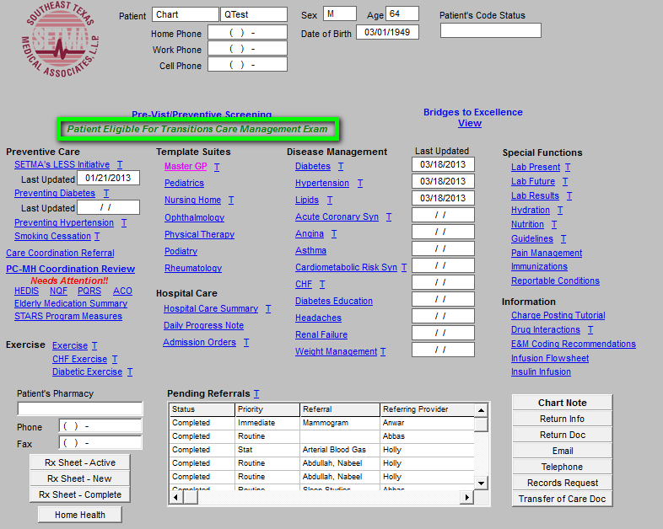
Care Transitions Management Codes
When a patient is seen at SETMA who has been discharged from the hospital, a note automatically appears on the AAA Home Template, indicating that the
patient is eligible for a Transitions of Care Management evaluation.

Slide 55
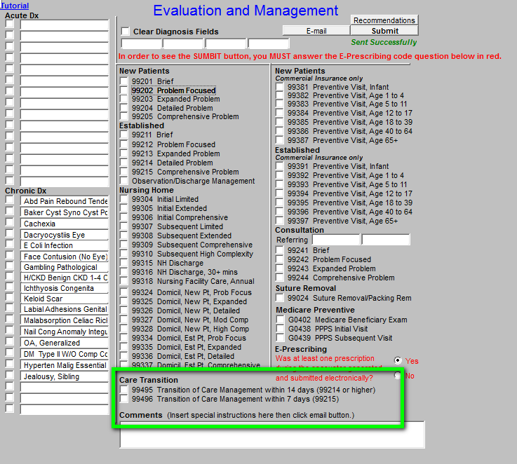
Care Transitions Management Codes
The Transitions of Care Management Codes (TMC Codes) have been added to
SETMA’s E&M Template (see below outlined in green.

Slide 56
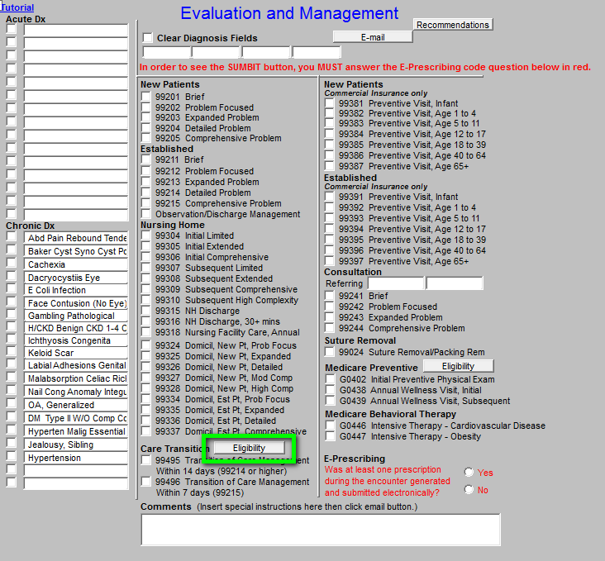
Care Transitions Management Codes
As seen in the
template to the right. SETMA has added a button entitled “Eligibility.”

Slide 57
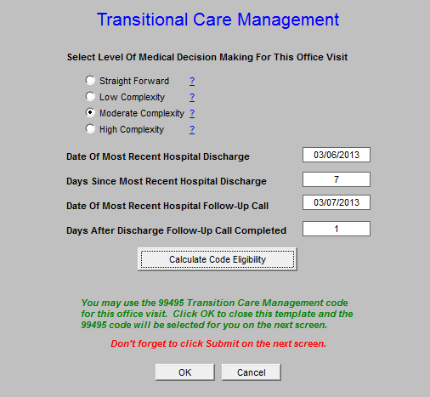
Care Transitions Management Codes
When the “eligibility” button is deployed, it will display this template.

Slide 58
Care Transitions Management Codes
The eligibility template aggregates the information required for determining if you have qualified for one of the TCM Codes and if you have, which one. The functionality in the background of the
template will search to see if the following requirements have been met:
The patient is being seen in 7 or 14 days from discharge
The patient’s visit qualifies for a 99214 or a 99215
The patient had a contact within two days of being discharged
Medication reconciliation was done after the hospital discharge
Plan of Care and Treatment Plan was given to the patient and/or care giver

Slide 59
Care Transitions Management Codes
When you click “Eligibility,” you will need to establish the complexity of the visit by clicking in the radial button next to the Complexity of the visit, i.e., moderate or high. If you have already selected the Complexity of Decision making level on the E&M template, you simply click on the “Calculate Code Eligibility” button and the appropriate TCM code will be selected.
A detailed explanation of this process can be found at www.jameslhollymd.com at the following link:
http://www.jameslhollymd.com/epm-tools/transition-of-care-management-code-tutorial

Slide 60
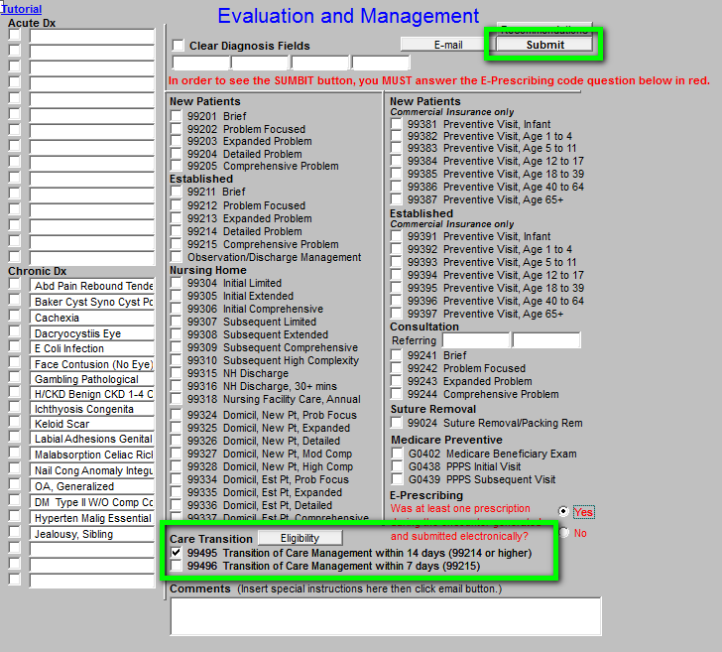
Care Transitions Management Codes
When all of the standards are met, the correct code will automatically be check.
When you complete the steps above don’t forget to click
the “Submit” button. See “submit” to the right in Green

Slide 61
Questions
Please feel free to ask any questions you may have.
You are welcome to contact Dr. Holly at jholly@jameslhollymd.com
or at
(409) 654-6819

Slide 62
Appendix
Slides 62-67 – HI concepts presented earlier in this presentation.
Slides 68-73 – Additional detail on SETMA’s view of the “baton.”
Slides 74-80 – IHI concepts on Transitions of Care from Inpatient to Ambulatory Care.

Slide 63
Institute for Healthcare Improvement
In October, 2007, IHI published the
Triple Aim which includes the “simultaneous
pursuit of:
“Improving the experience of care
“Improving the health of populations
“Reducing per capita costs of health care”

Slide 64
Redesign of Primary Care Services and Structures
“(Included)…(five) components which would contribute to
fulfilling the Triple Aim:
1. “Focus on individuals and families
2. “Redesign of primary care services and structures
3. “Population health management
4. “Cost control platform
5. “System integration & execution”
(http://www.ihi.org/offerings/Initiatives/TripleAim/Pages/Approach.aspx)

Slide 65
Institute for Healthcare Improvement
“Triple Aim is a framework for partnering with local government agencies, social service organizations, health plans, faith groups, and other community stakeholders to achieve three powerful goals simultaneously…
“(IHI’s)…program is ideal for change agents in health related organizations who are responsible for developing strategy, delivering front-line care, or crafting policy for a specific population.”

Slide 66
The Triple Aim
“Preconditions for the Triple Aim include:
“Enrollment of Identified population
“A commitment to universality for its members
“The existence of an organization, an ‘integrator’ that accepts responsibility for all three aims for that population.”
Donald M. Berwick, Thomas W. Nolan and John Whittington
Health Affairs May 2008 vol. 27 no. 3 759-769

Slide 67
The Triple Aim
The Triple Aim and the Moral Test of Government:
“The moral test of government is how it treats those who
are In the dawn of life, the children; those who are in the
twilight of life, the aged; and those in the shadows of life,
the sick, the needy and the handicapped.” (November 4,
1977, Senator Humphrey, Inscribed on the entrance of the
Hubert Humphrey building, HHS Headquarters)
Donald Berwick, “The Moral Test”
Keynote Presentation, December 7, 2011
IHI 23rd Annual National Forum on
Quality Improvement in Health Care

Slide 68
Are You Ready To Be An Integrator?
From the healthcare provider’s perspective, the following are Triple Aim Integrators:
Medicare Advantage
Medical Home
Accountable Care Organizations
Each of these “structures” requires primary care redesign in order to be successful.

Slide 69
SETMA’s Model of Care
The Redesign of Primary Care Services and Structures requires that “Basic
health care services are provided by a variety of professions: doctors,
nurses, mental health clinicians, nutritionists, pharmacists, and others.” The
steps to this redesign requires that the primary care “integrator”:
“Have a team for basic services that can deliver at least 70% of the necessary medical and health-related social services to the population.
“Deliberately build an access platform for maximum flexibility to provide customized health care for the needs of patients, families, and providers.
“Cooperate and coordinate with other specialties, hospitals, and community services related to health.” (IHI)

Slide 70
The Baton
This picture is a portrayal of the “plan of care and treatment plan” which is like the “baton” in a relay race. As in the race, if the “baton” is dropped, or if it is not “passed” in the allotted time, no matter how good the members of the team, the race is lost.

Slide 71
The Baton
“The Baton” is the instrument through which responsibility for a patient’s health care is transferred to the patient or family. Framed copies of this picture hang in the public areas of all SETMA clinics and a poster of it hangs in every examination room. The poster declares:
Firmly in the provider’s hand
--The baton -- the care and treatment plan
Must be confidently and securely grasped by the patient,
If change is to make a difference
8,760 hours a year.

Slide 72
The Baton
The poster illustrates:
That the healthcare-team relationship, which exists between the patient and the healthcare provider, is key to the success of the outcome of quality healthcare.
That the plan of care and treatment plan, the “baton,” is the engine through which the knowledge and power of the healthcare team is transmitted and sustained.
That the means of transfer of the “baton,” which has been developed by the healthcare team, is a coordinated effort between the provider and the patient.

Slide 73
The Baton
That typically the healthcare provider knows and understands the patient’s healthcare plan of care and the treatment plan, but without its transfer to the patient, the provider’s knowledge is useless to the patient.
That the imperative for the plan – the “baton” – is that it must be transferred from the provider to the patient, if change in the life of the patient is going to make a difference in the patient’s health.

Slide 74
The Baton
That this transfer requires that the patient “grasps” the “baton,” i.e., that the patient accepts, receives, understands and comprehends the plan, and that the patient is equipped and empowered to carry out the plan successfully.
That the patient knows that of the 8,760 hours in the year, he/she will be responsible for “carrying the baton,” longer and better than any other member of the healthcare team.

Slide 75
IHI Reference
Rutherford P, Nielsen GA, Taylor J, Bradke P, Coleman E. How-to Guide: Improving Transitions from the Hospital to Community Settings to Reduce Avoidable Re-hospitalizations. Cambridge, MA: Institute for Healthcare Improvement; June 2012.
Available at www.IHI.org

Slide 76
Improved Transition & Reception
Institute for Healthcare Improvement
“An improved transition out of the hospital (and from post-acute care and rehabilitation facilities) as well as…
“An activated and reliable reception into the next setting of care such as a primary care practice, home health care agency, or a skilled nursing facility.”

Slide 77
Activated Receivers
An example of an activated receiver is a physician‘s office with a specified process for scheduling post-hospital follow-up visits within 2 to 4 days of discharge.
“Although the care that prevents re-hospitalization occurs largely outside of the hospital, it starts in the hospital.”

Slide 78
Key Changes to Improve Transitions
Perform an Enhanced Assessment of Post-Hospital Needs
“Involve the patient, family caregiver(s), and community provider(s) as full partners in completing a needs assessment of the patient‘s home-going needs.
“Reconcile medications upon admission.
“Create a customized discharge plan based on the assessment.”

Slide 79
Key Changes to Improve Transitions
Ensure Post-Hospital Care Follow-Up
“Assess the patient‘s medical and social risk for readmission and finalize the customized discharge plan.
“Prior to discharge, schedule timely follow-up care and initiate clinical and social services as indicated from the assessment of post-hospital needs and the capabilities of patients and family caregivers.”

Slide 80
Key Changes to Improve Transitions
Provide Real-Time Handover Communications
“Give patient and family members a patient-friendly post-hospital care plan that includes a clear medication list.
“Provide customized, real-time critical information to the next clinical care provider(s).
“For high-risk patients, a clinician calls the individual(s) listed as the patient‘s next clinical care provider(s) to discuss the patient‘s status and plan of care.”

Slide 81
Risk of Readmissions
The Journal of Hospital Medicine recently published a pair of studies in which researchers analyzed data from California and Austria to determine the risk factors of hospital readmission.
Medicare
Medicaid
African American Race
Inpatient use of narcotics
Inpatient use of corticosteroids
Cancer with and without metastasis
Renal Failure
Congestive Heart Failure
Weight loss

