Slide 1
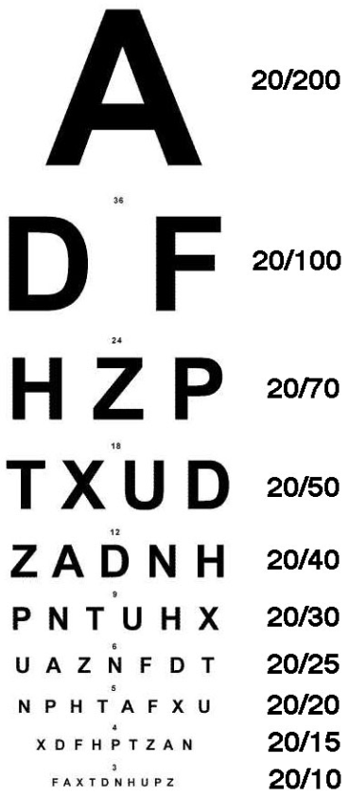
Current Status and Vision for SETMA Diabetes
Dr Jaweed Akhter

Slide 2
SETMA Diabetes Current Status and Future Vision
Overview of Diabetes Mellitus in Texas
Prevalence, projection and costs
Current Status SETMA Diabetes
Accreditations
Management Tools
Automating care of Diabetes
Documentation of evaluation of standard care
Clinical Care : Excellence, Opportunities
Academic Meetings, Provider Updates
Public Education, Community programs
Teaching, Training & Research
Institutional Collaborations
Summary

Slide 3
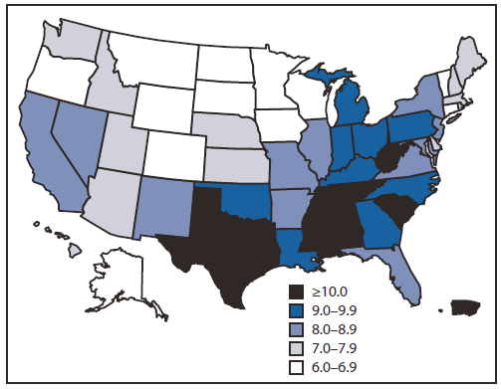
Prevalence of diagnosed diabetes among adults aged ≥18 years in the United States during 2010.

Slide 4
Texas Diabetes Control and Prevention Program Diabetes Status in Texas 2012
Prevalence of Diabetes by Race/Ethnicity and Age Group,
Age Group Caucasian(%) African American (%) Hispanic (%) All Races (%)
18 – 44 2.2 (1.2-3.2) 8.0 (3.7-12.3) 4.2 (2.8-5.7) 3.5 (2.7 -4.3)
45 – 64 10.1 (8.7-11.5) 20.8 (15.9-25.7) 21.5 (18.2-24.7) 14.0 (12.7-15.3)
65+ 19.2 (17.4-21.0) 38.0 (29.5-46.4) 32.2 (27.0-37.5) 23.0 (21.2-24.8)

Slide 5
Texas' Diabetic Population Will Quadruple by 2040
Year Number Percent
2005/7 1,732,447 9.9%
2010 2,221,727 11.9%
2020 3,903,995 17.1%
2030 5,783,481 20.8%
2040 7,980,225 23.8%
Diabetes in Texas was responsible for an estimated $18.5 billion in costs during CY2011: $12.3 billion in direct medical costs and $6.2 billion in indirect costs

Slide 6
Current Status at SETMA Joslin Diabetes Center
SETMA’s Diabetes Self-Management Education Program and MNT is nationally recognized by the American Diabetes Association
NCQA Diabetes Recognition : 11 quality measures
NQF Accreditation has 6 Diabetes specific quality metrics in addition to smoking cessation, weight management
Healthcare Effectiveness Data and Information Set (HEDIS) : Diabetes management is an important component
Individual Provider Reporting since 2009-
Joint Commission Accreditation highlights overall standard/ quality of the healthcare organization

Slide 7
SETMA Joslin Diabetes Center
Center offers comprehensive care of complex diabetes cases and preventive management for patients with pre diabetes
Collaboration with ophthalmology, podiatry, cardiology, vascular surgery and will increasing links mental health, renal, bariatric surgery
Factors for Success : Established brand (SETMA, Joslin), strong primary care referral base, accessible to local target population, meets key performance indicators based on national standards

Slide 8
Where SETMA is at Present
others Aspire to be in the Future

Slide 9
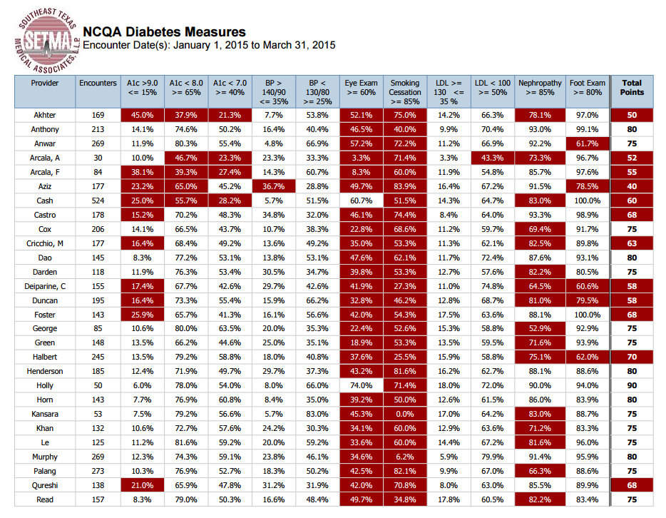

Slide 10
Dilated Eye Exam

Slide 11
Flu Vaccination

Slide 12
Monofilament Exam

Slide 13
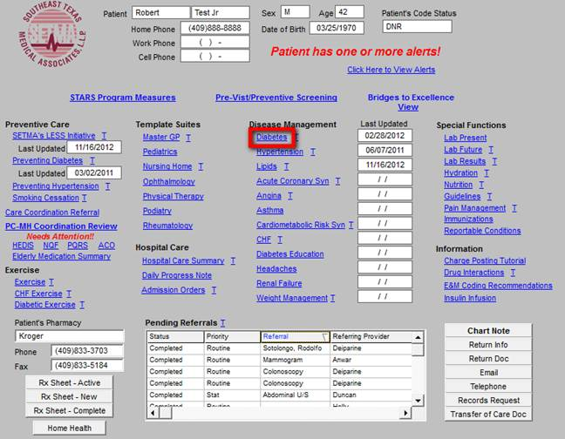

Slide 14
Disease Management Tools
Diabetes Disease Management
Comprehensive Diabetes Template
Includes specific Diabetes Sys review
Includes all standard of care measures
Vaccination guidelines
Cardiovascular risks
HTN, Lipid templates
Renal failure template
Patient information tools (16) including goals, foot care, meals, insulin, complications
individualized Diabetes plan document

Slide 15
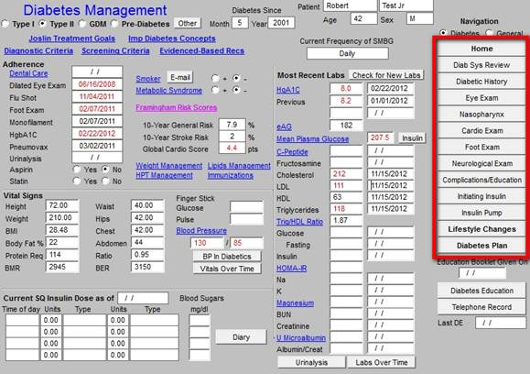

Slide 16
Disease Management Tools
Preventing Diabetes
Screening guidelines & mgmt, prediction based on age, FBG,TG.
Extensive pt information comorbidity,
types of surgery
Complications:micronutrient def
LESS Initiative
Wt loss guidelines, drugs. Documents
Diabetic Exercise
Retinopathy, neuropathy, CVD, nephropathy: contraindications, type of exercise

Slide 17
Automating the care of patients with diabetes
Has the patient had a hemoglobin A1c within the past 3 months?
Has the patient has a urinalysis in the past year?
Has the patient had a dilated eye examination in the past year?
Has the patient had an examination of the feet in the past year including a test of feeling in the feet?
Has the patient had a test for protein in the urine in the past year?
Has the patient had a flu immunization in the past year?
Has the patient had a cholesterol test in the past year?
Is the patient on a statin drug?
Is the patient on aspirin?
If the patient has protein in the urine, is the patient on an ACE Inhibitor or an ARB ?

Slide 18
Clinical care : Goals and Strengths
Challenge is to deliver individualized, quality care, which is cost effective , has impact on our patients lives and has local relevance while overall increasing volume
Are we positioned to do so?
Highly Accredited Center
Excellent Diabetes Educator Staff
Excellent EHM tools
Full range of specialized services available : Pumps, CGMS, Inhaled insulin etc
Strong Primary Care Support
Linkages with related services
High Quality Lab support
Ability to impart training

Slide 19
Clinical Opportunities Diabetes
Catchment area : approx 400,000
Est DM population 40,000
If 5% additional DM new patients to SETMA 2,000 pts
Est. additional visits per year for DM
Increase in related specialties visits
Generation of significant addition relevant investigations, ancillary services and consultations

Slide 20
Referrals

Slide 21
Care Coordination

Slide 22
Clinical areas of focus/development
Diabetes Mellitus specialized clinics
Type 1, Gestational, Pump,
Diabetes Prevention and Metabolic Syndrome
Weight Management /Obesity
Metabolic Bone Disease

Slide 23
Academic Growth
Clinical Case Meetings
Practice Guidelines/ Updates ; Affiliates Conference call
Journal Club
Core Lectures
Administrative Meetings; SETMA, Joslin
Involve local diabetologists and endocrinologists

Slide 24
Provider Update activities
Annual CME Activity
Physicians, nurse practitioners, CDE, nurses, trainees etc
Highlight practice updates and emerging trends
Highlight role of technology in diabetes management and patient safety
Attempt to get CME accreditation for activity

Slide 25
Public Education
Impart Diabetes Education needed to PPP : public, press, politicians/legislators.
World Diabetes Day Nov 14
Smaller, quarterly, public education programs
Get involved in local media on DM and related topics
Clinic newsletter

Slide 26
Community Programs
Diabetes Prevention
Diabetes Screening
Diabetes Education
Development of Public Educational Material
Training of CDE’s
Mental health program
Insulin Bank

Slide 27
Teaching
Electives : Local and International medical students
IMG for clinical and research experience
Rotating residents from FP, IM programs
Students of nutrition studies, pharmacy, CDE trainees
? Lamar University Collaboration

Slide 28
Research opportunities
Seek and initiate industry sponsored clinical trials
Evaluate our own data
Grants : Capacity building, education, diabetes prevention, adherence promotion
Collaboration with academic units

Slide 29
Collaborations
Joslin Clinic affiliate and collaboration status
Extend formal/ informal linkages with state and national diabetes departments
Networking with ADA, AADA, AACE
State groups working on Diabetes Prevention
Establish/enhance international linkages

Slide 30
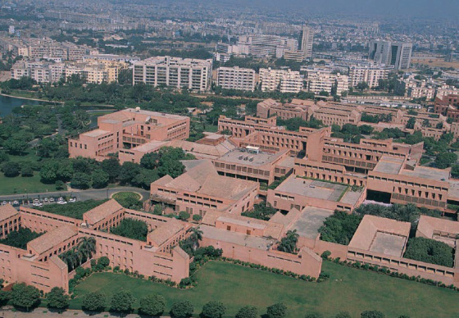

Slide 31
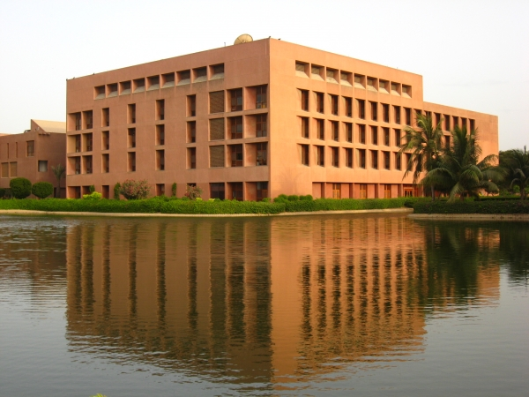

Slide 33
Summary
DM is a rapidly growing problem worldwide and in Texas with significant and increasing costs to individuals, families and society
We have the capacity, management tools to assist the patient achieve the best care based on current standards.
Our quality metrics are regularly audited and meet all the accredit ting organizations’ current standards
Opportunities to impact diabetes in area, prevention, progression and care
Clinical opportunities to expand our reach and services
Training and teaching work can expand
Public educational activities and CME activities would have benefits
Consider heath impact, capacity building grants
Time, finances will be constraints which we will have to work within

Slide 35
NCQA Diabetes Recognition (2010-16)
Diabetes Recognition Program (DRP)
}
Clinical Measures (Required) Criteria 2012 Version Points 2015 Version
HbA1c Poor Control >9.0%** ≤15% of patients in sample 12.0 15.0
HbA1c Control <8.0% 65% of patients in sample 8.0 10.0
HbA1c Control <7.0% 40% of patients in sample 5.0 7.0
Blood Pressure Control
≥140/90 mm Hg**≤35% of patients in sample 15.0 30.0
Blood Pressure Control
<130/80 mm Hg**25% of patients in sample 10.0 REMOVED
Eye Examination 60% of patients in sample 10.0 12.0
Smoking and Tobacco Use and
Cessation and Treatment Assistance85% of patients in sample 10.0 12.0
LDL-Control ≥130 mg/dl** ≤35% of patients in sample 10.0 REMOVED
LDL-Control <100 mg/dl** 50% of patients in sample 10.0 REMOVED
Nephropathy Assessment 85% of patients in sample 5.0 7.0
Foot Examination 80% of patients in sample 5.0 7.0
Total Points 100.0 100.0
Points Needed to Achieve Recognition 75.0 70

