Slide 1
Decreasing the Potential for Abuse of Controlled Substances with e-Prescribing
Dr. James L. Holly, CEO, Southeast Texas Medical Associates, LLP
Adjunct Professor, Family and Community Medicine UTHSCSA School of Medicine
April 12, 2016
HHSC Health Care Quality Webinar Series

Slide 2
Conflict of Interest
Dr. Holly has no conflicts of interest to disclose.
All of SETMA’s Electronic Patient Management and Clinic Decision Support materials are deployed at www.jameslhollymd.com. There is nothing for sale on that site and anything there can be used without permission, attribution or cost, with the one restriction that nothing can be repackaged and sold.

Slide 3
Goals and Objectives
Identify Safety and Quality issues related to all medication prescribing habits and methods
Medication Reconciliation – A Modest Proposal for Automation
Medication Prescribing
e-Prescribing of Routine Medications
e-Prescribing of Control Substances
Use of Prescription Access in Texas
Auditing of Prescription Drug Usage with Urine Drug Screens
Decreasing the use of antipsychotics in the elderly
Awareness of drugs of abuse in patients receiving controlled substances

Slide 4
DOJ DEA Office of Diversion Control
The United States Department of Justice DEA Office of Diversion Control has a webpage with frequently asked questions relating to electronic prescriptions of controlled substances. “The questions and answers…are intended to summarize and provide information for prescribing practitioners regarding the “Drug Enforcement Administration (DEA) Interim Final Rule with Request for Comment ‘Electronic Prescriptions for Controlled Substances.’”
The webpage can be found at
http://www.deadiversion.usdoj.gov/ecomm/e_rx/faq/practitioners.htm

Slide 5
Prescription Access in Texas (PAT)
Increased Use of Prescription Access in Texas
Provided by the Texas Department of Public Safety, this is another point-of-care tool which allows Texas physicians to review their patients’ prescribing information and/or the provider’s own prescribing information.
This allows the provider to know whether or not patients are receiving controlled-substance-prescription medication from more than one healthcare provider. This is the only database for Schedule II-V controlled substances in the state of Texas.
More information can be found at https://www.texaspatx.com and at www.getepcs.com.

Slide 6
The Future: A Modest Proposal - Automation
Quality care and patient safety would be immeasurably advanced if an automated medication reconciliation function could be accomplished in the next two years: http://www.jameslhollymd.com/your-life-your-health/a-modest-proposal-automated-medication-reconciliation
The two most complicated and difficult problems in medical record keeping are consistently and relentlessly maintaining an accurate, complete and current medication list and maintaining a similar list for chronic problems for which a patient is being followed. (see Problem List Reconciliation Tutorial: EPM Tools - Problem List Reconciliation: The Tools Required to Facilitate the Maintenance of a Current, Valid and Complete Chronic Problem List in an EMR): http://www.jameslhollymd.com/your-life-your-health/a-modest-proposal-automated-medication-reconciliation
Automation will require e-prescribing of all medications including e-prescribing of controlled substances.

Slide 7
Pre-ePCS Sequence for Prescriptions
With ePCS, patients have increased confidence that their medication needs are and will be met and the process is more convenient.
Convenience Is The New Word For Quality: http://www.jameslhollymd.com/Presentations/HIMSS-2012-Leaders-and-Innovators-Breakfast-Meeting

Slide 8
Pre-ePCS Sequence for Prescriptions
Do you remember the prescription refill sequence before e-Prescribing?
Prescription is written
Taken by patient to pharmacy
Pharmacist can’t read it
Pharmacy calls provider
Provider doesn’t remember
Provider asks for chart
Chart can’t be found
Three days later prescription finally filled by which time everyone is mad

Slide 9
Current Use of Electronic Prescribing
E-Prescribing is a prescriber's ability to electronically send an accurate, error-free and understandable prescription directly to a pharmacy from the point-of-care and is an important element in improving the quality of patient care.
E-Prescribing is part of the Meaningful Use Standards.
In 2016, almost all chain pharmacies and independent pharmacies are e-prescribing capable.
As of April, 2014, 70% of physicians in the United States were e-prescribing medications through an EMR. Today, almost all physicians can e-prescribe.
The Foundation of success in e-Prescribing of Controlled Substances is the capability and experience with e-prescribing of all other medications.
Controlled substances account for approximately 20% of all prescriptions.

Slide 10
Current Use of Electronic Prescribing
As of 2015, the electronic prescribing of controlled substances is legal in all 50 states.
SETMA has been e-PCS since April, 2015.
State Wide, approximately 5% of Texas physicians are using e-PCS
Work flow changes are never easy but this one has had great benefits to SETMA.
Remember, the principle of change: If you are going to make a change, it must make a difference.
For SETMA the effect of e-PCS has been uniformly positive for the provider, the staff and the patient.

Slide 11
E-Prescribing and e-PCS Benefits
Improved patient safety and quality of care
Reduces or eliminates phone calls and call backs to pharmacies
Eliminates Faxes to pharmacies
Streamlines the refill requests and authorization processes
Increases patient adherence
Increases patient convenience
Improves reporting ability and accuracy of medication lists

Slide 12
ePCS Decreases Potential Abuse/Harm
SETMA’s use of ePCS decreases the potential for abuse/harm:
Eliminating the duplication of prescriptions
Eliminating alteration of numbers of refills and of quantity prescribed
Creating a record of all e-prescribed controlled substances
Requiring a provider-specific, unique six-digit number, which changes every thirty-seconds for ePCS
Eliminating the ability for anyone but the prescribing physician to create the e-prescription
Allows the provider to audit own use of controlled substances

Slide 13
The Convenience of e-PCS
Wherever a SETMA provider has access to our EMR – clinic, nursing home, personal home, emergency department, hospital or hotel – the provider can respond to a patient request for a medication refill.
No longer do we have to tell the patient at the time of hospital discharge on Friday night that they will have to wait until Monday to have their medication refilled. It can be done right there and the documentation is automatically in the EMR because the refill is being done through the EMR.
No longer does a patient have to arrange for transportation to the clinic to “pick up” a handwritten, triplicate prescription; it is done electronically.

Slide 14
e-PCS Increases Patient Adherence
Collaboration between Physicians, Nurse Practitioners, Physician Assistants and pharmacists has never been more real.
While the credentialed provider must complete the prescription process, the entire team is involved with various steps.
Patient safety and quality of care requires careful transitions of care between all members of the healthcare team; this includes during evenings, nights, weekend, and holidays.
Gone are the days when pharmacists had to interpret prescription orders.
Now pharmacies receive prescriptions electronically and providers receive notifications that a prescription has been received by the pharmacist.
Quality, safety and convenience are increased.

Slide 15
Efficiency and Cost Effectiveness
Efficiency has an element of cost effectiveness, if you look at the institutional
(Long-Term Care Facility) cost of controlled-substance medication refills:
Call the doctor
Doctor writes the prescription
Calls and tells the institution it is ready
Institution sends someone to get the prescription
Institution takes the prescription o the pharmacy
Institution goes back to pharmacy to get the medication

Slide 16
Efficiency and Cost Effectiveness
This process is repeated 12 times a year or more for each resident. If all of these steps take only 30 minutes for each refill, and if the institution has 50 patients, that’s 12 times a year x 30 minutes an event x 50 patients divided by 8 hours a day, which is a great deal of time.

Slide 17
Efficiency and Cost Effectiveness
With ePCS, the math changes:
Secure Text or e-mail sent to provider by the facility – 1 minute
Provider ePCS – 1 minute
Pharmacy receives electronic order – zero minutes
Pharmacy batches, fills and delivers the medication – 5 minutes due to shared cost
The equation changes to 12 times a year 7 minutes x 40 patients divided by 8
hours in a day – The current system takes 8.57 times the effort time and cost
to do the same tasks as can be done by ePCS.

Slide 18
Implementation of ePCS at SETMA
Electronic Systems are Prepared
Electronic Systems are Tested
Process is Demonstrated with a small group
Provider Training in Monthly Provider Meetings and in Permanent Laboratory for Training
Continuous Follow-up to see that the Process is working and that it is being used.
Skeptics are won over.

Slide 19
ePCS Decreases Potential Abuse/Harm
Before prescribers can “go live” with EPCS, a provider or practice must:
Ensure their EHR is upgraded, certified, audited and enabled for ePCS
Achieve required personal ID proofing – this will require independent vendor.
Secure Two-Factor Authentication (TFA) credential
Use TFA to set system access controls and be able to audit the use of the function (provider and IT)

Slide 20
ePCS Decreases Potential Abuse/Harm
Factors which quality for two-factor authentication:
Something you have – a smart card or token
Something you know – a secure password or access code
Something you are – retinal scan, finger print, etc.

Slide 21
The Conundrum
When I started practicing medicine in 1973, urine drug screens were done to determine whether or not a person was abusing medications, whether illegal or prescription drugs.
Today, urine drugs screens are used to determine whether patients are taking their prescription pain medications or whether they or others are diverting them to illicit sales and use.

Slide 22
The Conundrum
Some physicians adopted a policy of not prescribing any controlled substances; however that is as problematical as over prescribing.
The Texas Medical Board requires physicians to provide treatment for legitimate chronic pain conditions while also requiring physicians to use those medications appropriately.

Slide 23
The Conundrum: Controlled Substances
Tension which exists between
Patients who need pain medications and other medications which are subject to abuse,
Providers who want to properly treat patients with these medications,
Increasing abuse of pain medications and
Increasing demands by the Texas Medical Board upon physicians who prescribe these medications.

Slide 24
The Conundrum
Every month, the Texas Medical Board publishes the names of doctors whose licenses and/or prescribing privileges have been suspended or revoked due to inadequate record keeping in the prescribing of narcotic pain medications and/or who are over prescribing such drugs without adequate documentation of their necessity.

Slide 25
The Conundrum
In most states, medical-practice acts include not only standards for when and how to prescribe narcotics, but also the admonition that the under-treatment of pain is as culpable as the over prescribing of narcotics and/or the over prescribing of narcotics without adequate surveillance or documentation.

Slide 26
The Conundrum and Policies
ePCS gives all providers the opportunity to review their prescribing habits.
Rather than deal directly with suspected abuse of controlled substances, healthcare providers have often attempted to put barriers in a patient's access to these medications.
One policy which has been commonly used is that a patient has to be seen in the office before a controlled substance can be refilled.
That may or may not contribute to the decrease of abuse but it also can contribute to patient anxiety when they need their medications and can’t get them.

Slide 27
The Conundrum and Policies
Having to be seen before a controlled substance can be refilled may be a reasonable policy, but ePCS gives us the opportunity to review our prescribing habits to determine if a policy is just a method for making the acquiring of controlled substances more difficult without improving patient-care quality and safety.
If the patient legitimately needs controlled substances, they should be no more difficult to obtain than any other medication.
If abuse is suspected, it is more important to directly address that than it is just to make it more difficult for patients to obtain medication.

Slide 28
The Conundrum: Drugs of Abuse
Deaths from prescription painkillers have quadrupled since 1999, killing more than16,000 people in the United States in 2013. Nearly two million Americans, aged 12 or older, either abused or were dependent on opioids in 2013.
Federal and state authorities are responding to the rapid rise in opioid abuse and deaths. Earlier in August, the White House announced funding for its High Intensity Drug Trafficking Areas (HIDTA) program that combines law enforcement and public health resources to help fight painkiller abuse.

Slide 29
High Intensity Drug Trafficking Areas
There are currently 28 HIDTA’s, which include approximately 17.2 percent of all counties in the United States and a little over 60 percent of the U.S. population.
HIDTA-designated counties are located in 48 states, as well as in Puerto Rico, the U.S. Virgin Islands, and the District of Columbia.
Each HIDTA assesses the drug trafficking threat in its defined area for the upcoming year, develops a strategy to address that threat, designs initiatives to implement the strategy, proposes funding needed to carry out the initiatives, and prepares an annual report describing its performance the previous year.

Slide 30
High Intensity Drug Trafficking Program

Slide 31
SETMA’s Pain Management Policy
For over fifteen years, SETMA has had a systematized pain-medication management tool/policy. This policy will print on the pain management document that will be given to the patient at the end of the visit. This policy states:
“Under no circumstances will the medication be refilled:
Prior to the renewal date at the prescribed dosage and frequency of use.
Without the patient being seen in the office.*
Without evidence of continuing need for medication.
On the weekend, evenings after hours, holidays or other times when your regular doctor is not available.”
*ePCS has made us rethink this element of our policy.

Slide 32
SETMA’s Pain Management Policy
“The following reasons will not be accepted by any SETMA provider for an early refill of pain medication and/or medication with a significant potential for habituation:
My medications were stolen.
I only got half of the prescription filled.
I dropped my medications into the sink, the sewer, the swimming pool or other watery body.
I left my medication in my hotel on my trip.
I missed my appointment.
The neurosurgeon and/or the surgeon cancelled my appointment.”

Slide 33
SETMA’s Pain Management Policy
Since the development of this tool, the Texas State Medical Board’s regulations have been strengthen and SETMA has responded to the changes by adding another tool which recommends the frequency of drug screening for “Controlled substances,” “Drugs of Abuse” and/or “Drugs which require a Drug of Abuse Screening for Interaction.” The steps of action with this tool are:
When the patient’s electronic medical record is opened and the patient is taking drugs in either of these categories, an alert appears which states, “Urine Drug Screen Suggested.”
Next to this suggestion is a button entitled “click here.” When this button is clicked, the following appears.
Any drugs which have been prescribed for the patient and which should be periodically screen will appear in the appropriate box.

Slide 34
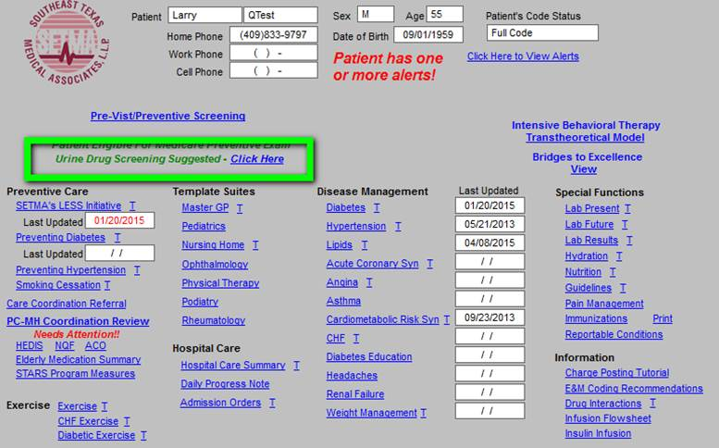
SETMA’s Pain Management Policy

Slide 35
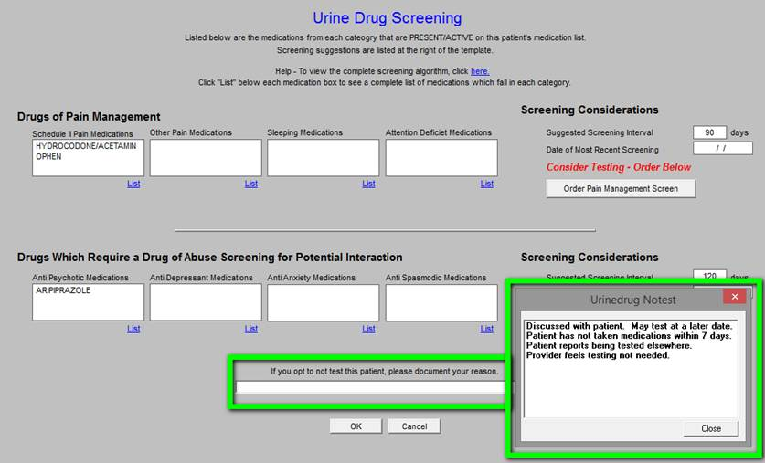
SETMA’s Pain Management Policy

Slide 36
SETMA’s Pain Management Policy
When the Urine-Drug-Screening tool is deployed, there are several reasons why a “suggested” drug screen alert might not be done, although many of those reasons are being shown to be invalid as we find that when we do the screen it proves the patient is not taking the medication.
If you opt not to do a drug screen, you can document your reason for not doing by click in the space which is outlined in green below and then selecting the appropriate reason in the second box below, also outlined in green.
SETMA is committed to complying with all State Board of Medicine requirements and to making sure that we use narcotics appropriately. These tools help us do that more efficiently.

Slide 37
ePCS at SETMA
Once the decision is made to prescribe a controlled substance and/or to renew the prescription, it should be done electronically.
All Southeast Texas Medical Associates, LLP (SETMA) providers have the ability to electronically prescribe controlled substances electronically (ePCS).
This is another major step in the safe and effective use of controlled substances and places SETMA in the company of about 6% of physicians nationally who are currently using this function.

Slide 38
ePCS at SETMA
Only providers who have had ePCS access granted in the EMR may send controlled substance prescriptions. The provider’s smart card, PIN number and code from their SETMA iPhone are all required to send each prescription. Thus, nurses and unit clerks may not send the prescriptions on behalf of the provider.
A provider may only renew and send a controlled substance that he/she originally wrote. They may not renew and send an ePCS prescription that was created by another provider. In this case, they would need to stop the previous prescription rather than renew it and then create a new prescription to send.
All steps for creating and entering the ePCS prescription are the same as for any other medication at SETMA. The only difference in the process will be when you go to send the prescription electronically to the pharmacy.

Slide 39
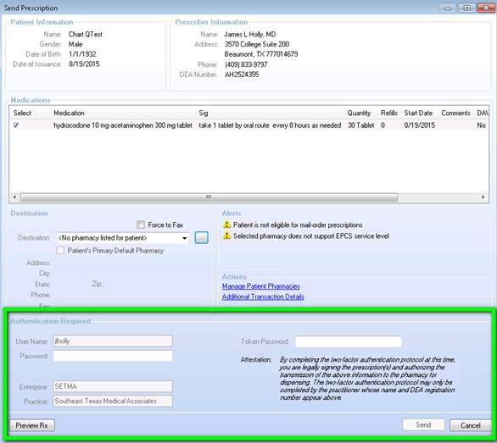
ePCS at SETMA
When sending a controlled substance this additional section of information at the bottom of the screen under “Authorization Required” appears.

Slide 40
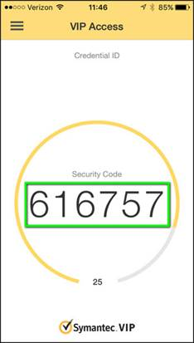
ePCS at SETMA
In the “Password:” box a provider must enter their PIN number that is associated with their smart card.
Also, in the “Token Password” box the provider must enter the rolling code from the VIP Access app on their iPhone which requires a four-digit PIN to access. This code changes every 30 seconds and is specific to each provider.

Slide 41
ePCS at SETMA
Only once the provider has successfully entered both their PIN Password and the 30 second Token Password from their iPhone will they be able to click the “Send” button and the prescription will be routed to the pharmacy like all other electronic prescriptions.

Slide 42
ePCS at SETMA: Auditing of Use
The audit at SETMA, allows the provider, with the click of a button, to display a summary of their e-Prescribing of control substances.
The audit can be for 30, 60, 90, or 180 days.
The Audit will display the number of prescriptions filled in that period of time and the number of distinct patients.
The audit will display eight data points about each e-prescription of controlled substances: type, date, provider, patient, medication, quantity, refills and sig code.

Slide 43
ePCS at SETMA: Auditing of Use

Slide 44
SETMA’s Letter to Pharmacies
In September of 2015, SETMA sent a letter to 105 local pharmacies about the SETMA’s ability to e-prescribe controlled substances. We wanted to let pharmacies know we were taking the step to curb prescription drug abuse and asked them to partner with us.
We asked them to complete a questionnaire about their intentions regarding ePCS.

Slide 45
SETMA’s Letter to Pharmacies
“This correspondence is to inquire as to whether your pharmacy can receive electronic prescriptions and electronic prescriptions for controlled substances (ePCS).
Would you please take a moment to complete the enclosed questionnaire and place it in the enclosed self-addressed envelope. This will help us know which pharmacies our patients can use with these new functions and will hopefully enable us to encourage all pharmacies to use these functions. The questionnaire includes:
Can you receive electronic prescriptions?
Can you receive electronic prescriptions for controlled substances?
If you cannot receive either of the above, do you plan to begin doing so?
When will that function be available at your pharmacy?
If you do not respond to this inquiry, we will assume that you can do neither and will let our patients know that we cannot use this function in their care.”

Slide 46
Beyond ePCS
Beyond controlled substances and much like the Urine Drug Screening Suggestion in our system, SETMA has developed other tools to ensure the appropriate use of different types of medications in all healthcare settings.
In an effort to decrease the inappropriate use of antipsychotic medications in Texas Nursing Homes, The Texas Medical Foundation and the Texas Department of Aging and Disability provided this toolkit. Because SETMA provides care to over 90% of the long-term care residents in Southeast Texas, which comprises a five county area, and because SETMA documents the care of those patients in our electronic patient record (EMR), we have taken this tool kit and created a Clinical Decision Support tool to improve the care of the patients for whom we have responsibility.

Slide 47
Reduction of Antipsychotics
When the Nursing Home Master template is deployed there is a button which launches the Antipsychotics toolkit. There are five sections to the toolkit:
Is the patient on one or more antipsychotic drugs?
Does the patient have one or more diagnoses for an antipsychotic drug?
The following are not adequate indications for treating behavioral or psychological symptoms of dementia with antipsychotics.
Start with the following general principles to reduce antipsychotic use.
What to do when…

Slide 48
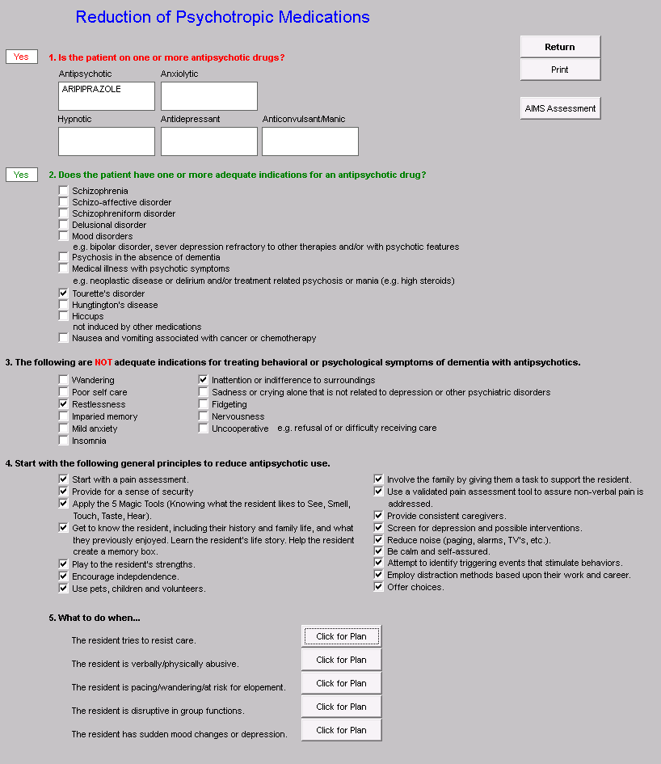
Reduction of Antipsychotics

Slide 49
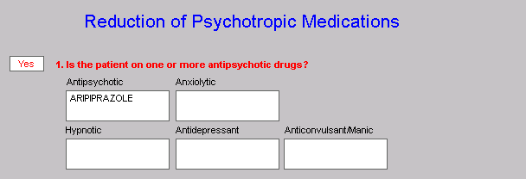
Reduction of Antipsychotics
When this button is deployed, the EMR is searched for Antipsychotic Drugs in these Classifications:
Antipsychotic
Anxiolytic
Hypnotic
Antidepressant
Anticonvulsant/Manic
This is a partial list of psychotropic drugs commonly used in the long-term care setting. Some of these drugs are listed under their official classifications, but may be seen with the intended use of the above classifications to alter/change mood or behavior. Any drugs which are found are automatically listed under its category.

Slide 50
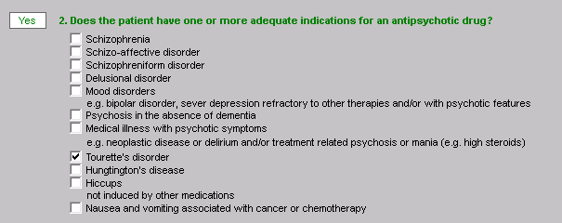
Reduction of Antipsychotics
In section 2 of this template, the computer automatically denotes: “Does the patient have one or more adequate indications for an antipsychotic drug?”
If there is no appropriate diagnosis for the use of an antipsychotic medication, consideration should be given for discontinuing the medication and/or for employing one of more of the therapeutic or environment interventions provided below.

Slide 51
Reduction of Antipsychotics
Section 3 of the tool kit lists the indications for which antipsychotics are often used but which are inadequate indications for such use.

Slide 52
Reduction of Antipsychotics
Section 4 lists alternatives for antipsychotic medications when there is not an indication for their use. This section lists 16 actions which can be instituted to decrease the use of antipsychotic medications. The example shows all of the actions checked off but generally you would only began a few at a time.

Slide 53
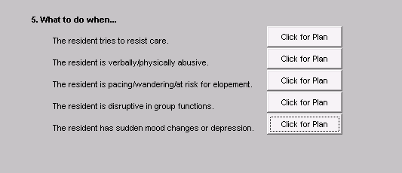
Reduction of Antipsychotics
Section five is entitled “What can be done…” Each of the five recommendations give specific guides for helping patients cope with their new surroundings and with their decreasing mental acuity.

Slide 54
Reduction of Antipsychotics
What to do when…The resident tries to resist care.

Slide 55
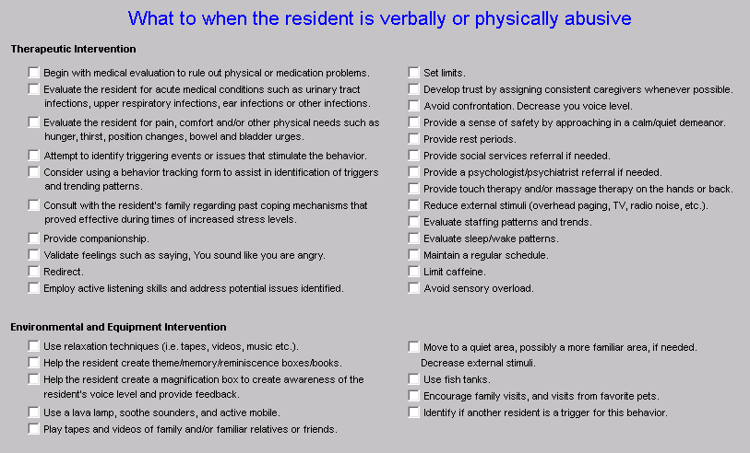
Reduction of Antipsychotics
What to do when…The resident is verbally/physically abusive.

Slide 56
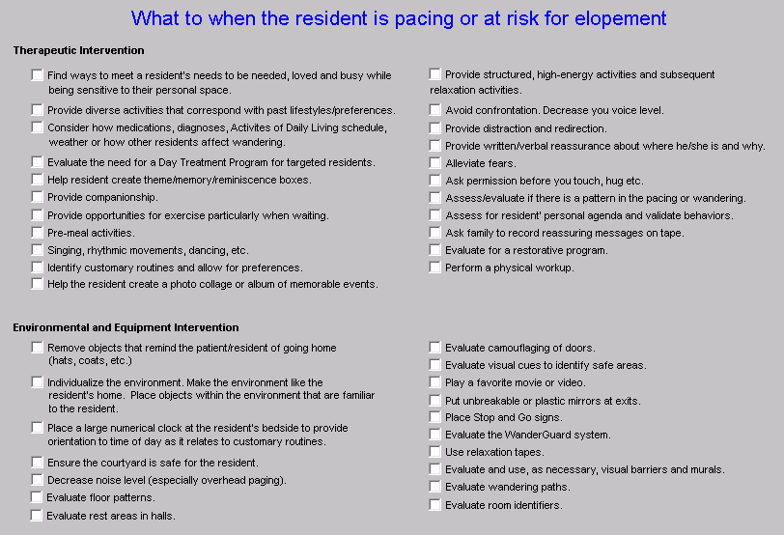
Reduction of Antipsychotics
What to do when…The resident is pacing/wandering/at risk for elopement.

Slide 57
Reduction of Antipsychotics
What to do when…The resident is disruptive in group functions.

Slide 58
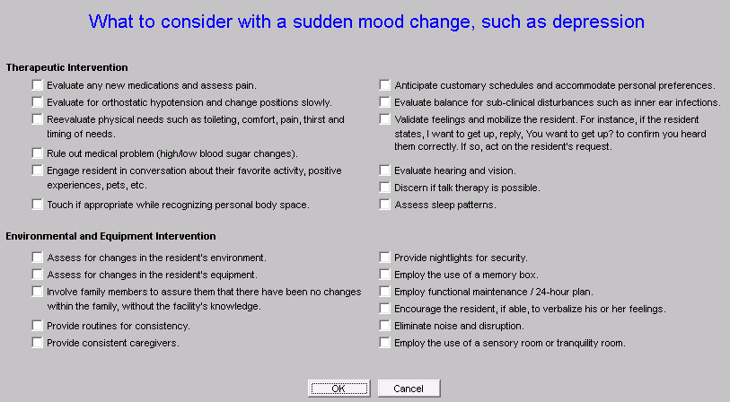
Reduction of Antipsychotics
What to do when…The resident has sudden mood changes or depression.

