Slide 1
National Nurse Practitioner Symposium July 10-13, 2014 Keystone, Colorado
Mrs. Norma Duncan, CFNP
Dr. James L. Holly, CEO
Southeast Texas Medical Associates, LLP

Slide 2
EHR for the Patient and Provider Norma Duncan, APRN, FNP James Holly, MD
Thursday, July 10, 2014
EDUCATIONAL SESSIONS D6 – 2:30 PM - 4:00 PM
1.5 CONTACT / CE HOURS

Slide 3
Adding New Members to the Team
Before SETMA learned of the power and necessity of EHR, we discovered the necessity of a team approach to 21st Century medicine.
In June of 1996, SETMA invited a CFNP to joint our provider staff.
Two days later, a seminal event: the broken vial of blood.
January 4, 1998 Mrs. Norma Duncan joined SETMA.
Today, SETMA has fourteen NP colleagues and is negotiating with others.
In 2000, one NP said of SETMA’s CEO, “You’re almost good enough to be a nurse practitioner.”

Slide 4
SETMA and the EHR
In October, 1997, SETMA determined to purchase an EHR.
On March 30, 1998, we signed our first check for $675,000 which started our journey in electronics.
On January 26, 1999, we began using our EHR.
On January 29, 1999 all patients were seen in the EHR.
On May 5, 1999, our world changed.

Slide 5
Selling the EHR
The selling of the EHR not only encouraged each participant in the healthcare process to "buy in" to the concept, but it also put SETMA in the position of "having to" succeed. Once we announced that we were going to do EHR, and once we "bragged" on what it would accomplish for our practice and our patients, we had no choice but to succeed.
Selling the EHR is not unlike the Spanish Explorer, Hernan Cortez ,who arrived on the Yucatan Peninsula in the year 1519.
One historical account relates the events.

Slide 6
The Vision of EHR
SETMA’s Fahrenheit 451 Project
As SETMA grew in understanding of electronics, and the power of electronic records and management we realized how inefficient, ineffective and expensive healthcare by paper was.
451 Degrees Fahrenheit is the kindling point of paper. While we did not and do not burn books or even paper, we adopted it as a metaphor for the advance of EHR.

Slide 7
Our World Changed: Four Seminal Events May, 1999
These events transformed SETMA’s vision and healthcare delivery:
First, we concluded that EMR was too hard and too Expensive if all we gained was the ability to document a patient encounter electronically. EMR was only “worth it,” if we leveraged electronics to improve care for each patient; to eliminate errors which were dangerous to the health of our patients; and, if we could develop electronic functionalities for improving the health and the care of our patients.

Slide 8
Our World Changed: Four Seminal Events May, 1999
We also recognized that healthcare costs were out of control and that EHR could help decrease that cost while improving care.
Therefore, we began designing disease-management and population-health tools, which included “follow up documents,” allowing SETMA providers to summarize patients’ healthcare goals with personalized steps of action through which to meet those goals.
We transformed our vision from how many x-rays and lab tests were done and how many patients were seen, to measurable standards of excellence of care and to actions for the reducing of the cost of care.
We learned that excellence and expensive are not synonyms.

Slide 9
Our World Changed: Four Seminal Events May, 1999
The second event was that based on our study of Peter Senge’s The Fifth Discipline and of “systems thinking,” SETMA defined ten principles of how to design an EHR and how to build a medical practice.
Pursue Electronic Patient Management rather than Electronic Patient Records.
Bring to bear upon every patient encounter what is known rather than what a particular provider knows.
Make it easier to do it right than not to do it at all.
Continually challenge providers to improve their performance.
Infuse new knowledge and decision-making tools throughout an organization instantly.

Slide 10
Our World Changed: Four Seminal Events May, 1999
Establish and promote continuity of care with patient education, information and plans of care.
Enlist patients as partners and collaborators in their own health improvement.
Evaluate the care of patients and populations of patients longitudinally.
Audit provider performance based on the Consortium for Physician Performance Improvement Data Sets.
Create multiple disease-management tools which are integrated in an intuitive and interchangeable fashion giving patients the benefit of expert knowledge about specific conditions while they get the benefit of a global approach to total health.

Slide 11
Medical Home
Later, SETMA realized that these principles are the foundation of patient-centered medical home.
This made PC-MH not only a transformative natural step also made it a logical imperative.
By March, 2014, SETMA was recognized or accredited as a PC-MH by:
NCQA Tier III – 2010-2016
AAAHC – 2010-2017
URAC – 2014-2017
The Joint Commission – 2014-2017

Slide 12
Our World Changes: Four Seminal Events May, 1999
The third seminal event was the preparation of a philosophical base for our future; developed in May, 1999, this blueprint was published in October, 1999. It was entitled, More Than a Transcription Service: Revolutionizing the Practice of Medicine With Electronic Health Records which Evolves into Electronic Patient Management.
This document is published on our website under Your Life Your Health.

Slide 13
Our World Changes: Four Seminal Events May, 1999
Fourth, we determined to adopt a celebratory attitude toward Our progress in EMR.
In May, 1999, my cofounding partner was lamenting that we were not crawling yet with our use of the EMR. I agreed and asked him, “When your son first turned over in bed, did you lament that he could not walk, or did you celebrate this first milestone of muscular coordination of turning over in bed?” He smiled and I said, “We may not be crawling yet, but we have started. If in a year, we are doing only what we are currently doing, I will join your lamentation, but today I am celebrating that we have begun.”
These four seminal events have defined SETMA’s EMR pilgrimage and are the foundation of our success.

Slide 14
Trust and Hope
Nevertheless, in the midst of health information technology innovation, we must never forget that the foundations of healthcare change are “trust” and “hope.”
Without these, science is helpless!

Slide 15
SETMA’s Model of Care
SETMA’s Redesign of Primary Healthcare n– SETMA’s Model of Care - - involved five steps:
Performance Tracking – one patient at a time
Performance Auditing – by panel or by population
Performance Analysis – statistical analysis
Performance Reporting – publicly by Provider Name www.jameslhollymd.com
Quality Assessment and Performance Improvement

Slide 16
Clusters & Galaxies

Slide 17
Clusters & Galaxies

Slide 18
Quality Metrics
Quality metrics not an end in themselves!
Optimal health at optimal cost is the goal of quality care. Quality metrics are simply “sign posts along the way.” They give directions to health.
Metrics are like a healthcare “Global Positioning System”: it tells you where you are, where you want to be, and how to get from here to there.
Ultimately, the goal will be measured by the well being of patients, but the guide posts to that destination are given by the analysis of patient and population data.

Slide 19
Quality Metrics
The tracking of quality metrics should be incidental to the care patients are receiving and should not be the object of care. Consequently, the design of the data aggregation in the care process must be as non-intrusive as possible. Notwithstanding, the very act of collecting, aggregating and reporting data will tend to create an Hawthorne effect.
Emphasis on the patient's health will overcome any distortion in care of the Hawthorne effect.

Slide 20
Auditing Provider Performance

Slide 21
Step II - Auditing Provider Performance

Slide 22
Public Reporting of Performance

Slide 23
Step IV - Public Reporting of Performance

Slide 24
Quality Assessment & Performance Improvement
Quality Assessment and Performance Improvement (QAPI) is SETMA’s roadmap for the future. With data in hand, we can begin to use the outcomes to design quality initiatives for our future.
We can analyze our data to identify disparities in care between
Ethnicities
Socio-Economic Groups
Age Groups
Genders

Slide 25
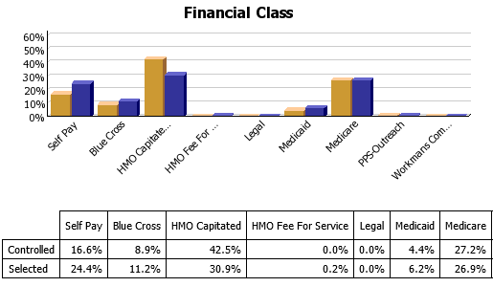
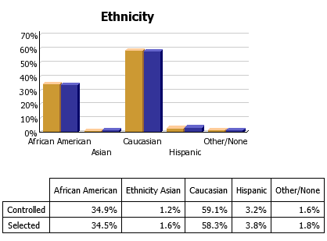
Quality Assessment & Performance Improvement

Slide 26
How Medical Home Helps You
It prepares you for the future by helping you recapture the best of the past.
The foundations of health care are trust and hope.
Today, patients have more trust in technology than in their healthcare provider.
PC-MH helps you engage the patient as a part of their healthcare team and helps them take charge of their own care with the trust and hope that “making a change will make a difference.”

Slide 27
How Medical Home Helps You
You are the healthcare generation which is bridging the health science revolution with health delivery transformation. Medical Home is the substance, structure and support of that bridge.
Future generations of healthcare providers will not experience the quality chasm which has motivated the Medical Home movement and they will not see a “bridge,” only a continuum of care.

Slide 28
PC-MH Poster Child
It allows you to envision a future of your own creation in healthcare.
One patient who came to the clinic was angry & depressed. He left the clinic with The SETMA Foundation buying all of his medications, giving him a gas card to get to our ADA certified DSME program, the fees waived for the classes, help in applying for disability, and an appointment to an experimental program for preserving the eyesight of patients with diabetes. He returned in six weeks with something we could not prescribe. He had hope and joy. By the way, his diabetes was to goal for the first time in years.
This is PCMH and it is humanitarianism. They may be the same thing.

Slide 29
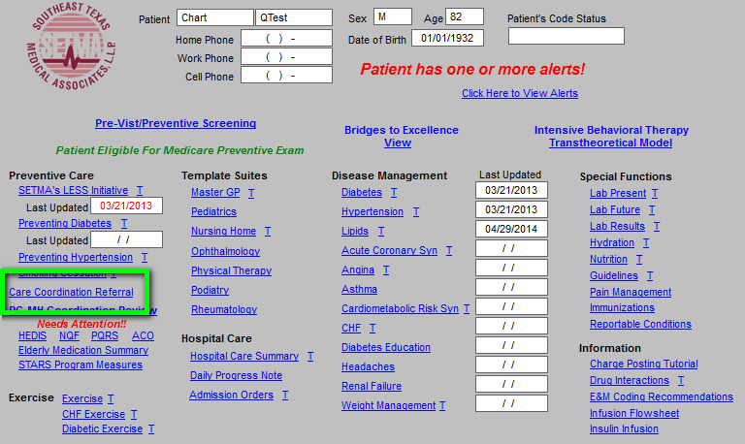
Care Coordination Referral

Slide 30
Care Coordination Referral

Slide 31
The Baton
The following picture is a portrayal of the “plan of care and treatment plan” which is like the “baton” in a relay race.

Slide 32
The Baton
“The Baton” is the instrument through which responsibility for a patient’s health care is transferred to the patient or family. Framed copies of this picture hang in the public areas of all SETMA clinics and a poster of it hangs in every examination room. The poster declares:
Firmly in the provider’s hand --The baton -- the care and treatment plan Must be confidently and securely grasped by the patient, If change is to make a difference 8,760 hours a year.

Slide 33
The Baton
The poster illustrates:
That the healthcare-team relationship, which exists between the patient and the healthcare provider, is key to the success of the outcome of quality healthcare.
That the plan of care and treatment plan, the “baton,” is the engine through which the knowledge and power of the healthcare team is transmitted and sustained.
That the means of transfer of the “baton,” which has been developed by the healthcare team, is a coordinated effort between the provider and the patient.

Slide 34
The Baton
That typically the healthcare provider knows and understands the patient’s healthcare plan of care and the treatment plan, but without its transfer to the patient, the provider’s knowledge is useless to the patient.
That the imperative for the plan – the “baton” – is that it must be transferred from the provider to the patient, if change in the life of the patient is going to make a difference in the patient’s health.

Slide 35
The Baton
That this transfer requires that the patient “grasps” the “baton,” i.e., that the patient accepts, receives, understands and comprehends the plan, and that the patient is equipped and empowered to carry out the plan successfully.
That the patient knows that of the 8,760 hours in the year, he/she will be responsible for “carrying the baton,” longer and better than any other member of the healthcare team.

Slide 36
The Baton
http://www.jameslhollymd.com/Presentations/patient-engagement-primary-care-physician
The activation and engagement document is the “baton,” Whether created at the end o f the hospital stay, the office encounter, the emergency department visit, it is the document through which responsibility for the patient's care is transferred from the provider to the patient.

Slide 37
The Baton Video
http://www.youtube.com/watch?v=_jfOz0BPh_E

Slide 38
SETMA’s Care Transitions
SETMA’s Care Transition involves:
Evaluation at admission – transition issues: “lives alone,” barriers, DME, residential care, medication reconciliation, or other needs
Fulfillment of PCPI Care Transitions Quality Metric Set
Hospital Care Summary and Post Hospital Plan of Care and Treatment Plan at discharge
Post Hospital Follow-up Coaching – a 12-30 minute call made by members of SETMA’s Care Coordination Department and additional support
Follow-up visit with primary provider within in 2-4 days, which is the last critical step in Care Transitions

Slide 39
1. Evaluation At Admission
Barriers to Care including support requirements
Does the patient live alone? (ICD-9 V603; ICD-10 Z602; SNOMED “Lives Alone – No Help Available”)
Activities of Daily Living – is the patient safe to live independently
Hospital Plan of Care - a document given to patient/family at admission - includes potential for re-hospitalization, estimated length of stay, why hospitalized, expected length of hospitalization, procedures and tests planned, contact information for how to call hospital-team members.
Establishes communication with all who are involved in patient's care: attending, nursing staff, hospital service team, family.
Links ambulatory patient activation to inpatient activation.

Slide 40
2. Fulfillment of Quality Metric Sets
SETMA has completed “Discharge Summaries “ in ambulatory EMR since the year 2000.
June, 2009, PCPI published Transitions of Care Quality Metric Set
SETMA adopted PCPI Measurement Set immediately
SETMA’s Quality Metrics Philosophy
The Limitations of Quality Metrics
SETMA began Public reporting by provider name at www.jameslhollymd.com of performance on quality metric sets for 2009-First Quarter 2013.
In 2011 completed research project with AMA to determine if SETMA’s fulfillment of measures is valid. The answer? “Yes.”

Slide 41
Care Transition Audit
The PCPI Measurement Set involves 14 actions which are audited. SETMA’s deployment is such that if at the end of the documentation of the Hospital Care Summary, any of the metrics not met (appear in red), the “Click to Update/review” button can be depressed. This will take the provider to the point in the document where that element should be documented.

Slide 42
Care Transition Audit
The PCPI Measurement Set also involves 4 actions which must be completed. These actions are documented by the provider who completes the Hospital Care Summary by entering his/her name and the time and date of completion.

Slide 43
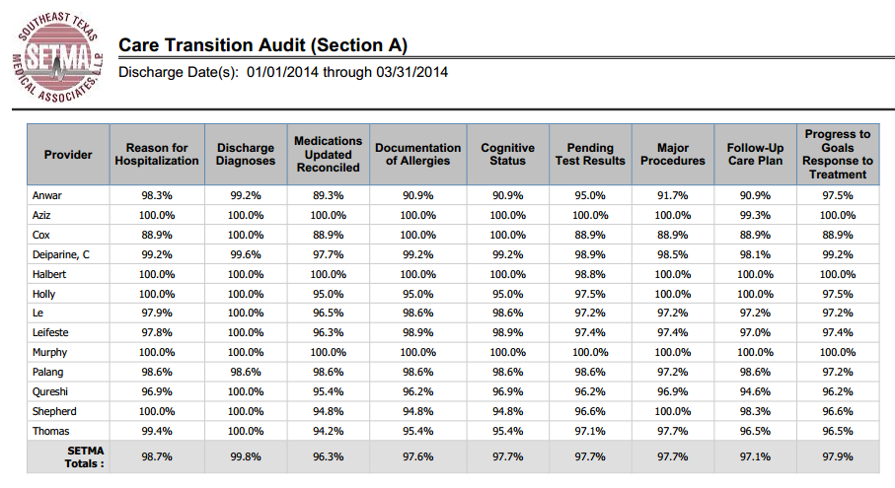
Care Transition Audit
Publicly reported at www.jameslhollymd.com

Slide 44
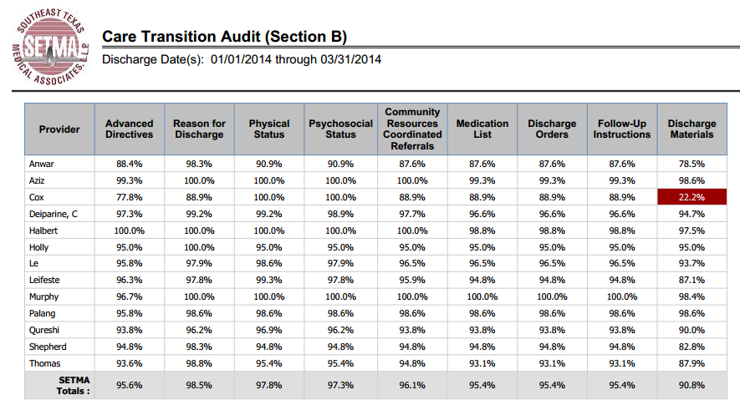
Care Transition Audit
Publicly reported at www.jameslhollymd.com

Slide 45
3. Hospital Care Summary & Post-Hospital Plan of Care and Treatment Plan
At NQF Care Transitions Conference, October, 2010, changed name of “discharge summary.”
Includes follow-up appointments, reconciled medication lists (4 reconciliations: admission, discharge, care coaching call, follow-up appointment), plan of care and treatment plan.
In last 60 months, completed 21,000+ discharges.
98.7% of time, document given to patient, hospital, care giver, nursing home, etc., at discharge.
This is the tool which transfers responsibility for care to the patient. SETMA calls it the Baton.

Slide 46
Three Inpatient Batons
The Hospital Admission Plan of Care
The Hospital Care Summary and Post Hospital Plan of Care and Treatment Plan
Post Hospital Plan of Care and Treatment Plan
The link below is to de-identified examples of these three documents from a real patient here.
http://www.jameslhollymd.com/Presentations/Transitions-of-Care-Initiative-to-Reduce-Preventable-Readmissions-Institute-for-Healthcare-Improvement

Slide 47
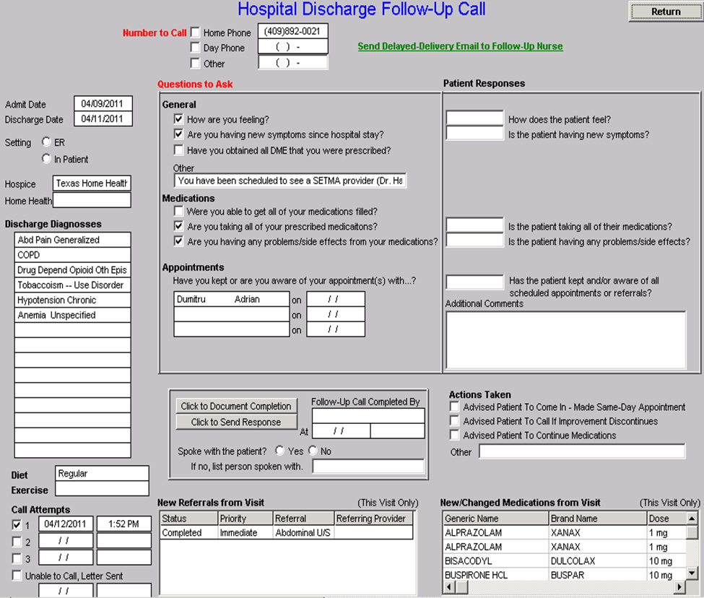
Hospital Follow-Up Call
After the care transition audit is completed and the “baton” document is generated, the provider completes the Hospital-Follow-up-Call template.
All of the data is automatically entered. The provider checks off questions to be asked and additional queries to be made and sends the call request.

Slide 48
Hospital Follow-Up Call
During the preparation of the “baton” handoff, the provider checks off the questions which are to be asked the patient in the follow-up call.
The call order is sent to the Care Coordination Department electronically. The day following discharge, the patient is called.
The call is the beginning of the “coaching” of the patient to help make them successful in the transition from the inpatient setting.

Slide 49
Hospital Follow-Up Call
A 12-30 minute call made by members of SETMA’s Care Coordination Department the day after discharge.
If after three attempts, contact is not made, a letter is automatically generated for mailing to the patient.
Additional phone calls, or other interventions can be scheduled by the care coordination department
Results of the follow-up phone call are sent back to the healthcare provider.
If problems are discovered, immediate appointment is given or other appropriate intervention is initiated, including a home visit.

Slide 50
Hospital Follow-Up Call
SETMA’s Care Coordination Department is currently completing over 3,300 calls to patients monthly. Our analytics shows that the patient receiving or not receiving a care coaching call is one of the key predictors for readmission to the hospital. This includes hospital and clinic follow-up calls, missed appointment calls and follow-up calls generated by the department itself.
Monthly, SETMA closes our offices for one-half day during which time all providers meet for training and review of performance. In those meetings, we have reviewed many IHI papers on Care Transitions.

Slide 51
SETMA Foundation
Under the Medical Home model the provider has NOT done his/her job when he/she simply prescribes the care which meets national standards. Doing the job of Medical Home requires the prescribing of the best care which is available and accessible to the patient, and when that care is less than the best, the provider makes every attempt to find resources to help that patient obtain the care needed.

Slide 52
SETMA Foundation
Because we treat such a vulnerable population, in 2008, SETMA established the SETMA Foundation. Thus far, the SETMA partners have contributed $3,000,000 to the Foundation. These funds cannot profit SETMA and can only be used to pay for the care of our patients by providers who will not see them without being paid. SETMA treats all of these patients at no cost.

Slide 53
SETMA Foundation PC-MH Poster Child
In February 2009, SETMA saw a patient who has a very complex healthcare needs. When seen in the hospital as a new patient, he was angry, bitter and hostile. No amount of cajoling would change the patient’s demeanor.
During his hospital follow-up, it was discovered that the patient was only taking four of nine medications because of expense; could not afford gas to come to the doctor; was going blind but did not have the money to see an eye specialist; could not afford the co-pays for diabetes education and could not work but did not know how to apply for disability. He also was uninsured.

Slide 54
SETMA Foundation PC-MH Poster Child
He left after the hospital follow-up visit with the Foundation providing:
All of his medications. The Foundation has continued to do so for the past four years at a cost of $2,200 a quarter.
A gas card so that he could afford to come to multiple visits for education and other health needs.
Waiver of cost for SETMA’s ADA accredited Diabetes Self-Management Education and Medical Nutrition Therapy programs.
Appointment to an experimental, vision-preservation program.
Assistance with applying for disability. Which he received after four months. Three years later his Medicare became active.

Slide 55
SETMA Foundation
Are gas cards, disability applications, paying for medications a part of a physician’s responsibilities? Absolutely not; but, are they a part of Medical Home? Absolutely! This patient, who was depressed and glum in the hospital, such that no one wanted to go into the patient’s room, left the office with help.
He returned six-weeks later with a smile and with hope, which may be that the biggest result of Medical Home. Without hope patients will not make changes.
His diabetes was treated to goal for the first time in ten years. He has remained treated to goal for the past four years.

Slide 56
SETMA Foundation
Every healthcare provider doesn’t have a foundation and even ours can’t meet everyone’s needs, but assisting patients in finding the resources to support their health is a part of medical home.

Slide 57
SETMA Foundation
And, when those resources cannot be found, Medical Home will be “done” by modifying the treatment plan so that what is prescribed can be obtained.
The ordering of tests, treatments, prescriptions which we know our patients cannot obtain is not healthcare, even if the plan of care is up to national standards.

Slide 58
Care Transitions & Hospital Readmissions
For14 years, we have focused on processes, believing that outcomes will inevitably follow, which outcomes will then inevitably be sustainable.
SETMA expects to significantly affect hospital preventable re-admission rates over the next two years and to sustain those improvements.
Supported by care transitions, coordination of care, medication reconciliation (at multiple points of care) patient safety, quality of care and cost of care will be positively impacted.

Slide 59
Conclusions
The problem of readmissions will not be solved by more care: more medicines, more tests, more visits, etc.
The problem will be solved by redirecting the patient’s attention for a safety net away from the emergency department.
The problem will be solved by our having more proactive contact with the patient.

Slide 60
Conclusions
The problem will be solved by more contact with the patient and/or care giver in the home: home health, social worker, provider house calls.
The problem will be solved by the patient and/or care giver having more contact electronically (telephone, e-mail, web portal, cell phone) with the patient giving immediate if not instantaneous access.

Slide 61
Care Transitions
http://www.youtube.com/watch?v=HPbrE46_EoU

Slide 62
Implementing Medicare Transitional Care Management Services

Slide 63
Transitions of Care Management New Codes Announced
November 16, 2012
CY 2013 Physician Fee Schedule Final Rule published
Two new codes introduced for physicians and qualifying nonphysical practitioner care management services for a patient following a discharge from a hospital, SNF, CMHC, outpatient observation or partial hospitalization
January 30, 2013
First payable date of service for Transitional Care Management (TCM) codes
March 2013
SETMA began using TCM codes on eligible patients

Slide 64
Criteria For New Codes
Criteria | 99495 | 99496
Level of Medical Decision Making | Moderate Complexity (99214) or Higher | High Complexity (99215)
Days Since Discharge | Within 14 Days | Within 7 Days
Follow-Up Contact | Within 2 Business Days of Discharge | Within 2 Business Days of Discharge

Slide 65
Potential for Increased Revenue
TCM codes are billed in place of traditional Evaluation & Management (E&M) codes and offer a higher level of reimbursement.
In the age of decreasing reimbursement, it is important to be able to access sources of additional reimbursement which are being made available to those providers who can demonstrate their ability to provide excellent care.
TCM codes are just one example of increase revenue sources available to providers who provide excellent care.

Slide 66
Potential for Increased Revenue
Level of Medical Decision Making | E&M Code Reimbursement | TCM Code Reimbursement | Increase
Moderate Complexity | 99214 $101.12 | 99495 $154.53 | $53.41
High Complexity | 99215 $135.63 | 99496 $218.27 | $82.64

Slide 67
How To Implement A Sustainable Solution?
The benefit of increase reimbursement is obvious, but how do you implement a solution which is sustainable and can be time and time again with out placing an additional burden on an already stretched provider?
The answer…the power of electronics.

Slide 68
Make It Easier To Do It Right Than Not At All
Because SETMA uses the same EHR in both inpatient and outpatient settings, all of the information needed to determine a patient’s eligibility for the TCM codes is automatically aggregated and calculated in the background.
All a provider has to do is begin an office visit and if the patient is eligible, they will be alerted on our main AAA_Home template in the EHR.

Slide 69
SETMA’s Follow-Up Calls
Every patient that SETMA discharges from the hospital is scheduled to receive a call from our Care Coordination Department.
SETMA has been calling all patients discharged from the hospital since 2009.
We did not have to implement anything new in order to fulfill the follow-up contact requirement of the new TCM codes.

Slide 70
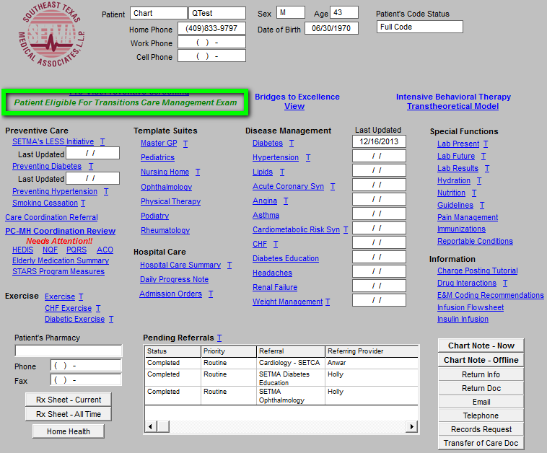
Make It Easier To Do It Right Than Not At All

Slide 71
Make It Easier To Do It Right Than Not At All
At the conclusion of the visit, when the provider accesses the billing template, they will again be reminded to bill the TCM code is eligible.
Again, this requires no extra work on the provider as all of the information has already been aggregated in the background.

Slide 72
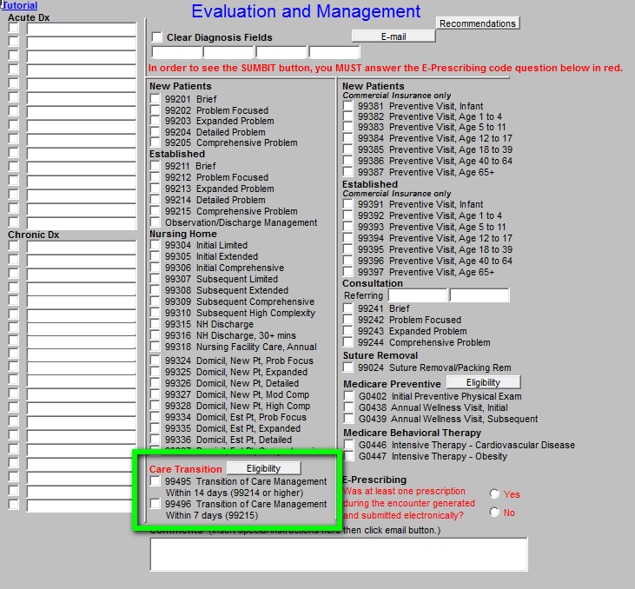
Make It Easier To Do It Right Than Not At All

Slide 73
Make It Easier To Do It Right Than Not At All
When the “Care Transition” label is shown in red, the provider clicks the Eligibility button to confirm that all of the criteria have been met to bill a TCM code in place of a traditional E&M code.
The only thing that the provider must do is select the Level of Medical Decision Making that they feel they performed during the office encounter.
99124 (Moderate Complexity or higher) Level of Medical Decision Making required for TCM code 99495
99125 (High Complexity) Level of Medical Decision Making required for TCM code 99496

Slide 74
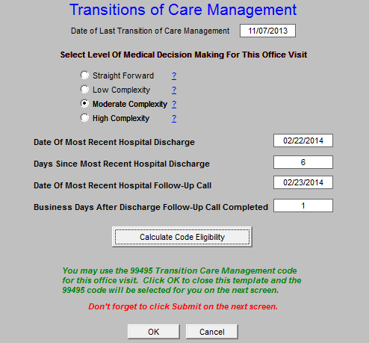
Make It Easier To Do It Right Than Not At All

Slide 75
Make It Easier To Do It Right Than Not At All
The provider simply clicks “Calculate Code Eligibility” and the EHR confirms if all criteria to bill a TCM code have been met.
If so, the highest eligible TCM code is automatically selected, the provider closes the screen and clicks Submit.
The work is done!

Slide 76
HCC Risk Adjustment Factor
http://www.jameslhollymd.com/Presentations/coding-to-ensure-accurate-health-risk-scoring
This link gives a detailed instruction about how to use HCC Risk Adjustment Factor in relationship to:
Medicare Advantage
Accountable Care Act
Medical Home

Slide 77
Numbers Don’t Lie

Slide 78
Medicare Preventive Services: Initial Preventive Physical Exam & Annual Wellness Visit

Slide 79
Medicare Preventive Services
Historically, the Centers for Medicare and Medicaid Services (CMS) have not paid for preventive care or for routine physical examinations. But there are parts of the Accountable Care Act (ACA) which provide benefits which suggest that CMS is getting serious about Preventive Health Services which have the potential for moving us toward the fulfillment of the Triple Aim: improved care (processes), improve health (outcomes) and decreased costs (sustainability).

Slide 80
Medicare Preventive Services
The ACA has made provision for the following Preventive Health Services at little or no cost to Medicare beneficiaries. The new Intensive Behavioral Therapy codes for obesity and cardiovascular disease along with the Initial Preventive Physical Exam (IPPE), the Annual Wellness Visit Initial and Annual Wellness Visit Subsequent are significant advances in recognizing the value of preventive care and in recognizing the expertise of those who have the tools to provide those services.

Slide 81
Medicare Preventive Services
Along with the Transitions of Care Management Codes which have been published this year, these preventive codes encourage the “right stuff” in primary healthcare delivery. SETMA is determined to support and to promote these efforts by utilizing them in our practice. The key to these codes is that there is no deductible and CMS pays the provider for the full allowable benefit. This is a savings to patients and it is also a revenue benefit to the healthcare provider. The payment for the IPPE is approximately $159 with no cost to the patient. If a screening EKG and/or screening abdominal ultrasound is warranted and ordered at this time, the fee is paid in addition to the IPPE fee and it is paid without deductible, also.

Slide 82
Medicare Preventive Services
G0402 Initial Preventive Physical Examination (IPPE) (Also called the Welcome to Medicare Preventive Visit )
G0438 Annual Wellness Visit, Initial (AWV) Annual wellness visit, including a personalized prevention plan of service (PPPS), first visit.
G0439 Annual Wellness Visit, Subsequent (AWV) Annual Wellness visit, including a personalized prevention plan of service (PPPS), subsequent visit. Annual Wellness Visits can be for either new or established patients as the code does not differentiate. The initial AWV, G0438, is performed on patients that have been enrolled with Medicare for more than one year.

Slide 83
Medicare Preventive Services – SETMA’s Solution
One of the difficulties of these benefits is for a provider to remember who is eligible to receive this benefit. In order to facilitate the use of these codes and to provide a no-cost benefit to our patients, SETMA has deployed an electronic means of alerting the provider to the fact that the patient qualifies for this benefit.

Slide 84
Medicare Preventive Services – SETMA’s Solution
One of the difficulties of these benefits is for a provider to remember who is eligible to receive this benefit. In order to facilitate the use of these codes and to provide a no-cost benefit to our patients, SETMA has deployed an electronic means of alerting the provider to the fact that the patient qualifies for this benefit.

Slide 85
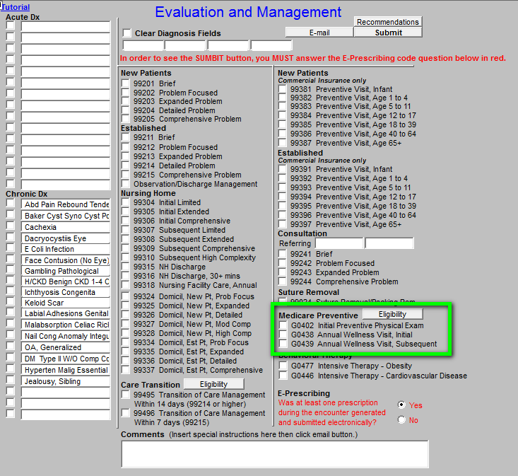
Make It Easier To Do It Right Than Not At All

Slide 86
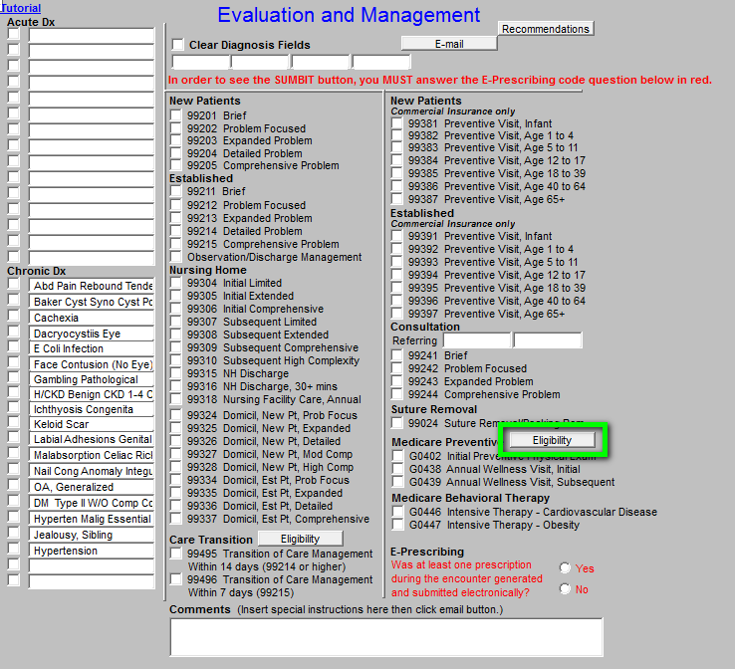
Make It Easier To Do It Right Than Not At All
With one click, providers can determine the eligibility to bill the Medicare Preventive Services.

Slide 87
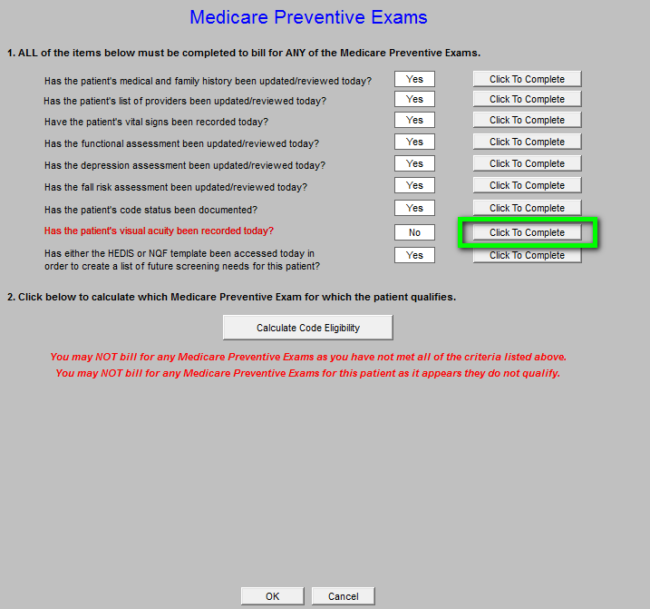
Make It Easier To Do It Right Than Not At All
All the elements require to bill for the Medicare Preventive Services codes are displayed.
The system highlights in red the required items which have not been completed.
If an item has not been done, the provider can click the link next to the element in order fulfill the requirement.

Slide 88
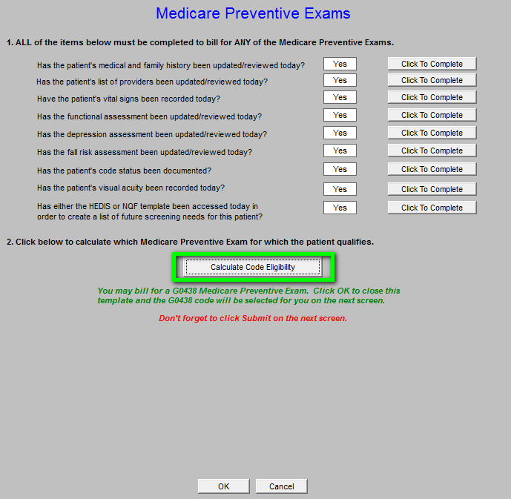
Make It Easier To Do It Right Than Not At All
When all elements have been fulfilled, the “Calculate Code Eligibility” button will determine the appropriate code (G0402, G0438 or G0439) that can be used.

Slide 89
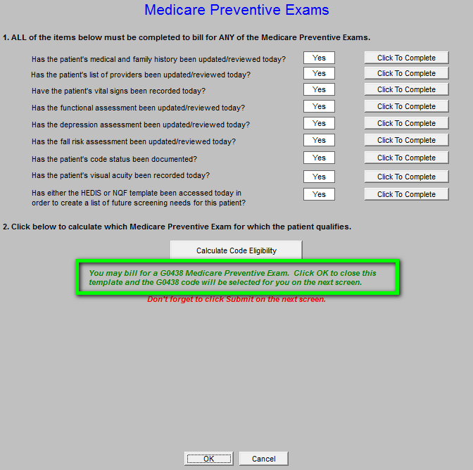
Make It Easier To Do It Right Than Not At All
When this template is closed, the correct code is selected and the provider simply clicks “Submit” to bill the code.
No additional work by the provider is required!

