Slide 1
IHI's 15th Annual International Summit on Improving Patient Care in the Office Practice and the Community Mini Course on Transitions of Care
Washington D. C.
March 9, 2014
Dr. James L. Holly
CEO, Southeast Texas Medical Associates, LLP
www.jameslhollymd.com

Slide 2
Care Transitions
In SETMA’s Model of Care -- Care Transition involves:
Evaluation at admission with Hospital Plan of Care produced and given to the patient -- transition issues “lives alone,” barriers , DME, residential care, or other needs. The Plan of Care includes: why hospitalized, what will be done, consolations, procedures, tests, estimated length of stay and potential for readmission.
Fulfillment of PCPI Transitions of Care Quality Metric Set
Post Hospital Follow-up Coaching
A 12-30 minute call made by members of SETMA’s Care Coordination Department
Plan of Care and Treatment Plan
Follow-up visit with primary provider

Slide 3
Care Transitions & Hospital Readmission
In SETMA’s experience, there are fifteen steps required to address care coordination and hospital readmissions, as a function of a quality care initiative which is sustainable.
The steps and the solution for each are as follows.

Slide 4
Care Transitions & Hospital Readmission
January,1999, SETMA began using the EHR to document patient encounters.
May, 1999, SETMA modified the goal to electronic patient management (EPM) in order to leverage the power of electronics to improve treatment outcomes.
October, 1999, SETMA began using the EMR in the hospital for hospital H&Ps, creating continuity-of-care processes, based on healthcare data being electronically created and being available at all points of care.

Slide 5
Care Transitions & Hospital Readmission
In 2000, realizing that excellent care in the 21st Century was going to be team-based, SETMA formed a hospital service team, which provides 24-hour-a-day, seven-day a week, in-house coverage for all of our patients.

Slide 6
Care Transitions & Hospital Readmission
In 2001, SETMA began using the EHR to produce hospital discharge summaries which further advanced continuity-of-patient-care and established the groundwork both for care transitions and for effectively addressing preventable readmissions.
At this point, medication reconciliation could take place in the: clinic, hospital, nursing home, home health and emergency department.

Slide 7
Care Transitions & Hospital Readmission
In 2003, SETMA designed hospital-admission-order sets, based on national standards of care, which created a consistency of treatment plans and eliminated delay in the initiation of excellent care.

Slide 8
Care Transitions & Hospital Readmission
Also, in 2003, SETMA began using the EHR in all thirty-two nursing homes we staff. Because our patients’ care is managed in the same electronic data base, whether in the ambulatory setting, hospice, home health, physical therapy, hospital, emergency department, or nursing home, there is a continuity-of-care which is data and information driven.

Slide 9
Care Transitions & Hospital Readmission
In 2004, SETMA designed an electronic, Inpatient Medical Record Census (IMRC); deployed on SETMA’s intranet and HIPPA compliant, the IMRC allows searchable-data recording of:
date of admission to the hospital
place of admission
date and time of completion of the History and Physical
date of discharge
date and time of completion of the Hospital Care summary and post-hospital plan of care and treatment plan.
Posting of questions from business office which need research by hospital care team.

Slide 10
Care Transitions & Hospital Readmission
In 2007, SETMA’s partners realized that many of our patients, even those with insurance, cannot afford all of their health care. This resulted in the creation of The SETMA Foundation.
SETMA partners have given over $2,500,000 to the Foundation which pays for medications, surgeries and other care, such as dental, for our patients who cannot afford it.

Slide 11
Care Transitions & Hospital Readmission
In June, 2009, the Physician Consortium for Performance Improvement (PCPI) published the first national quality measurement set on Care Transitions; the same month, SETMA deployed the measures in our EHR. Since then, of the over 21,000 discharges from the hospital, 98.7% have had the Hospital Care Summary completed at the time the patient left the hospital.

Slide 12
Care Transitions & Hospital Readmission
October, 2009, SETMA adapted a Business Intelligence tool to create an audit of hospitalized patients to examine differences between patients who are re-admitted and those who are not.
The audit looks at: gender, ethnicity, socio-economic issues, social isolation, morbidities and co-morbidities, lengths of stays, age, timing of follow-up after discharge, whether a follow-up call was received and other issues.
These measures look for leverage points for “making a change, which will make a difference in readmissions”

Slide 13
Care Transitions & Hospital Readmission
November, 2009, SETMA began publicly reporting performance on over 300 quality metrics by provider name at www.jameslhollymd.com. Disease management plans-of-care documents for diabetes, hypertension, and cholesterol, include the provider performance on that patient’s care, as judged by these quality metrics.

Slide 14
Care Transitions & Hospital Readmission
In July, 2010, pursuant to becoming a NCQA, Tier 3 PC-MH, SETMA created a Department of Care Coordination, tasked with:
Post Hospital follow-up calling
Completing SETMA Foundation Referrals
Patient counseling for barriers to care
Establishing continuity of care
Engaging patients in their own care
Alerting providers to patients’ special needs
Another level of mediation reconciliation

Slide 15
Care Transitions & Hospital Readmission
September, 2010, at a National Quality Forum workshop on Care Transitions, SETMA realized that the term “discharge summary” was outdated. We changed the name to “Hospital Care Summary and Post Hospital Plan-of-Care and Treatment-Plan,” long and perhaps awkward, this name, is functional, focusing on the unique elements of Care Transition which contribute to the foundation for a sustainable plan for addressing preventable readmissions to the hospital.

Slide 16
Care Transitions & Hospital Readmission
In 2010, SETMA deployed both a secure web portal and a health information exchange to allow the seamless exchange of information between the hospitals , nursing homes, home health agencies, hospices, and SETMA. The HIE has been expanded to a multi-county project including all healthcare providers and agencies, which will ultimately be the key to preventing readmission to the hospital.

Slide 17
Care Transitions & Hospital Readmission
Since 1997, SETMA has partnered with a Medicare Advantage home health agency, with other home health agencies and with free-standing hospices to provide compassionate, competent care for our patients in settings other than hospital inpatient to reduce readmissions of our most vulnerable patients while providing excellent care to them.

Slide 18
Care Transitions & Hospital Readmission
As a Patient-Centered Medical Home, SETMA makes certain that the Hospital Care Summary and Post Hospital Plan of Care and Treatment is transmitted to the next site of care as the “baton,” (see below). With these care coordination, continuity of care and patient-support functions, SETMA believes that we are ready to make a major effort to decrease preventable readmissions to the hospital.

Slide 19
Hospital Care Summary
SETMA’s Hospital Care Summary is a suite of templates with which the transition of care document Is created. (A full tutorial of these templates can be found on our website at www.jameslhollymd.com under “Electronic Patient Tools” at “Hospital Based Tools.”)
The following is a screen shot of the Master Discharge Template entitled “Hospital Care Summary”. This screen shot is from the record of a real patient whose identify has been removed.

Slide 20
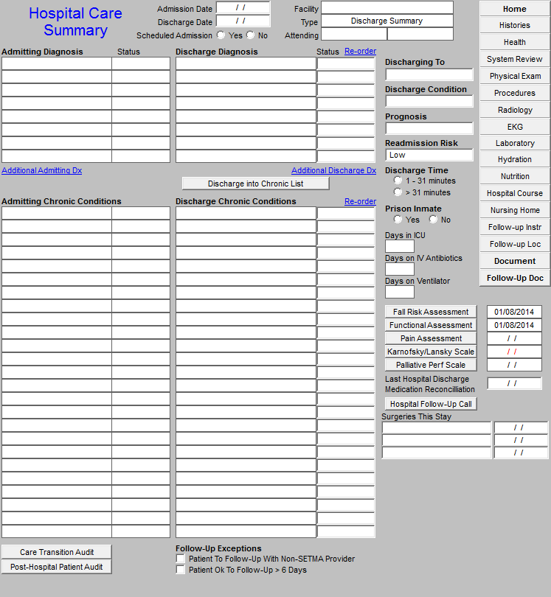

Slide 21
Care Transition Audit
At the bottom of this template, there is a button Entitled “Care Transition Audit.” Once the suite of Templates associated with the Hospital Care Summary has been completed, the provider depresses this button and the system automatically aggregates the data which has been documented and displays which of the 18-data points have been completed and which have not.

Slide 22
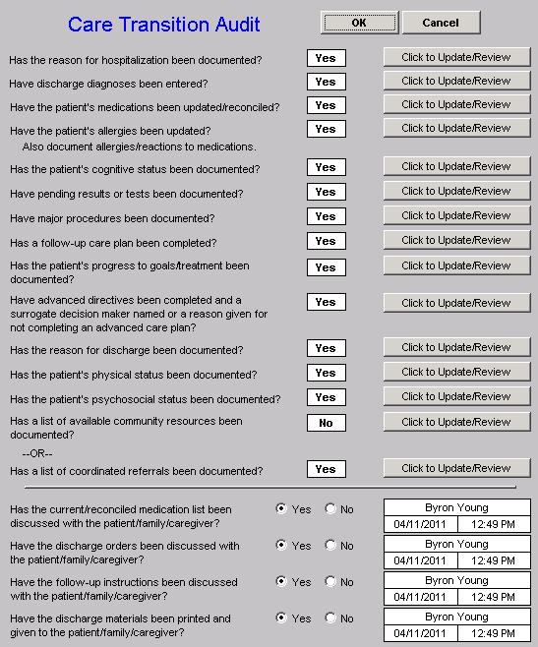

Slide 23
Care Transition Audit
The elements in black have been completed; any in red have not. If an element is incomplete, the provider simply clicks the button entitled “Click to update/Review.” The missing information can then be added. This fulfills one of SETMA’s principles of EHR design which is “We want to make it easier to do it right than not to do it at all.”

Slide 24
Care Transition Audit
Quarterly and annually, SETMA audits each provider’s performance on these measures and publishes that audit on our website under “Public Reporting,” along with over 200 other quality metrics which we track routinely.
The following is the care transition audit results by provider name for 2013.

Slide 25
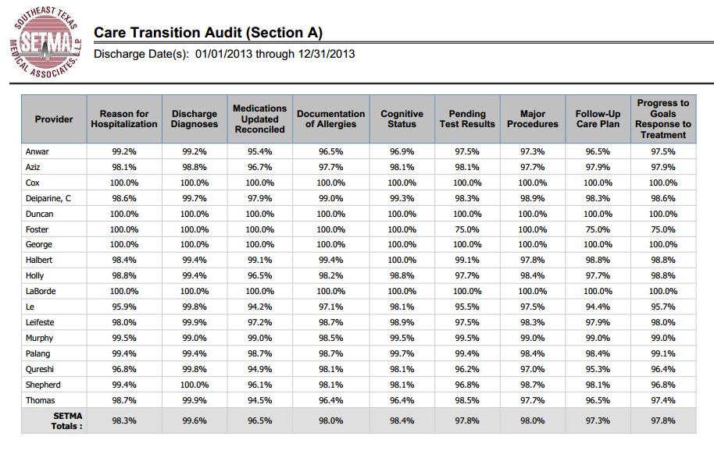

Slide 26
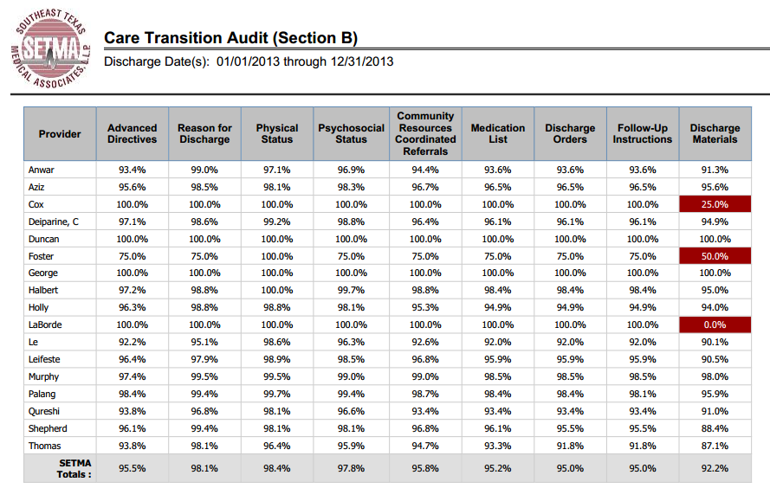

Slide 27
Hospital Care Summary
Once the Care Transition issues are completed, The Hospital Care-Summary-and-Post- Hospital-Plan-of Care-and Treatment-Plan document is generated and printed. It is given to the patient and/or to the patient’s family, and to the hospital.

Slide 28
The Baton
The following picture is a portrayal of the “plan of care and treatment plan” which is like the “baton” in a relay race.

Slide 29
The Baton
“The Baton” is the instrument through which responsibility for a patient’s health care is transferred to the patient or family. Framed copies of this picture hang in the public areas of all SETMA clinics and a poster of it hangs in every examination room. The poster declares:
Firmly in the provider’s hand --The baton -- the care and treatment plan Must be confidently and securely grasped by the patient, If change is to make a difference 8,760 hours a year.

Slide 30
The Baton
The poster illustrates:
That the healthcare-team relationship, which exists between the patient and the healthcare provider, is key to the success of the outcome of quality healthcare.
That the plan of care and treatment plan, the “baton,” is the engine through which the knowledge and power of the healthcare team is transmitted and sustained.
That the means of transfer of the “baton,” which has been developed by the healthcare team, is a coordinated effort between the provider and the patient.

Slide 31
The Baton
That typically the healthcare provider knows and understands the patient’s healthcare plan of care and the treatment plan, but without its transfer to the patient, the provider’s knowledge is useless to the patient.
That the imperative for the plan – the “baton” – is that it must be transferred from the provider to the patient, if change in the life of the patient is going to make a difference in the patient’s health.

Slide 32
The Baton
That this transfer requires that the patient “grasps” the “baton,” i.e., that the patient accepts, receives, understands and comprehends the plan, and that the patient is equipped and empowered to carry out the plan successfully.
That the patient knows that of the 8,760 hours in the year, he/she will be responsible for “carrying the baton,” longer and better than any other member of the healthcare team.

Slide 33
Hospital Follow-Up Call
After the care transition audit is completed and the document is generated, the provider completes the Hospital-Follow-up-Call document:

Slide 34
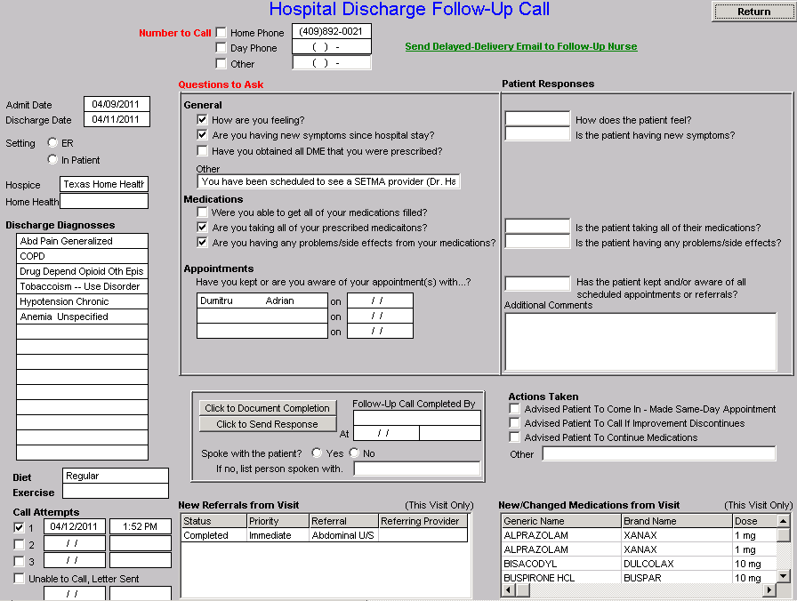

Slide 35
Hospital Follow-Up Call
During that preparation of the “baton,” the provider checks off the questions which are to be asked the patient in the follow-up call.
The call order is sent to the Care Coordination Department electronically. The day following discharge, the patient is called.
The call is the beginning of the “coaching” of the patient to help make them successful in the transition from the inpatient setting.

Slide 36
Hospital Follow-Up Call
The Care-Coordination, post-hospital call takes 12-30 minutes with each patient and engages the patient in eliminating barriers to care.
If appropriate, an additional call is scheduled at an appropriate interval.
If after three attempts, the patient is not reached by phone, the box in the lower left-hand corner by “Unable to Call, Letter sent” is checked. Automatically, a letter is created which is sent to the patient asking them to contact SETMA.

Slide 37
Coordinated Care
The genius and the promise of the Patient-Centered Medical Home are symbolized by the “baton.” Its display continually reminds the provider and will inform the patient, that to be successful, the patient’s care must be coordinated, and must result in coordinated care.
In 2011, we expanded the scope of SETMA’s Department of Care Coordination, we know that the principal failure-points of coordination are at the “transitions of care,” and that the work of the healthcare team – patient and provider – is that together they evaluate, define and execute a plan which is effectively transmitted to the patient.

Slide 38
Follow-Up Visit
The Transition of Care is complete when the patent is seen by the primary care provider in follow-up.
Many issues are dealt with in this follow-up visit, but one of them is another potential referral to the Care Coordination Department. If the patient has any barriers to care, the provider will complete the following template.
In this case, with checking three buttons, the need for financial assistance with medications and transportation is communicated to the Care Coordination Department.

Slide 39
SETMA Foundation
Under the Medical Home model the provider has NOT done his/her job when he/she simply prescribes the care which meets national standards. Doing the job of Medical Home requires the prescribing of the best care which is available and accessible to the patient, and when that care is less than the best, the provider makes every attempt to find resources to help that patient obtain the care needed.

Slide 40
SETMA Foundation
In February 2009, SETMA saw a patient who has a very complex healthcare situation. When seen in the hospital as a new patient, he was angry, bitter and hostile. No amount of cajoling would change the patient’s demeanor.
During his office-based, hospital follow-up, it was discovered that the patient was only taking four of nine medications because of expense; could not afford gas to come to the doctor; was going blind but did not have the money to see an eye specialist; could not afford the co-pays for diabetes education and could not work but did not know how to apply for disability.

Slide 41
SETMA Foundation
He left SETMA with the Foundation providing:
All of his medications. The Foundation has continued to do so for the past two years at a cost of $2,200 a quarter.
A gas card so that he could afford to come to multiple visits for education and other health needs.
Waiver of cost for diabetes education in SETMA’s American Diabetes Association accredited Diabetes Self Education and Medical Nutrition Therapy program.
Appointment to an experimental, vision-preservation program at no cost.
Assistance with applying for disability.

Slide 42
SETMA Foundation
Are gas cards, disability applications, paying for medications a part of a physician’s responsibilities? Absolutely not; but, are they a part of Medical Home? Absolutely! This patient, who was depressed and glum in the hospital, such that no one wanted to go into the patient’s room, left the office with help.
He returned six-weeks later. He had a smile and he had hope. It may be that the biggest result of Medical Home is hope. And, his diabetes was treated to goal for the first time in ten years. He has remained treated to goal for the past two years.

Slide 43
Implementing Medicare Transitional Care Management Services
IHI, Washington D. C.
March 9, 2014
Dr. James L. Holly
CEO, Southeast Texas Medical Associates, LLP
www.jameslhollymd.com

Slide 44
Transitions of Care Management New Codes Announced
November 16, 2012
CY 2013 Physician Fee Schedule Final Rule published
Two new codes introduced for physicians and qualifying nonphysical practitioner care management services for a patient following a discharge from a hospital, SNF, CMHC, outpatient observation or partial hospitalization
January 30, 2013
First payable date of service for Transitional Care Management (TCM) codes
March 2013
SETMA began using TCM codes on eligible patients

Slide 45
Criteria For New Codes
Criteria | 99495 | 99496
Level of Medical Decision Making | Moderate Complexity (99214) or Higher | High Complexity (99215)
Days Since Discharge | Within 14 Days | Within 7 Days
Follow-Up Contact | Within 2 Business Days of Discharge | Within 2 Business Days of Discharge

Slide 46
Potential for Increased Revenue
TCM codes are billed in place of traditional Evaluation & Management (E&M) codes and offer a higher level of reimbursement.
In the age of decreasing reimbursement, it is important to be able to access sources of additional reimbursement which are being made available to those providers who can demonstrate their ability to provide excellent care.
TCM codes are just one example of increase revenue sources available to providers who provide excellent care.

Slide 47
Potential for Increased Revenue
Level of Medical Decision Making | E&M Code Reimbursement | TCM Code Reimbursement | Increase
Moderate Complexity | 99214 $101.12 | 99495 $154.53 | $53.41
High Complexity | 99215 $135.63 | 99496 $218.27 | $82.64

Slide 48
How To Implement A Sustainable Solution?
The benefit of increase reimbursement is obvious, but how do you implement a solution which is sustainable and can be time and time again with out placing an additional burden on an already stretched provider?
The answer…the power of electronics.

Slide 49
Make It Easier To Do It Right Than Not At All
Because SETMA uses the same EHR in both inpatient and outpatient settings, all of the information needed to determine a patient’s eligibility for the TCM codes is automatically aggregated and calculated in the background.
All a provider has to do is begin an office visit and if the patient is eligible, they will be alerted on our main AAA_Home template in the EHR.

Slide 50
SETMA’s Follow-Up Calls
Every patient that SETMA discharges from the hospital is scheduled to receive a call from our Care Coordination Department.
SETMA has been calling all patients discharged from the hospital since 2009.
We did not have to implement anything new in order to fulfill the follow-up contact requirement of the new TCM codes.

Slide 51
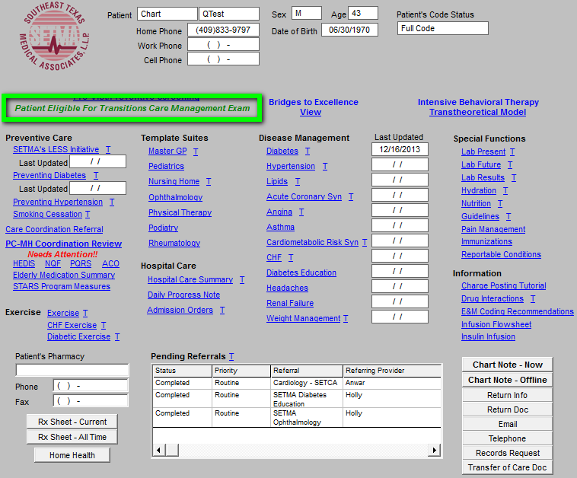

Slide 52
Make It Easier To Do It Right Than Not At All
At the conclusion of the visit, when the provider accesses the billing template, they will again be reminded to bill the TCM code is eligible.
Again, this requires no extra work on the provider as all of the information has already been aggregated in the background.

Slide 53
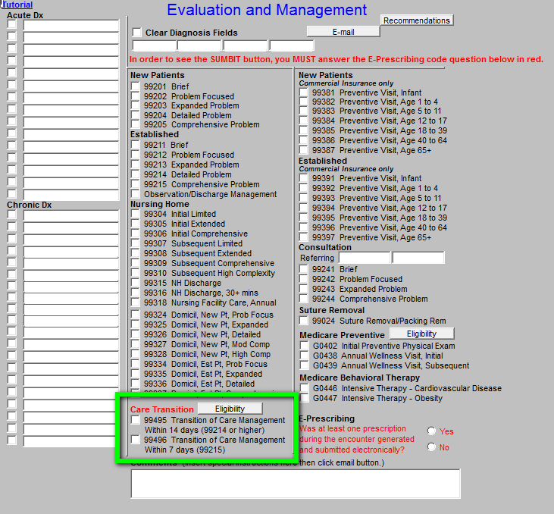

Slide 54
Make It Easier To Do It Right Than Not At All
When the “Care Transition” label is shown in red, the provider clicks the Eligibility button to confirm that all of the criteria have been met to bill a TCM code in place of a traditional E&M code.
The only thing that the provider must do is select the Level of Medical Decision Making that they feel they performed during the office encounter.
99124 (Moderate Complexity or higher) Level of Medical Decision Making required for TCM code 99495
99125 (High Complexity) Level of Medical Decision Making required for TCM code 99496

Slide 55
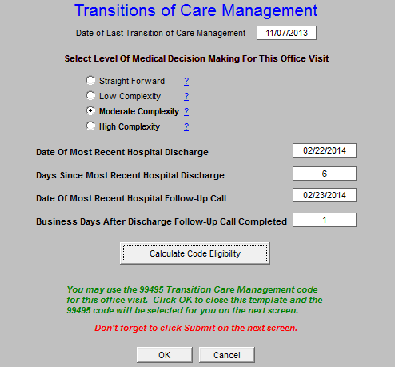

Slide 56
Make It Easier To Do It Right Than Not At All
The provider simply clicks “Calculate Code Eligibility” and the EHR confirms if all criteria to bill a TCM code have been met.
If so, the highest eligible TCM code is automatically selected, the provider closes the screen and clicks Submit.
The work is done!

