Slide 1
SETMA’s Approach to MACRA and MIPS Dr. James L. Holly CEO, Southeast Texas Medical Associates, LLP Adjunct Professor, Family & Community Medicine UT Health San Antonio www.jameslhollymd.com

Slide 2
Conflict of Interest
Dr. Holly has no conflicts of interest to disclose.
Any materials referenced from or at www.jameslhollymd.com are accessible and/or useable without cost

Slide 3
Learning Objective
To see the continuity between organizational focus and systems design before and after MACRA and MIPS
To describe how Southeast Texas Medical Associates’ (SETMA) transformation between 1995 and 2005 prepared for MACRA and MIPS
To learn how to fulfill MACRA and MIPS without interfering with the patient/ provider relationships
To demonstrate how to meet MIPS requirements with systems redesign
SETMA’s complete tutorial for MIPS can be found in slides 48-83 which will not be covered in today’s presentation

Slide 4
SETMA’s Achievements
Accreditations - A Brief Summary of SETMA’s
Achievements, Advances, Awards and Accreditations
Achievements which have Advanced SETMA: The Time-line, Philosophy and Principles which Underlie that Advancement
Awards and Achievements of Southeast Texas Medical Associates, LLP - 1995-2017

Slide 5
SETMA’s Work in Thinking About and Preparing for MACRA and MIPS
As SETMA began thinking about Medicare Access and CHIPS Reauthorization Act of 2015 (MACRA) and the Merit-Based Incentive Plan System (MIPS), we reviewed our efforts to transform SETMA since 1995.
In 2016, SETMA received CMS’s Quality Resource and Utilization Report (QRUR) on SETMA’s performance on our work in 2014 which was compiled by CMS in 2015.
We analyzed that report and designed solutions for improving quality and cost.
This link provides an annotated summary of 24 articles that document this process.
http://www.jameslhollymd.com/Letters/complete-summary-and-annotated-list-of-all-24-articles-discussing-setmas-work

Slide 6
Provider Training 10.18.16 -- MACRA & MIPS
http://www.jameslhollymd.com/Presentations/macra-and-mips-setma-tutorial-for-quality-improvement-metrics
Slide Deck for SETMA Provider Meeting, October 18, 2016
http://www.jameslhollymd.com/Presentations/mips-quality-measures-summary-audit
Slide Deck for Provider Meeting, October 18, 2016, Auditing Provider MIPS Performance

Slide 7
Complexity of MACRA & MIPS
To understand the complexity of this new program, review the following formula by which a provider’s Composite Performance Score (CPS) will be calculated by CMS with the following eight factors:
CPS = [(quality performance category score x quality performance category weight) + (resource use performance category score x resource use performance category weight) + (CPIA performance category score x CPIA performance category weight) + (advancing care information performance category score x advancing care information performance category weight)] x 100.

Slide 8
1999 -- Practice & Systems Principles Part I
SETMA’s preparation for MACRA and MIPS actually began in May,1999 when we
defined ten principles for electronic medical record and practice transformation.
Pursue Electronic Patient Management rather than Electronic Patient Records
Bring to every patient encounter what is known, not what a provider knows
Make it easier to do “it” right than not to do it at all
Continually challenge providers to improve their performance
Infuse new knowledge and decision-making tools throughout an organization instantly

Slide 9
1999 -- Practice & Systems Principles Part II
Promote continuity of care with patient education, information and plans of care
Enlist patients as partners and collaborators in their own health improvement
Evaluate the care of patients and populations of patients longitudinally
Audit provider performance based on endorsed quality measurement sets
Integrate electronic tools in an intuitive fashion giving patients the benefit of expert knowledge about specific conditions

Slide 10
SETMA’s Model of Care – Part I
It continued as SETMA defined a new 5-part model of care:
The tracking of preventive care, screening care and quality standards for acute and chronic care. SETMA’s design is such that tracking occurs simultaneously with the performing of excellent care by the entire healthcare team, including the healthcare provider, nurse, clerk, management, etc.
The auditing of performance on the same standards either of the entire practice, of each individual clinic, or of each provider on a population, or on a panel of patients.
The statistical analyzing of audit results by practice, clinic or provider. This includes analysis for ethnic disparities, and other discriminators such as age, gender, payer class, socio-economic groupings, education, frequency of visit, frequency of testing, etc. This exposes leverage points through which SETMA can improve care.

Slide 11
SETMA’s Model of Care – Part II
The public reporting by provider’s name of performance on hundreds of quality measures. This pressures providers to improve, and allows patients to know what is expected of them.
The design of Quality Assessment and Permanence Improvement (QAPI) Initiatives .
In this Model of Care, SETMA’s design of the plan of care and the medical-home-coordination summary activates each patient, engaging them in their own healthcare, allowing them and even requiring them to share the decision making process with the healthcare provider.
We believe this is the best way to overcome provider and patient “treatment inertia.”

Slide 12
2005 -- The Future of Healthcare
SETMA believes that the key to the future of healthcare is an internalized ideal and a personal passion for excellence rather than reform which comes from external pressure. Transformation is self-sustaining, generative and creative. In this context, SETMA believes that efforts to transform healthcare may fail unless four strategies are employed, upon which SETMA depends in its transformative efforts:
The methodology of healthcare must be electronic patient management (2000).
The content and standards of healthcare delivery must be evidenced-based medicine (1995).
The structure and organization of healthcare delivery must be patient-centered medical home (2009).
The payment methodology of healthcare delivery must be that of capitation with additional reimbursement for proved quality performance and cost savings (1997).

Slide 13
2000-2017 -- SETMA’s Preparation for MIPS
Began use of EMR (1998, voluntary)
Physician Consortium for Performance Improvement (PCPI, 2000, voluntary)
Healthcare Effectiveness Data and Information Set (HEDIS, 2002, voluntary)
National Quality Forum (NQF, 2004, voluntary)
Physician Quality Reporting Initiative (PQRI, 2006, participation voluntary, program required by The 2006 Tax Relief and Health Care Act)
Public Reporting by Provider Name on Performance on Quality metrics (2009, voluntary)
Data Analytics for Population Management (2009, voluntary)
Physician Quality Reporting System (PQRS, 2011, participation required, program required by 2010, Affordable Care Act)
Patient-Centered Medical Home (PC-MH, 2009, voluntary)
Meaningful Use I, II, & III (American Recovery and Reinvestment Act , 2011)

Slide 14
MACRA and MIPS
On this foundation, SETMA is prepared to respond to the fact that beginning in 2019, all physician payments from the Centers for Medicare and Medicaid (CMS) will be made on the basis of a new system called MACRA (Medicare Access and CHIP Reauthorization Act of 2015) and MIPS (Merit-Based Incentive Payment System).
The new payment mode will be based on a healthcare provider “composite performance score” (CPS). This score will be made up of the following percentages in the first year (note: these percentages are constantly changing):
quality (50%),
resource use (10%),
advanced care information (25%), and
clinical practice improvement activity (15%).

Slide 15
The Goal of MACRA and MIPS
The goal of CMS is to increase the focus on quality and value-based care. By the end of 2016, CMS plans to tie 30% of Medicare payments to alternative payment models and to tie 85% of fee-for-service payments to quality.
To do that, the Quality Payment Program has been created and has two branches. Clinicians will either participate in MIPS or an APM (Alternative Payment Model). Most clinicians will be subject to MIPS.
Clinicians will be excluded from MIPS if they:
meet a low volume threshold,
are in their first year of Medicare Part B Participation, or
if they participate in the other branch of the quality payment program, an advanced alternative payment model (APM).

Slide 16
What is MIPS?
MIPS is a single incentive program that streamlines three current programs within it:
the physician quality reporting system (PQRS),
Value Based Payment, and
the Medicare EHR incentive program for eligible professionals (Meaningful Use for EP).
The fourth component of MIPS is new to CMS: Clinical Practice Improvement Activities. It is not new, however, not new to practices accredited by NCQA, AAAHC, URAC and/or the Joint Commission for PC-MH:

Slide 17
MACRA and MIPS

Slide 18
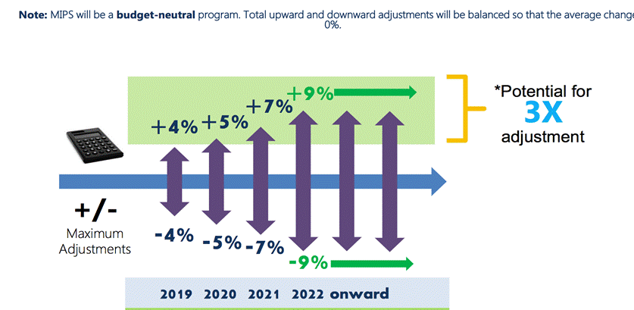
MACRA and MIPS

Slide 19
APMs
Advanced Alternative Payment Models (APMs) are defined by CMS as new approaches to paying for medical care through Medicare that incentivize quality and value. MACRA doesn’t create new Advanced Alternative Payment Models. Just as MACRA created MIPS, a program to change the reimbursement model, that’s the exact goal of MACRA under APMs as well; additional incentives for APM participation.
Although the majority of clinicians will be subject to MIPS, those that participate in Advanced Payment Models at a certain threshold, such as Accountable Care Organizations, will be excluded from the MIPS program. To be considered as an APM, at least 50% of the participating clinicians must use a certified EHR technology. This threshold increases to 75% after year one. The group must also base payment on quality measures comparable to those in the MIPS program.

Slide 20
APMs
Finally, APM entities are required to bear more than nominal financial risk. Eligible Clinicians can become Qualifying APM Participants if a certain percent of their patients or payments are through an APM. QP’s are eligible for a 5% lump sum bonus in years 2019 - 2024 and even higher in subsequent years. Only QP’s are excluded from MIPS.
Accountable Care Organization (ACP)
Comprehensive Primary Care Plus (CPC+) program
Others

Slide 21
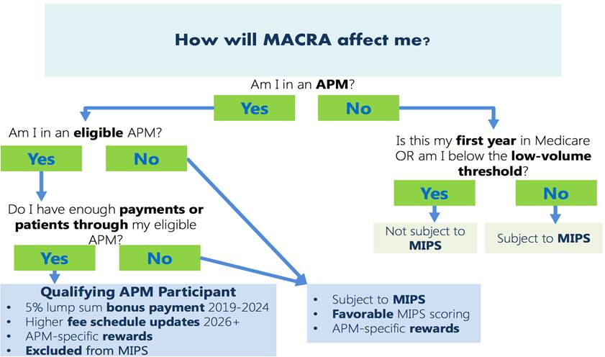
APMs

Slide 22
SETMA’s Readiness for MIPS Fulfillment
Payment adjustment made up of four parts shown below.
Quality - This will be gleaned from the Clinical Quality Measures (CQMs) that SETMA reports to CMS. CQM is the new PQRS. Measures are physician selected and SETMA has many good ones to report.
Advancing Care Information - This is the next phase of Meaningful Use. All of SETMA providers meet these measures and will continue to do so.
Clinical Improvement Activities - “Clinicians recognized as a Tier III Medical Home by NCQA earn full credit in this category.” SETMA is accredited for Patient-Centered Medical Home by NCQA at their highest level (Tier III) and by AAHC, URAC and the Joint Commission.
Cost - This will be gleaned from claims data. There is nothing to do on our part for this until CMS’s QRUR is received.

Slide 23
SETMA’s Readiness Assessment
On October 6, 2016, SETMA discovered that the four categories defined by MIPS in 2015 correlate with the four strategies SETMA defined in 2000-2005 (see slide 9 above) for the transformation of our practice.
Early in our development, SETMA came to believe that the key to the future of healthcare transformation was an internalized ideal and a personal passion for excellence, rather than reform which comes from external pressure.
Transformation is self-sustaining, generative and creative. In this context, SETMA believes that efforts to transform healthcare may fail unless the four strategies described in slide 11 are employed.
SETMA’s transformative efforts are dependent upon these fours standards.

Slide 24
SETMA’s Strategies and MIPS Categories
SETMA’s Strategy | MIPS Category
1. Methodology of healthcare must be electronic patient management | MIPS Advancing Care Information (an extension of Meaningful Use with a certified EMR)
2. The content and standards of healthcare delivery must be evidenced-based medicine | MIPS Quality (an extension of PQRI/PQRS which in 2019 will become MIPS)
3. The structure and organization of healthcare delivery must be patient-centered medical home | MIPS Clinical Practice Improvement activities (This MIPS category is met fully by Level 3 NCQA PC-MH Recognition).
4. The payment methodology of healthcare delivery must be that of capitation with additional reimbursement for proved quality performance and cost savings | MIPS Cost (measured by risk adjusted expectations of cost of care and the actual cost of care per fee-for-service Medicare and Medicaid beneficiary)

Slide 25
Potential Hazards of MACRA & MIPS – Part I
The most difficult aspects of the new program are:
There is not an absolute standard against which healthcare providers will be measured.
Provider evaluation will always be a judgment made two years after the fact, i.e., you will practice and perform in 2017, in 2018 you performance will be aggregated , but it will be 2019 before you know where you stand.
The biggest problem with this moving target is that you have to assume that everyone's results mean the same performance. That is not necessarily the case.
It is possible that if everyone begins to perform at a high standard that the distribution would be very narrow.

Slide 26
Potential Hazards of MACRA & MIPS – Part II
The possibility exists that a person could be performing at a 95% level and still be a standard deviation below the mean which could result in a penalty for a performance which everyone would consider excellent.
Larger organizations and/or duplicitous organizations (the two are not synonymous) can find or use methods which meet the standard without achieving the excellence of care implied by the measurement.
Organizations may focus on intentionally meeting a few metrics which could result in a high performance on an artificial metric without a significant improvement in care or outcomes. SETMA addressed this by making the fulfillment of quality metrics “incidental” to excellent care rather their being the “intention” of our model of care.

Slide 27
Core of SETMA’s Principles Not Adopted by MACRA and MIPS
At the core of SETMA’s four strategies is the belief that one or two quality metrics will have little impact upon the processes or the outcomes of healthcare delivery, and that they will do little to reflect quality outcomes in healthcare delivery.
In the Centers for Medicare and Medicaid Services (CMS) mandatory Physician Quality Reporting System (PQRS), which in 2011replaced the voluntary Physicians Quality Reporting Initiative (PQRI) healthcare providers are required to report on nine quality metrics of the providers’ choice, but this requirement will be reduced to six quality metrics under MIPS in 2019.
SETMA argues that this is a minimalist approach to providers quality reporting and is unlikely to change healthcare outcomes or quality.

Slide 28
Clusters and Galaxies
SETMA currently tracks over 200 quality metrics, but this number does not tell the whole story. SETMA employs two definitions in our use of quality metrics in our transformative approach to healthcare:
A “cluster” is seven or more quality metrics tracked for a single condition, i.e., diabetes, hypertension, etc.
A “galaxy” which is multiple clusters tracked in the care of the same patient, i.e., diabetes, hypertension, lipids, CHF, etc.
SETMA believes that fulfilling a single or a few quality metrics does not change outcomes, but fulfilling “clusters” and particularly “galaxies” of metrics, which are measurable by the provider at the point-of-care, can and will change outcomes.
In SETMA’s model, a single patient, at a single visit, for a single condition, will have eight or more quality metrics fulfilled, which WILL change the outcome of that patient’s treatment.

Slide 29
Clusters and Galaxies

Slide 30
Clusters and Galaxies
But the “real” leverage comes when multiple “clusters” of quality metrics are measured in the care of a single patient who has multiple chronic conditions.
The following illustrates a “galaxy” of quality metrics.
A single patient, at a single visit, with multiple “clusters” involving multiple chronic conditions thus having 60 or more quality metrics fulfilled in his/her care, which WILL change the quality of outcomes and which will result in the improvement of the patient’s health. And, because of the improvement in care and health, the cost of that patient’s care will inevitably decrease as well.
(Remember that foundational to this concept is that the fulfillment of quality metrics is incidental to excellent care rather than being the intention of that care.)

Slide 31
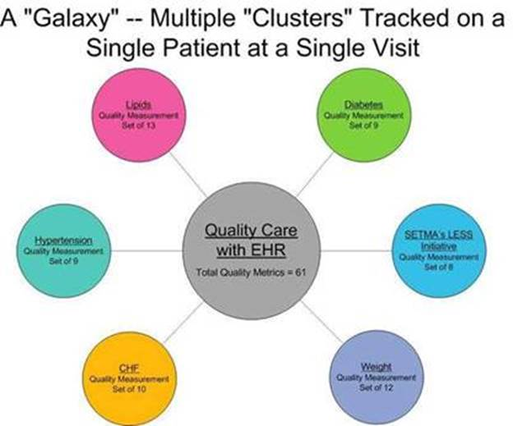
Clusters and Galaxies

Slide 32
Quality and Cost (QRUR)
For 2015 PQRS, SETMA was required to report on 9 PQRS measures. In 2017, MIPS requires us to report on six measures.
From those measures a Quality and Cost score will be calculated to determine performance for MACRA and MIPS incentive payments. These calculations are contained in the Quality Resource and Utilization Report (QRUR).
In 2016, SETMA received from CMS, our QRUR for performance in 2014 which was analyzed by CMS in 2015. In 2017, provider performance is being reporting to CMS. It will be analyzed in 2018 and payments for 2019 will be based on the results.

Slide 33
Quality and Cost (QRUR)

Slide 34
Quality and Cost (QRUR)

Slide 35
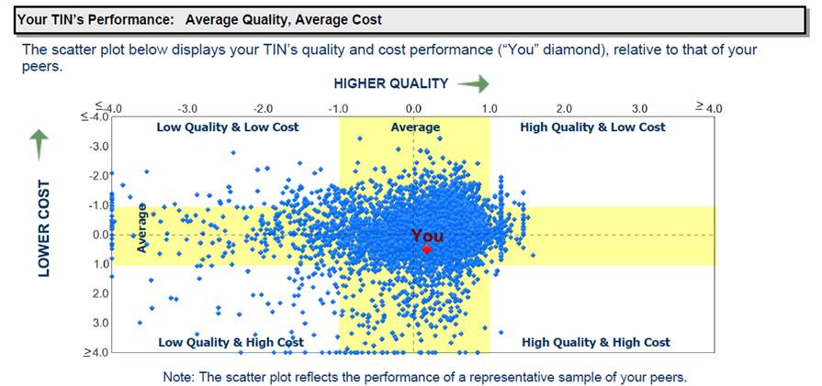
Quality and Cost (QRUR)

Slide 36
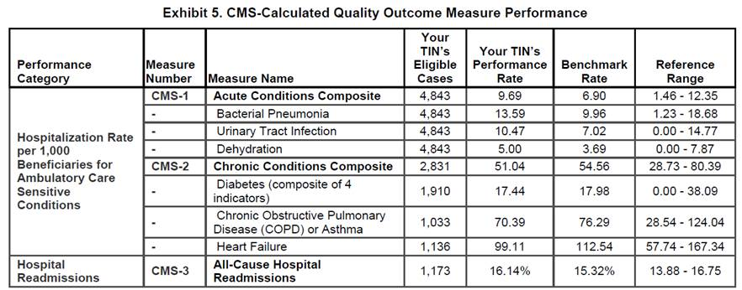
Quality and Cost (QRUR)
In 2014, SETMA’s Chronic conditions Composite was excellent. Our Acute Conditions Composite was high.

Slide 37
Quality and Cost (QRUR)
The three acute condition which make up the Acute Conditions Composite are related to patients who have pneumonia, UTI and dehydration.
SETMA has over 1400 nursing home patients. The most common reason for admissions in this population are: pneumonia, UTI, and dehydration.
While our numbers are still within one standard deviation, we have designed ways to improve these numbers.

Slide 38
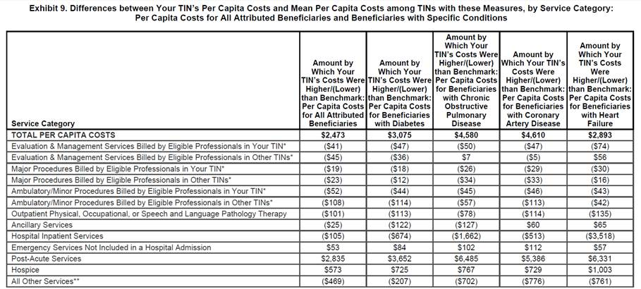
Quality and Cost (QRUR)

Slide 39
Quality and Cost (QRUR)
The services where SETMA’s costs are higher are “Post Acute Care.” This presents:
Home Health
LTAC
In-Patient Rehabilitation
Skilled Nursing
The good news is that these are not areas where physicians are increasing costs for their own benefit but all of these areas are for the benefit of the patient. We are discussing ways in which we can decrease these costs without compromising patient safety and quality of care.

Slide 40
SETMA’s Implementation of MACRA and MIPS
SETMA has completed an analysis of these reports and has designed tools for improving our cost and quality. This shows that SETMA has prepared well for this time with:
NCQA recognition as a Tier 3 Patient-Centered Medical Home from 2010-2019 which meets the MIPS Clinical Practice Improvement Activities requirement of MIPS.
A nineteen-year use of a certified EMR meeting Meaningful Use standards and now the MIPS Advancing Care Information Systems (MACRA MIPS Where Does SETMA Stand).

Slide 41
SETMA’s Implementation of MACRA and MIPS
Pursuing quality standards by the development of a Model of Care which includes tracking, auditing, analyzing statistically, public reporting by provider name of quality performance and the designing of quality improvement with this data. (see SETMA’s Model of Care Patient-Centered Medical Home: The Future of Healthcare Innovation and Change). From this came SETMA’s participation in PQRI (2007) and PQRS (2011) and now MIPS.
Being attentive to the cost of the care we deliver to all patients but particularly to Medicare Advantage beneficiaries and Medicare Fee-for-Service patients and Medicaid patients.

Slide 42
SETMA’s Implementation of MACRA and MIPS
As we use the Final 2015 date from the QRUR to design solutions to improved quality, SETMA has deployed the following MACRA/MIPS Quality Measure template. This templates identifies the metrics, gives their descriptions, identifies to whom they apply and shows you how to easily and efficiently meet each of them.
If we follow this easy tool, our MIPS quality performance with improve dramatically.

Slide 43
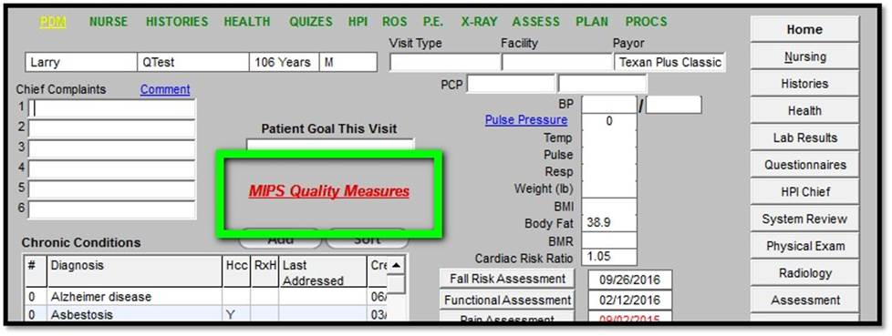
SETMA’s Implementation of MACRA and MIPS

Slide 44
SETMA’s Implementation of MACRA and MIPS

Slide 45
SETMA’s Implementation of MACRA and MIPS

Slide 46
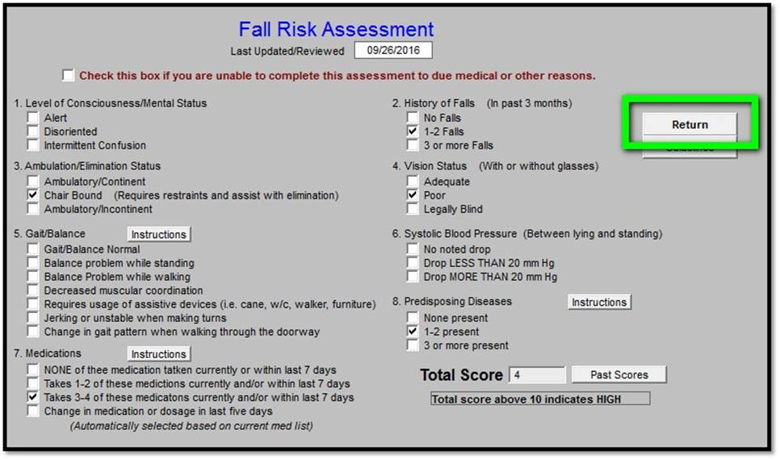
SETMA’s Implementation of MACRA and MIPS

Slide 47
SETMA’s Implementation of MACRA and MIPS

Slide 48
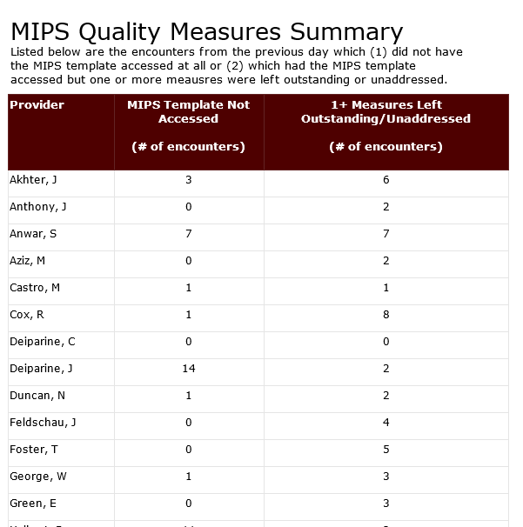
SETMA’s Daily Audit of MIPS Performance

Slide 49
Addendum
The following slides are the complete tutorial for MACRA/MIPS implementation in SETMA’s EHR.

Slide 50
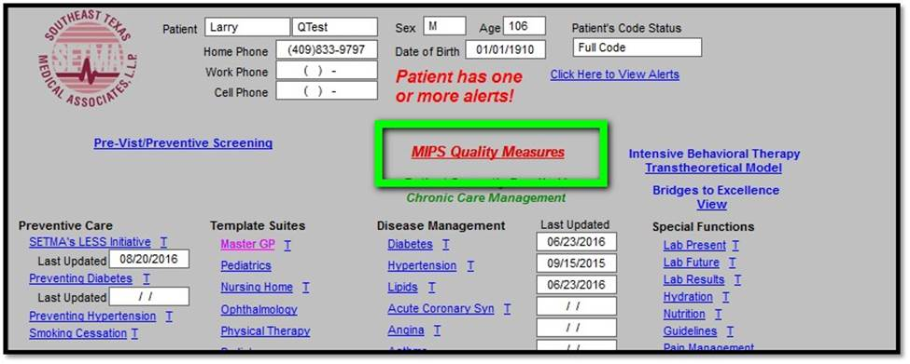
Addendum – Tutorial for SETMA’s MACRA and MIPS Implementation
AAA Home

Slide 51
Addendum – Tutorial for SETMA’s MACRA and MIPS Implementation
Master GP

Slide 52
Addendum – Tutorial for SETMA’s MACRA and MIPS Implementation
Plan

Slide 53
Addendum – Tutorial for SETMA’s MACRA and MIPS Implementation
The measures we are using for MIPS are listed on the following template. In order to meet the measure which the MIPS tool indicates is not done, you simple click the button to the left of the measures name, number and description:

Slide 54
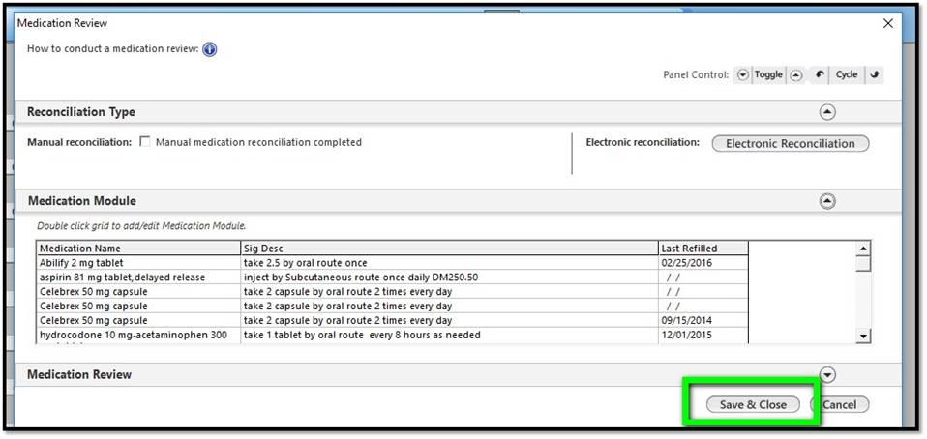
Addendum – Tutorial for SETMA’s MACRA and MIPS Implementation
Click the button opens the template which allows you to complete a medication reconciliation. Use the Save & Close button to return.

Slide 55
Addendum – Tutorial for SETMA’s MACRA and MIPS Implementation
Fall Risk -- All of SETMA’s providers and nurses are familiar with SETMA’s Fall Risk Questionnaire. It is an important issue with the elderly or disabled. Be sure that as you measure the patient’s risk that if they are at increased risk you address issue of safety with the patient or the patient’s family.

Slide 56
Addendum – Tutorial for SETMA’s MACRA and MIPS Implementation
Clicking the button opens the template to complete a fall risk assessment. Use the Return button to go back when finished.

Slide 57
Addendum – Tutorial for SETMA’s MACRA and MIPS Implementation
BMI is an important measurement in a patient’s care. Because we do it so automatically, we need to remind ourselves of how high BMIs - above 30 - increase patient risk for dementia, cancer, metabolic syndrome, diabetes and a host of other disorders. In addition to measuring the BMI, we must be taking steps along with SETMA LESS Initiative tool to encourage patients to moderate their eating, to increase their exercise and to lose weight.

Slide 58
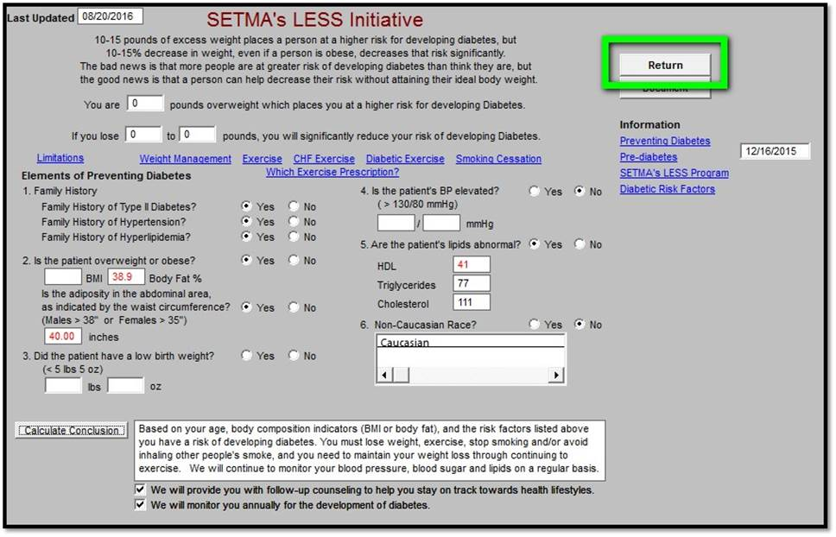
Addendum – Tutorial for SETMA’s MACRA and MIPS Implementation
Opens the LESS Initiative template to complete BMI assessment and follow-up. Use the Return button to go back when finished

Slide 59
Addendum – Tutorial for SETMA’s MACRA and MIPS Implementation
Blood Pressure -- The single most important metric in healthcare is for patients to control their blood pressure; even for patients with diabetes, controlling the blood pressure is more important even than controlling the blood sugar.

Slide 60
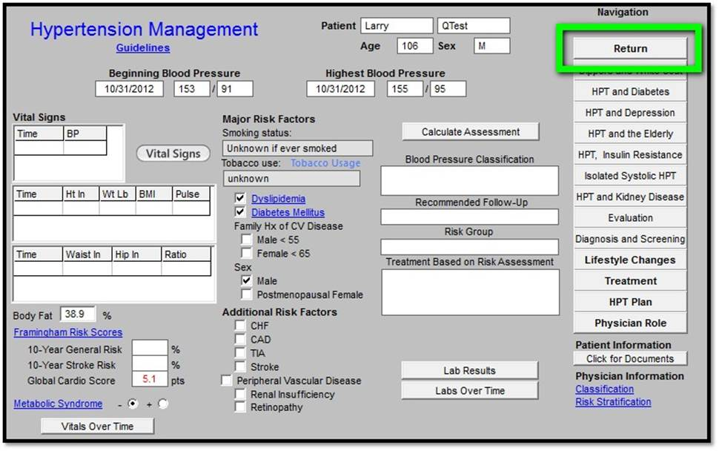
Addendum – Tutorial for SETMA’s MACRA and MIPS Implementation
Opens the hypertension suite of templates to address elevated blood pressure. Use the Return button to go back when finished.

Slide 61
Addendum – Tutorial for SETMA’s MACRA and MIPS Implementation
High Risk Medications - Whether in the Medicare Advantage Stars Program, MIPS, HEDIS or other quality metric standards the decreasing use of potentially high risk medications in those over 65 is important. Please remember, going forward with MIPS, even if the patient begins the year on one or more of these medications, if you do not renew that medication in the reporting year, you meet this metric standard.

Slide 62
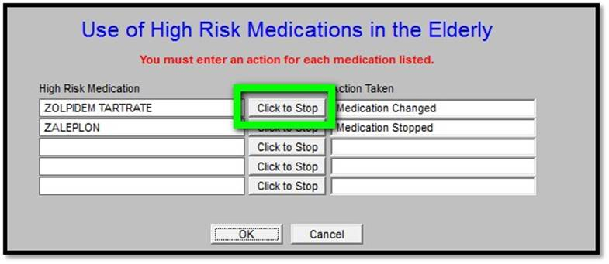
Addendum – Tutorial for SETMA’s MACRA and MIPS Implementation
Opens the follow pop-up which will list any active medications for the current patient which are deemed high risk. You must enter a response next to each medication. If you click the “Click to Stop” button, it will automatically stop that medication in the patient’s chart. Click OK when done.

Slide 63
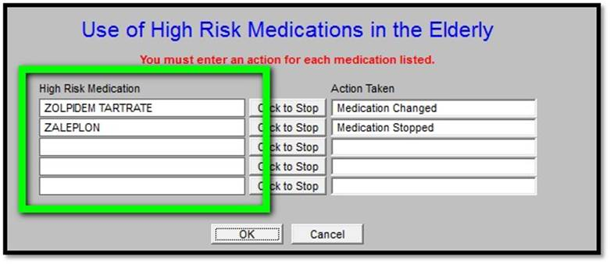
Addendum – Tutorial for SETMA’s MACRA and MIPS Implementation
Opens the follow pop-up which will list any active medications for the current patient which are deemed high risk. You must enter a response next to each medication. If you click the “Click to Stop” button, it will automatically stop that medication in the patient’s chart. Click OK when done.

Slide 64
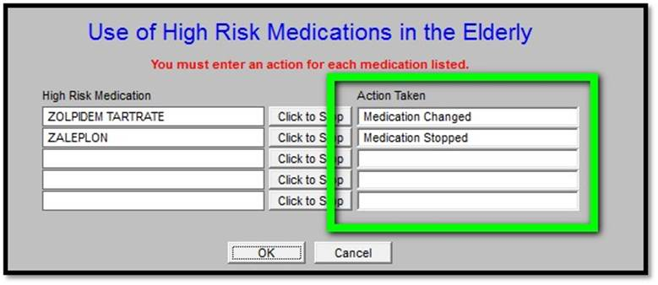
Addendum – Tutorial for SETMA’s MACRA and MIPS Implementation
Opens the follow pop-up which will list any active medications for the current patient which are deemed high risk. You must enter a response next to each medication. If you click the “Click to Stop” button, it will automatically stop that medication in the patient’s chart. Click OK when done.

Slide 65
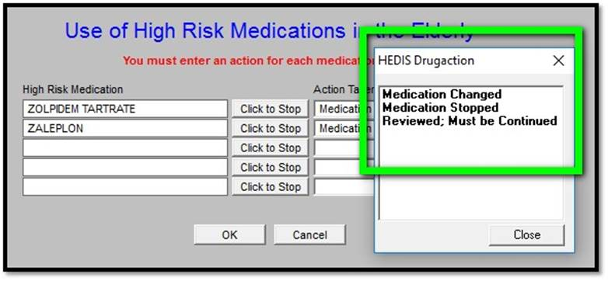
Addendum – Tutorial for SETMA’s MACRA and MIPS Implementation
Opens the follow pop-up which will list any active medications for the current patient which are deemed high risk. You must enter a response next to each medication. If you click the “Click to Stop” button, it will automatically stop that medication in the patient’s chart. Click OK when done.

Slide 66
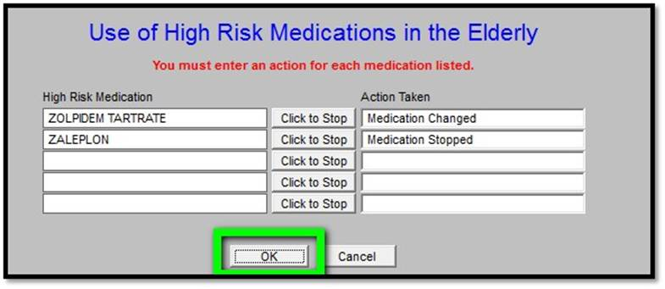
Addendum – Tutorial for SETMA’s MACRA and MIPS Implementation
Opens the follow pop-up which will list any active medications for the current patient which are deemed high risk. You must enter a response next to each medication. If you click the “Click to Stop” button, it will automatically stop that medication in the patient’s chart. Click OK when done.

Slide 67
Addendum – Tutorial for SETMA’s MACRA and MIPS Implementation
Pneumonia Vaccine - the Automated Team and the SETMA Health Maintenance will already alert you to the fact that your patient needs a pneumonia immunization but this redundant opportunity makes sure that ALL of SETMA’s patients get this important preventive medicine service.

Slide 68
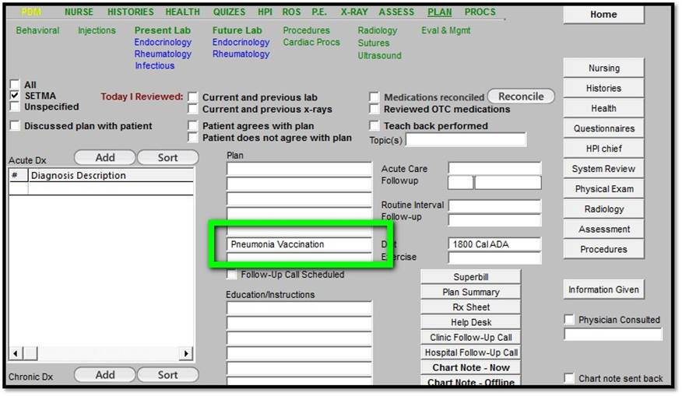
Addendum – Tutorial for SETMA’s MACRA and MIPS Implementation
Makes notation of vaccination order on Plan section of chart.

Slide 69
Addendum – Tutorial for SETMA’s MACRA and MIPS Implementation
Anti-Depressant Medication - If a patient is diagnoses with depression, they should have an active medication prescription or at least the next 180 days (six months). This tool will alert you if your patient does not have such a prescription.

Slide 70
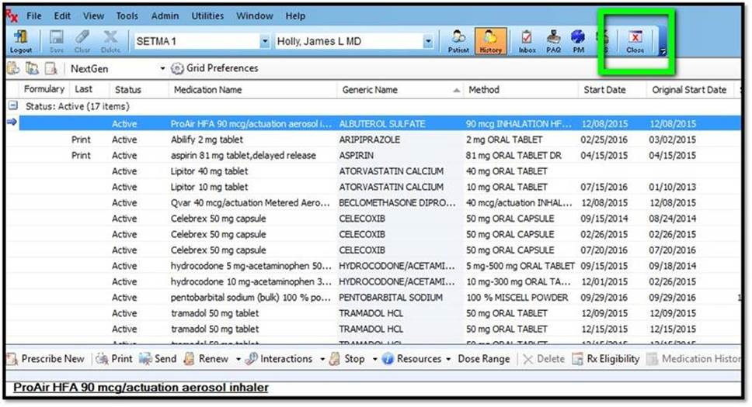
Addendum – Tutorial for SETMA’s MACRA and MIPS Implementation
Automatically opens medication module to add or edit medications related to depression. Click Close when done to return.

Slide 71
Addendum – Tutorial for SETMA’s MACRA and MIPS Implementation
Hgb A1c - the MIPS measure requires that a patient with diabetes have at least one HgbA1c annually. If the value is 7.0% or less, that is all that is needed. If the value is above 7.0%, you need to see the patient again after a change in medication or treatment recommendations and repeat the A1c

Slide 72
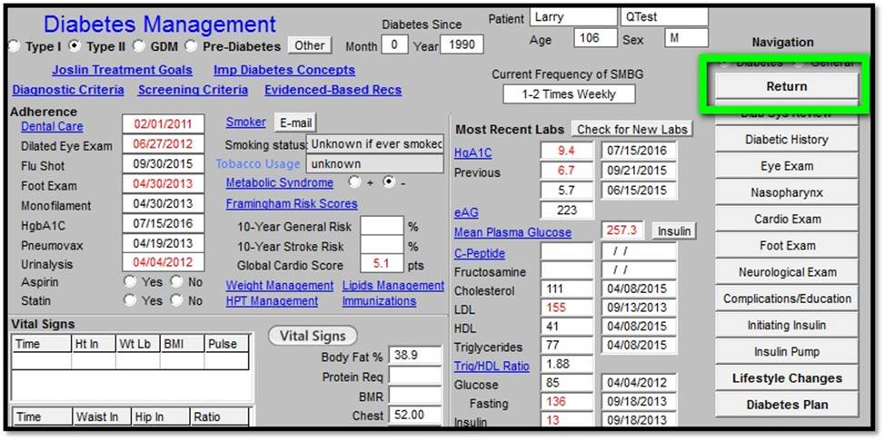
Addendum – Tutorial for SETMA’s MACRA and MIPS Implementation
The above button opens the Diabetes suite of templates to address elevated HbA1c control. Use the Return button to go back when finished.

Slide 73
Addendum – Tutorial for SETMA’s MACRA and MIPS Implementation
“Order HbA1c” automatically creates a lab order for a Glycohemoglobin from the main template. The patient’s Diabetes diagnosis code is automatically associated with the test. No other steps are required other than sending the patient to the lab.

Slide 74
Addendum – Tutorial for SETMA’s MACRA and MIPS Implementation
The Nephrology metric has two parts for patients with diabetes - one is that the patient is on an ACE or ARB and the other is that they have a urine sample for albuminuria annually.

Slide 75
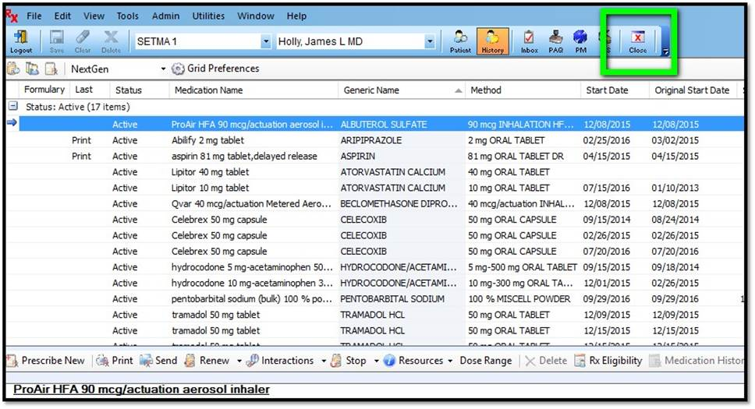
Addendum – Tutorial for SETMA’s MACRA and MIPS Implementation
Automatically opens medication module to add or edit medications related to nephropathy. Click Close when done to return.

Slide 76
Addendum – Tutorial for SETMA’s MACRA and MIPS Implementation
“Order Micral Strip” automatically creates a lab order for a Micral Strip from the main template. The patient’s Diabetes diagnosis code is automatically associated with the test. No other steps are required other than sending the patient to the lab.

Slide 77
Addendum – Tutorial for SETMA’s MACRA and MIPS Implementation
Heart Risk and Cholesterol Screening - Patients within the below indicated age ranges should have their heart risk calculated and have an annual lipid test.

Slide 78
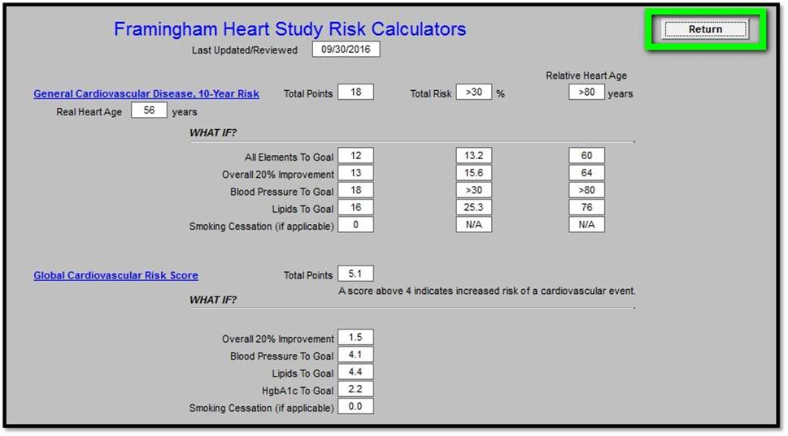
Addendum – Tutorial for SETMA’s MACRA and MIPS Implementation
The Heart Risk can be done easily by using SETMA’s Framingham Heart Study Risk Calculators

Slide 79
Addendum – Tutorial for SETMA’s MACRA and MIPS Implementation
“Order Lipid” automatically creates a lab order for a Lipid Panel on the main lab template. No other steps are required other than sending the patient to the lab.

Slide 80
Addendum – Tutorial for SETMA’s MACRA and MIPS Implementation
Patients with Ischemic Vascular Disease should be on aspirin or other anti-thrombotic.

Slide 81
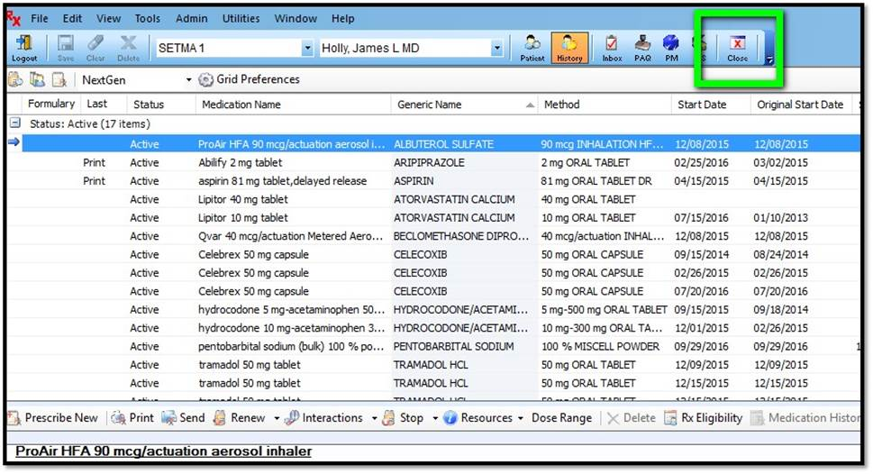
Addendum – Tutorial for SETMA’s MACRA and MIPS Implementation
Automatically opens medication module to add or edit medications related to nephropathy. Click Close when done to return.

Slide 82
Addendum – Tutorial for SETMA’s MACRA and MIPS Implementation
The Return button will take you back to either AAA Home, Master GP or the Plan, depending on which template you accessed it from.

Slide 83
Addendum – Tutorial for SETMA’s MACRA and MIPS Implementation
With color coding.

