Slide 1
SETMA’s Automated Team Function Dr. James L. Holly CEO, Southeast Texas Medical Associates, LLP Adjunct Professor Family & Community Medicine University of Texas Health Science Center San Antonio School of Medicine Clinical Associate Professor Department of Internal Medicine School of Medicine Texas A&M Health Science Center
University of Texas Health Science Center
School of Medicine FAMILY Medicine Grand Rounds
JULY 22, 2015

Slide 2
Conflicts of Interest
James L. Holly, MD has no conflicts of interest to report in relationship to this presentation.

Slide 3
Goals and Objectives
Principles of Practice and EMR Development
Recognizing and Benefiting from Seminal Moments in Practice Transformation
How to address provider fatigue and/or burn-out
The Progression from Clinical Decision Support and Disease Management Tools to Process Automation
Improving Provider Performance and Satisfaction with Automation
Developing Tools for Provider and Patient Collaboration

Slide 4
Four Seminal Events – May, 1999
The first event was the announcement that the electronic health records (EHR) was too hard and too expensive if we only gained the ability to document a patient encounter electronically.
EHR was only “worth it,” if we could leverage electronics:
to improve care for each patient;
to eliminate errors which were dangerous to the health of patients; and,
to improve the care and health of all patients and of population groups.
This was our transition from EMR to electronic patient management (EPM).

Slide 5
Four Seminal Events – May, 1999
The second event was the application of Peter Senge’s The Fifth Discipline as we defined ten principles which guided SETMA’s EMR development and SETMA’s transformation, ten years later, into a Patient-Centered Medical Home (PC-MH). The principles are:
Pursue Electronic Patient Management rather than EMR
Bring what is known to every patient encounter, not just what a particular provider knows
Make it easier “to do it right than not to do it at all”
Continually challenge providers to improve their performance
Infuse new knowledge and decision-making tools throughout an organization instantly

Slide 6
Four Seminal Events – May, 1999
Promote continuity of care with patient education, information and plans of care
Enlist patients as partners and collaborators in their own health improvement
Evaluate the care of patients and populations of patients longitudinally
Audit provider performance based on endorsed quality measurement sets
Integrate electronic tools in an intuitive fashion giving patients the benefit of expert knowledge about specific conditions

Slide 7
Four Seminal Events – May, 1999
Cortez - Fahrenheit 451 - Maginot Line
The third seminal event was the preparation of a philosophical base for our future; written in May, 1999 and published in booklet form in October, 1999, this blueprint was entitled, “More Than a Transcription Service: Revolutionizing the Practice of Medicine: And Meeting the Challenge of Managed Care With Electronic Medical Records (EMR) which Evolves into Electronic Patient Management. “
This booklet was distributed to our practice and our community. It became our declaration that we were going to succeed at this process at any cost and at any effort.
We called that our "Cortez Project". Like Cortez, we scuttled our ships; there was no going back. We had to succeed.

Slide 8
Four Seminal Events – May, 1999
The fourth seminal event was that we determined to adopt a celebratory attitude toward our progress in EMR.
In May, 1999, my cofounding partner was lamenting that we were not crawling yet with our use of the EMR. I agreed and asked him, “When your son first turned over in bed, did you lament that he could not walk, or did you celebrate this first milestone of muscular coordination of turning over in bed?” He smiled and I said, “We may not be crawling yet, but we have begun. If in a year, we are doing only what we are currently doing, I will join your lamentation, but today I am celebrating that we have begun.”

Slide 9
Four Seminal Events – May, 1999
SETMA’s celebratory spirit has allowed us to focus on the future through many lamentable circumstances and has allowed us to press forward through many disappointments. Focusing on our successes kept us moving forward and the cumulative effect was always success.

Slide 10
Transformation of Primary Care
The future of primary care is providers with internalized ideals and personal passion for excellence. Transformation is the goal, as it is self-sustaining and generative (creative tension).
SETMA believes that the strategies which must be employed in this transformative effort are:
The methodology of healthcare must be electronic patient management.
The content and standards of healthcare delivery must be evidenced-based medicine.
The structure and organization of healthcare delivery must be patient-centered medical home.
The payment methodology of healthcare delivery must be that of capitation with additional reimbursement for proved quality performance and cost savings.

Slide 11
Application of Evidenced Based Medicine
Clinical Decision Support
Disease Management Tools
The SETMA Model of Care
The tracking by each provider on each patient of the provider’s performance on preventive care, screening care and quality standards for acute and chronic care.
The auditing of performance on the same standards either of the entire practice, of each individual clinic, and of each provider on a population, or of a panel of patients.
The statistical analyzing of the above audit-performance in order to measure improvement by practice, by clinic or by provider.
The public reporting by provider of performance on hundreds of quality measures. This places pressure on all providers to improve, and it allows patients to know what is expected of them.
The design of Quality Assessment and Permanence Improvement (QAPI) Initiatives.

Slide 12
How many tasks will a provider do?
In May, 2012, at a Massachusetts Medical Society Conference, this question was asked. After a lengthy discussion, the speaker who asked the question answered it by saying, “You can get a provider to do one thing at every visit.”
The last speaker said, “You can’t answer that question until you answer three other questions:
How important is the task you are asking providers to do?
How much time does it take?
How much energy does it take?

Slide 13
How many tasks can you get a provider to do?
If you were to create a formula to represent this process, there would be a direct correlation between how many tasks a provider can or will do and how important the tasks are; the more important the tasks, the more tasks a provider will do.
There would be an inverse relationship between how much time it takes and how many tasks will be done; the more time it takes, the fewer tasks will be done.
There would also be an inverse relationship between how much energy it takes and how many tasks will be done; the more energy it takes, the fewer tasks will be done.
The key to getting more done is to determine what is important and only to do that, and then to make the completion of the important tasks require less energy and less time.

Slide 14
Complexity Demands Systemic Solutions
The Texas State Health Department’s Reportable Conditions illustrates the standardization and the automation of parts of healthcare processes. Remember, “The more complex a problem is, the more systemic the solution must be.”
Today, SETMA providers make a diagnosis, and when that diagnoses is one of the seventy-eight reportable conditions, automatically, the condition is reported to the state with the provider doing nothing more than making the diagnosis.
If an important task is not being done either because the provider is resistant to doing it, or because the provider has “too much” to do, automate it. (Remember the Maginot Line)

Slide 15
Complexity Demands Systemic Solutions
In August, 2010, the American Academy of Family Practice Journal recommended that every family physician calculate one Framingham Risk Score for each of their patients every five years.
There are 12 Framingham Risk Scores
To turn these scores into a tool for challenging patients with the premise “If you make a change, it will make a difference.”
You can add “What If Scenarios” to each
But now you have 72 computations
Can you get a provider to do all of these scores at every visit?

Slide 16
How can we change the future of Primary Care?
Make it easier to do it right than not do it at all!
With automation, imitate Henry Ford, who automated the manufacturing of automobiles with assembly lines and in so doing made it possible for those who made cars to afford to drive them.
There are many aspects of patient care which can be automated.
Classically, SETMA has used clinical decision support as reminders to providers, but now we are realizing that many of the tasks which were the object of CDS, actually could and should be automated, requiring no input from the provider.
For instance, the value of the flu immunization is not enhanced by it being ordered by a healthcare provider, or by it being given by a registered nurse.
And, the process of a flu immunization can be automated.

Slide 17
The Idea of Automation Grows
In June, 2013, the American Medical News published an article entitled, “Serious work put into making primary care fun again.”
With an anticipated serious shortage of primary care physicians over the next twenty years, the article addressed how to improve the lot of primary care providers, stating in part:
“Amid alarming rates of physician burnout, hundreds of clinics nationwide are redesigning their practices with a goal in mind beyond improving the quality of care. They are aiming to make life as a primary care doctor enjoyable once more. Twenty-three of these clinics...describe practice innovations that can ease the chaos, administrative overload, miscommunication and computerized busy work that too often characterize primary care.”

Slide 18
Genesis of an Idea
In 1993, John Patrick set IBM on another course and changed the company's future.
Reading his story made me wonder, is it possible for SETMA to set medicine on another course and to change the future.
John did not want people to work “collaterally,” side by side, maybe going in the same direction, maybe even having the same goal, but working independently and at best in a cooperative manner; he wanted people to work “collaboratively,” synergistically, leveraging the generative power of a team in creating a new future which they partially envision but which even they could not control.

Slide 19
Genesis of an Idea
What can we do today in healthcare which would mirror the changes IBM experienced? How can we change “collaterallists” into “collaborativists”?
How can we use the power of electronics, analytics, and informatics principles to energize radical change to create a new future in healthcare?
Testing and measurement is a science. In most industries, quality is determined by testing performance.

Slide 20
Genesis of an Idea
But, in healthcare we are involved in a new kind of “testing.” The tests used to measure the performance of healthcare providers are unique. Therefore:
If we are going to measure the quality of care given by healthcare providers:
If we are going to give a test to healthcare providers, and
If we are going to give them the test questions before hand, and
If the test is open-book, and
If there is no time limit for taking the test

Slide 21
Genesis of an Idea
Why not “cheat?” Look up the answers before the test so providers can know their performance before they get the test results.
Don’t wait until an insurer, an ACO, or an agency measures your HEDIS performance. Know your performance by measuring your performance yourself.
In fact, know your performance at the time you see a patient. The ultimate “game changer” in healthcare is when the provider knows how he/she is doing in the care of an individual patient, or in the care of a panel or population of patients and then when the provider turns around and shares this information with patients and with the public at large.
The game is changed because the motivation to improve is maximized.

Slide 22
There is no cheating!
Of course, ethically there is no “cheating” in this context.
Unlike traditional medical-education tests, this test is not measuring what you know; it is measuring what you have access to and it is measuring to what you pay attention.
It is measuring how efficiently and excellently you are applying what you know.
The test is not measuring what you remember; it is measuring what you are reminded of.
If you have Clinical Decision Support (CDS) which remind you of what needs to be done and if you have CDS tools which allow you to measure your own performance at the point of care, you can consistently improve your performance.

Slide 23
Abraham Lincoln
This is the power of data analysis in the quality improvement of healthcare; it is the power of a provider knowing his/her own performance at the point of care.
This is the application of Abraham Lincoln’s 1858 statement in which he said:
“If we can first know where we are and whither we are tending; we can better judge what to do and how to do it.”

Slide 24
The Maginot Line
In April, 2013, after a three and a half hours presentation of SETMA’s system to eight Medicare Advantage executives, they asked how they could get other providers to perform as well as SETMA.
They were told to develop leaders who will help improve the processes and outcomes of care, but that they must recognize also that some times physician leaders use their positions to resist, or to obstruct change rather than to facilitate it.
This is not unlike the French Government after World War I.

Slide 25
The Maginot Line
Determined never to be invaded by Germany again, in the 1930s the French constructed a fixed, defensive fortification between France and Germany called the Maginot Line.
The French did not know what General George Patton intuitively knew. In an era of mechanized warfare, fixed fortifications could be and were easily ignored.
The enemy went around the Maginot Line. Similarly, when the barrier to healthcare improvement is created by the refusal of healthcare providers to accept new realities and new standards of care, health systems will simply go around them.
The intent is to make the obstructing providers irrelevant to the process. The reality is if healthcare providers become fixed fortifications against the future, the process and the system will go around them.

Slide 26
Value Equals Quality Divided By Cost
The lessons of the industrial revolution give us guidance here. Rather than handmade tools and machines made by artisans who were creative geniuses, machines were made by other machines and they were reproduced in mass.
Costs went down and quality went up, so the value escalated geometrically.
Appling these lessons of standardization, automation and reproducibility to healthcare, we can get to our goals much faster.
Henry Ford made a new machine on an assembly line which was nothing more than a standardized, automated method for producing a product which also required human input.

Slide 27
Value Equals Quality Divided By Cost
If healthcare providers look at every process and outcome in healthcare as a sum of that which can be automated and standardized, and of that which still requires human input, healthcare quality can improve predictably.
The cost can be reduced consistently, and provider and patient satisfaction can improve.
Some things in healthcare cannot yet be standardized and automated but the satisfaction of receiving the care that can be, will be increased by determining what can be automated and standardized and then by doing so.

Slide 28
How can we change the future?
When a patient is given an appointment and the system determines that the patient has not had a current flu immunization and the appointment time is in the appropriate time frame to receive the vaccine, the system should order the flu immunization, and send the order to the nurse, to the chart and to charge posting. The provider is not involved which increases the probability that it will be done.
Additionally, the system should be programmed so that every patient who has not made an appointment in the time frame for a flu immunization should be notified electronically at the beginning of the flu-immunization season that they need to have a flu shot and toward the end of the immunization season, the system should check again to see who has not had the shot.

Slide 29
How can we change the future?
This principle can be expanded to all chronic conditions for which the patient is being treated and/or for all screening and preventive care the patient requires.
In the future, all healthcare process will be evaluated for:
That which can and should be automated, all based on evidence-based medicine
That which requires human input based on patient-centered care
This will give the healthcare provider more time to focus on the patient while fulfilling the processes (care) which we believe will improve the health (outcomes) and which will decrease the cost of excellent care.
Automation of care can help healthcare providers fulfill the “triple aim” and it can reduce or even eliminate “burn out.”

Slide 30
The Idea of Automation Grows
In the June, 2013, article discussed above, the clinics found that:
Planning visits ahead of time,
Delegating more tasks to nurses and medical assistants,
Holding daily meetings and
Using standing orders for recurring items
“not only improves patient satisfaction but also creates happier doctors.”
The study also found, “Physician satisfaction is an essential ingredient in transforming the delivery of medical care...”

Slide 31
The Idea of Automation Grows
All medical care, and especially primary care, is incredibly complex, creative work that requires willing, engaged participants and strong support to be successful.
The study said, “....We use silly words like ‘joy’ and ‘love’ and ‘hope’ because that's what we need. We don't need more rules or checklists or regulations.”

Slide 32
The Idea of Automation Grows
Reviewing the recommendations from these clinics, SETMA is already doing all of the things they recommend but SETMA believes the processes of care can be improved even more.
And, It is obvious that the improvements we discussed will also improve the professional satisfaction of primary healthcare providers and that those improvements will decrease the stress upon primary care providers.

Slide 33
The Explanation and the Execution – The Vision
As we learn more about how to improve our health and as we are able to change the future of our health more, excellence in healthcare increasingly is dependent upon two things:
a team approach and
the automation of those standardized tasks,
Which while they are critical to excellent care, can be completed without requiring the time and attention of team members. This gives the team more time to interact with one another personally.
This standardization and automation of care brings us one step closer to the ultimate promise of electronic patient management which is the ultimate goal of electronic patient records.
The Automated Team is the logical extension of clinical decision support.

Slide 34
The Explanation and the Execution – The Team
The majority of healthcare is delivered and received in the ambulatory setting in a clinician’s office.
While the healthcare team is much broader, in the ambulatory setting, the principle members of the team are the patient, the nursing staff and the healthcare provider.
Ultimately, while the standardization and automation of this team’s functions will spread across all areas of care, Southeast Texas Medical Associates’ efforts begin with diabetes.
Each member of the team - patient, nurse, and provider -- contribute to the excellence of ambulatory care for diabetes.

Slide 35
The Explanation and the Execution – The Plan
When a patient who has diabetes makes an appointment, based on evidenced-based medicine and national standards of care, the electronic record will immediately:
Search the patient’s entire medical record to determine what tests, procedures, consultations or interventions are required and
Which have not been performed.
Interventions will be directed at the prevention of the complications of diabetes and/or at the improvement of the care of the patient with diabetes.
Because diabetes is a progressive disease, excellence of care at one point in time may not reflect excellence of care at another time, thus the reason why the “automated team” needs an updated, current and complete plan of care and treatment plan at each visit.

Slide 36
The Explanation and the Execution – The Automation
When the patient presents for their appointment, three documents will have been prepared:
For the nurse, a document will have been prepared which lets the nurse know what elements of his/her contribution to the team’s effort are not up to date and need to be addressed, such as The LESS Initiative, the 10-gram monofilament sensory examination, immunizations, medication reconciliation, etc.

Slide 37
The Explanation and the Execution – The Automation
When the patient presents for their appointment, three documents will have been prepared:
For the patient, a patient engagement and activation document will have been prepared which tells the patient what tests, procedures or referrals have been scheduled. An explanation will be provided to the patient as to why he/she is being asked to have these tests, procedures, or appointments. As stated above, all interventions will be directed toward the improvement of the patient’s care and the avoidance of the complications of diabetes. With this document, the patient will know what his/her responsibility is to support the efforts of the team.

Slide 38
The Explanation and the Execution – The Automation
When the patient presents for their appointment, three documents will have been prepared:
For the provider, a document will have been prepared which explains the information which has been given to the nurse and the patient. The provider will be alerted to whether or not the patient has been treated to goal for diabetes and if they are not, the provider will be encouraged to change medication, life-styles, education, etc., in order to achieve control.

Slide 39
The Team’s Activation - True Patient-Centered Care
Each team member will have access to the documents given to other members of the team. Each team member will know what is expected of the team and each team member will know the goals are for the entire team.
Because the team will be spending less time on the tasks of ordering and scheduling tests, procedures and referrals, there will be more time for the building of relationships and for the activation and engagement of each member of the team.
This will leave more time for the provider to listen to the patient’s healthcare concerns and desires, to modify the patient’s plan of care and treatment plan to improve outcomes and to make certain that he grasps the “baton” through which the patient will accept responsibility for their care.

Slide 40
Pre-visit/Preventive Screening
Every ambulatory visit at SETMA starts with the Pre-Visit/Preventive Screening template which is seen below. The illustration below shows the template after it has been deployed, which means that the notations created by The Automated Team functions are already present on the template.
The legend for this template is that all elements in black apply to the patient and have been done. All elements in grey, do not apply to the patient and all items which apply to the patient and which have not been done appear in red. When the template is opened, all elements of diabetes are automatically searched by the computer and the elements of diabetes care which have not been done are automatically completed. The completed items are noted in green on this template. Eventually, all items on this template will be automated but SETMA has started with diabetes.

Slide 41
Pre-visit/Preventive Screening
Once any non-automated measures have been dealt with, the nurse and/or provider will click the button entitled “Return.” At that time, three documents will be automatically created. They are discussed and illustrated below. There is a document for the nurse, for the patient and for the healthcare provider. All members of the ambulatory healthcare team will receive all information given to the other members of the team:
The information given to the nurse will also appear on the document prepared for the patient and for the provider.
The information given to the patient will also appear on the document provided for the nurse and the provider.
The information given to the provider will also appear on the document provided to the patient and the nurse.

Slide 42
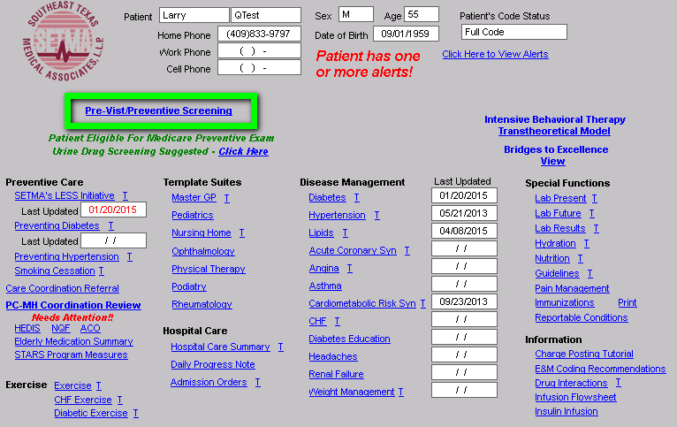
Pre-visit/Preventive Screening

Slide 43
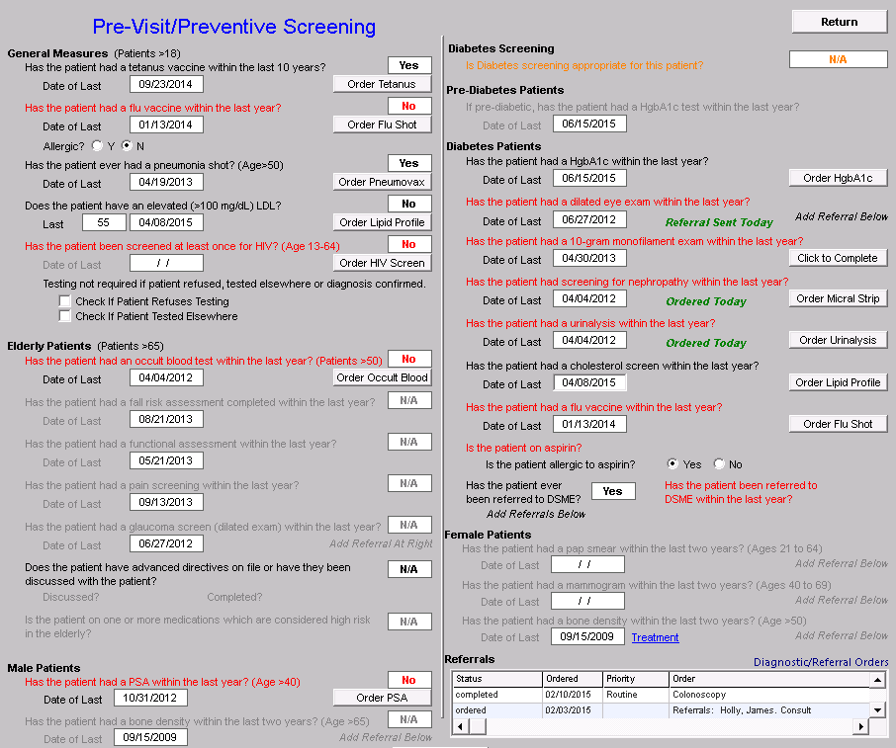
Pre-visit/Preventive Screening

Slide 44
Pre-visit/Preventive Screening
We believe that when complete, the Automated Team functions will free up 25-35% of the healthcare providers’ time, allowing all quality issues to be completed successfully and allowing the healthcare provider to spend more time with the patient.
The question is, “Will automation help in the Maintenance of Board Certification and will it facilitate SETMA providers continue meeting the standards for NCQA Diabetes Recognition and Cardiac and Stroke Recognition, NCQA Tier III PC-MH, AAHC PC-MH and Ambulatory Care standards, URAC PC-MH and the Joint Commission PC-MH and Ambulatory Care Standards?”

Slide 45
Pre-visit/Preventive Screening
The question is, “Will the Automated Team functions, which should have all SETMA providers consistently fulfilling all quality metrics and patient information materials, improve outcomes of care?
We know what our outcomes performance has been with clinical decision support (CDS) tools, with this expansion of the CDS tools into the Automated Team functions, will our performance and patient outcomes continue to improve? We expect so, but only time will tell.

Slide 46
Patient Engagement and Activation
While decreasing stress on providers and freeing up more time for patient interaction are important goals of The Automated Team, the greatest promise for improving outcomes come form patient engagement and activation.
To facilitate patient activation and engagement, the patient will be informed by staff teaching and by a document as to the tests, procedures and referrals which have been initiated by automation.

Slide 47
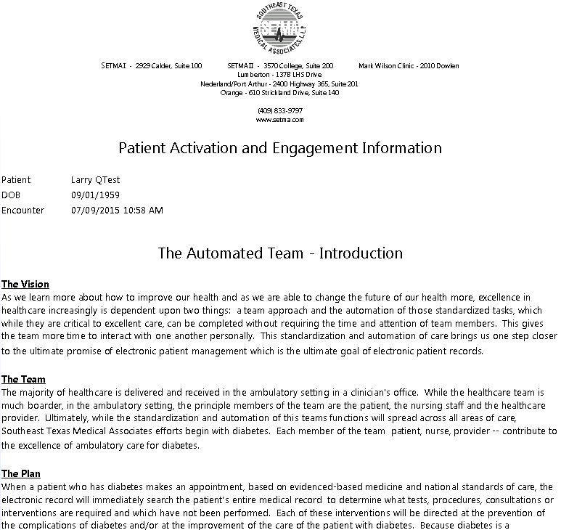
Patient Engagement and Activation – Patient Document

Slide 48
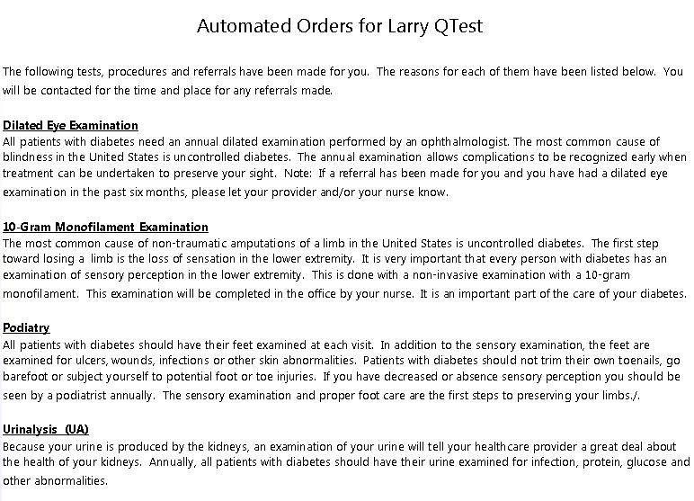
Patient Engagement and Activation – Patient Document

Slide 49
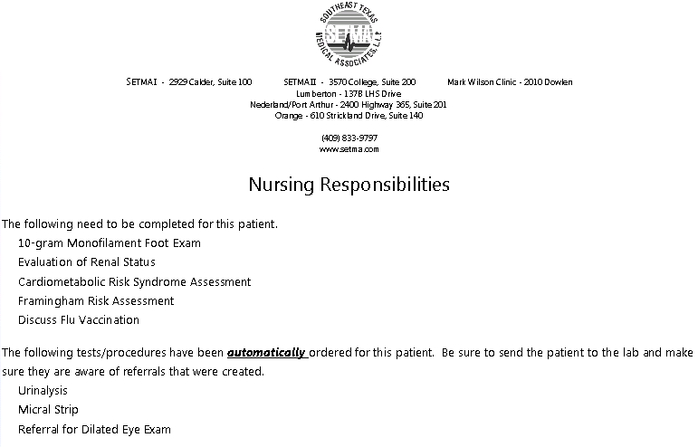
Patient Engagement and Activation – Nurse Document

Slide 50
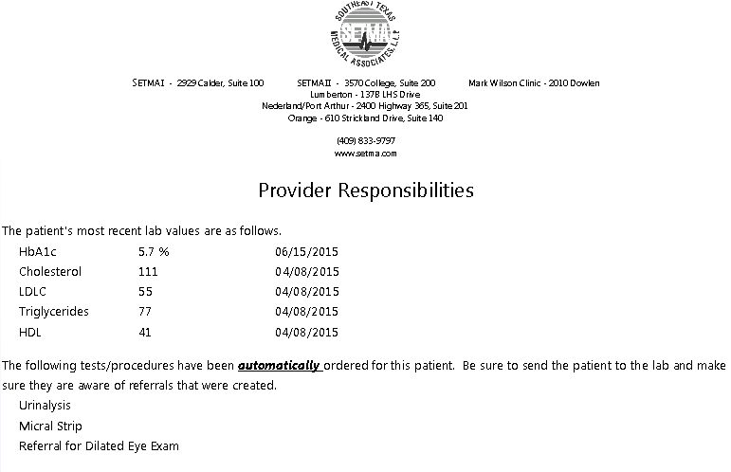
Patient Engagement and Activation – Provider Document

