Slide 1
Texas HIV Coalition Meeting Anatomy of a Public Health Journey
May 3, 2013
Austin, Texas
James L. Holly, MD
CEO SETMA, LLP
www.jameslhollymd.com

Slide 2
Healthcare Provider Workflow
How many tasks can you get a healthcare provider
to complete at each patient encounter?
The answer depends upon:
How important is the task or its result?
How much time does it take to complete?
How much energy does it take?

Slide 3
Healthcare Provider Workflow
If the task is very important and of great benefit to the patient and to the provider, and
If the task takes very little time, and
If the task takes very little energy, it is possible to get a provider to do a number of tasks consistently.
Illustration: Framingham Risk Scores
The task is very important to the
provider and patient but how much
energy and how much time does it
take?

Slide 4
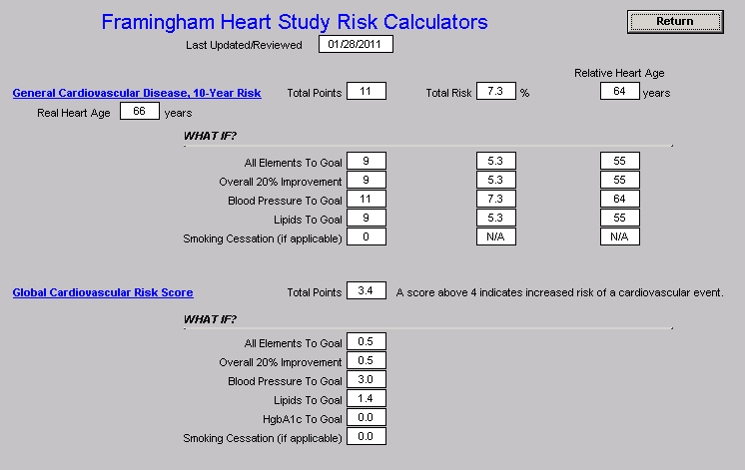
Framingham Risk Scores – “What If Scenario”

Slide 5
May, 1999 -- SETMA’s EMR Development Principles
Pursue Electronic Patient Management rather than Electronic Patient Records
Bring to bear upon every encounter what is known rather than what a particular provider knows.
Make it easier to do it right than not to do it at all.
Continually challenge providers to improve their performance.
Infuse new knowledge and decision-making tools throughout an organization instantly.
Establish and promote continuity of care with a common data base and with personalized patient education, information and plans of care.

Slide 6
May, 1999 -- SETMA’s EMR Development Principles
Enlist patients as partners and collaborators in their own health improvement.
Evaluate the care of patients and populations of patients longitudinally.
Audit provider performance based on the Consortium for Physician Performance Improvement Data Sets.
Create multiple disease-management tools, integrated in an intuitive and interchangeable fashion, giving patients the benefit of expert knowledge about specific conditions while getting the benefit of a global approach to their health.

Slide 7
A New Task for SETMA’s Providers
Texas Department of State Health Services
HIV/ASTD Prevention and Care Branch
In Collaboration with the
Center for Disease Control
Promoting Annual HIV
Screening for ages 13-64
March 15, 2011 Should SETMA participate?

Slide 8
SETMA’s Public Health Journey
On March 15, 2011, Mrs. Tam Kiehnoff, Medical Case Management Coordinator, Triangle AIDS Network, asked SETMA’s CEO to meet with Mrs. Isabel Clark, Texas Department of State Health Services, Program Specialist V, HIV/ASTD Prevention and Care Branch.
That meeting took place on March 16th. On the same day, SETMA contacted Baptist Hospital of Southeast Texas about participating.

Slide 9
SETMA’s Public Health Journey
March 23rd, SETMA announced the deployment of a tool for the routine screening of HIV.
SETMA’s in-house reference laboratory was not performing HIV testing at this time.
On July 1, the day that SETMA launched the HIV Screening Public Health Initiative, SETMA’s laboratory began performing HIV testing in house.
The following is SETMA’s Clinical Decision Support for this initiative.

Slide 10
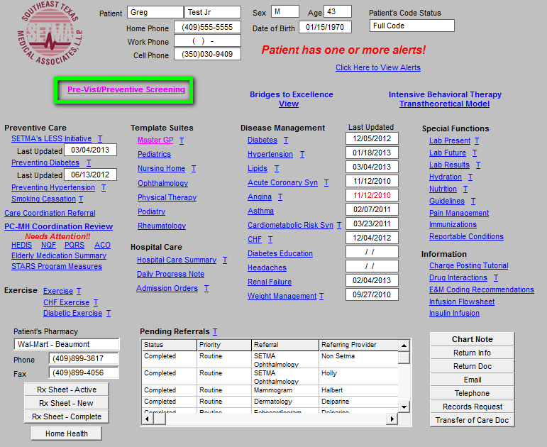
HIV Screening Tool in EMR

Slide 11
HIV Screening Tool in EMR
When the button outlined in green above is deployed, it launches SETMA’s Pre Visit Screening and Prevention template.
This is where every visit at SETMA begins. The legend is:
Any item in red applies to the patient and has not been done.
Any item in black applies to the patient and has been done.
Any item in grey does not apply to the patient.

Slide 12
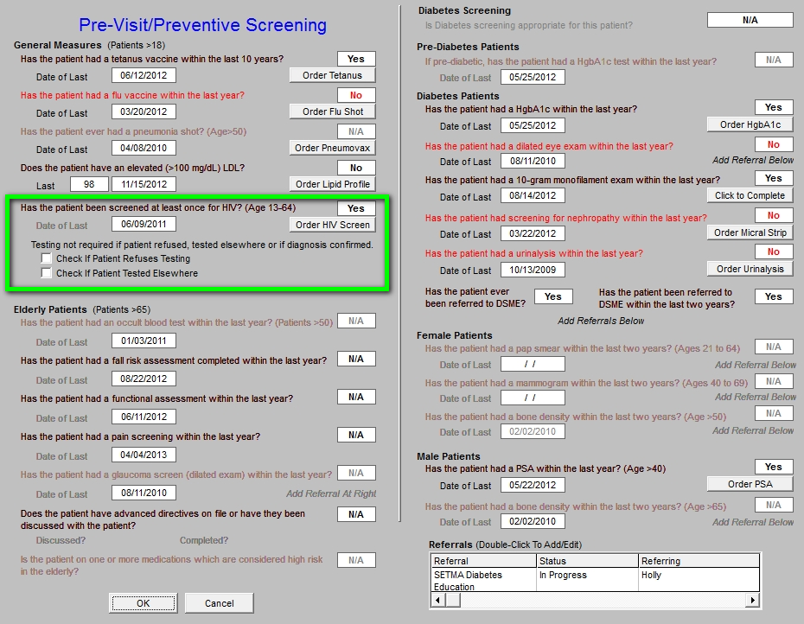
HIV Screening Tool in EMR

Slide 13
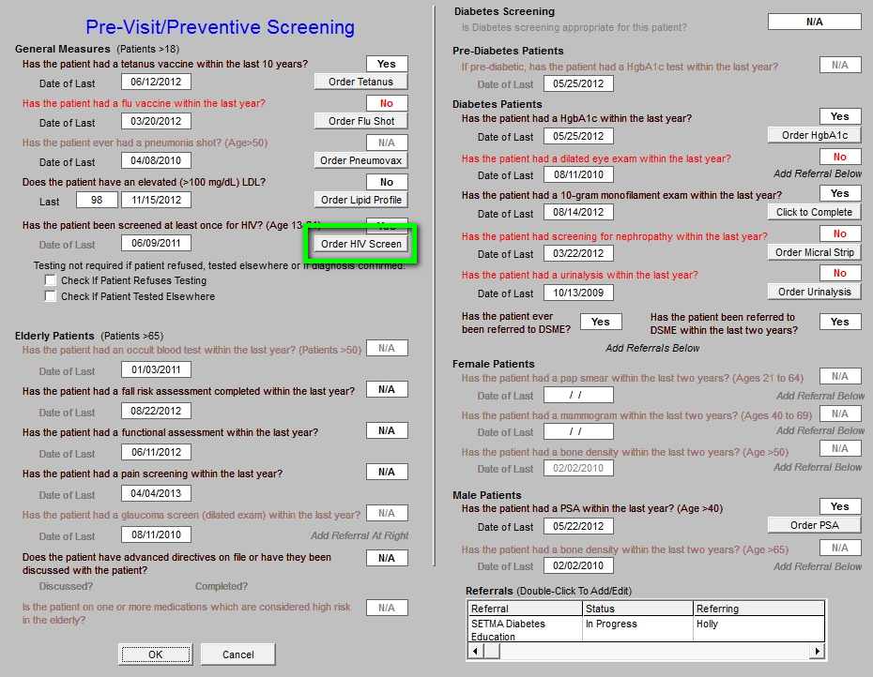
HIV Screening Tool in EMR

Slide 14
HIV Screening Tool in EMR
On the template above, when the button outlined in green is clicked, the following happens:
The HIV test is ordered.
The order is sent to the chart, billing and the lab.
Determines whether the patient's insurance will pay for test, or if bill goes to state grant (this was prepared when it was still thought that SETMA would participate in the CDC program).
Release is automatically populated with patient information.
The consent form is printed.

Slide 15
HIV Screening Tool in EMR
Outlined in green below is a function whereby the provider can denote that the patient refuses HIV testing, or that the patient has been tested in the past.
When the patient has previously been tested, the patient’s report of the result is recorded and an effort is made to obtain the documentation of the laboratory result.

Slide 16
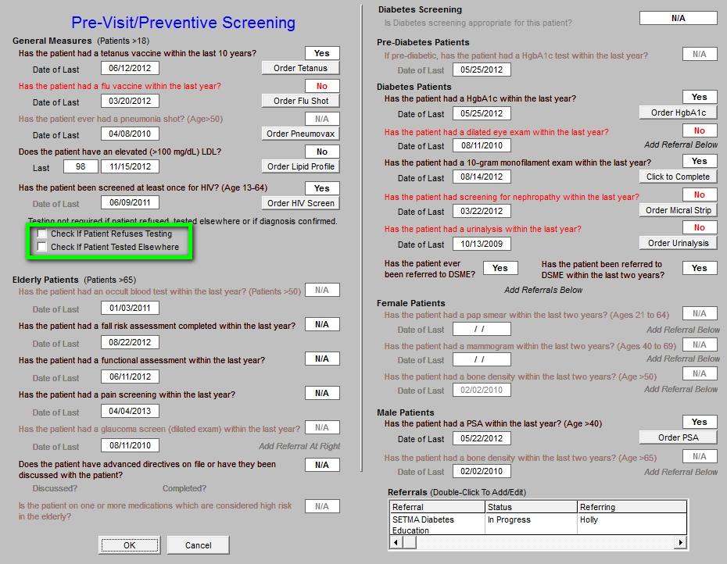
HIV Screening Tool in EMR

Slide 17
HIV Screening Tool in EMR
SETMA uses the same EMR and database in the hospital and clinic, and one of our major hospitals participates in the screening program, therefore, we capture HIV testing done outside of SETMA.
This eliminates redundant testing and increases provider compliance with the screening protocol.
The following slides show the method by which hospital-HIV testing is captured so that it interacts actively with SETMA’s entire data base, i.e., HIV test done at Baptist Hospital will be captured in SETMA’s audit of performance.

Slide 18
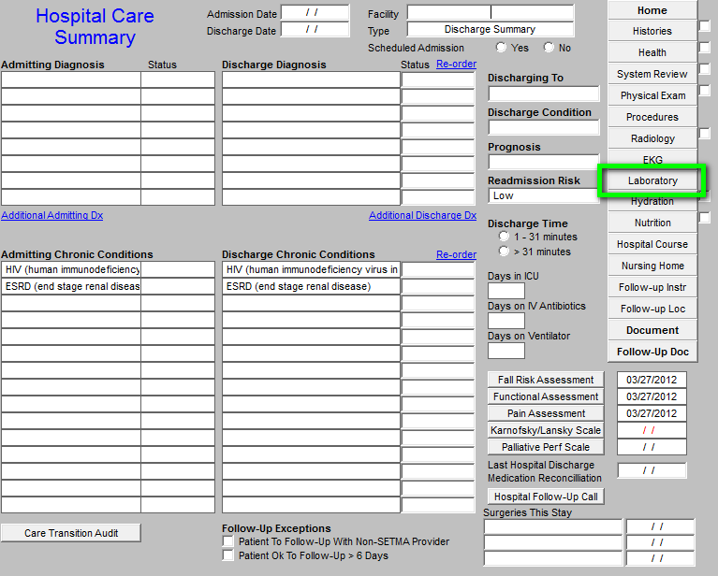
HIV Screening Tool in EMR

Slide 19
HIV Screening Tool in EMR
In September, 2010, SETMA changed the name of the “discharge summary” to “Hospital Care Summary and Post Hospital Plan of Care and Treatment Plan.” In the past 3 years, SETMA has discharged over 14,000 patients from the hospital. 98.7% of the time the Summary and Plan has been received by the patient prior to leaving the hospital.
In the template above and those to follow, we demonstrate how test results are captured in SETMA’s EMR from the hospital for continuity of care including HIV Screening.

Slide 20
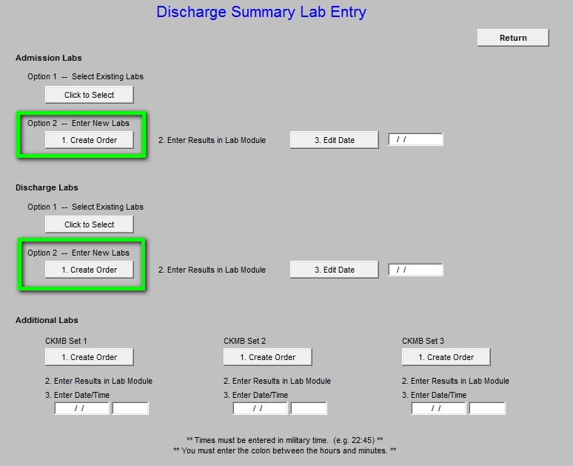
HIV Screening Tool in EMR

Slide 21
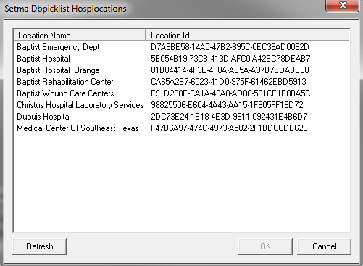
HIV Screening Tool in EMR

Slide 22
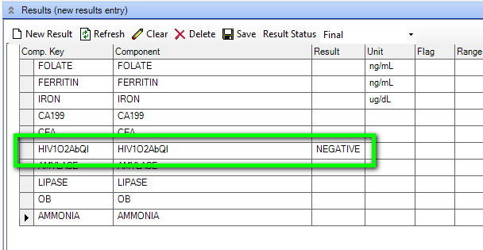
HIV Screening Tool in EMR

Slide 23
Texas State Reportable Conditions
Simultaneously, with the development and deployment of the HIV Clinical Decision Support tool, SETMA developed a tool for enhancing our compliance with Texas State Reportable Conditions.
Two of those reportable conditions are HIV and AIDS.
This tool is the link between HIV Screening and provider responsibility to report confirmed positive outcomes to the Texas Department of State Health Services.

Slide 24
Texas State Reportable Conditions
April 30, 2011, Dr. Edward J. Sherwood, Professor of Medicine at the Texas A&M School of Medicine delivered a CME lectured entitled, “The Ethics of Infectious Disease.”* He distributed a publication of the Texas Department of State Health Services
which detailed 78 reportable conditions. The list included HIV and AIDS.
Rather than ask providers to memorize 78 conditions, SETMA designed a Clinical Decision Support tool to do this reporting electronically.
*This lecture was the best CME lecture I have ever heard.

Slide 25
Texas State Reportable Conditions
SETMA’s Information Technology department was charged with designing a functionality which would:
Display the reportable conditions for provider review.
Detail the time frame for reporting each disease.
Automatically, denote on the reportable conditions template the diagnosis which is identified by the provider when it is documented on the assessment template in the EMR.
Simultaneously, with number three, send an e-mail to SETMA’s Care Coordination Department which would report the condition to the State.
The fact that the reporting requirement has been completed will be reported to the provider and will be stored in the EMR in a searchable fashion.

Slide 26
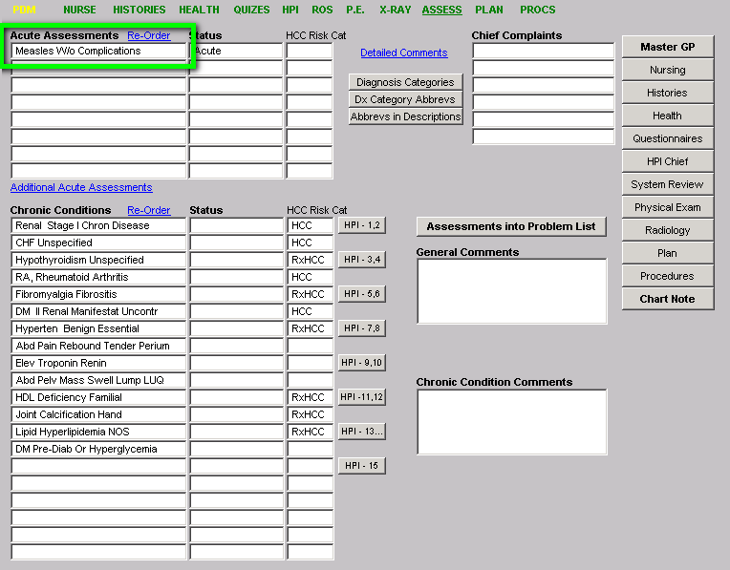
Texas State Reportable Conditions

Slide 27
Texas State Reportable Conditions
As seen above, outlined in green, the provider completes the assessment of the patient.
When that assessment documents a reportable condition, including HIV or AIDS, the provider’s responsibility for complying with Texas Reportable Conditions is done.
The following template shows the diagnoses of “measles” documented on SETMA’s electronic version of the Texas State Department of Health Services Reporting Guidelines.

Slide 28
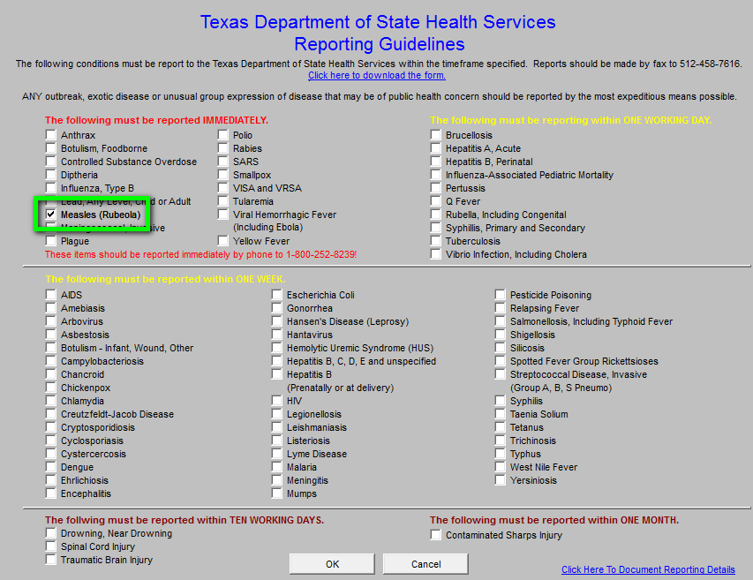
Texas State Reportable Conditions

Slide 29
Texas State Reportable Conditions
The checking of “measles” was done automatically when the ICD-9 code (soon to be ICD-10) was selected in the assessment of the patient.
SETMA’s electronic version of the Texas State Department of Health Services Reporting Guidelines is also an excellent educational tool as the provider can review the reportable-conditions template without a diagnosis.
Principle: What a healthcare provider must remember, i.e., 78 reportable conditions, can often be forgotten; however, when the provider does not have to remember those conditions, they often don’t forget them.

Slide 30
Texas State Reportable Conditions
When the button on SETMA’s AAA Home template, outlined in green below, is deployed, the Texas State Department of Health Services Reporting Guidelines template appears.
The template can be used as a review for providers or nurses of what needs to be reported and/or to note that the diagnosed infectious condition, in this case “measles,” has been automatically checked as a result of the provider having selected this diagnoses on the assessment template.

Slide 31
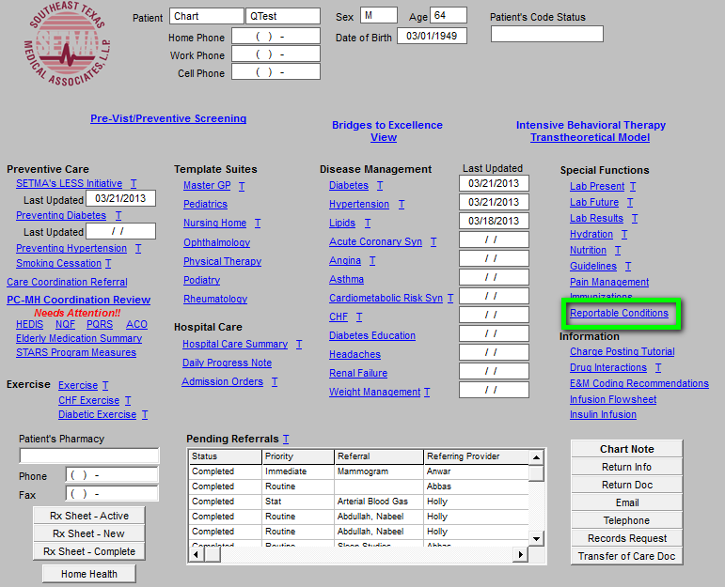
Texas State Reportable Conditions

Slide 32
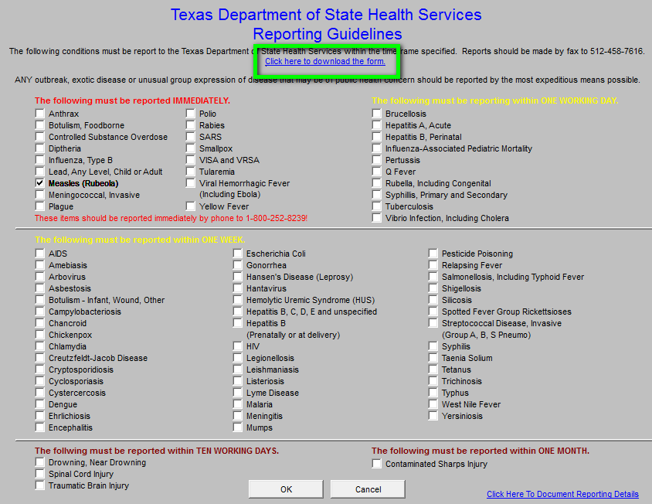
Texas State Reportable Conditions

Slide 33
Texas State Reportable Conditions
To review, when the reportable diagnosis is selected:
The system automatically checks the diagnosed disease on the Texas Department of State Health Services Reporting Guidelines template where the list of 78 reportable conditions are displayed.
A message is sent to the Care Coordination Department.
The message appears in the workflow of the Care Coordination team.
Once the report to the state is made, a note is added to the patient’s chart noting that Health Department notification has been done and the provider is notified of that fact.
The beauty of this solution is that the provider simply diagnoses a suspected reportable condition and the process is completed without further action by the provider.

Slide 34
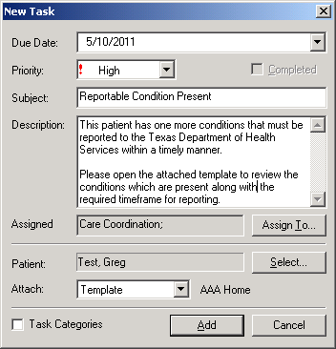
Texas State Reportable Conditions
This is the Care Coordination telephone alert which is automatically sent to SETMA’s Care Coordination Department when the reportable diagnosis is made.

Slide 35
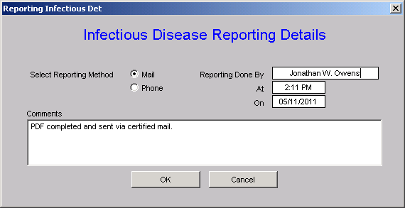
Texas State Reportable Conditions
When the Care Coordination department reports the infection, this template allows for the documentation of that report and for sending notice of the report to the treating provider.

Slide 36
Texas State Reportable Conditions
To print the Department of Health reporting form, SETMA’s Care Coordination Department goes to SETMA’s electronic version of the Texas Department of State Health Services Reporting Guidelines template and clicks on the link which is outlined in green.
This deploys a printable version of the Initial Provider Disease Reporting form.

Slide 37
Texas State Reportable Conditions

Slide 38
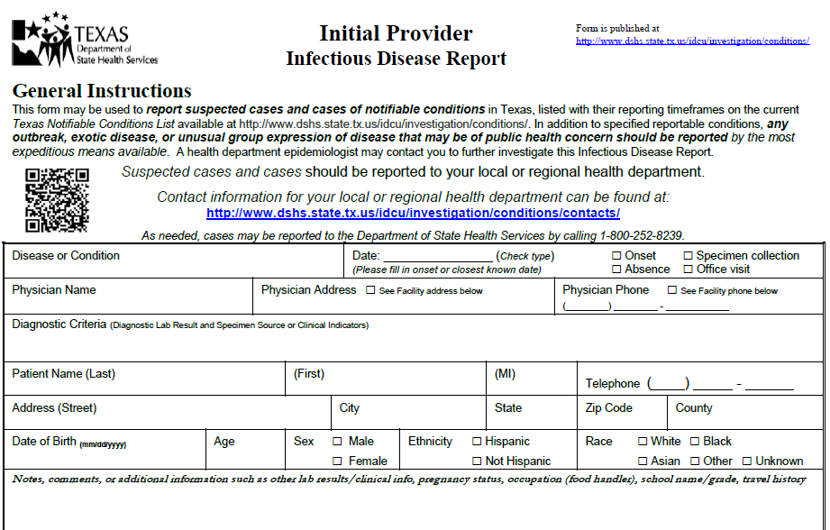
Texas State Reportable Conditions

Slide 39
Texas State Reportable Conditions
Since SETMA designed this solution, several issues have arisen
which were unanticipated.
Does the Department of Health want previously reported incidences of chronic infectious diseases such as hepatitis and HIV to be “re-reported?”
Does the Department of Health want infectious diseases previously reported in other states reported when the patient moves to Texas?
Does the state have a way of determining that a chronic infectious disease has been previously reported or not?
In regard to EMR solutions, the diagnosis of “Coumadin Toxicity” is reported as an “overdose.” Obviously, this is not the intent of public health officials to know the incidence of narcotic or psychotropic drug overdoes. The power of electronics has to be guided so as not to report conditions not intended to be reported.

Slide 40
SETMA’s Public Health Journey
Remember, all of the above only takes us to March 23, 2011 but our public health journey continues.
In the course of the next several months, one academician said:
“In the years I have worked in public health, I have never before encountered practicing physicians so committed to supporting public health with timely, complete and accurate reporting of reportable conditions.”

Slide 41
SETMA’s Public Health Journey
In April and May of 2011, SETMA reviewed the contract which the Texas Department of State Health Services and the Centers for Disease Control required for our participation.
On May 13, 2011, SETMA notified the Texas Department of State Health Services that the complexities of their contract made it impossible for us to join their program.
However, we determined to move forward with a screening program independent of the CDC program.

Slide 42
SETMA’s Public Health Journey
For May 26th and June 2, 2011, my weekly
newspaper columns were about SETMA’s HIV
Screening project. They can be read at:
http://www.jameslhollymd.com/your-life-your-health/hiv-why-should-i-be-tested
http://www.jameslhollymd.com/your-life-your-health/texas-state-reportable-infectious-disease
“

Slide 43
SETMA’s Public Health Journey
In close collaboration with the Texas Department of State Health Services, but without a contractual relationship, SETMA set a start date of July 1, 2011, for the routine screening of HIV.
Our progress was slower than expected but has gained momentum, so that it is now a sustainable part of our work flow, our quality improvement and our auditing and reporting activities.
As we approach the second anniversary of our launch date, we look forward to meeting our expectation of exceeding an 80% compliance with the standards of our program by the end of our third year in July, 2014.

Slide 44
Deployment Events: Provider Response
“I have found every patient in the age groups amenable to the testing – no resistance at all.” June 30, 2011 (While the official program began July 1, 2011, some providers started addressing this with patients before that date.)
July, 2011 – first month of reporting -- 2,600 eligible patients only 152 were tested but one unknown HIV patient was found. (August 10, 2011)
E-mail sent to all providers, “May I appeal to you to initiate the HIV testing on all patients 13-64. (August 10, 2011)

Slide 45
Deployment Events: Provider Response
“One of the questions the patients are asking is who is paying for the testing. We are getting a lot of refusals if the patient has to pay for the test.” (August 11, 2011)
“They don’t; if insurance doesn't pay, SETMA will write off the cost.” (SETMA’s CEO, August 11, 2011)
On public television in October, 2011, and in a personal letter to all patients who refused the testing, SETMA’s commitment to screening for HIV without a personal cost to patients was repeated.

Slide 46
August 23, 2011 – Who’s Paying?
SETMA’s Central Billing Office reported that we are receiving reimbursement from the majority of the larger commercial insurances.
Aetna
BCBS
Humana
Humana Military
Health Select
Medicare if we have a payable diagnosis
Medicaid

Slide 47
The Results
In our first month, while the overall result was not wonderful, we did discover one previously unknown positive result. We were all pleased to be able to intervene successfully in that patient’s life for it is a fact that as in all areas of life, so in having HIV and not knowing it:
THE ONLY THING WHICH CAN HURT YOU IS WHAT YOU DON’T KNOW!

Slide 48
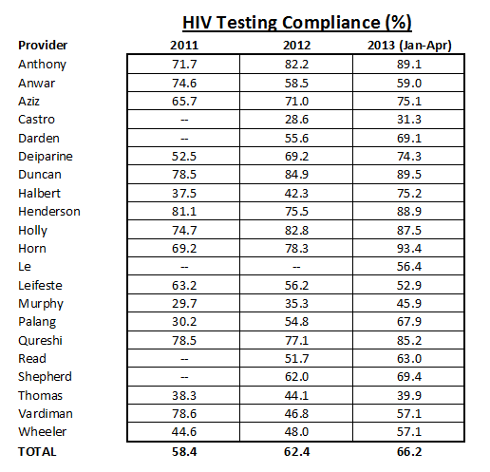
The Results

Slide 49
Following-Up On Those Who Refuse Testing
In October, 2011, SETMA sent a letter to all patients who had declined HIV testing. It stated:
“I grew up hearing an adage which stated, ‘What you don’t know can’t hurt you.’…In healthcare what you don’t know can kill you…The good news is that with the right medical management HIV can be treated and a person who is HIV positive can live a normal life…If your insurance company does not pay for the HIV Screening…SETMA will pay for your testing. That’s how much we care for you. If there is a co-pay for the testing we will pay the fee. You will pay nothing for being screened for HIV.”

Slide 50
Public Appeal
SETMA sponsored three television segments on HIV Screening.
In October, SETMA’s CEO had his blood drawn for HIV screening on live television. He announced that the following week, he would disclose his result.
The following week, a SETMA partner announced that Dr. Holly was not going to reveal his results. The reasons are explained in a video which is to follow.

Slide 51
Dr. Holly’s HIV Test Drawn On Live TV

Slide 52
Dr. Holly’s HIV Results On Live TV

Slide 53
Barriers To Patient Participation
I have been somewhat surprised at how difficult it has been to get general acceptance of the screening, although it is improving. The following are the barriers, we have experienced:
Patients do not want to pay anything for the test so if there is any doubt, they will decline testing. We have remedied this by our willingness to pay for the cost if their insurance does not.

Slide 54
Barriers To Patient Participation
We have had some examples of a provider who thought it was easier to simply say the patient refused than it was to get their permission. We have remedied this by sending a letter every three months to the patients who declined and making sure they knew they did not have to pay for the test and inviting them to come in at no charge to have the HIV screening test.

Slide 55
Barriers To Patient Participation
Because there have only been two positives, some providers harbor an unspoken prejudice that the value of the screening is less than other matters which vie for their attention.
We are remedying this by reinforcing that there is good scientific evidence supporting the value of HIV screening.
Each month, SETMA closes its office for a half day for practice-wide conferences where we review quality performance, healthcare transformation and the use of clinical decision support. Our HIV Screening is a part of those sessions.

Slide 56
The Cost
SETMA started reporting patient HIV results done in SETMA’s in-house lab on July 1, 2011. To date, we have completed 4549 HIV tests in house. Cost to perform each test is $12.88 cost per reportable.
Between July, 2011 and March, 2013, the HIV Screening project has cost SETMA $58,591.
In that time, SETMA has been reimbursed for 1534 tests for a total reimbursement of $54,102.68. This shows a monthly direct cost to SETMA of $224.41.
In that SETMA originally allocated $60,000 of revenue to this project when we determined not to work with the CDC, this is an outstanding return.

Slide 57
The Future
HIV Screening is now a part of SETMA’s healthcare DNA. We will continue this program until we can report that 100% of those who look to SETMA for healthcare have been screened. By our own example – my grandchildren were tested when they visited SETMA – and by evidenced-based medicine, we will continue this program.
Nothing speaks more to our commitment than the statement, “Even if you don’t want to pay or can’t, we want you to be tested such that SETMA will pay the cost.” We continue that commitment.

