Slide 1
The Importance of Data Analytics in Physician Practice Maine Health Transitions of Care Symposium May 22, 2014
James L. Holly, MD
CEO, SETMA, LLP
www.jameslhollymd.com
Adjunct Professor
Department of Family and Community Health
School of Medicine
The University of Texas Health Science Center at San Antonio

Slide 2
The Nature of Knowledge
“Information” is inherently static while “learning” is dynamic and generative (creative). In The Fifth Discipline, Peter Senge, said: “Learning is only distantly related to taking in more information…”
Classically, taking in more information has been the foundation of medical education. Traditional CME has perpetuated the idea that “learning” is simply accomplished by “learning more facts.”

Slide 3
Knowledge Can Transform
Knowledge only has power to transform when it is
held in the mind of persons who have “Personal
Mastery,” which is the discipline of:
continually clarifying and deepening your personal vision (where you want to go),
focusing your energies (attention & resources),
developing patience (relentlessness), and
seeing reality objectively (telling yourself the truth)

Slide 4
Transformation Distinguishes Two Groups
Forward thinkers transform; day dreamers wish for change but seldom see it. Senge said:
“The juxtaposition of vision (what we want) and a clear picture of current reality (where we are) generates…‘creative tension,’ (which is) a force to bring vision and reality together, through the natural tendency of tension to seek resolution.”

Slide 5
Analytics Transform Knowledge
Analytics transform knowledge into an agent for change. In reality, without analytics, we will neither know where we are, where we are going or how to sustain the effort to get there.
For transformation to take place through knowledge, we must be prepared to ask the right questions, courageously accept the answers and to require ourselves to change.

Slide 6
Transformation Requires Truthfulness
Those with “personal mastery”
Live in a continual learning mode.
They never ARRIVE!
They are acutely aware of their ignorance, their incompetence, their growth areas.
And they are deeply self-confident!

Slide 7
Knowing Limitations
The safest person is not the one who knows everything, which is impossible, but the safest person is the one who knows what she/he does not know.
You will never be held accountable for what you don’t know; you will be held account-able for what you don’t know that you don’t know.

Slide 8
Healthcare Transformation
Healthcare transformation, which will produce continuous performance improvement, results from internalized ideals, which create vision and passion, both of which produce and sustain “creative tension” and “generative thinking.”
Transformation is not the result of pressure and it is not frustrated by obstacles. In fact, the more difficult a problem is, the more power is created by the process of transformation in order to overcome the problem.

Slide 9
Analytics and Transformation
The greatest frustration to transformation is the unwillingness or the inability to face current reality. Often, the first time healthcare provides see audits of their performance, they say, “That can’t be right!”
Through analytics – tracking data, auditing performance, statistical analysis of results – we learn the truth. For that truth to impact our performance, we must believe it.

Slide 10
Analytics and Transformation
Through acknowledging truth, privately and publicly, we empower sustainable change, making analytics a critical aspect of healthcare transformation.

Slide 11
Technology Alone Is Not The Answer
While an Electronic Health Record (EHR) has tremendous capacity to capture data, that is only part of the solution. The ultimate goal must be to improve patient care and patient health, and to decrease cost, not just to capture and store information!
Electronic Patient Management employs the power of electronics to track, audit, analyze and display performance and outcomes, thus powering transformation.

Slide 12
Continuous Performance Improvement
SETMA’s philosophy of health care delivery is that every patient encounter ought to be evaluation-al and educational for the patient and provider.
CPI is not an academic exercise; it is the dynamic of healthcare transformation. The patient and the provider must be learning, if the patient's delivered healthcare and the provider’s healthcare delivery are to be continuously improving.

Slide 13
Continuous Performance Improvement
Addressing the foundation of Continuous Performance Improvement, IOM produced a report entitled: “Redesigning Continuing Education in the Health Professions” (Institute of Medicine of National Academies, December 2009). The title page of that report declares:
“Knowing is not enough; we must apply.
Willing is not enough; we must do.”
- Goethe

Slide 14
Public-Reporting: Assumptions
Public Reporting by Provider name is transformative but quality metrics are not an end in themselves.
Optimal health at optimal cost is the goal of quality care. Quality metrics are simply “sign posts along the way.” They give directions to health.
Metrics are like a healthcare “Global Positioning System”: it tells you where you are, where you want to be, and how to get from here to there.

Slide 15
Public-Reporting: Assumptions
Business Intelligence (BI) statistical analytics are like coordinates to the destination of optimal health at manageable cost.
Ultimately, the goal will be measured by the well-being of patients, but the guide posts to that destination are given by the analysis of patient and population data.

Slide 16
Public-Reporting: Assumptions
There are different classes of quality metrics. No metric alone provides a granular portrait of the quality of care a patient receives, but together, multiple sets of metrics can give an indication of whether the patient’s care is going in the right direction. Some of the categories of quality metrics are:
access,
outcome,
patient experience,
process,
structure and
costs of care.

Slide 17
Public-Reporting: Assumptions
The tracking of quality metrics should be incidental to the care patients are receiving and should not be the object of care.
Consequently, the design of the data aggregation in the care process must be as non-intrusive as possible.
Notwithstanding, the very act of collecting, aggregating and reporting data will tend to create an Hawthorne effect.

Slide 18
SETMA’s Lipid Audit

Slide 19
Public-Reporting: Assumptions
The power of quality metrics, like the benefit of the GPS, is enhanced if the healthcare provider and the patient are able to know the coordinates – their performance on the metrics -- while care is being received.
SETMA’s information system is designed so that the provider can know how she/he is performing at the point-of-service.

Slide 20
HEDIS

Slide 21
Public-Reporting: Assumptions
Public reporting of quality metrics by provider name must not be a novelty in healthcare but must be the standard. Even with the acknowledgment of the Hawthorne effect, the improvement in healthcare outcomes achieved with public reporting is real.

Slide 22
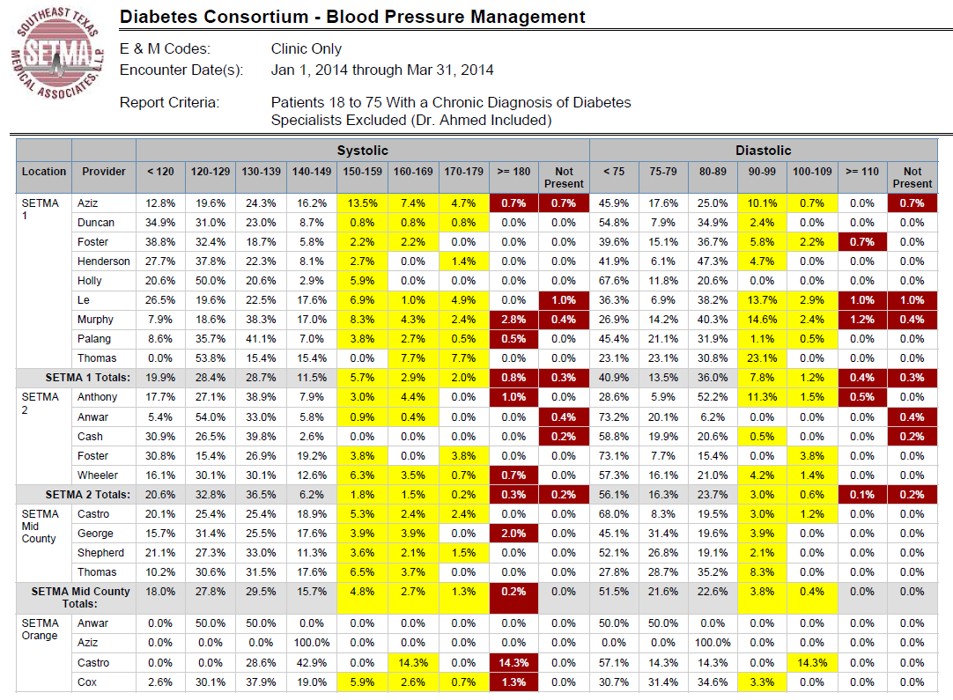
PCPI Diabetes

Slide 23
Public-Reporting: Assumptions
Quality metrics are not static. New research and improved models of care will require updating and modifying metrics.
Illustrations:
With diabetes, it may be that HbA1C goals, after twenty years of having the disease, should be different.
With diabetes, if after twenty years, a patient does not have renal disease, they may not develop it.

Slide 24
Clusters and Galaxies
A “cluster” is seven or more quality metrics for a single condition, i.e., diabetes, hypertension, etc.
A “galaxy” is multiple clusters for the same patient, i.e., diabetes, hypertension, lipids, CHF, etc.
Fulfilling a single or a few quality metrics does not change outcomes, but fulfilling “clusters” and “galaxies” of metrics at the point-of-care can and will change outcomes.

Slide 25
Clusters

Slide 26
Galaxies

Slide 27
Statistical Analysis
Beyond these clusters and galaxies of metrics, SETMA uses statistical analysis to give meaning to the data we collect.
While the clusters and galaxies of metrics are important, we can learn much more about how we are treating a population as a whole through statistical analysis.

Slide 28
Statistical Analysis
Each of the statistical measurements which SETMA calculates -- the mean, the median, the mode and the standard deviation -- tells us something about our performance, and helps us design quality improvement initiatives for the future.
Of particular, and often, of little known importance, is the standard deviation.

Slide 29
Mean Versus Standard Deviation
The mean (average) is a useful tool in analytics but can be misleading when used alone. The mean by itself does not address the degree of variability from the mean.
The mean of 40, 50 and 60 is 50.
The mean of 0, 50 and 100 is also 50.
Standard deviation gives added value to the mean by describing how far the range of values vary from the mean.
The standard deviation of 0, 50 and 100 is 50.
The standard deviation of 40, 50 and 60 is 10.

Slide 30
Mean Versus Standard Deviation
SETMA’s mean HgbA1c has been steadily improving for the last 10 years. Yet, our standard deviation calculations revealed that a small subset of our patients were not being treated successfully and were being left behind.
By analyzing the standard deviation of our HgbA1c, we have been able to address the patients whose values fall far from the average of the rest of the clinic.

Slide 31
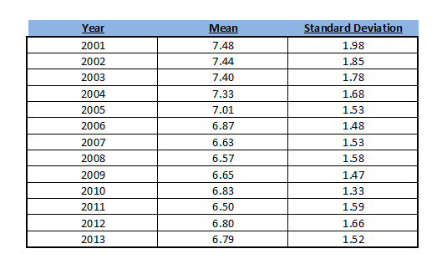
Mean Versus Standard Deviation

Slide 32
Mode
The mode helps describe the frequency of an event, number or some other occurrence.
The mode can be applied to more than just a set of numbers. For example, the mode could be useful if you wanted to find the most frequently occurring principle diagnosis for admission to the hospital or which geographic area (zip code) has the highest frequency for a given condition.

Slide 33
Diabetes Care Improvements
2000 – Design and Deployment of EHR-Based Diabetes Management Tool
HbA1c Improvement of 0.3%
2004 – Design and Deployment of American Diabetes Association Recognized Diabetes Self Management (DSME) Program
HbA1c Improvement of 0.3%
2006 – Recruitment of Endocrinologist
HbA1c Improvement of 0.25%

Slide 34
Diabetes Audit - Trending

Slide 35
The Value of Trending
In 2009, SETMA launched a Business Intelligence
software solution for real-time analytics.
Trending revealed that from October-December,2009,
many patients were losing HbA1C control. Further
analysis showed that these patients were being seen
and tested less often in this period than those who
maintained control.

Slide 36
The Value of Trending
A 2010 Quality Improvement Initiative included writing all patients with diabetes encouraging them to make appointments and get tested in the last quarter of the year.
A contract was made, which encouraged celebration of holidays while maintaining dietary discretion, exercise and testing.
In 2011, trending analysis showed that the holiday-induced loss of control had been eliminated.

Slide 37
Ethnic Disparities
In its staff, SETMA is a multi-ethnic, multi-national, multi-faith practice and so we are in our patient population.
It is important to SETMA that all people receive equal care in access, process and outcomes. As a result, we examine our treatment by ethnicity, as well as by many other categories.

Slide 38
Ethnic Disparities
Approximately, one-third of the patients we treat with diabetes are African-American and two-thirds are Caucasian. As the control (gold) and uncontrolled (purple) groups demonstrate, there is no distinction between the treatment of these patients by ethnicity, effectively eliminating ethnic disparity in SETMA’s treatment of diabetes.

Slide 39
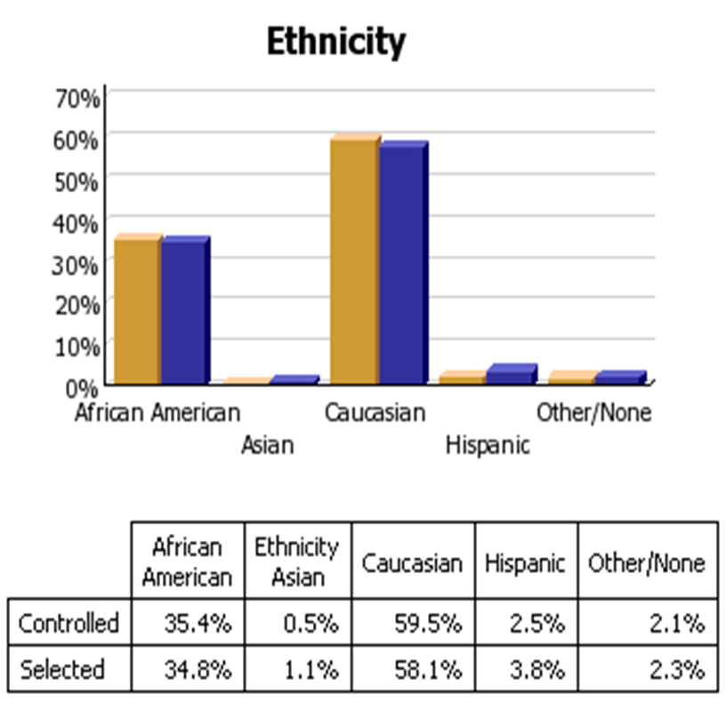
Diabetes Audit - Ethnicity

Slide 40
Diabetes Care Improvements
Financial barriers to care are a significant problem in the United States. seven years ago, SETMA initiated a zero co-pay for capitated, HMO patients in order to eliminate economic barriers to care.
Comparing FFS Medicare patients and capitated HMO, and uninsured patients, it can be inferred from this data that the elimination of economic barriers results in improved care.
Through SETMA’s Foundation, we are making further attempts to compensate for economic barriers to care.

Slide 41
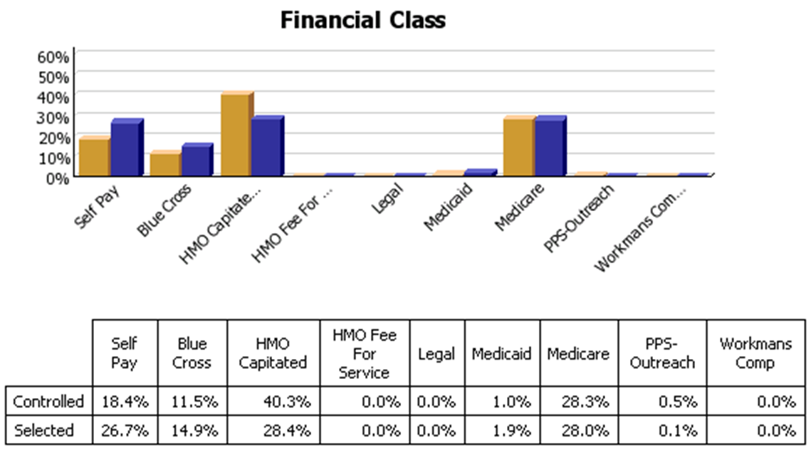
Diabetes Audit – Financial Class

Slide 42
Auditing Data
SETMA’s ability to track, audit and analyze data has improved as illustrated by the following NCQA Diabetes Recognition Program audit which takes 16 seconds to complete through SETMA’s Business Intelligence (BI) software deployment.
While quality metrics are the foundation of quality, auditing of performance is often overlooked as a critical component of the process.

Slide 43
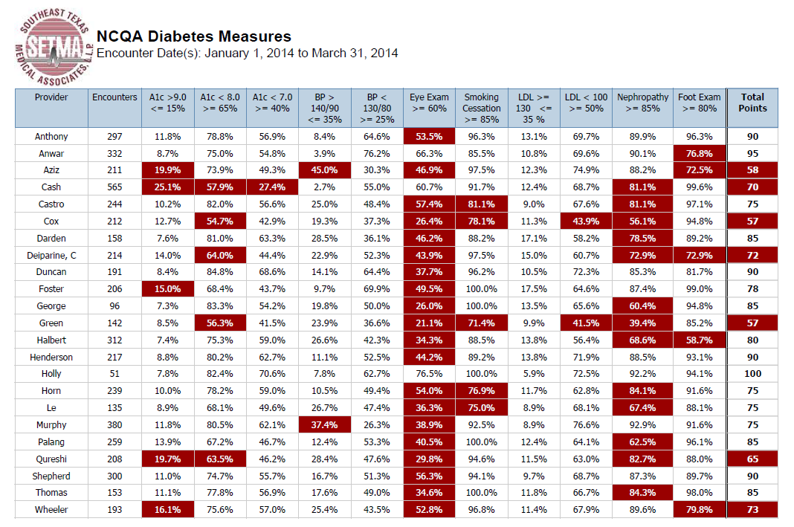
Auditing Data

Slide 44
Recognizing Patterns
SETMA is able to analyze patterns to explain why one population, or one patient is not to goal while others are. Our analysis looks at:
Frequency of visits
Frequency of testing
Number of medications
Change in treatment if not to goal
Attended Education or not
Ethnic disparities of care
Age and Gender variations, etc.

Slide 45
Recognizing Patterns

Slide 46
Recognizing Patterns

Slide 47
Recognizing Patterns

Slide 48
Predictive Modeling
Our data is not only useful to see how we did or how we are doing, we can also use it to predict the future.
By looking more closely at our trending results, we can extrapolate those trends into the future and begin to predict what we think will happen.
By analyzing past trends of patients who have been readmitted to the hospital, we have been able to predict the factors that we believe are likely to reduce a patient’s risk of unnecessary readmission to the hospital.

Slide 49
Hospital Readmissions
When we looked at our past readmission data, we found that three actions played a significant role in keeping patients from coming back to the hospital unnecessarily. They are:
The patient received their Hospital Care Summary and Post Hospital Plan of Care and Treatment Plan (previously called the Discharge Summary) and the time of discharge.
A 12-30 minute care coaching call the day after discharge from the hospital.
Seeing the patient in the clinic within 5 days after discharge.

Slide 50
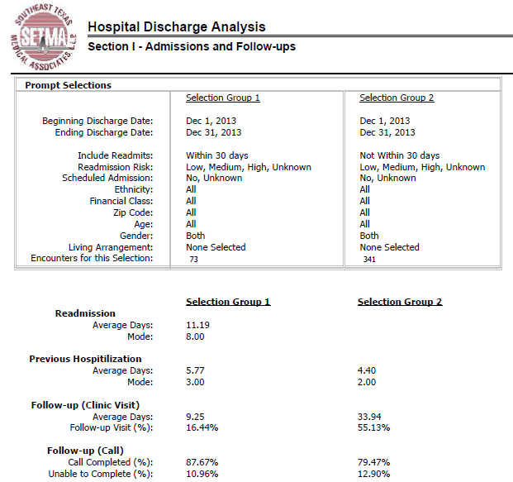
Hospital Readmissions

Slide 51
Predictive Modeling
By predicting our future, we are able proactively to respond in the present. As a result, we have
Increased the quality of our care
Decreased the cost of our care
Increased patient compliance with treatment
Increased patient satisfaction

Slide 52
The Four Domains of Health’s Future
Since SETMA adopted electronic medical records in 1998, we have come to believe the following about the future of healthcare:
The Substance Evidence-based medicine and comprehensive health promotion
The Method Electronic Patient Management
The Dynamic Patient-Centered Medical Home
The Funding Capitation and Payment for Quality

Slide 53
The SETMA Model of Care
Founded on the four domains of what we believe to be the future of healthcare, SETMA’s mode of care includes the following:
Personal Performance Tracking One patient at a time
Auditing of Performance By panel or population
Analysis of Provider Performance Statistical analysis
Public Reporting By provider name at www.jameslhollymd.com
Quality Assessment and Performance Improvement

Slide 54
The Key to The SETMA Model of Care
The key to this Model is the real-time ability of providers to measure their own performance at the point-of-care. This is done with multiple displays of quality metric sets, with real-time aggregation of performance, incidental to excellent care. The following are several examples which are used by SETMA providers.

Slide 55
Data Aggregation Incidental to Care Pre-Visit/Preventive Screening

Slide 56
Data Aggregation Incidental to Care National Quality Forum Measures
There are similar tools for all of the quality metrics which SETMA providers track each day. The following is the tool for NQF measures currently tracked and audited by SETMA:

Slide 57
Data Aggregation Incidental to Care National Quality Forum Measures

Slide 58
Public Reporting of Performance
One of the most insidious problems in healthcare delivery is reported in the medical literature as “treatment inertia.” This is caused by the natural inclination of human beings to resist change. As a result, when a patient’s care is not to goal, often no change in treatment is made.
To help overcome this “treatment inertia,” SETMA publishes all of our provider auditing (both the good and the bad) as a means to increase the level of discomfort in the healthcare provider and encourage performance improvement.

Slide 59
Public Reporting of Performance
Once you “open your books on performance” to public scrutiny; the only place you have in which to hide is excellence!

Slide 60
Engaging The Patient In Their Care
While we use public reporting to induce change in the care given by our providers, we also take steps to engage the patient and avoid “patient inertia.”
We challenge the patient by giving them information needed to change and the knowledge that making a change will make a difference.

Slide 61
Engaging The Patient In Their Care

Slide 62
Engaging The Patient In Their Care

Slide 63
Activating and Engaging The Patient In Their Care

